Slide 1

Can You Measure It?
Planning a Successful “Round Robin”
Paul Schiffelbein
ASTM Committee Week
14 June 2006

Slide 2
Overview
Measurement system analysis (Round robin, Interlaboratory Study (ILS), Interlaboratory Comparison (ILC), Gage Study) description, definitions and motivation
Round robin guidelines
Round robin logistics
Data Analysis
Precision and bias statement

Slide 3

Purpose of Measurement System Analysis
Ensure the measurement system has adequate accuracy: precision and bias
Identify sources of measurement variation (and make improvements, if necessary)
Compare several test devices, test methodologies, test locations (linearity, bias, sensitivity)
Quantify measurement variability for reference

Slide 4
Measurement Process Variation
Observed Process Variation
Actual Process Variation
Measurement Variation
Variation
due to Labs, Operators, Devices,
Time
Variation
due to
Gage
Long-term Process Variation
Short-term Process Variation
Variation within a Sample
“bias”
Bias
“Short-term”
“Long-term”
Simple
Linearity
Stability
“precision”
Notes:
Like all processes, the measurement process has CTQs. The list above are the most common CTQs used for measurement process. MSA quantifies the amount of variation for these key CTQs.
M 6 - Data Collection

Slide 5
ISO 5725-1, ASTM E177
Accuracy: The closeness of agreement between a test result and the accepted reference value
  “Accuracy,” when applied to a set of test results, involves a combination of random components and a common systematic error or bias component
Bias: the difference between the expectation of test results and an accepted reference value
  Bias is the total systematic error as contrasted to random error. There may be one or more systematic components contributing to the bias.

Slide 6
ISO 5725-1, ASTM E177
Precision: The closeness of agreement between independent test results obtained under stipulated conditions.
  Precision depends only on the distribution of random errors and does not relate to the true value or the specified value.
Precision can be decomposed into short- and long-term (or narrow and wide) components. Repeatability and reproducibility are used to quantify this concept.

Slide 7
ISO 5725-1
  Repeatability: Precision under repeatability conditions
    independent test results
    the same test method
    identical test items
    the same laboratory
    the same operator
    the same equipment
    within short time interval
  Repeatability standard deviation: The standard deviation of test results obtained under repeatability conditions
  Repeatability limit (“r”): the absolute difference between two test results obtained under repeatability conditions should be less than or equal to this value

Slide 8
ISO 5725-1
  Reproducibility: Precision under reproducibility conditions
    independent test results
    the same test method
    identical test items
    different laboratories
    different operators
    different equipment
    longer time interval
  Reproducibility standard deviation: The standard deviation of test results obtained under reproducibility conditions
  Reproducibility limit (“R”): the absolute difference between two test results obtained under reproducibility conditions should be less than or equal to this value

Slide 9
ASTM/ISO Usage
Observed Process Variation
Actual Process Variation
Measurement Variation
Variation
due to Labs, Operators, Devices,
Time
Variation
due to
Gage
Long-term Process Variation
Short-term Process Variation
Variation within a Sample
“Short-term”
“repeatability”
“bias”
Bias
“Long-term”
Simple
Linearity
Stability
“reproducibility”
Notes:
Like all processes, the measurement process has CTQs. The list above are the most common CTQs used for measurement process. MSA quantifies the amount of variation for these key CTQs.
M 6 - Data Collection

Slide 10
Gage R&R/Auto Industries Usage
Observed Process Variation
Actual Process Variation
Measurement Variation
Variation
due to Labs, Operators, Devices,
Time
Variation
due to
Gage
Long-term Process Variation
Short-term Process Variation
Variation within a Sample
Bias
“Short-term”
“repeatability”
“Long-term”
“reproducibility”
“bias”
Simple
Linearity
Stability
“Gage”
Notes:
Like all processes, the measurement process has CTQs. The list above are the most common CTQs used for measurement process. MSA quantifies the amount of variation for these key CTQs.
M 6 - Data Collection

Slide 11
Round Robin Guidelines
    E 691 “Standard Practice for Conducting an Interlaboratory Study to Determine the Precision of a Test Method”
    D 2904 “Standard Practice for Interlaboratory Testing of a Textile Test Method that Produces Normally Distributed Data”

Slide 12
Round Robin Guidelines
The design should be as simple as possible in order to obtain estimates of within- and between-laboratory variability that are free of secondary effects
Study should include a minimum of five laboratories
A minimum of two operators should be used per laboratory
When multiple instruments within a laboratory are used, tests must be made on all equipment to establish the presence or absence of the equipment effect.

Slide 13
Logistics: D 885 Case Study
Motivation: The current version of D 885 was written for traditional tensile testing machines. Automated tensile testers are now being used in high-tenacity fiber testing, and need to be included in this standard. The current study will include three types of automated testers, as well as parallel testing on traditional tensile test devices. The objective of this study is to quantify test precision of traditional and automated testers, as well as any bias seen between the device types. The study will only address aramid materials.

Slide 14
Logistics: D 885 Case Study
Responsibility: Task group D13.19 (Tire Cord and Fabrics) has overall responsibility of the ILS. Dawn Caullwine (chair) will act as overall coordinator for conducting the ILS. The coordinator will supervise the distribution of materials and protocols to the laboratories and receive the test result reports from the laboratories.

Slide 15
Logistics: D 885 Case Study
Study Design: Nine materials will be tested on each of three types of automated tensile test devices. Two devices of each type will be used. Yarn will be supplied in pre-twisted state for testing. Untwisted yarn will also be provided to Statimat labs, so testing can be performed both on pre-twisted yarn, and yarn automatically twisted by the test machine. Two laboratories will also test the materials using traditional methods for reference. Each of those laboratories will use two operators.

Slide 16
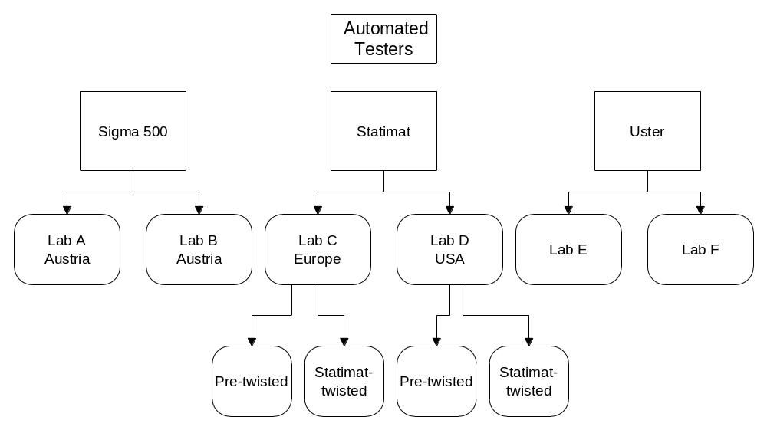
Logistics: D 885 Case Study

Slide 17
Logistics: D 885 Case Study
Materials: The ILS will include the following nine materials (All samples are shipped twisted and ready to test, except for Statimat laboratories, which receive both twisted and untwisted samples):
  Kevlar®: 195 denier
  Kevlar®: 600 denier
  Kevlar®: 1140 denier
  Nomex®: 200 denier
  Nomex®: 1600 denier
  Technora®: 550 denier
  Twaron®: 840 denier
  Twaron®: 1500 denier
  Twaron®: 3000 denier

Slide 18
Logistics: D 885 Case Study
Test Determinations and Test Results: The number of test determinations required for a test result is specified in each individual test method. For the purpose of this study, each laboratory will make one hundred (100) determinations (breaks) for each material.

Slide 19
Logistics: D 885 Case Study
Test Determinations and Test Results: The following properties (and associated measurement units) will be recorded:
  Break strength (BS) N
  Elongation at break (EB) %
  Modulus between 300 mN/tex and 400 mN/tex (MOD) CN/tex
  FASE @ 0.3% N
  FASE @ 0.5% N
  FASE @ 1.0% N
Use nominal linear density for modulus calculation.

Slide 20
Logistics: D 885 Case Study
Details: The test method being studied is D885-03. Specify the type of equipment used, including manufacturer, model, and software program. Samples should be conditioned as per D885 7.1 to moisture equilibrium in an environmentally controlled room for a minimum of 16 hours, at RH 55 +/- 2% and temperature 24 +/- 1 degrees C (72 +/- 2 degrees F).
Specific for Para-Aramid:
  Gauge length: 500mm
  Crosshead rate: 250mm/min. (50%)
Etc.

Slide 21
Logistics: D 885 Case Study
Data: Data should be entered into the Excel workbook provided. Label the workbook with your laboratory name, fill in the test data, and send the completed file to:
Paul Schiffelbein
DuPont Engineering, Quality Management & Technology
paul.a.schiffelbein@usa.dupont.com
302/774-2417

Slide 22
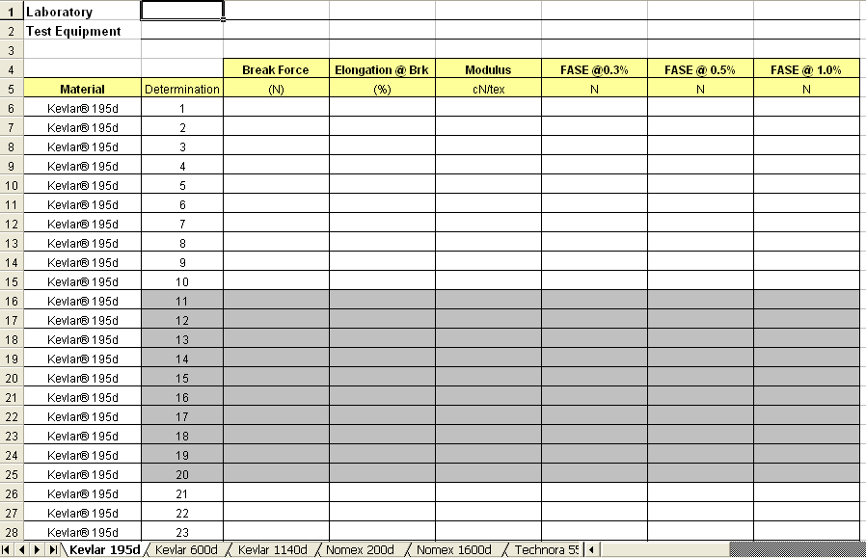
Logistics: D 885 Case Study

Slide 23
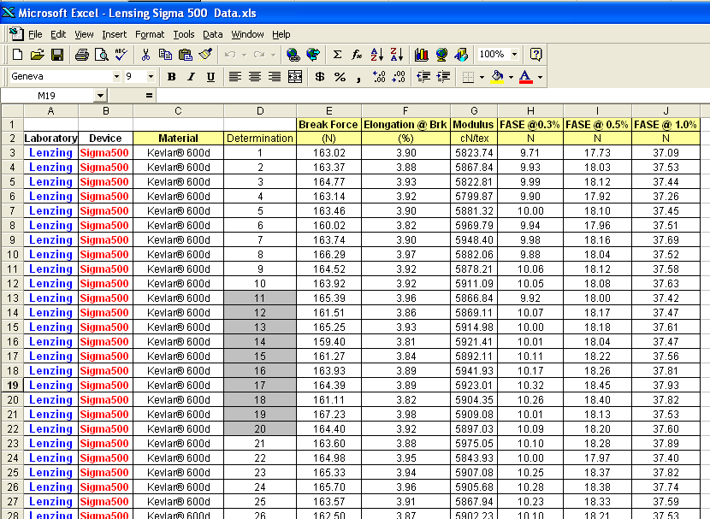
Logistics: D 885 Case Study

Slide 24
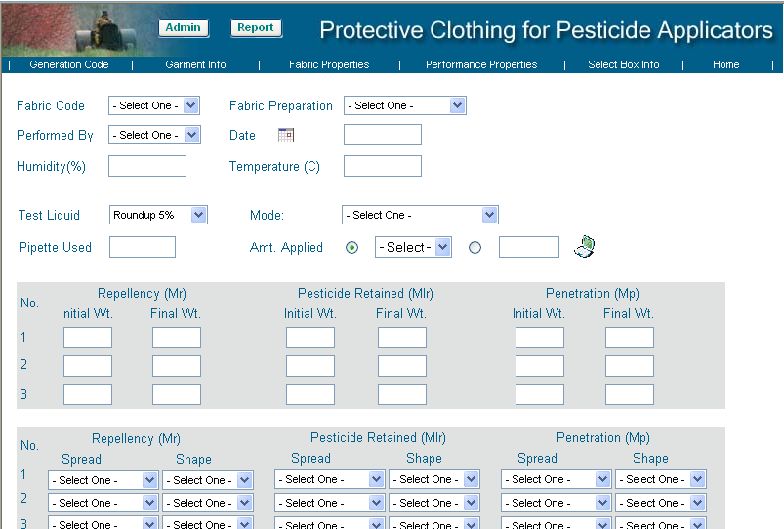
A Better Way?: Internet Entry for F 2130 RR
Figure courtesy of Dr. Anugrah Shaw, UMES

Slide 25
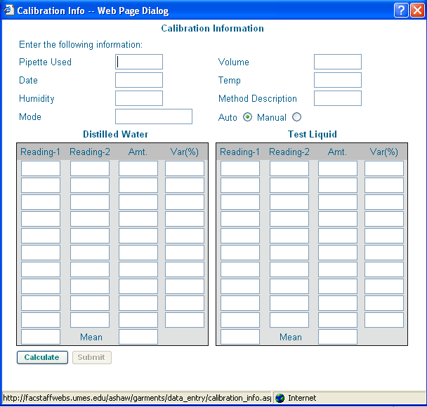
Data Structure Guaranteed!

Slide 26
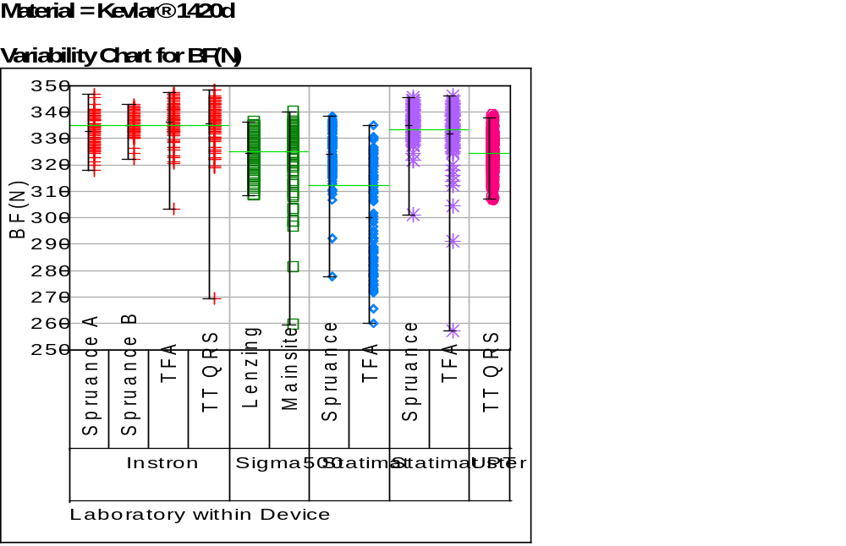
Logistics: D 885 Case Study
Data Analysis:

Slide 27
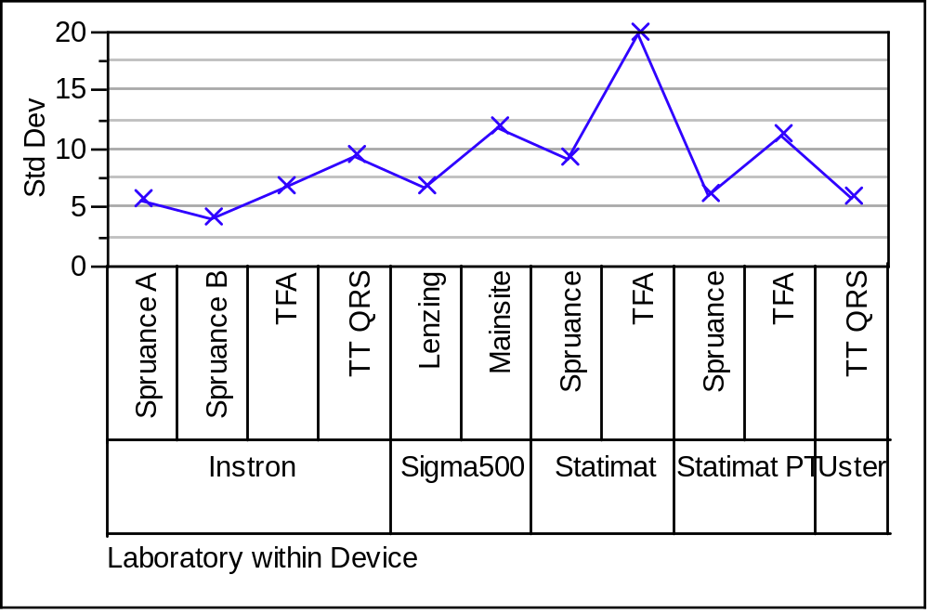
Logistics: D 885 Case Study
Data Analysis:

Slide 28
Repeatability and Reproducibility
Use between- and within-laboratory variance components:
σ_{R} = √σ²_{L} + σ²_{r}
Where:
σ_{R} is the reproducibility standard deviation
σ_{r} is the repeatability standard deviation
σ_{L} is the square root of the inter-laboratory
(device, operator, etc.) variance component

Slide 29
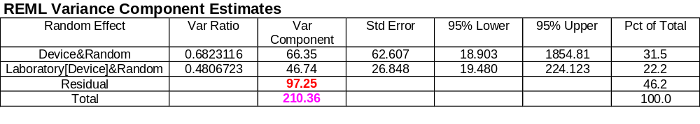
Logistics: D 885 Case Study
Data Analysis:
Repeatability variance
Reproducibility variance
(one estimate)
Reproducibility variance
(another estimate)

Slide 30
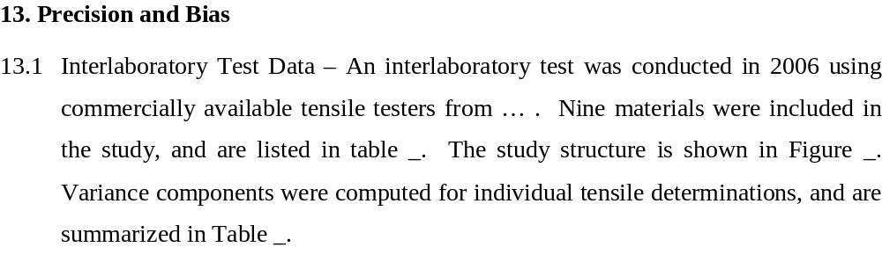
Logistics: D 885 Case Study
Precision and Bias Statement:

Slide 31
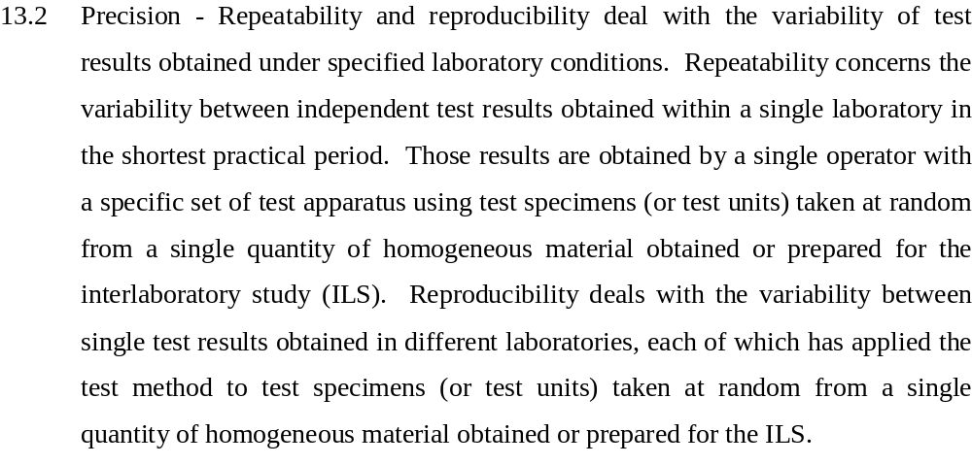
Logistics: D 885 Case Study
Precision and Bias Statement:

Slide 32
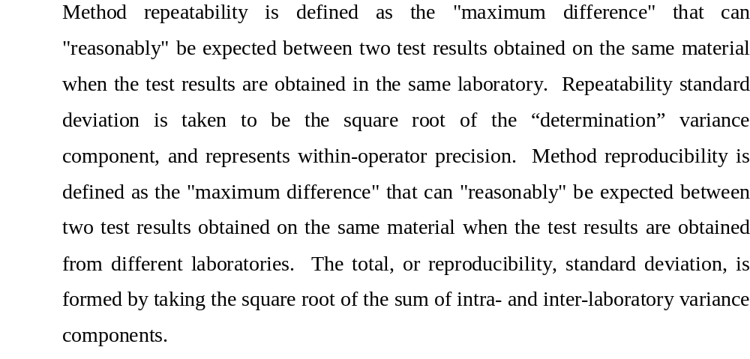
Logistics: D 885 Case Study
Precision and Bias Statement:

Slide 33
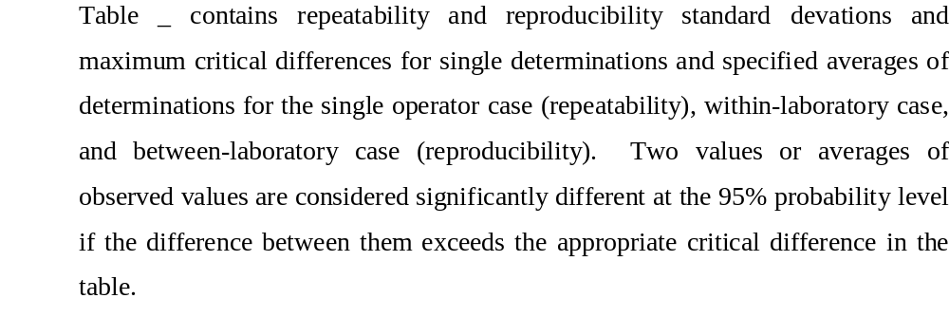
Logistics: D 885 Case Study
Precision and Bias Statement:

Slide 34

Logistics: D 885 Case Study
Precision and Bias Statement:

Slide 35
Summary
Explicitly state objectives for your study, and make sure all participants understand them
Write protocol covering responsibilities, timing, samples and sample handling, test equipment and set-up, sampling plan, properties, units, etc.
Details are important! Be specific, explicit, and discuss ahead of time with task group to avoid surprises. Communicate!
Set up data collection to be as “goof proof” as possible, and to facilitate subsequent analysis

Slide 36

Thank you

