Slide 1


K.RAMAKRISHNAN COLLEGE OF TECHNOLOGY
(AUTONOMOUS), TRICHY.
HELPDESK MANAGEMENT SYSTEM
PRESENTED
Grish Narayanan S
2303811710421048
SUPERVISOR
Mr. M. Saravanan, M.E.,
AP/CSE.

Slide 2
PRESENTATION OVERVIEW
Objective
Project Introduction
Problem Statement
Methodologies (Programming concepts relevant to problem statement)
Architecture of the proposed system
List of Modules
Merits
Results and Discussion
Queries

Slide 3
OBJECTIVE
Provide a streamlined and efficient solution for managing help desk tickets.
Facilitate the creation, viewing, and closure of tickets.
Enhance support request tracking and resolution.
Offer an intuitive and user-friendly graphical user interface (GUI) using Java Swing.
Ensure seamless performance of ticket-related activities.
Improve overall support process and customer satisfaction.
Ideal for small to medium-sized teams to maintain organized help desk operations.

Slide 4
PROJECT INTRODUCTION
Java-based application for managing help desk tickets.
Utilizes an intuitive graphical user interface (GUI) built with Swing components.
Efficiently handles support requests by allowing users to create, view, and close tickets.
Consists of two main classes: HelpDeskSystem and Ticket.
HelpDeskSystem class extends JFrame and serves as the main interface.
Incorporates Swing components like JTextArea, JTextField, and buttons.

Slide 5
PROBLEM STATEMENT
Develop a HelpDesk Management System for efficient ticket management.
Implement the system using Java with Swing components for the GUI.
Allow users to create, view, and close help desk tickets.
Ensure the interface is user-friendly and intuitive for ease of interaction.
Manage tickets dynamically using an ArrayList.
Provide visual display of tickets in a JTextArea.
- Facilitate user input through a JTextField.

Slide 6
METHODOLOGIES
Class Design:
HelpDeskSystem: Main window.
Ticket: Ticket details.
UI Setup:
JTextArea for tickets.
JTextField for input.
JButton for create, view, close.
JPanel for buttons.
Event Handling:
ActionListener for buttons.
Data Management:
ArrayList for tickets.
Main Method:
SwingUtilities.invokeLater for GUI.

Slide 7
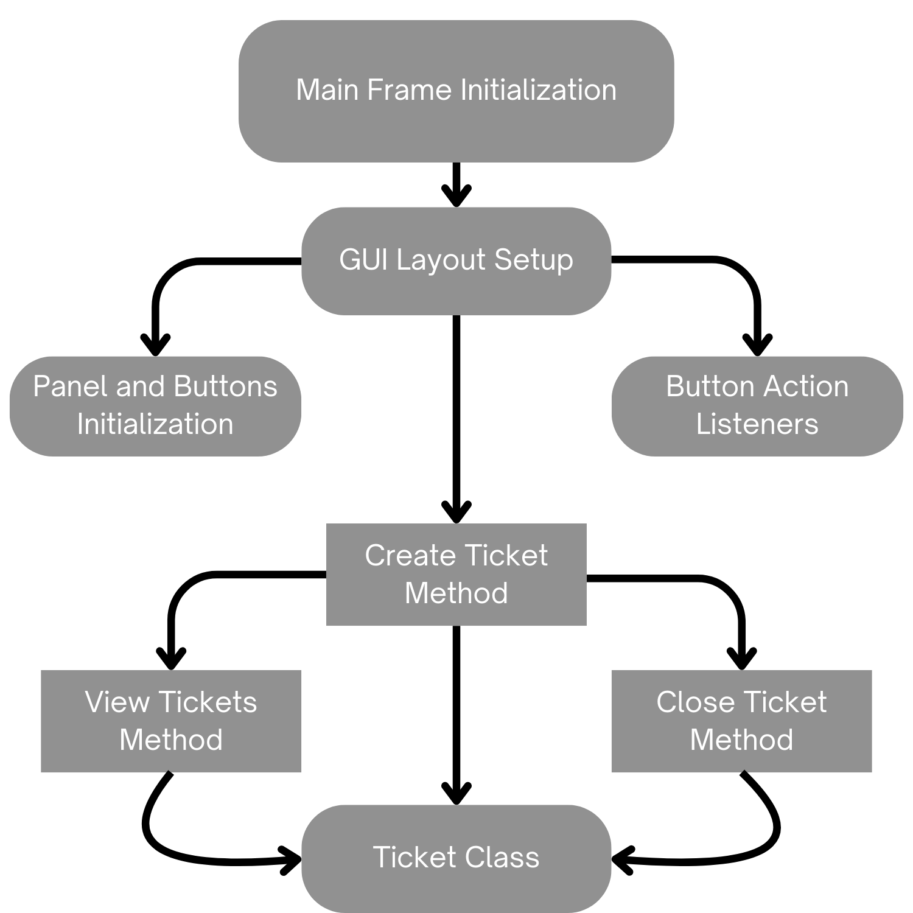
ARCHITECTURE OF THE PROPOSED SYSTEM

Slide 8
LIST OF MODULES
MODULE DESCRIPTON
UI Setup:
Initialize components.
Organize with BorderLayout.
Event Handling:
Implement button actions.
Create: Adds ticket.
View: Displays tickets.
Close: Closes ticket.
Data Management:
Use ArrayList for tickets.
Ticket class details.
Main Application:
Create GUI with SwingUtilities.invokeLater.
Display HelpDeskSystem.

Slide 9
MERITS
User-Friendly Interface: Intuitive GUI with clear components, making it easy to navigate and use.
Efficient Data Management: Uses ArrayList for dynamic ticket storage and management.
Modular Design: Clear separation of concerns enhances maintainability and readability.
Cross-Platform Compatibility: Written in Java, ensuring it can run on any platform with a JVM.

Slide 10
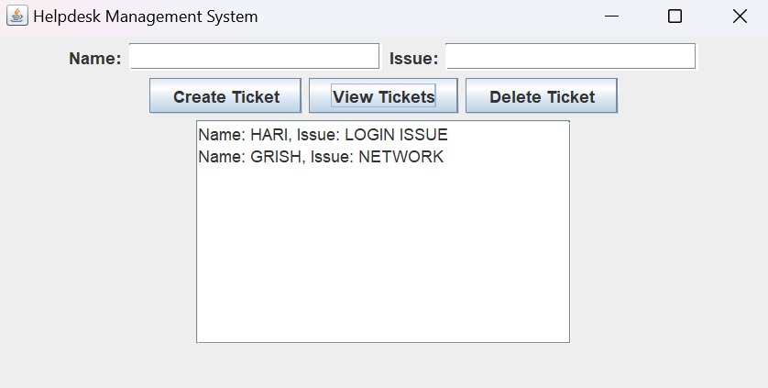
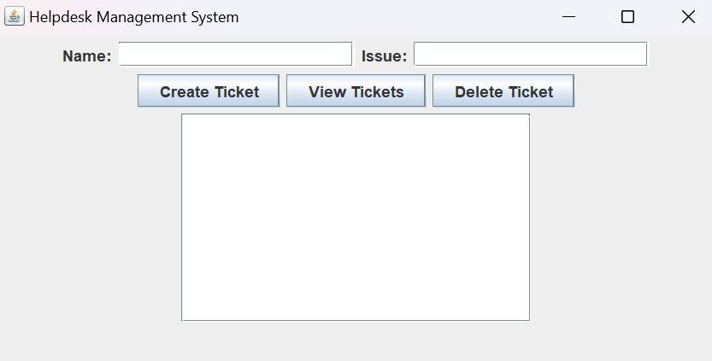
RESULTS AND DISCUSSION

Slide 11
QUERIES ?

