Slide 1


K.RAMAKRISHNAN COLLEGE OF TECHNOLOGY
(AUTONOMOUS), TRICHY
Health Monitoring
PRESENTED BY
2303811710421048- GRISH NARAYANAN S

Slide 2
PRESENTATION OVERVIEW
Problem Identification
Objective
Proposed system
  Block diagram of proposed system
  Data structures used
  Modules

Slide 3
PROBLEM IDENTIFICATION
Many people, especially those with chronic conditions, need continuous monitoring of their vital signs to stay healthy. Traditional methods are often inconvenient and don't provide real-time data, making it hard to detect and respond to health issues promptly. This project aims to create an easy-to-use system that continuously tracks vital signs, alerts users to potential health problems, and helps them get timely medical attention.

Slide 4
OBJECTIVE
The objective of a health monitoring project is to keep track of important health data, like heart rate and temperature, in real-time. This helps in detecting any unusual changes early so that timely action can be taken to ensure better health and well-being.

Slide 5
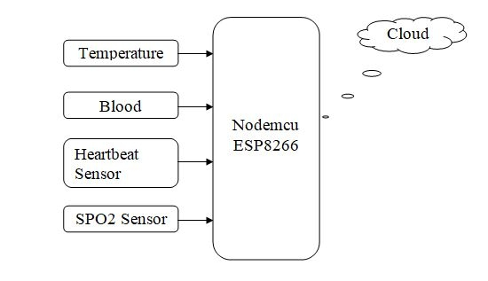
PROPOSED SYSTEM
BLOCK DIAGRAM
Source code

Slide 6
DATA STRUCTURES USED
Arrays and Lists: These are used to store and manage sensor data. They can hold multiple data points collected over time, allowing for time-series analysis
Trees: These are particularly useful in hierarchical data representation. For example, a health monitoring system might use a tree structure to represent the hierarchical relationship between various body systems and organs
Graphs: These are used to represent relationships between different data points or sensors. For instance, in a health monitoring system, a graph could be used to represent the correlation between different health parameters

Slide 7
MODULES
Data Collection Module
Data Storage Module
Data Processing Module

Slide 8
ADVANTAGES OF PROPOSED SYSTEM
Better Health Outcomes - Helps doctors catch issues early and treat them faster.
Accurate Data - Automatically collects health data, reducing mistakes.
Patient Involvement - Patients can see their own health data and manage their health better.
Efficient Resource Use - Helps doctors manage their time and focus on urgent cases.
Data Insights - Analyzes large amounts of data to find health trends and improve treatments.

Slide 9
AGENDA
Architecture of the proposed system
Partial Prototype built
Working Prototype Testing and Validation
Program Execution and Output

Slide 10
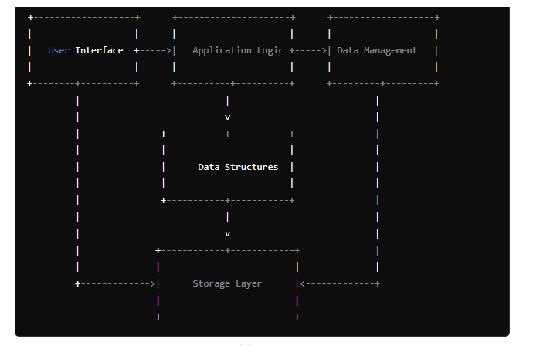
ARCHITECTURE OF THE PROPOSED SYSTEM

Slide 11
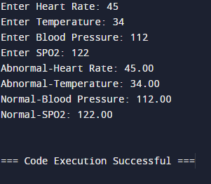
OUTPUT’S

Slide 12
WORKING PROTOTYPE TESTING
AND VALIDATION
Test Cases :
Positive Test Cases
Negative Test Cases

Slide 13
THANK YOU

