Slide 1
BESS as Process
Life-Insurance
Which reservation strategy, and when?
A systematic comparison for intermittent solar-to-methane production
SOTA COMMISSION II — INTERMITTENT ABUNDANCE

Slide 2
THE IDEA
A cold reactor costs more than a lost kilowatt-hour
Remote, off-grid plants that convert solar electricity into a storable fuel, here synthetic methane via Sabatier synthesis, run into an intermittency problem that conventional battery controllers do not account for.
4–6
Every kWh looks the same. A controller that only tracks the electrical balance treats an idled electrolyzer the same as a reactor left to go cold.
Cold means idle. Restarting the Sabatier reactor costs 4–6 hours of dedicated, high-power reheating — time that comes directly out of production.
The real question. An earlier prototype showed proactive battery reservation helps. But reservation is a whole design space — which mechanism is worth building, and where?
HOURS OF LOST PRODUCTION PER COLD-START
This project builds and compares seven distinct battery-reservation strategies on one shared digital twin, across three climates and four levels of forecast error — 84 full-year simulations in total.
2

Slide 3
ARCHITECTURE & ASSUMPTIONS
One digital twin, seven interchangeable strategies
PV Array
Electrolyzer
+ DAC
ASSUMPTIONS
PV surplus only
Sabatier cooling omits the reaction's own exothermic heat (conservative — real reactors cool somewhat more slowly).
Battery model excludes long-term degradation.
Forecast error is additive Gaussian noise, not the time-correlated, often-asymmetric error of real forecasts.
RTU is a generic hard-limit abstraction, not a specific real device's configuration.
Battery
(BESS)
Sabatier reactor
full battery access
RTU — deterministic hard-limit layer (SOC bounds, load caps, reserve lock)
Seven strategy modules plug into one shared decide() interface between the battery and the reactor —
only the control logic changes between runs; the electrolyzer/DAC path above is identical for all seven.
3

Slide 4
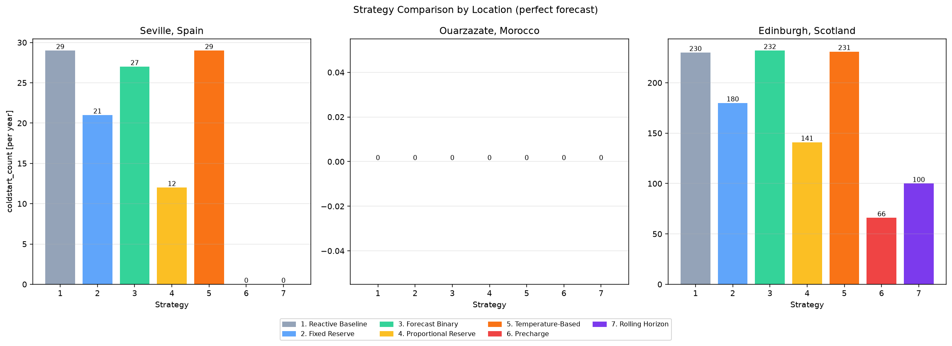
RESULTS
Complexity does not predict effectiveness
Strategy | Complexity | Seville | Ouarzazate | Edinburgh
1. Reactive Baseline | 1 | 29 | 0 | 230
2. Fixed Reserve | 1 | 21 | 0 | 180
3. Forecast Binary | 2 | 27 | 0 | 232
4. Proportional Reserve | 3 | 12 | 0 | 141
5. Temperature-Based | 4 | 29 | 0 | 231
6. Precharge | 3 | 0 | 0 | 66
7. Rolling Horizon | 5 | 0 | 0 | 100
Cold-starts per year, perfect forecast. Complexity is a manually assigned 1–5 score, not a measured runtime. Ouarzazate stays at zero for every strategy — a control case, not one where strategy choice matters.
4

Slide 5
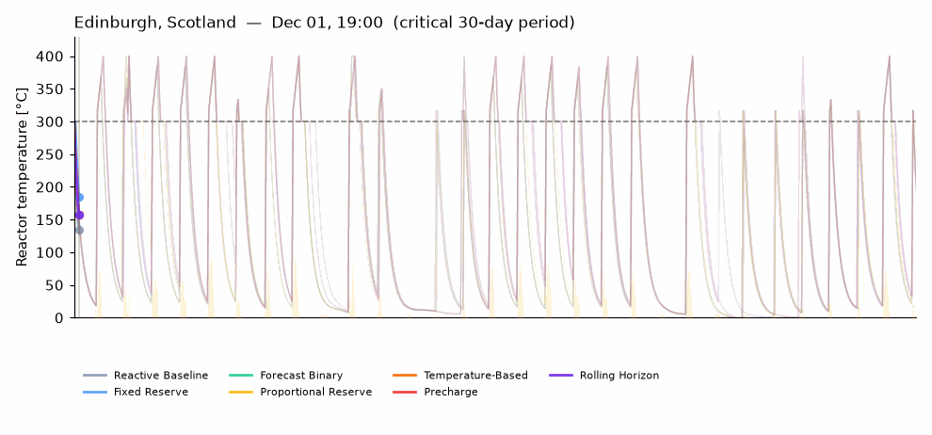
WATCH IT HAPPEN
The same 30 days, seven controllers, one reactor
Edinburgh, Scotland — the worst 30-day stretch of the year, replayed hour by hour. Reactor temperature for all 7 strategies against the same weather (animates during the slideshow).
5

Slide 6
WHAT WORKED, WHAT FAILED
The simplest strategy won — until the forecast got noisy
WHAT WORKED
WHAT FAILED
Precharge and Rolling Horizon fully eliminate cold-starts in Seville.
Under a perfect forecast, simple Precharge beats expensive Rolling Horizon in Edinburgh: 66 cold-starts/yr vs. 100.
That ranking reverses as forecast error grows — Rolling Horizon degrades gracefully and overtakes Precharge past ~10–20% error.
No strategy reaches zero in Edinburgh: the 2,000 kWh battery is undersized for that climate's worst deficit, a limit the simulation makes visible rather than assumed.
Letting the electrolyzer/DAC draw partially from the battery above a reserve floor caused 300+ cold-starts/yr — worse than doing nothing.
Cause: a single winter night's reactor-protection need (~760 kWh) already exceeds the largest reserve tested (800 kWh).
The Temperature-Based strategy's formula was implemented backwards during development (larger reserve when hottest, none when coldest).
Corrected, it still ties the baseline: the reactor's own maintenance logic pins it at minimum temperature within ~2 hours of every night, leaving the formula nothing to compute.
6

Slide 7
NEXT
From simulated forecast error to a live decision framework
Live forecasts. All 84 runs already cover imperfect forecasts, but as synthetic, independent Gaussian noise. Swap in a live weather feed, whose errors are time-correlated and often biased in ways white noise isn't, and see if the same strategy rankings hold.
Hybrid strategies. Test designs no single strategy captures alone — e.g. a thermodynamic trigger paired with a rolling-horizon projection.
Closed-loop chemistry. Couple the reactor's thermal state to an explicit H₂/CO₂ mass balance for a fully closed-loop yield model.
The answer to “which life-insurance strategy is worth its complexity” depends on climate and on how much you trust your forecast — and this project turns that into something computable instead of guessed at.
github.com/GRKG9T/SoTA-Commission-II-Intermittent-Abundance-Csontos-Tamas
7

