Slide 1
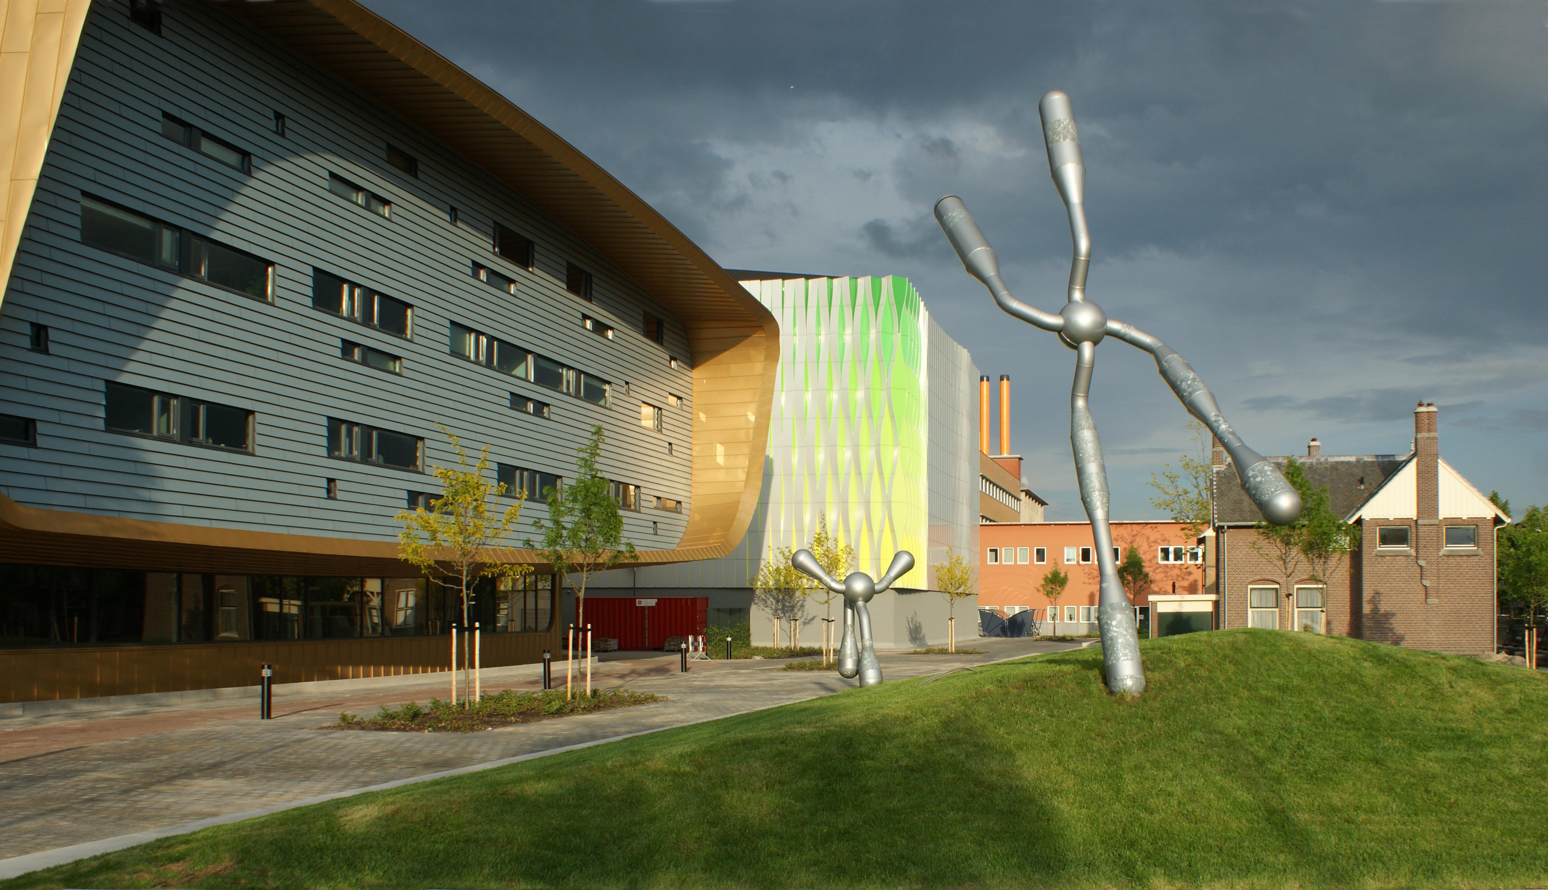
Microbiome data analysis workshop (pipelines)
28/05/2024
Dr. Ranko Gacesa
Dept. of Gastroenterology and Hepatology
University Medical Center Groningen, The Netherlands

Slide 2
Topic for today
Our standard workflow for microbiome data (or “microbiome pipeline”)
Short version
Test data example
What to do (and not do) with real data
Long version:
Pipeline layout and functionality
Configuration
Job script files
Feedback
What can we do better?
Your favorite new toys?

Slide 3
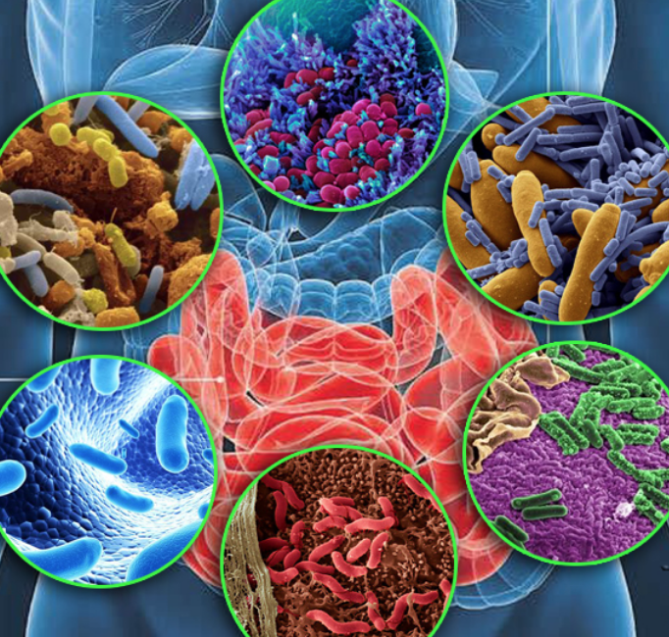

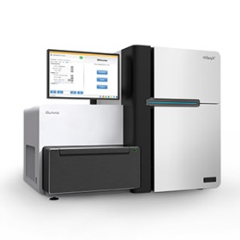


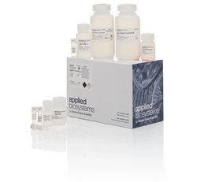



Metagenomic sequencing for microbiome analysis
DNA
DNA library
Sequencing data
What now?
Notes:
IBD: UC & CD – differ in location & pathology, same/similar sympthoms
Associated with various factors such as diet, smoking and genetics, but also gut microbiome; I am specifically looking into this

Slide 4

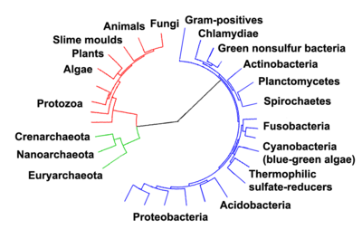


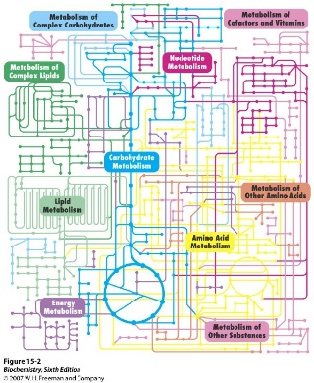
Microbiome profiling
Raw data
cleaned
data
Taxonomic profiling
(Metaphlan)
Taxonomical composition
QC (kneaddata)
Functional profiling
(Humann)
Encoded functions (MetaCyc)
Virulence factors
Antibiotic resistances genes
Functional profiling
(shortBRED)

Slide 5




MAG-based analysis
Refined binned
contigs
Metagenomic
data
Bin Refining
and/or re-assembly
Binned contigs
A
A
B
B
QC (kneaddata)
C
C
QC, taxonomy assignment
(GTDBK, CheckM)
Assembly
(MegaHIT,
MetaSpades)
Binning
Metagenome-assembled genomes (MAGs)
Bacterial abundances
Contigs
*
Evolutionary pressures
Novel taxa
Strain-level SNP distances
Semi automated
*
Pangenomics
(ROARY)
Functional annotation
(BAKTA)
Growth rates
Viruses,
plasmids
Community
modeling
*
Wish list – not ready yet
*

Slide 6
Data processing pipeline, workflow
Raw data
cleaned
data
Taxonomical composition
(Metaphlan result)
Taxonomic profiling
(Metaphlan)
QC (kneaddata)
Assembly
(megahit)
FastQC
Strainphlan
FastQC
contigs
Humann
Binning
(maxbin2,metabat2, concoct)
Strainphlan markers
QC report
QC report
3 x bins
shortBRED (VFDB)
Refining (metawrap)
Extra scripts
(see previous slides)
Humann tables
(MetaCyc)
shortBRED (CARD)
Refined bins
Clade profiles,
distance matrices,
phylogenetic trees
GTDB-TK
CheckM
SALMON
CARD Profile
(shortBRED)
Taxonomy
Quality
Abundance
Extra scripts
(see previous slides)
VFDB Profile
(shortBRED)
Annotation
Bin quality tables

Slide 7

Microbiome profiling, technical part
Biobakery tools: https://huttenhower.sph.harvard.edu/tools/
Other ideas are welcome!

Slide 8
Microbiome profiling, short version
1/a) Log into the cluster, make a folder and go there
1/b) Copy data (paired-end fastq files) into the folder
1/c) Copy pipeline config file into the folder
2) Tell pipeline to write jobs
3) Run jobs
3/b) [optional]: run panphlan jobs
4) Check completed jobs
5) Sort results
6) Merge results
7) [optional] Annotate MAGs
… do downstream processing (not covered by this tutorial)

Slide 9
Data processing, demonstration of pipeline
1/a) Log into the cluster*, make a folder and go there
ssh airlock+habrok
cd /scratch/${USER}/
mkdir <mytest> replace <mytest> with actual name
cd <mytest>
*: I keep track of tools on habrok, not on gearshift!
1/b) Let’s put some test data there
Format must be:
<name>_[12].fq[.gz]
OR <name>.bam [PE bam]
OR <name>_[12].fastq[.gz]
cp /projects/hb-tifn/tools/GMH_pipeline/test_data/*.fq.gz .
ls -l
1/c) And the pipeline config file tuned for test data
Config file tells pipeline what to do, see later slides for details
cp /projects/hb-tifn/tools/GMH_pipeline/test_data/dag3pipe.cfg .
less dag3pipe.cfg
This is master config file, try and figure it out
(details in later slides)
NOTE: this are small example datasets and config tuned to run fast, actual config we want to use for real data is:
/projects/hb-tifn/tools/GMH_pipeline/GMH_pipe.cfg

Slide 10
Data processing, demonstration of pipeline
Note: alias can help a lot – this replaces full command with GMH_pipe:
2) Tell the pipeline to write jobs:
alias GMH_pipe='python /projects/hb-tifn/tools/GMH_pipeline/GMH_pipe.py'
module load Python/3.11.3-GCCcore-12.3.0
python /projects/hb-tifn/tools/GMH_pipeline/GMH_pipe.py writejobs
ls -l
pipeline is written in python
3) Run the jobs
OR
for i in *_p1.sh; do sbatch $i; done
Use alias (see above) or full path
GHM_pipe runjobs
… wait until jobs are no longer running …
Extra: To check the status of jobs
check what is running for your user
squeue -u ${USER}
4) Tell pipeline to look for completed jobs
If python is not loaded
ml Python
GHM_pipe checkjobs
ls -l
Will scan all folders in the current ${PWD} for results and report
Pipeline makes files with list of completed / non-completed jobs

Slide 11
Data processing, demonstration of pipeline
Note: alias can help a lot – this replaces full command with GMH_pipe:
3/b) Running panphlan jobs
… wait until jobs are no longer running* (technically only cleaning has to be done) …
for i in _pp01.sh; do sbatch ${i}; done
Basically we only need to submit panphlan jobs
BUT: SLURM has job limit, and if we have multiple bugs and many samples, that can be many jobs,
so either submit them in batches or use something like
for i in _pp01.sh; do sbatch ${i}; sleep 30s; done
This makes system wait 30 seconds between each job submission
*: NOTE: run it in screen or it will stop queuing jobs when you log out of the cluster!
**: NOTE2: if anyone plans to do bigger panphlan runs, let me know and I will look into implementing better solution to this!

Slide 12
Data processing, demonstration of pipeline
5) Sort the results
cd <folder where we ran the pipeline>
GMH_pipe sortresults --outPath ../<my_tests>_results_sorted
ls -l ../<my_tests>_results_sorted
Pipeline will sort results by putting each data type into its folder (e.g. metaphlan results; humann results,
assemblies…)
Sorted samples go into this path
6) Result merging
cd ../results_sorted
GMH_pipe mergeresults --jobConfig ../GMH_pipe.cfg
bash ./mergercommand.sh
Assuming we are in <folder where we ran the pipeline>
Config file is not in our folder, so we have to point to it
(or copy it to this folder)
This script does the data merging (GMH_pipe mergeresults prepares this script): this implementation was done to make it easier to work around some weird interactions between cluster, modules, conda, and python

Slide 13
Extra scripts for dealing with bins / MAGs
Collection of extra scripts is in: /projects/hb-tifn/tools/GMH_pipeline/utils
NOTE: most of these are outdated or very specific – do not blindly run them unless you are sure what they do!
Some useful scripts:
Check results of assembly, binning & MAG generation
cd <folder where we ran the pipeline>
python /projects/hb-tifn/tools/GMH_pipeline/utils/binning_ptmp/batchruns/checkBinningPipeline.py
Consolidate bin quality results into a nice table (sample -> bin -> quality -> taxonomy)
make sure sortresults (step [5] ) was run:
cd <root folder of sorted results>
python /projects/hb-tifn/tools/GMH_pipeline/utils/binning_ptmp/collectBinStatsSortedSamples.py
Annotate refined bins
Note: this script waits a bit between submitting jobs to avoid swamping SLURM, run it in screen
make sure sortresults (step [5] ) was run:
cd <root folder of sorted results>
bash /projects/hb-tifn/tools/GMH_pipeline/utils/BAKTA/refinedBinsRunBAKTA.sh

Slide 14
Extra scripts for dealing with strainphlan results
Strainphlan post-processing scripts are in: /projects/hb-tifn/tools/GMH_pipeline/utils/strainphlan
Basic workflow:
generate markers [this is done by strainphlan part of main pipeline]
profile clades;
2/b: parse clade profile to select clades to compare
3. compare markers, build multiple alignment & phylogenetic trees
4. calculate distance matrices from multiple alignments
5. analyze data (e.g. ordination on distance matrices, distances between groups…) [out of scope of this tutorial, usually done in R]
Scripts:
2. Profile strainphlan markers to find how many samples have which clades
make sure sortdata is done
cd <sorted data root folder>
mkdir strainphlan_processing
cd strainphlan_processing
sbatch /projects/hb-tifn/tools/GMH_pipeline/utils/strainphlan/sp4_profileClades_mp400.sh ../strainphlan
Or wherever you want to put data
Location of strainphlan .pkl files of analyzed dataset

Slide 15
2. Profile strainphlan markers to find how many samples have which clades
If it works, you should get:
strainphlan4_clades_50.txt file [or _<number>.txt if different cutoffs were used]
Example:
Thu May 2 16:15:16 2024: Start StrainPhlAn 4.0.6 execution
Thu May 2 16:15:16 2024: Loading MetaPhlAn mpa_vOct22_CHOCOPhlAnSGB_202212 database...
Thu May 2 16:15:39 2024: Done.
Thu May 2 16:15:42 2024: Detecting clades...
Thu May 2 16:32:34 2024: Done.
Thu May 2 16:32:34 2024: Detected clades:
Thu May 2 16:32:34 2024: t__SGB15233: in 6 samples.
Thu May 2 16:32:34 2024: t__SGB15356: in 6 samples.
Thu May 2 16:32:34 2024: t__SGB2318: in 6 samples.
Thu May 2 16:32:34 2024: t__SGB14252: in 6 samples.
Thu May 2 16:32:34 2024: t__SGB2290: in 6 samples.
Thu May 2 16:32:34 2024: t__SGB15317: in 6 samples.
Thu May 2 16:32:34 2024: t__SGB15318: in 6 samples.
This is metaphlan DB; if it does not match your metaphlan run, things will fail!
2/b: run parser on this file
python /projects/hb-tifn/tools/GMH_pipeline/utils/strainphlan/profileCladesParse.py -I strainphlan4_clades_50.txt -N <min samples>

Slide 16
2/b: run parser on this file
python /projects/hb-tifn/tools/GMH_pipeline/utils/strainphlan/profileCladesParse.py -I strainphlan4_clades_50.txt -N <min samples>
Output is _parsed file [e.g. strainphlan4_clades_50_parsed.txt]
This is just text file with a list of taxa:
t__SGB15233
t__SGB15356
t__SGB2318
t__SGB14252
…
3) compare markers, build multiple alignment & phylogenetic trees:
To do this, run one job of runMarkerComparison_ for each clade to analyze.
For example for metaphlan 4.0.0, script is:
/projects/hb-tifn/tools/GMH_pipeline/utils/strainphlan/sp4_runMarkerComparison_mp400.sh
while read CLADE
do
sbatch /projects/hb-tifn/tools/GMH_pipeline/utils/strainphlan/sp4_runMarkerComparison_mp400.sh ../strainphlan4 ${CLADE}
done < strainphlan4_clades_50_parsed.txt
location of .pkl files
Clade to analyze
Basically: read strainphlan4_clades_50_parsed.txt [clades] one line at a time and submit marker comparison job for each line [clade]
Note: there might be hundreds or thousands of clades, try not to swamp SLURM / run useless stuff

Slide 17
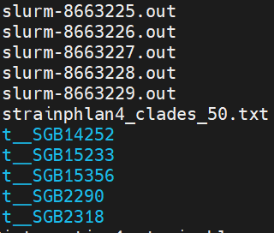
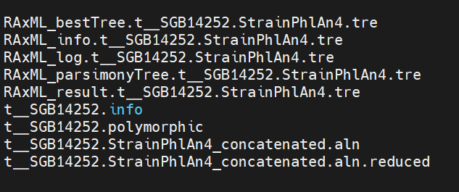
3) compare markers, build multiple alignment & phylogenetic trees:
- Assuming it works, you will get one folder per clade (and one slurm .out file for debugging if necessary):
Job output files
List of clades
Results per clade
Strainphlan results:
RAxML phylogenetic tree (maximum likelihood)
RAxML phylogenetic tree (parsimony)
Marker differences statistics
Multiple alignment of markers of our samples

Slide 18
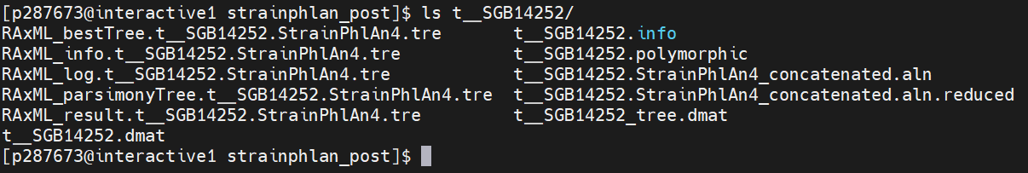
3) compare markers, build multiple alignment & phylogenetic trees:
- Assuming it works, you will get one folder per clade (and one slurm .out file for debugging if necessary):
Multiple alignments => distance matrices scripts:
(run them from this folder [each strainphlan clade should be in separate folder] )
Tree-based distance matrix (works better with longer distances, more stable/reliable/accurate):
/projects/hb-tifn/tools/GMH_pipeline/utils/strainphlan/makeTreeDistMatAll.sh
Kimura-distance matrix (older method, quick, might make sense as validation):
/projects/hb-tifn/tools/GMH_pipeline/utils/strainphlan/makeDistMatAll.sh
Matrices will be generated in folders with other strainphlan results:
Tree-based distances
Kimura distances

Slide 19
Notes / Issues / current quirks of the pipeline
panphlan scripts do not run automatically, they have to be sbatched individualy:
These are: <sample>_pp*.sh [e.g. p076_M2_pp01.sh]
This is “working as intended” to prevent flooding SLURM with jobs
MetaSPADES does not run binning automatically
Workaround: use MEGAHIT
Work in progress!
Metaphlan4.1 and virus profiling is currently alpha / experimental, there might be bugs!
MAG annotation is not automated
As (1), this is “working as intended” to prevent flooding SLURM

Slide 20
Data processing, real data
Basically the same workflow applies, with few modifications:
Notes:
Jobs will take much longer: it takes ~24 hours for run of one sample, the majority of this is humann
Jobs will occasionally crash due to time limits, memory limits, data corruption and random reasons
For time/memory limit crash, adjust config file to increase limits, re-make jobs and re-run failed jobs
Corrupted zipped fastq files tend to fail at kneaddata or to produce 0 size metaphlan files, can be bit tricky to diagnose. No easy fix – basically re-copy the data and try again, if it still fails, there was a problem with hard drive
Random job crashes happen – it is usually something cluster-side – if there is no explanation why job failed, try re-running
Make sure strainphlan post-processing scripts use the same version of database as the main pipeline run: otherwise weird stuff will happen or no markers will be found
If not sure, check raw metaphlan output files (they will start with something like #mpa_vOct22_CHOCOPhlAnSGB_202212 ← this is database version )
and/or load appropriate conda (check .cfg file) and run strainphlan –h to check which DB is used
By default:
metaphlan 4.00: DB is mpa_vJan21_CHOCOPhlAnSGB_202103
metaphlan 4.06: DB is mpa_vOct22_CHOCOPhlAnSGB_202212
metaphlan 4.10: DB is mpa_vJun23_CHOCOPhlAnSGB_202307

Slide 21
Data processing, real data
Basically the same workflow applies, with few modifications:
Starting config files:
Standard profiling (metaphlan4, stainphlan4, humann3.6):
/projects/hb-tifn/tools/GMH_pipeline/GMH_pipe.cfg
Backward compatibility profiling (metaphlan & stainphlan4, humann3.6; metaphlan & strainphlan 3, humann3):
/projects/hb-tifn/tools/GMH_pipeline/GMH_pipe_bb34.cfg
MAG generation:
/projects/hb-tifn/tools/GMH_pipeline/GMH_pipe_MAGs.cfg
Metaphlan 4.1 & Virus profiling: [experimental!]
/projects/hb-tifn/tools/GMH_pipeline/GMH_pipe_mp41_viruses.cfg
NOTES:
Metaphlan3 default DB is: mpa_v30_CHOCOPhlAn_201901
Metaphlan4 default DB is: mpa_vOct22_CHOCOPhlAnSGB_202212
Metaphlan4.1 default DB is: mpa_vJun23_CHOCOPhlAnSGB_202307

Slide 22
Data processing, real data
(Quick) notes on config files:
Jobs will take much longer: it takes ~24 hours for run of one sample, the majority of this is humann
Jobs will occasionally crash due to time limits, memory limits, data corruption and random reasons
For time/memory limit crash, adjust config file to increase limits, re-make jobs and re-run failed jobs
Corrupted zipped fastq files tend to fail at kneaddata or to produce 0 size metaphlan files, can be bit tricky to diagnose. No easy fix – basically re-copy the data and try again, if it still fails, check the raw data
Random job crashes happen – it is usually something cluster-side – if there is no explanation why job failed, try re-running

Slide 23
Data processing, real data, what NOT to do:
Keep following in mind:
Don’t blindly run the pipeline, please check rest of these slides
Do not edit pipeline or basic config files, if you do, make copy for yourself first and work on that!
Storage limits: pipeline does not automagically remove temporary files – this means data can and does add up, so clean the finished jobs regularly and be careful about storage limits
Max number of jobs: there is a limit of how many jobs user can queue at a time; pipeline makes up to 10 jobs per sample, so don’t flood the job manager – it is good idea to run samples in batches of 100-200 if dealing with large amount of data

Slide 24
Data processing pipeline, workflow
Raw data
cleaned
data
Taxonomical composition
(Metaphlan result)
Taxonomic profiling
(Metaphlan)
QC (kneaddata)
Assembly
(megahit)
FastQC
Strainphlan
FastQC
contigs
Humann
Binning
(maxbin2,metabat2, concoct)
Strainphlan markers
QC report
QC report
3 x bins
shortBRED (VFDB)
Refining (metawrap)
Extra scripts
(see previous slides)
Humann tables
(MetaCyc)
shortBRED (CARD)
Refined bins
Clade profiles,
distance matrices,
phylogenetic trees
GTDB-TK
CheckM
SALMON
CARD Profile
(shortBRED)
Taxonomy
Quality
Abundance
Extra scripts
(see previous slides)
VFDB Profile
(shortBRED)
Annotation
Bin quality tables

Slide 25
Data processing pipeline, config file, general config
Section [PIPELINE]: general config for the run
[PIPELINE]
doKnead = 1
doQC = 1
doMeta3 = 1
doStrainPhlan3 = 1
doHumann3 = 1
doVFDB_SB = 1
doCARD_SB = 1
jobout = 'JOBS_OUT'
usenodetmp = 0 # not implemented on gearshift, do not change!
doassemblymetaspades = 0 # not implemented on gearshift, do not change!
doassemblymegahit = 0 # not implemented on gearshift, do not change!
1 = run it, 0 = don’t run it
Where to put job logs
Extra stuff I implemented on peregrine,
Doesn’t work on
Calculon yet

Slide 26
Data processing pipeline, config file, one job example
FastQC config:
modules loaded before doing anything else
(separated by comma for multiple modules)
[QC]
modules = Anaconda3/5.3.0
paths =
condaEnv = /groups/umcg-tifn/tmp01/tools/conda_microbiome_July2021/envs/conda_dag3
memory = 4gb
cpus = 4
threads = 8
time = 3:59:00
fastqc = fastqc
paths to add to system path
SLURM config
Conda environment to load
Name of fastqc binary

Slide 27
Data processing pipeline, config sections VS jobs:
[PIPELINE] section: which jobs to write
[QC] section: fastqc jobs: <sample>_q1.sh & <sample>_q2.sh
[KNEAD] section: kneaddata: <sample>_p1.sh
[METAPHLAN3] section: metaphlan3: <sample>_p2.sh
[STRAINPHLAN3] section: strainphlan3: <sample>_p2_sp.sh
[HUMANN3] section: humann3: <sample>_p3.sh
[VFDB_SB] section: shortbred, VFDB markers: <sample>_vs.sh
[CARD_SB] section: shortbred, CARD markers: <sample>_ac.sh
NOTES:
Metaphlan requires Kneaddata results
Strainphlan & Humann require Metaphlan results
ShortBRED requires Kneaddata results

