Slide 1






Wireless Network Deployment Configuration
Donia Hamdy Awad
Nehal Desouky Ismail
Mariam Moustafa Mahmoud
Yasmine Yahia Elmetwally
Heba allah tarek fathy
by
Eng. Amr Reda

Slide 2
Wireless Network Deployment Configuration
1. Router Configuration (Acting as DHCP Server & Gateway)
2. Switch Configuration (Creating VLAN for Wireless Network)
3. Access Point Configuration (SSID & Security)

Slide 3

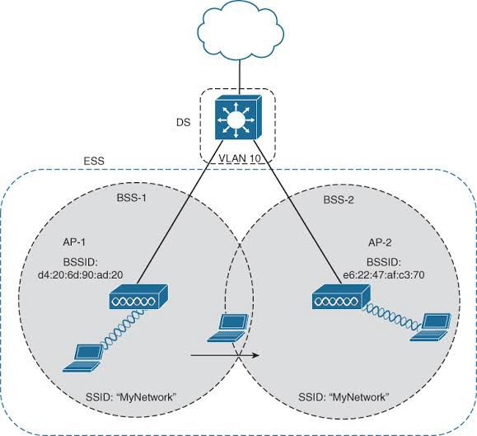
Network Topology
Router (acting as DHCP & gateway) connected to a core switch
Switch with VLAN 10 for wireless devices
Clients (Laptops, Mobile Devices, Pcs)
connecting to the APs

Slide 4
THANK
YOU

