Slide 1

ROMS
SMART RESTAURANT MANAGEMENT SYSTEM
Restaurant Ordering Management System
Real-time At-table QR Ordering & Online Table Reservation System
SWP391 · Software Development Project
FPT University · Fall 2026
Duong Trong
Pham Minh Duc
Ngo Viet Bao Huy
Team Leader
Team Member
Team Member
LIVE
roms-restaurant.duckdns.org
Notes:
[Duong Trong] Good morning, respected Committee members. Our team would like to present our SWP391 Capstone Project — ROMS, Restaurant Ordering Management System.
Our team consists of 3 members: Duong Trong (Team Leader), Pham Minh Duc (Backend & Database), and Ngo Viet Bao Huy (Frontend & Testing).
This presentation focuses on the two core operational pillars of the system: (1) Online Table Reservation and (2) Real-Time At-Table QR Code Ordering, followed by a live demonstration on our deployed production environment.

Slide 2
Three Major Restaurant Pain Points during Peak Hours
CONTEXT · PROBLEM
Paper-based and manual operations slow down guests, kitchen, and management
1
CUSTOMERS
2
KITCHEN
3
MANAGEMENT
Waiting for staff to bring menus and take orders during peak hours
Special requests (less spicy, no onions) are easily missed or mistaken
Unaware of cooking status; must wave hands to request the bill
Paper tickets easily get wet or lost; handwriting is hard to read
No clear FIFO queue → late tables receive food earlier than early tables
Out-of-stock items still ordered by guests; slow cancellation notice
Waiters running back and forth between tables, kitchen, and counter wastes labor
Reserved tables easily mistakenly assigned to walk-in guests
Manual item cancellation and bill settlement make auditing difficult
ROMS digitizes the entire chain: Table → Kitchen → Cashier — real-time, paperless
ROMS · Restaurant Ordering Management System · SWP391 · FPT University
2
Notes:
[Duong Trong] The motivation behind choosing ROMS stems from real-world F&B operational bottlenecks.
Customers face long waits for menus, frequent ordering errors, and no visibility into cooking status. Kitchen staff struggle with wet, lost paper tickets, unreadable handwriting, and the lack of a clear FIFO queue. Management loses labor as waiters constantly run back and forth, reserved tables get accidentally seated with walk-ins, and auditing manual bill cancellations is difficult.
ROMS digitizes the entire chain: Table → Kitchen → Cashier in real time.

Slide 3
ROMS: A Closed-Loop Digital At-Table Ecosystem
SOLUTION · POSITIONING
Comparison with Traditional Workflows and Conventional POS
Criteria | Traditional | Standard POS | ROMS Bistro
Table Ordering | Paper menu, wave hand to call staff | Staff enters order manually | Self-ordering via QR scan on mobile web
Guest Setup | None | Dedicated kiosk / proprietary app | Mobile web, zero app installation
Kitchen Link | Hand-delivered paper tickets | Thermal kitchen printer | Real-time KDS display (WebSocket)
Reservation | Handwritten logbook / Excel | Manual cashier entry | Online booking + pre-orders + safe lock
Recommendations | Floor staff | None | AI Assistant grounded on active menu
Zero-friction
Real-time
Strict Control
Intelligent
Scan & browse, no app download
Table ↔ Kitchen ↔ Cashier
Dynamic QR + waiter verification gate
AI suggestions & safe buffer lock
ROMS · Restaurant Ordering Management System · SWP391 · FPT University
3
Notes:
[Duong Trong] ROMS is far more than a standard cash register. Our key differentiators: guests self-order via mobile web (zero app installation required) protected behind waiter verification gates; orders dispatch to the kitchen in real time; online booking includes pre-ordering dishes with safe buffer time locking; and an AI Assistant recommends dishes strictly grounded on active restaurant menu items.

Slide 4
Feature: 10 Core Subsystems in Production
Feature
Strategically setting boundaries to achieve depth over breadth
Feature 10 Completed Subsystems
OUT-OF-SCOPE
1
Staff Authentication & RBAC Authorization
6
Floor Waiter Map & Table Call Bells
Multi-tenant restaurant chains
Native iOS / Android mobile apps
Loyalty points, e-wallets, table deposits
Deep warehouse & raw ingredient inventory
2
Floor Plan, Zone & Dynamic QR Management
7
Cashier POS · 8% VAT · PayOS VietQR
3
Menu & Category Management
8
Online Reservation & Pre-ordered Dishes
4
Dining Session & Batch Ordering Lifecycle
9
Revenue Analytics · Staff Rostering & Shifts
5
Real-time Kitchen Display System (KDS)
10
AI Dining Assistant for Table Ordering
ROMS · Restaurant Ordering Management System · SWP391 · FPT University
4
Notes:
[Duong Trong] With a 3-member team over one semester, we prioritized building production-ready features rather than spreading too thin. All 10 in-scope subsystems are fully completed and running on Docker.
We deliberately scoped out: multi-tenant chains, native apps, loyalty wallets, and deep warehouse inventory — allowing us to focus intensively on real-time responsiveness, data consistency, and enterprise security.

Slide 5
System Actors & Role-Based Access Control (RBAC)
ANALYSIS · ACTORS & RBAC
5 Human Actors + 1 Automated System Actor
Actor | Device | Authentication | Primary Privileges
Customer | Mobile web | QR token + Dining JWT | View menu, call staff, ask AI, order food, call waiter, request bill; online booking
Waiter | Floor tablet | 6-digit PIN → JWT | Floor map, open table (grant QR access), proxy ordering, serve dishes (SERVED), transfer/merge tables
Kitchen | KDS screen | 6-digit PIN → JWT | Receive & cook dishes, toggle out-of-stock (86), rush urgent priority orders
Cashier | Counter POS | 6-digit PIN → JWT | Review bill, 8% VAT, VietQR / cash payment, shift end cash reconciliation
Manager | Dashboard | 6-digit PIN → JWT | Staff & shifts, tables & QR, menu, reservation approvals, revenue reports
6-digit PIN hashed with BCrypt · Locked after 5 failed attempts · Daily shift schedule verification · Manager PIN recovery via Email OTP
ROMS · Restaurant Ordering Management System · SWP391 · FPT University
5
Notes:
[Pham Minh Duc] Greetings, Committee members. The system has 4 internal roles defined in UserRole enum: MANAGER, WAITER, KITCHEN, CASHIER, plus Customer and the automated System actor.
All staff (including Managers) authenticate using a 6-digit PIN hashed with BCrypt, automatically locked after 5 failed attempts; employees must have an active shift in staff_schedules for the current day to log in, backed by a 30s heartbeat. Managers can self-recover PINs via a 5-minute email OTP.
Guests access through dynamic QR tokens and only receive a Dining JWT once staff opens the table.

Slide 6
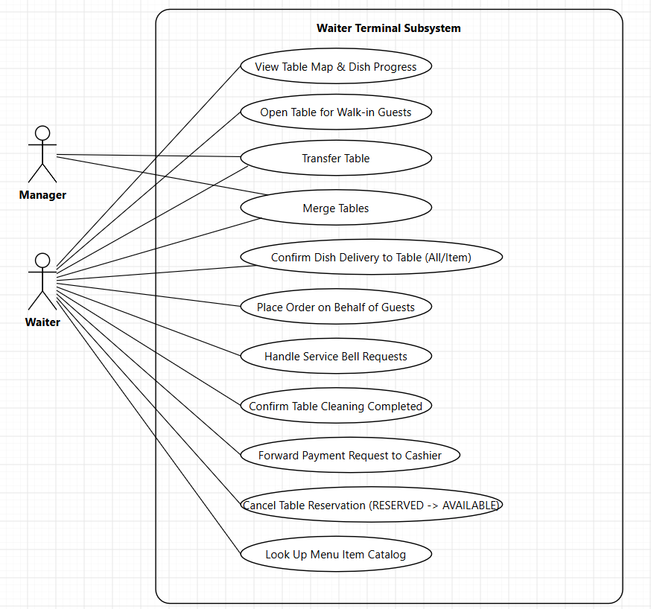
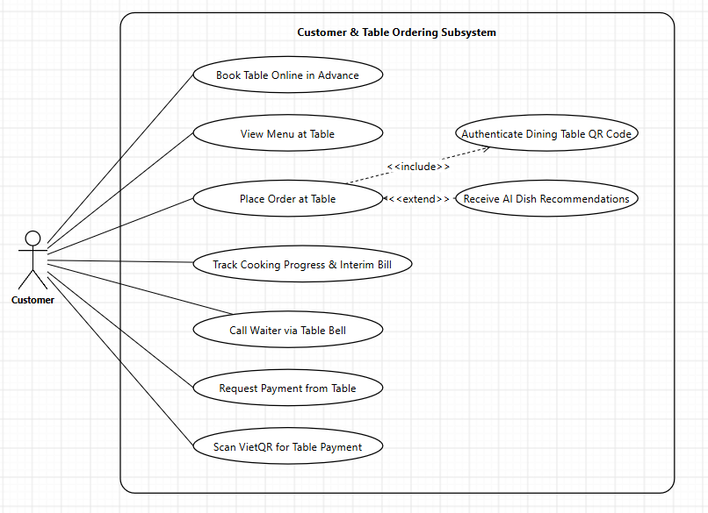
Use Case (1/3): Customer & Waiter Terminal
ANALYSIS · USE CASE 1/3
Front-of-House: Online booking, QR self-ordering, waiter table check-in, and dining service
ROMS · Restaurant Ordering Management System · SWP391 · FPT University
6
Notes:
[Pham Minh Duc] The system Use Cases are structured across 3 slides matching the operational lifecycle. Front-of-House: Customers can book tables online before arrival, or scan dynamic QR at the table to browse menu, consult AI Assistant, submit orders, ring call bell, and pay via VietQR. Alongside is the Waiter Terminal: live table status map, table check-in, transfer/merge tables, proxy ordering, serving confirmation, and table cleaning release.

Slide 7
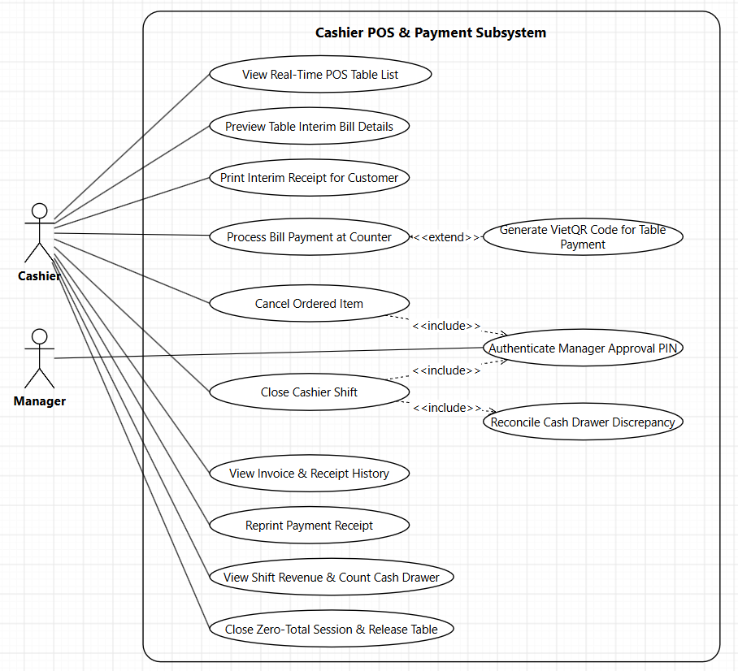
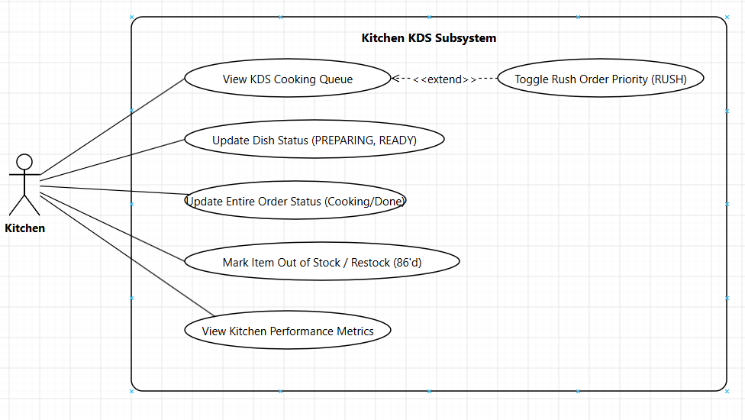
Use Case (2/3): Kitchen KDS & Cashier POS
ANALYSIS · USE CASE 2/3
Kitchen & Cashier: Kitchen order dispatching, 86 out-of-stock toggle, bill settlement & shift reconciliation
ROMS · Restaurant Ordering Management System · SWP391 · FPT University
7
Notes:
[Pham Minh Duc] The second group covers Kitchen and Cashier operations. On the Kitchen Display System (KDS), cooks monitor the prep queue, flag rush orders, update progress per item or batch, and actively 86 out-of-stock items directly at the station. At the Cashier POS, cashiers review bills, print pro-forma slips, process cash or PayOS VietQR, cancel dishes with Manager PIN approval, and perform end-of-shift drawer reconciliation.

Slide 8
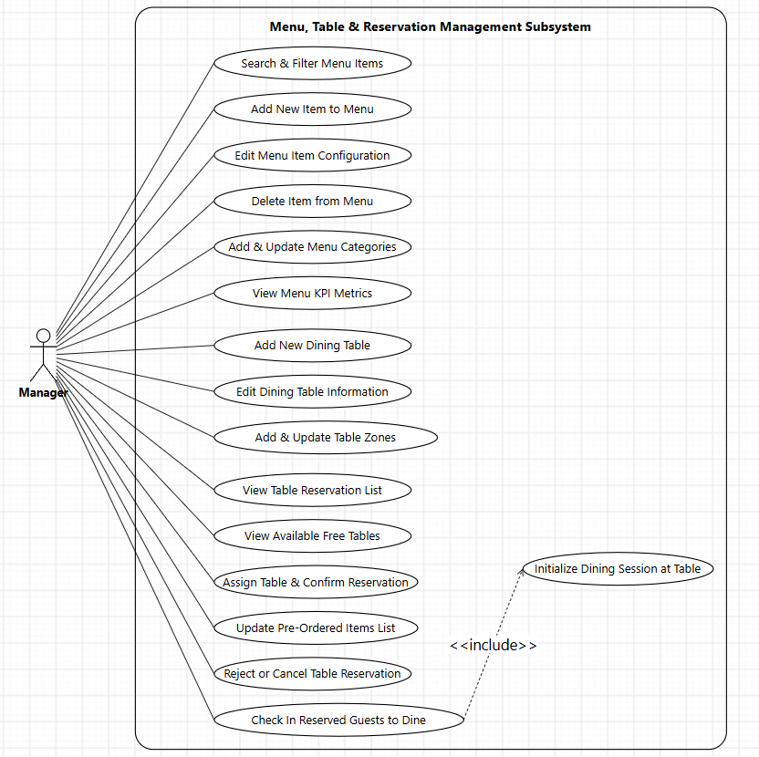
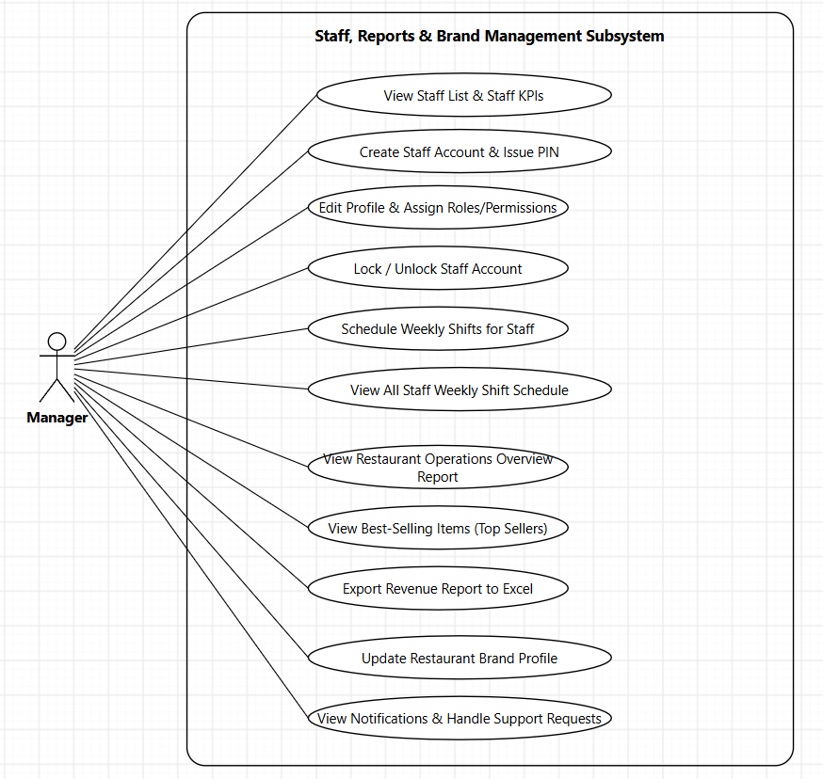
Use Case (3/3): Menu, Reservation & Staff Administration
ANALYSIS · USE CASE 3/3
Back-of-House: Menu configuration, table layout, reservation approval, shift rostering & revenue reporting
ROMS · Restaurant Ordering Management System · SWP391 · FPT University
8
Notes:
[Pham Minh Duc] The third group covers Restaurant Management (Back-of-House). On the left: menu administration, table layouts, zones, reservation approval workflow, available table assignment, and one-touch check-in. On the right: staff profiles, PIN provisioning, RBAC roles, weekly shift scheduling, restaurant brand configuration, and Excel revenue report exporting.

Slide 9
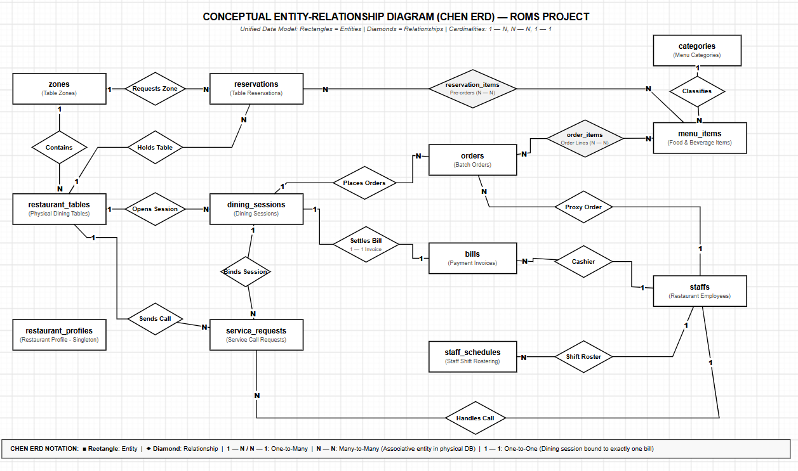
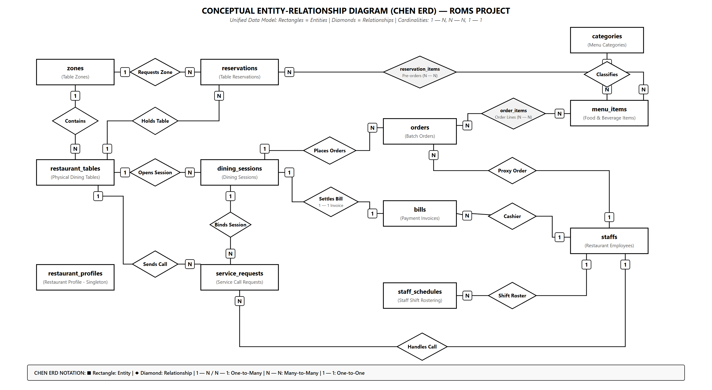
Project ERD
ROMS · Restaurant Ordering Management System · SWP391 · FPT University
9
Notes:
[Pham Minh Duc] The project data model comprises 14 entities unified in a clean conceptual Chen ERD. Part 1 manages table spaces, menu items, and reservations, resolving the N — N relationship between reservations and menu_items via reservation_items. Part 2 tracks at-table operations with dining_sessions as the core hub connected 1 — 1 with bills, and 1 — N with orders and service_requests.

Slide 10
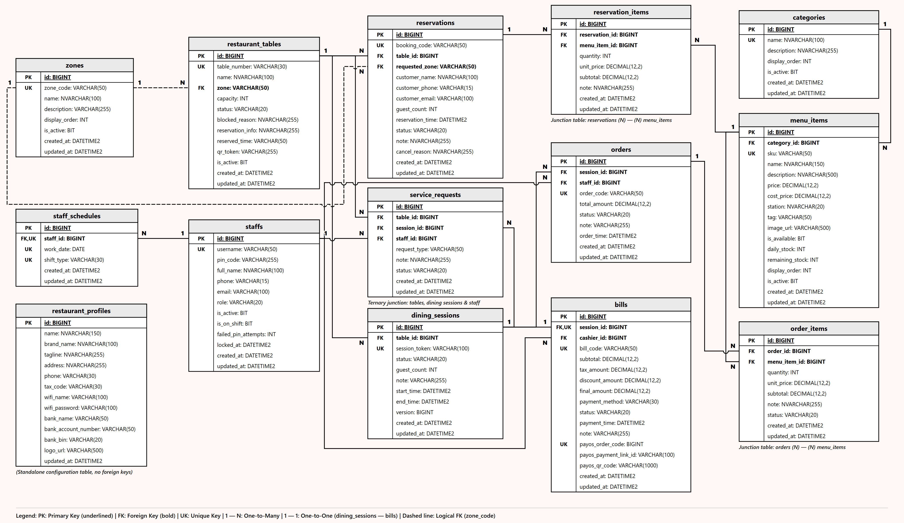
Physical Database Schema: 14 Normalized Tables
DESIGN · PHYSICAL ERD
Floor layout, reservations & menu catalog unified with QR dining sessions, batch ordering, billing & staff
ROMS · Restaurant Ordering Management System · SWP391 · FPT University
10
Notes:
[Pham Minh Duc] Here is our complete physical database schema in SQL Server comprising all 14 normalized tables.
On the left and top, we manage zones, tables, advance reservations, and menu items — where reservation_items resolves the many-to-many link and locks dish unit prices at booking time. Dashed lines from zones denote logical foreign keys storing zone_code, while solid lines represent physical foreign keys.
At the center and bottom right are our at-table operations anchored around dining_sessions: one session links to multiple order batches (orders, 1 — N) and service calls (service_requests, 1 — N), while enforcing a strict 1 — 1 relationship with bills. Order batches link to menu_items through order_items (N — N) to track preparation status per dish.

Slide 11
Two Core Business Workflows
WORKFLOW OVERVIEW
The remainder of the presentation dives deep into each workflow
FLOW 1 · ONLINE TABLE RESERVATION
1
2
3
4
5
6
Guest books table online
Select pre-ordered dishes (optional)
Manager assigns table & confirms
Buffer Time Lock active T−60' → T+45'
One-touch check-in upon arrival
Pre-orders dispatched to kitchen
FLOW 2 · AT-TABLE QR CODE ORDERING
1
2
3
4
5
6
7
Scan dynamic QR at table
Waiter opens table · grants access
Browse menu & consult AI Assistant
Place order batches
Kitchen cooks dishes (KDS)
Waiter serves dishes
Settle bill via VietQR
ROMS · Restaurant Ordering Management System · SWP391 · FPT University
11
Notes:
[Pham Minh Duc] The entire system centers around two core business workflows. Flow 1 — Online Reservation: guest books online with optional pre-ordered dishes, manager assigns table, system enforces safe buffer lock from T-60' to T+45', one-touch check-in upon arrival dispatches pre-orders to kitchen.
Flow 2 — QR Ordering: guest scans dynamic QR, waiter opens table activating session in real-time, guest asks AI and places order, kitchen receives on KDS, waiter serves, VietQR settles bill.
Next, Ngo Viet Bao Huy will present the deep dive into each workflow.

Slide 12
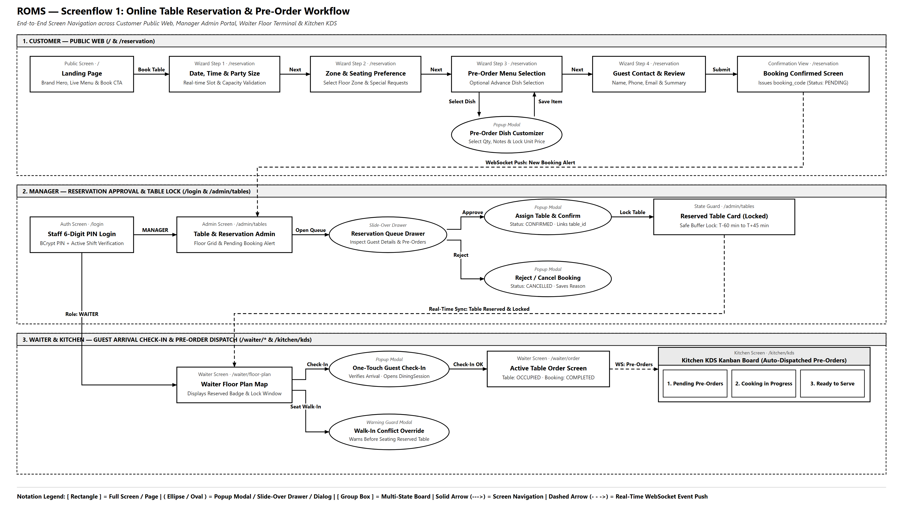
Workflow 1 — From Reservation to Table Check-in
FLOW 1 · RESERVATION
Screenflow Diagram: Customer → ROMS System → Manager / Waiter → Kitchen KDS
ROMS · Restaurant Ordering Management System · SWP391 · FPT University
12
Notes:
[Ngo Viet Bao Huy] Greetings, Committee members. I will present Flow 1 — Table Reservation.
Guests fill out the public booking form with optional pre-ordered dishes. The API creates a PENDING reservation with reservation_items, returning code RES-date-seq. The manager assigns an available table, transitioning status to CONFIRMED. When the guest arrives, the manager clicks check-in: reservation completes, table marks OCCUPIED, a DiningSession starts, and pre-ordered dishes automatically load into an Order pushed to the KDS via WebSocket.

Slide 13
Safe Table Buffer Time Lock
FLOW 1 · RESERVATION
Guarding reserved tables against accidental walk-in allocation
Example: Table B02 reserved for 19:30
Available for Walk-ins
SAFE BUFFER LOCK — blocks walk-in allocation
Released
T − 60'
T · Scheduled Time
T + 45'
18:30
19:30
20:15
During Lock Window
Why It Matters
Opening for walk-ins rejected by backend (HTTP 400) with guest name & minutes remaining
Manager can force override with forceOverride = true
Table card badges 'Safe Lock' and pre-order count
Walk-in dining takes 60–90 min: misallocating table leaves reserved guest stranded
Time-based lock automatically expires after T + 45'
Rule enforced server-side with comprehensive unit tests
ROMS · Restaurant Ordering Management System · SWP391 · FPT University
Presenter: Ngo Viet Bao Huy
13
Notes:
[Ngo Viet Bao Huy] Real-world problem: a table is booked for 19:30, but at 18:45 staff sees it empty and seats walk-in guests; walk-ins dine for 60–90 minutes, so at 19:30 the reserved guests have no table.
Solution: when a table has a CONFIRMED reservation at time T, the system locks it from T-60 min to T+45 min. During this window, attempting to open the table for walk-ins is rejected with HTTP 400 with guest info and minutes remaining; only managers can force override with forceOverride=true. After T+45', the lock automatically expires and the table returns to normal.

Slide 14
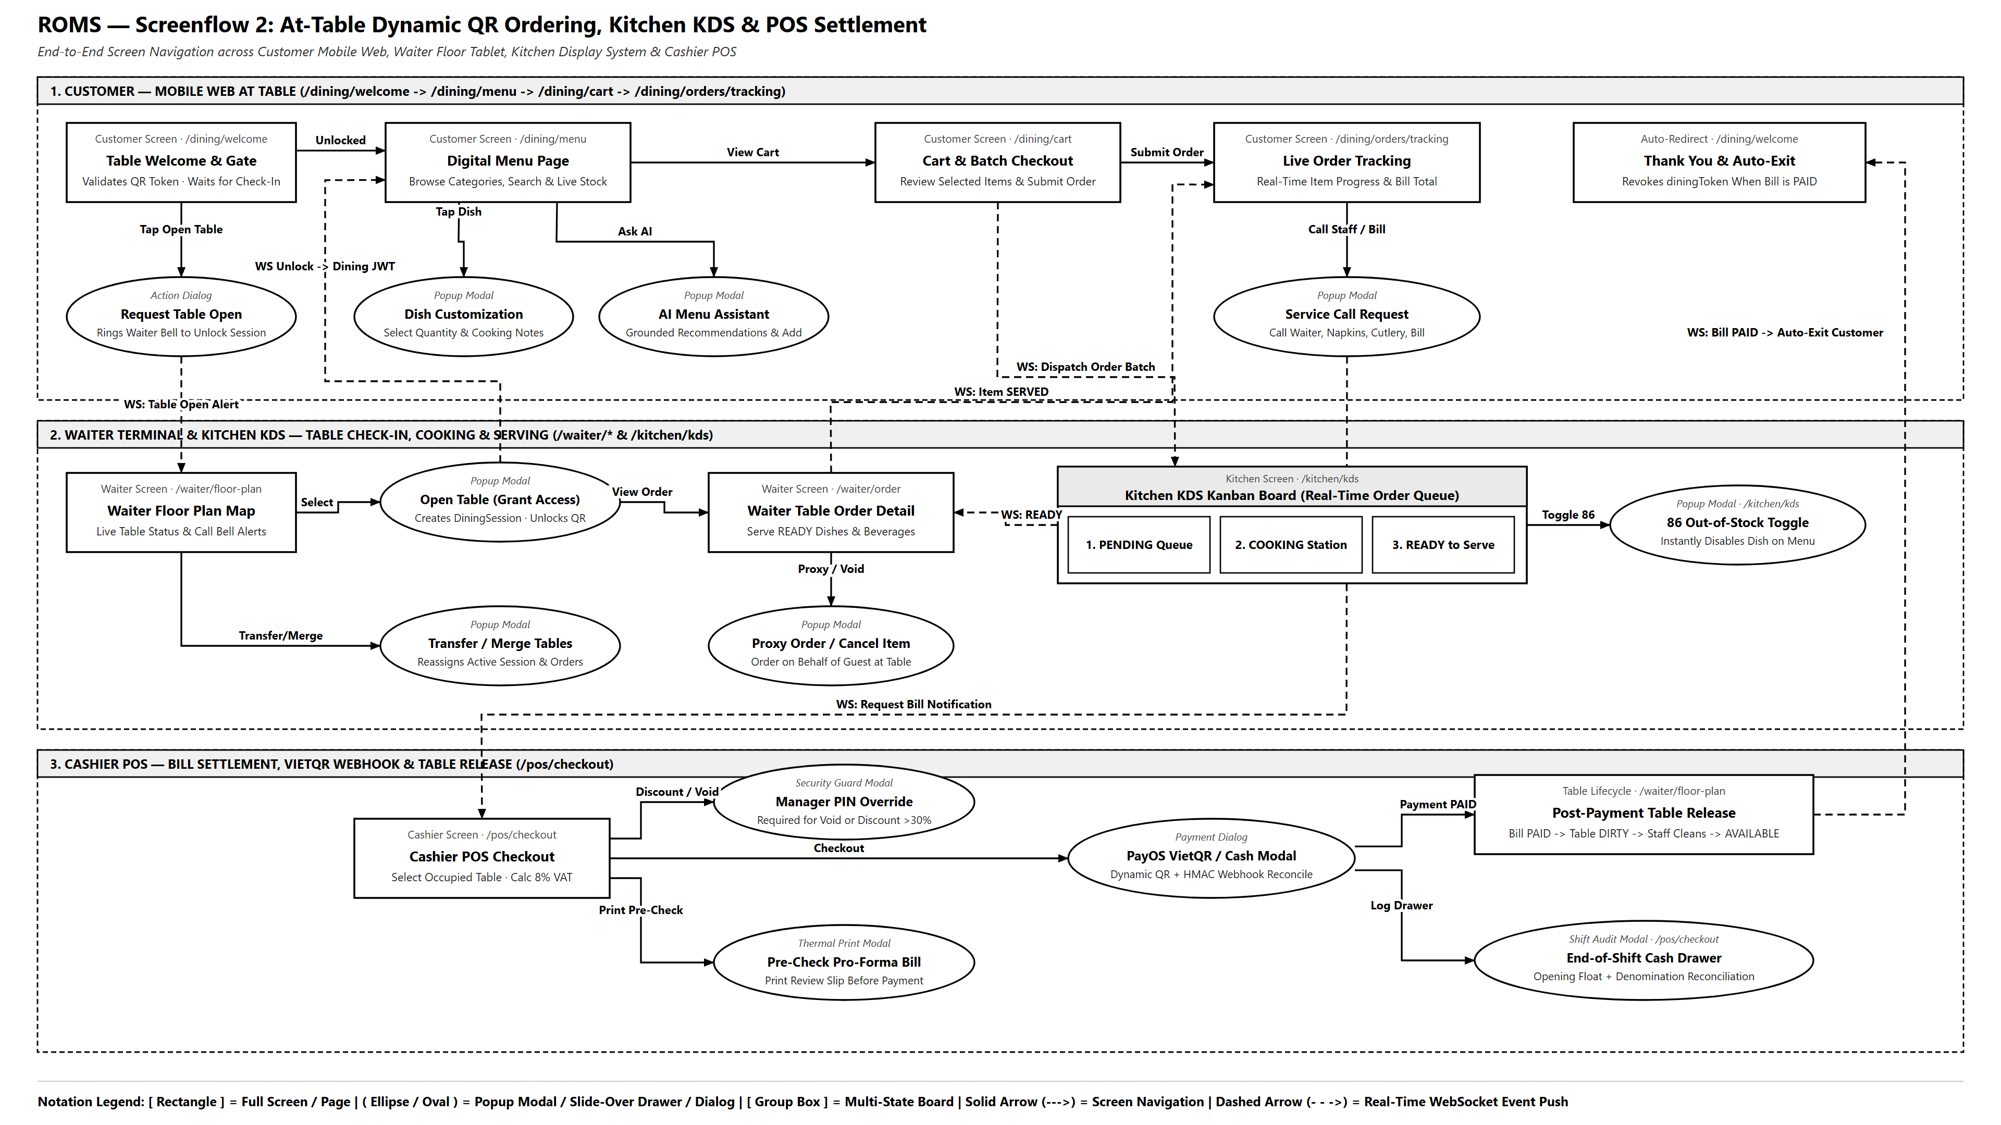
Workflow 2 — From QR Scan to Food Served
FLOW 2 · QR ORDERING
Screenflow Diagram: Customer Scans QR → Waiter Opens Table & Serves → Kitchen KDS Prepares
ROMS · Restaurant Ordering Management System · SWP391 · FPT University
Presenter: Ngo Viet Bao Huy
14
Notes:
[Ngo Viet Bao Huy] Flow 2 — QR Code Ordering. Guests scan the dynamic QR at table, app calls verify-qr. If the table is AVAILABLE, guests can preview the menu and tap 'Call Waiter to Open Table'. Once the waiter confirms the guest seated and opens the session (OCCUPIED), WebSocket events instantly unlock the customer's phone and grant a diningToken. Guests submit orders with diningToken — kitchen dishes start at PENDING, beverages route directly to READY. Kitchen receives orders via /topic/kitchen and phone updates in real-time.

Slide 15
Food Serving, VietQR Settlement & Table Release
FLOW 2 · QR ORDERING
From SERVED to AVAILABLE: A tamper-proof closed loop
1
2
3
4
5
6
Serving
Request Bill
Review Bill
Generate VietQR
Webhook
Release Table
Waiter taps SERVED
Guest taps on phone; POS notified in real-time
Subtotal + 8% VAT − Discount
PayOS dynamic QR (or cash)
HMAC signature verified → bill PAID
Session COMPLETED · table DIRTY → AVAILABLE
Bill (Sample Calculation)
Business Safeguards & Guards
Subtotal
480,000₫
Pending/cooking items → warning blocks settlement (requires explicit forceCheckout confirmation)
Discounts >30% / >200k, POS item cancellation, or shift closing → requires Manager PIN
PAID bill locks against duplicate charges · Table close → DIRTY → AVAILABLE & revokes diningToken
VAT 8%
38,400₫
Discount
0₫
Total
518,400₫
ROMS · Restaurant Ordering Management System · SWP391 · FPT University
Presenter: Pham Minh Duc
15
Notes:
[Pham Minh Duc] After waiters serve dishes and tap SERVED, guests tap 'Request Payment' (request-payment) and the POS is alerted in real-time. Cashiers review the bill: subtotal plus 8% VAT minus discounts. The system generates dynamic VietQR via PayOS (or handles cash). Upon transfer, PayOS sends a webhook, the backend verifies HMAC-SHA256 signature and marks bill PAID, session COMPLETED, table DIRTY; once cleaned, the table returns to AVAILABLE.
To safeguard revenue: pending/cooking items block checkout unless explicitly confirmed with forceCheckout; discounts >30% or >200k, POS item cancellations, or end-of-day shift closures strictly require Manager 6-digit PIN.

Slide 16
Live Demonstration Environment
LIVE DEMO
Running on a live deployment with multi-device real-time synchronization
Environment
Devices & Roles
Scenario A · Reservation (~2 mins)
roms-restaurant.duckdns.org
Docker Compose (4 containers): SQL Server 2022 + db-init · Spring Boot (Java 21) · React + Nginx 1.27 Proxy
Production sample data: zones, tables, active menu
Customer books table + pre-orders dishes
Manager assigns table → table card 'Safe Lock'
One-touch check-in upon arrival
Kitchen automatically receives pre-ordered items
Smartphone
Customer · Table 05
Tablet
Waiter
KDS Screen
Kitchen
Scenario B · QR Ordering (~3 mins)
Counter POS
Cashier
Scan QR at Table 05 → Request table open → Waiter Check-in
Ask AI for recommendations · order 1 dish + 1 beverage
KDS receives order; beverage routes directly to READY
Cooked → served → VietQR payment → DIRTY → AVAILABLE
Laptop
Manager
What the Committee Will Witness
Table opening activates QR in real-time
Buffer lock secures reserved tables
Beverages bypass kitchen queue
VietQR payment auto-reconciles via webhook
ROMS · Restaurant Ordering Management System · SWP391 · FPT University
Presented by: Entire Team
16
Notes:
[Ngo Viet Bao Huy moderates, team operates] Demo runs on a live 4-container Docker Compose setup at roms-restaurant.duckdns.org (SQL Server 2022 + db-init, Spring Boot Java 21, React 19 + Nginx 1.27 Reverse Proxy).
Scenario A (~2 minutes): customer books table with pre-ordered dishes → manager assigns table → table card displays safe lock → one-touch check-in → kitchen receives items.
Scenario B (~3 minutes): scan QR at Table 05 → tap Call Waiter → waiter check-in unlocks customer screen in real-time → consult AI → order 1 dish + 1 drink → KDS receives food, drink routes to READY → cooked → served → VietQR payment → table DIRTY then AVAILABLE.

Slide 17
Ecosystem Retrospective & Strategic Horizon
CONCLUSION · ROADMAP
Validated production milestones and next-generation architectural roadmap
10 / 10
Core Subsystems Deployed
100% paperless operations
< 5ms
STOMP Real-time Sync
Instant KDS & table dispatch
55 / 55
Automated Test Cases
Automated CI/CD validation
LIVE VPS
Cloud Docker Stack
roms-restaurant.duckdns.org
DELIVERED PRODUCTION PILLARS
End-to-end digitized on-premise dining ecosystem
STRATEGIC EXPANSION ROADMAP
Phased architectural evolution addressing RDS Section 4.2
01 · Closed-Loop Paperless Synchronization
Zero paper tickets across Table QR, Floor Tablet, KDS, POS, and Admin.
PHASE 1 · Split Billing & BOM Inventory
Split check evenly or per-dish; recipe-level ingredient tracking with cooking deduction.
02 · Real-Time KDS & Smart Beverage Routing
Ultra-fast STOMP dispatch, auto-routed bar line, and 1-tap 86'd stock lockout.
PHASE 2 · Online Deposit & Customer CRM
Advance deposit gateway eliminates no-shows; tier-based loyalty points & promo vouchers.
03 · Safe Buffer Time Lock
Algorithmic window guards tables; pre-orders lock historical unit pricing.
PHASE 3 · Multi-Branch Chains & Delivery
Centralized franchise multi-tenancy; 2-way sync with GrabFood, ShopeeFood & Native App.
04 · Automated VietQR Settlement & Grounded AI
PayOS HMAC webhook prevents duplicate billing; Gemini AI grounded on active menu.
PHASE 4 · Predictive Demand AI & Offline Edge
ML dining demand & prep forecasting; local edge LAN keeps POS & KDS active during ISP drops.
ROMS · Restaurant Ordering Management System · SWP391 · FPT University
17

Slide 18
ROMS · Restaurant Ordering Management System
Thank You Very Much
SWP391 Evaluation Committee & Mentors
Team ROMS welcomes your questions and feedback.
Duong Trong
Pham Minh Duc
Ngo Viet Bao Huy
Team Leader
Team Member
Team Member
LIVE
roms-restaurant.duckdns.org
Notes:
[Duong Trong] Our team sincerely thanks the Committee members and mentors for your dedicated guidance throughout the semester. We welcome your questions and feedback.

