Slide 1

SWP391 - SOFTWARE DEVELOPMENT PROJECT | OVERVIEW & RDS REVIEW
ROMS: Restaurant Ordering
Management System
Comprehensive Project Overview & Requirements and Design Specification (RDS) Milestone Presentation
Institution: FPT University Da Nang | Course Code: SWP391 | Term: Fall 2026
Team Composition: Dương Trong (Team Lead) | Phạm Minh Đức (Backend Lead) | Ngô Viết Bảo Huy (Frontend Lead)
Core Tech Stack: Spring Boot 3 + Spring Security (RBAC) + React + Microsoft SQL Server + STOMP WebSocket

Slide 2
1. PROJECT OVERVIEW
Pain Points in Traditional Restaurant Operations
Critical bottlenecks observed in peak-hour F&B operations necessitating digital automation
DINER & GUEST PAINS
• Peak Hour Delays: Customers must wait 10-15 minutes just to catch a waiter's attention and receive physical paper menus.
• Order Miscommunication: Special customization notes (e.g. no onions, less ice) get forgotten or lost during verbal relay.
• Lack of Transparency: Diners cannot see dish availability, ingredient visuals, or estimated cooking time.
• Checkout Frustration: Awkward hand waving and delayed bill delivery degrade the overall dining experience.
KITCHEN & CHEF PAINS
• Paper Ticket Chaos: Paper tickets get wet, stained with grease, or lost, creating kitchen confusion and food remake waste.
• Illegible Handwriting: Waiters' rushed handwritten notes lead to wrong dish preparations and customer disputes.
• Disordered Preparation: Chefs cannot identify which order arrived first, resulting in improper priority dispatching.
• Unannounced Stockouts: Dishes run out mid-shift without instant front-of-house synchronization, frustrating diners.
MANAGEMENT & AUDIT PAINS
• Revenue Leakage: Untracked order cancellations and unauthorized item voids create potential internal shrinkage.
• Zero Real-Time Visibility: Managers lack live data on active table occupancy, kitchen queue speed, and floor turnover.
• Labor Inefficiency: Waiters spend 70% of their floor time running back and forth delivering menus and taking notes.
• Untracked Reservations: No automated no-show policy; reserved tables sit vacant while walk-in diners are turned away.

Slide 3
1. PROJECT OVERVIEW
Project Scope & Architectural Philosophy
Defining MVP boundaries for a 3-person team over a 6-week SWP391 development lifecycle
SYSTEM SCOPE BOUNDARIES (SWP391 MATRIX)
CORE MUST-HAVE (100% Target For Defense):
✔ Staff Authentication & Role-Based Access Control (RBAC)
✔ Table Management & HMAC-SHA256 Cryptographic QR Verification
✔ Dining Session Lifecycle Management (Create / Join / Close)
✔ Digital Menu Catalog & Categorization CRUD
✔ Customer Batch Cart & Order Placement (Idempotency Key Guard)
✔ Kitchen Display System (KDS) Queue & Milestone State Machine
✔ Floor Waiter Service, Live Table Map & Dish Delivery
✔ Cashier Bill Aggregation, 8% VAT Calculation & Payment Settlement
✔ Advance Table Reservation & Automated No-Show Auto-Release
EXCLUDED FROM SCOPE (Explicit Out-of-Scope):
✖ Multi-branch / Multi-tenant SaaS (Restricted to exactly 1 restaurant)
✖ Native Mobile Apps (Optimized for pure responsive Mobile Web)
✖ Online Pre-payments / Deposits (Payment occurs upon in-store checkout)
✖ Customer Loyalty Points / Complex Voucher Redemption Engines
CORE ARCHITECTURAL PHILOSOPHY
1. Dining Session as the Central Heart
A Dining Table is just physical furniture. The Dining Session is the core temporal entity that binds multiple diners, batch orders, and the single final bill together.
2. QR Code is an Entry Point, Not the Product
Scanning the QR code simply establishes a cryptographically verified connection to an active Dining Session. The core value lies in real-time order state progression.
3. Quality Over Quantity
A focused system with 10 robust features handling real concurrency (optimistic locking, idempotency) is far superior to 20 half-baked features that crash under demo conditions.
4. Layered Separation of Concerns
Strict Spring Boot controller-service-repository pattern prevents business leaks into controllers and secures transaction boundaries.

Slide 4
2. REQUIREMENTS SPECIFICATION
System Actors & Role-Based Access Control (RBAC)
Clear separation of duties across 5 human roles and 1 automated system actor
Customer (Guest)
Role Type: External End-User
Scans table QR to join session; browses digital menu with real-time stock; places batch orders; tracks cooking milestones; calls waiter for assistance.
Waiter (Service Staff)
Role Type: Front-of-House
Monitors live floor table map; opens sessions for walk-ins; takes orders on customer behalf; serves READY dishes; handles guest assistance requests.
Kitchen Staff (Chef)
Role Type: Back-of-House
Operates KDS touchscreen; acknowledges incoming tickets; transitions milestones (CONFIRMED → PREPARING → READY); rejects unavailable items with reason.
Cashier (Billing)
Role Type: Front-of-House
Audits served items in session; applies tax/discounts; settles payments via Cash or VietQR dynamic payload; closes dining sessions and frees tables.
Restaurant Manager
Role Type: Administrator
Manages staff accounts & RBAC; configures table layouts & exports HMAC QR codes; maintains menu items & pricing; inspects sales analytics dashboard.
System Background Actor
Role Type: Automated Service
Validates HMAC-SHA256 tokens; brokers WebSocket real-time events; listens to payment IPN callbacks; runs cron jobs to auto-release no-show bookings.

Slide 5
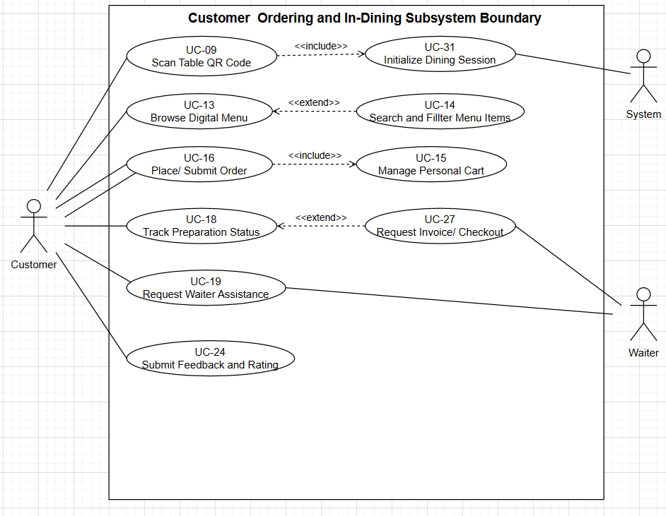
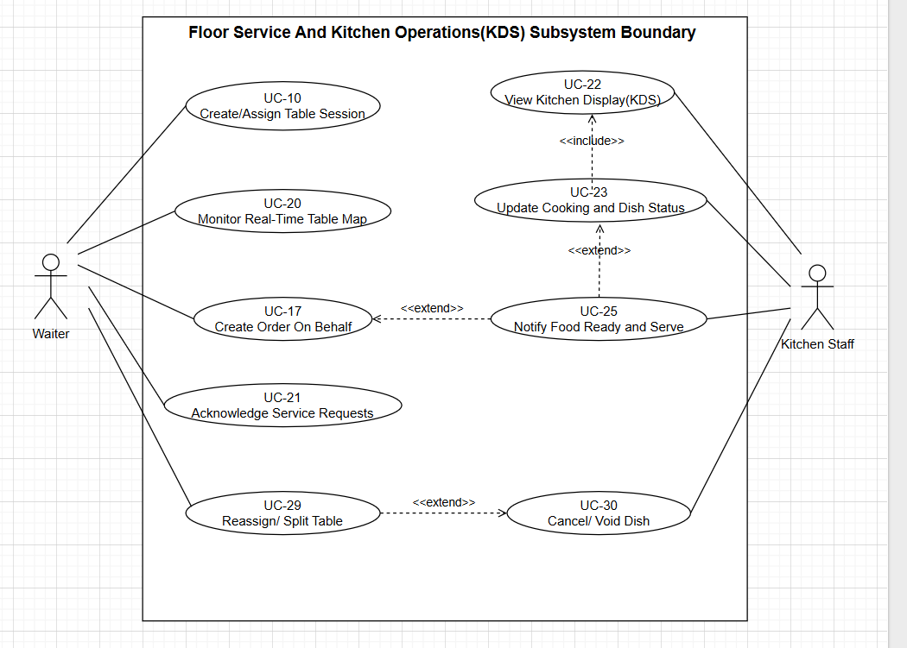
2. REQUIREMENTS SPECIFICATION
Front-of-House Use Cases: Customer & Waiter
Empowering diners with self-service ordering while equipping waiters with real-time floor tools
CORE FOH FUNCTIONAL HIGHLIGHTS
UC-09: Scan QR & Enter Session
Validates HMAC-SHA256 signature. Joins existing active session or prompts waiter initialization. Prevents session hijacking.
UC-13 & UC-15: Menu Browsing & Cart
Live categorized menu with stock availability. Diners add items, customize notes (e.g. 'ít đá'), and view shared table subtotal.
UC-16: Batch Order Placement
Submits batch order with UUID v4 Idempotency Key. Prevents duplicate tickets on network retry. Instantly broadcasts to KDS.
UC-18 & UC-19: Live Tracking & Cancellation
Tracks cooking milestones in real-time. Customers can self-cancel only before chef accepts order (PREPARING lock).
UC-10 & UC-17: Waiter Floor Support
Waiters monitor live table status map, create orders on behalf of elderly/walk-in guests, and deliver READY dishes (UC-23).
UC-24 & UC-25: Service Call System
One-tap assistance call (water, ice, utensils, checkout). Waiters receive instant push alerts on assigned floor tablets.
Customer Use Case Diagram (UC-09 to UC-19)
Waiter & Floor Service Use Case Diagram (UC-10, UC-17, UC-23, UC-25)

Slide 6
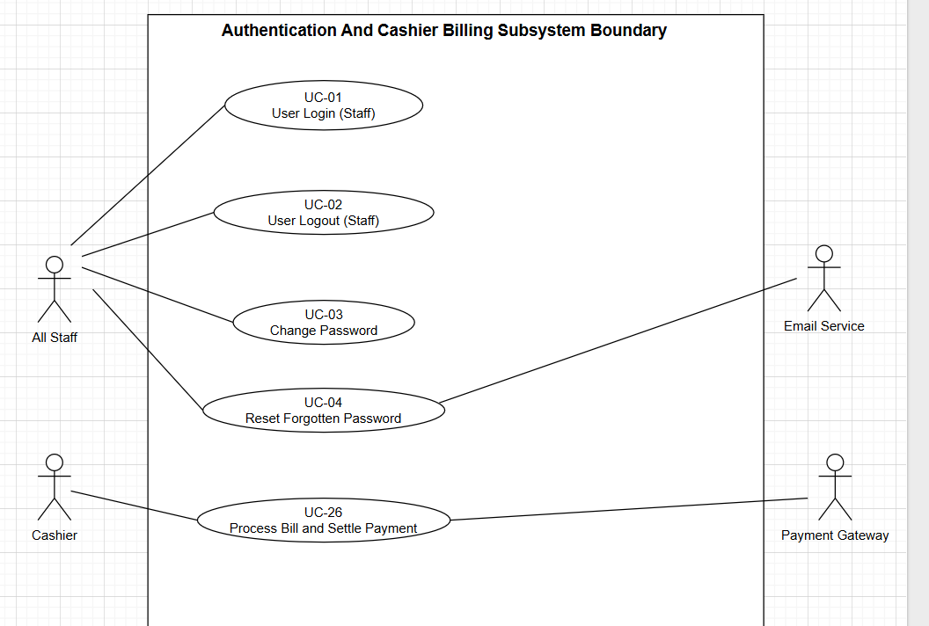
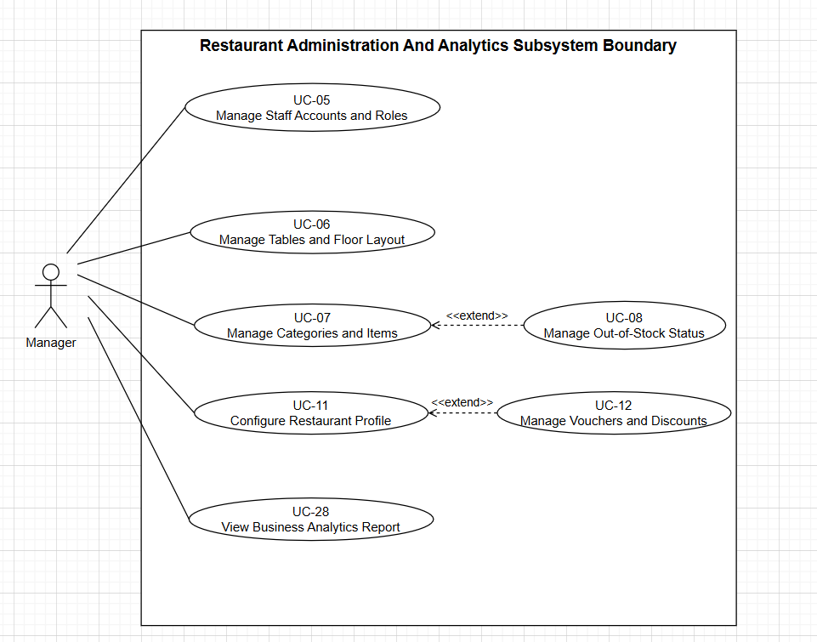
2. REQUIREMENTS SPECIFICATION
Back-of-House & Management Use Cases
Kitchen Display System (KDS), Cashier Settlement, and Administrative Governance
CORE BOH & ADMIN HIGHLIGHTS
UC-20 to UC-22: Kitchen KDS Lifecycle
Touchscreen ticket queue ordered by submission timestamp. Chefs transition items (CONFIRMED → PREPARING → READY). Out-of-stock items rejected with mandatory reason.
UC-31: Automatic Beverage Bypass Router
Pre-packaged beverages (is_drink = 1) bypass the cooking queue completely, auto-transitioning to READY for immediate waiter dispatch.
UC-26: Billing & Settle Payment
Cashier aggregates all SERVED items in the session. Applies 8% VAT. Settle via Cash or VietQR dynamic banking payload. Emits session CLOSED.
UC-07 & UC-08: Table & HMAC QR Management
Managers configure dining zones, table numbers, seating pax, and generate cryptographically signed QR code printouts.
UC-27: Advance Table Reservation
Customers book tables in advance. System auto-locks table 45m prior. Background cron auto-releases table if no-show exceeds 20 minutes.
UC-28: Sales & Performance Analytics
Live dashboard computing daily net revenue, order volume, table turnover ratios, and top-selling food items.
Kitchen & Cashier Use Case Diagram (UC-20 to UC-26)
Manager & System Use Case Diagram (UC-05 to UC-08, UC-27 to UC-28)

Slide 7
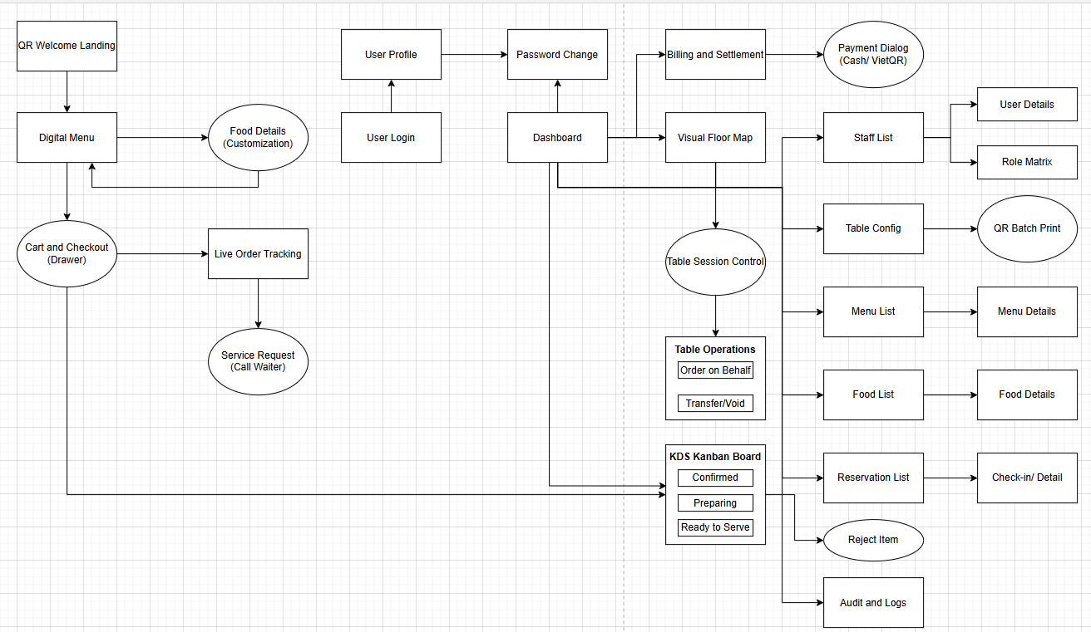
2. REQUIREMENTS SPECIFICATION
End-to-End Screens Flow & Diner Journey
Complete operational flow mapping customer actions to kitchen preparation and cashier settlement
Screens Flow Diagram (SCR-01 to SCR-18)
JOURNEY MILESTONES
Step 1: QR Scan & Entry
Customer scans physical table QR. System verifies HMAC signature and loads SCR-09 Welcome Landing.
Step 2: Menu & Batch Cart
Diners browse SCR-10 Menu, configure dish notes, and build shared cart in SCR-11.
Step 3: Idempotent Submission
Order placed with unique UUID header. Backend creates Order record and dispatches items to KDS.
Step 4: KDS Cooking Queue
Chefs see tickets on SCR-13 KDS, acknowledging and transitioning items to READY.
Step 5: Floor Serving
Waiters deliver dishes to the table and update item status to SERVED.
Step 6: Checkout & Settlement
Customer requests bill. SCR-17 Cashier consolidates SERVED items, accepts Cash/VietQR, and frees table.

Slide 8
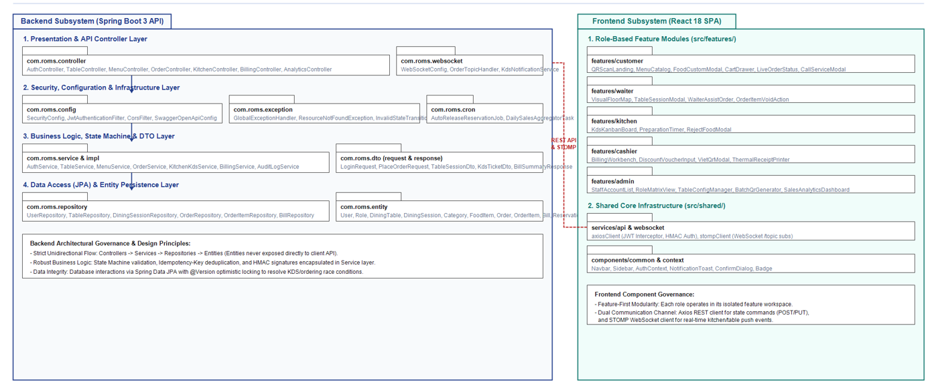
3. SYSTEM DESIGN (RDS)
System High-Level Architecture & Code Packages
Spring Boot 3 enterprise layered architecture enforcing strict separation of concerns
Code Packages & High-Level Architecture Diagram (com.roms.*)
PACKAGE STRUCTURE
com.roms.config
SecurityFilterChain, JwtAuthenticationFilter, CORS configuration, Swagger OpenAPI 3 docs.
com.roms.controller
RESTful API Presentation controllers enforcing role-based endpoint authorization and DTO validation.
com.roms.dto
Separated Request & Response DTOs, shielding internal JPA entities from direct external exposure.
com.roms.service & impl
Domain business logic, @Transactional boundaries, Order State Machine validation, HMAC checking.
com.roms.repository
Spring Data JPA data access layer with JPQL queries and @Version optimistic locking support.
com.roms.websocket
STOMP over SockJS message broker broadcasting real-time push events (/topic/table, /topic/kitchen).
com.roms.cron
Scheduled background workers: 5-min reservation auto-release and nightly sales aggregator.

Slide 9
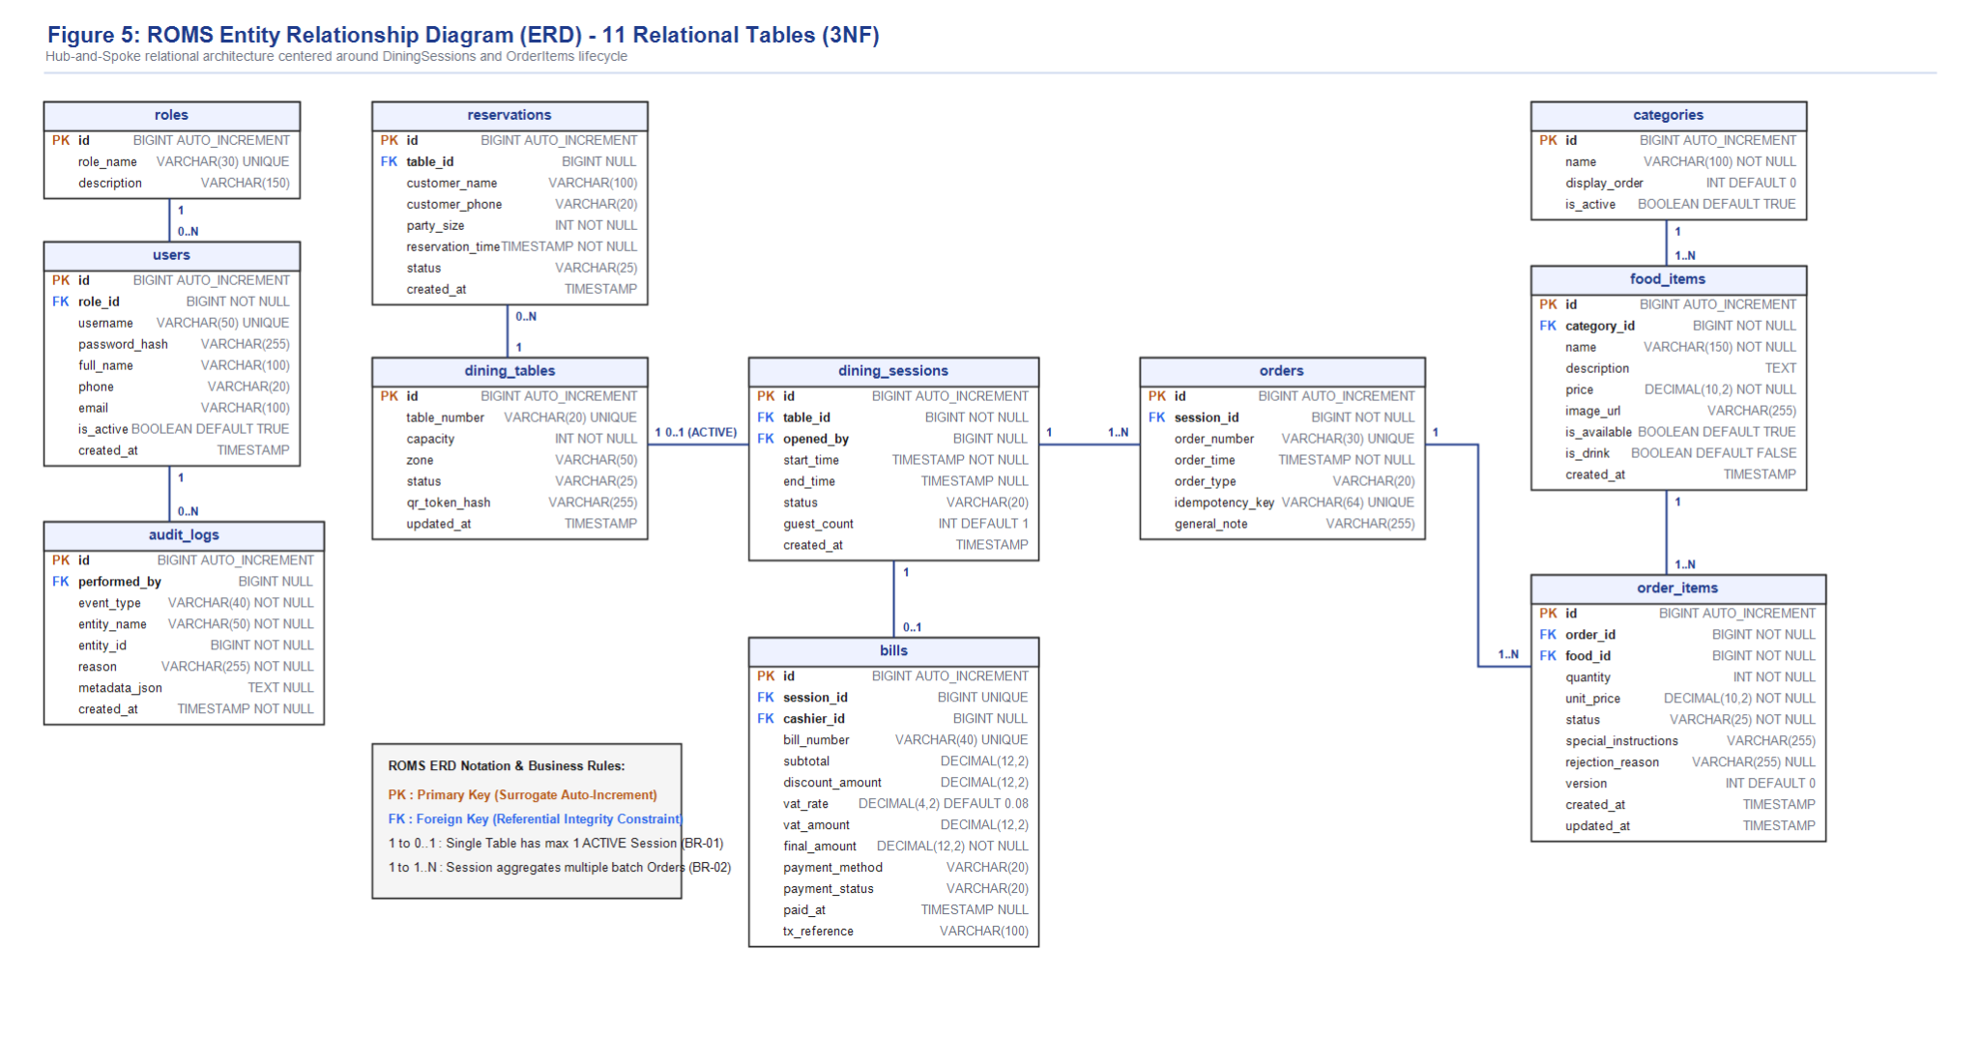
3. SYSTEM DESIGN (RDS)
Relational Database Design (11 Core Tables)
Enterprise relational schema centered around Dining Sessions with foreign key integrity and audit logs
Relational Database Schema (ERD) Diagram
SCHEMA DESIGN HIGHLIGHTS
dining_sessions (Hub)
The central hub linking dining_tables, orders, and bills. Only 1 active session per table (BR-01).
orders vs order_items
Orders represent batch checkouts. Order_items represent individual dish state machines with optimistic lock version.
Snapshot Pricing
order_items.unit_price stores price at placement time, protecting historical bills from future menu changes (BR-17).
audit_logs
Immutable trail recording item rejections, cancellations, and table transfers with user ID and reasons.
reservations
Tracks advance bookings, party size, and arrival time with foreign key to dining_tables.

Slide 10
3. SYSTEM DESIGN (RDS)
Business Rules & Strict Order State Machine
Rigorous state validation engines preventing illegal transitions and eliminating concurrency races
ORDER ITEM STATE MACHINE ENGINE
Happy Path Lifecycle
CONFIRMED → PREPARING → READY → SERVED
Strict linear progression. No skipping states (e.g. cannot jump from CONFIRMED directly to SERVED).
Customer Self-Cancellation (BR-05)
Diners can self-cancel ONLY while status is PENDING or CONFIRMED. Once chef moves item to PREPARING, cancellation is locked.
Kitchen Item Rejection (UC-22)
Chefs can transition CONFIRMED → REJECTED only if ingredients run out. Requires a mandatory rejection reason text.
Automated Drink Bypass (FN-03)
Items with is_drink = 1 bypass the kitchen queue entirely, auto-transitioning directly to READY for floor waiter delivery.
Manager Item Void (UC-29)
Authorized managers can void items at any stage with mandatory audit logging into audit_logs table.
CRITICAL BUSINESS RULES (BR-01 TO BR-17)
BR-01 & BR-02
A table can have exactly ONE active Dining Session at a time, but multiple diners can join the same session.
BR-08 & BR-16 (Checkout Lock)
A Dining Session CANNOT be completed while any order item remains in intermediate states (PENDING, CONFIRMED, PREPARING, READY). All must be SERVED, CANCELLED, or REJECTED.
BR-09 & BR-10 (Bill Computation)
The Bill aggregates ONLY items with status = SERVED. Cancelled and rejected items are strictly excluded ($0.00).
BR-11 (QR Integrity)
Customer access is rejected unless the HMAC signature matches the server secret and points to an ACTIVE table session.
BR-13 & BR-15 (Reservation Integrity)
A table marked RESERVED cannot be assigned to walk-ins during the active reservation window (45m prior). Reservations must be for future timestamps.

Slide 11
3. SYSTEM DESIGN (RDS)
Non-UI Functions & Security Architecture
Cryptographic integrity, concurrency deduplication, real-time messaging, and cron schedulers
FN-01: HMAC-SHA256 QR Verification
Security & Tamper Proofing
Every physical table QR embeds an HMAC-SHA256 signature calculated from table_id + secret_key. The backend validates this signature on every request, completely preventing URL spoofing or unauthorized table ordering.
FN-04: Idempotency Key & Dedup Service
Concurrency & Network Lag Protection
Each place-order request sends an Idempotency-Key header (UUID v4). If mobile network retransmission occurs or a customer double-clicks 'Submit', the backend rejects the duplicate request, guaranteeing zero duplicate tickets.
Real-Time WebSocket / STOMP Broker
Low-Latency Push Infrastructure
Subscribed channels (/topic/table/{id}, /topic/kitchen, /topic/waiter) deliver instantaneous updates to KDS screens when orders are submitted, and to diner phones when dishes are marked READY or SERVED.
FN-05 & FN-07: Background Cron Schedulers
Automated Background Workers
A 5-minute cron job scans upcoming reservations; if a guest is >20 minutes late without check-in, the table is automatically released to AVAILABLE. A nightly 00:05 cron aggregates daily sales metrics for fast dashboard queries.

Slide 12
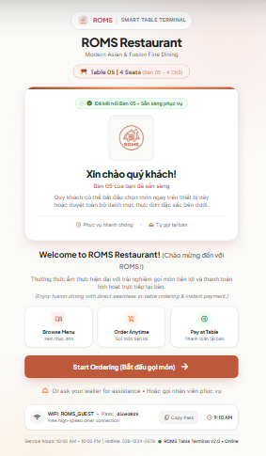
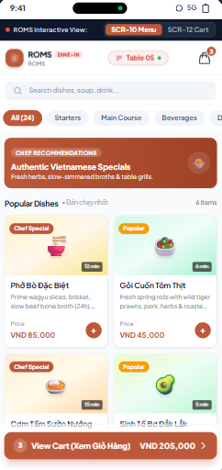
4. PROTOTYPE & USER INTERACTION
Customer In-Dining Experience: QR Entry, Menu & Cart
Pure responsive mobile web application requiring zero mobile app installation
SCR-09: QR Welcome Landing
SCR-10 & SCR-11: Menu & Cart
CUSTOMER INTERACTION HIGHLIGHTS
Zero App Installation Friction
Customers simply open their default camera app to scan the table QR code. The system immediately loads the mobile-optimized web application.
Session Identification & Welcome
Displays verified Table Number and allows the customer to join an existing session or initiate dining, showing diner count.
Categorized Visual Menu Browsing
Food items organized with vibrant photos, accurate prices, spice levels, and out-of-stock badges. Search and category quick-filtering.
Item Customization & Notes
Customers configure dish options and enter specific kitchen preparation notes (e.g. 'không hành tây', 'ít cay').
Shared Collaborative Table Cart
Multiple guests at the same table can view the consolidated cart, adjust quantities, and submit batch orders seamlessly.

Slide 13
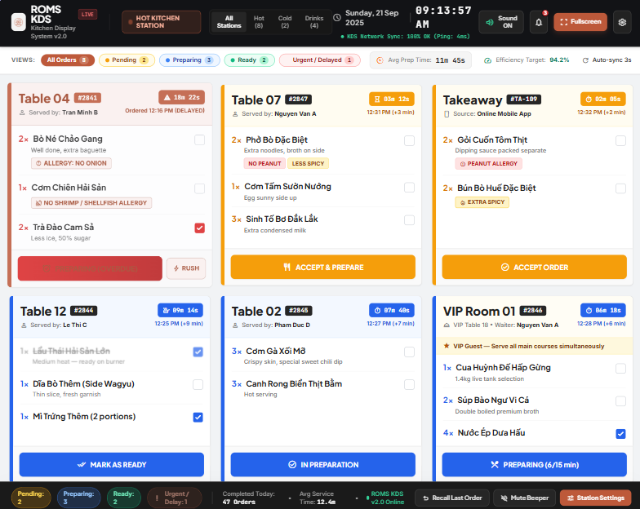
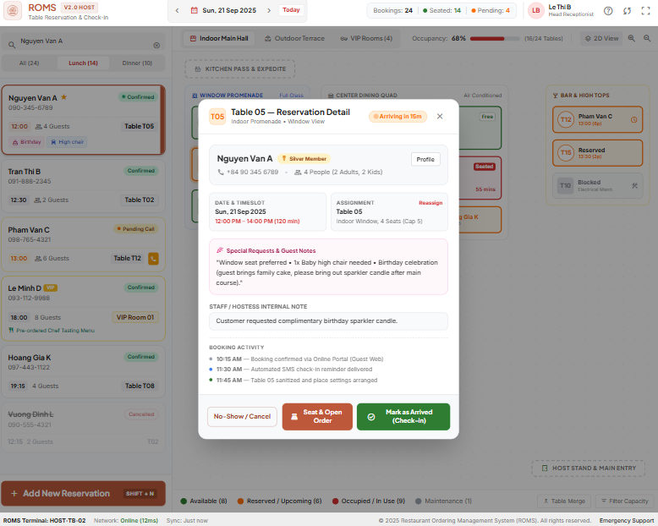
4. PROTOTYPE & USER INTERACTION
Operations Experience: Kitchen KDS & Floor Table Map
Real-time visual touch interfaces built for kitchen efficiency and floor coordination
Kitchen Display System (KDS) Touchscreen
Floor Table Map & Reservation Management
OPERATIONAL TOOLING CAPABILITIES
• KDS Ticket Cards: Real-time ticket queue with elapsed preparation timers; 1-tap milestone progression (CONFIRMED → PREPARING → READY); automatic color alerts for tickets exceeding 15 minutes.
• Live Table Map: Visual color-coded floor layout (Green: Available, Red: Occupied, Amber: Reserved, Gray: Cleaning). Staff can 1-tap initialize sessions, transfer tables, or check-in reservations.

Slide 14
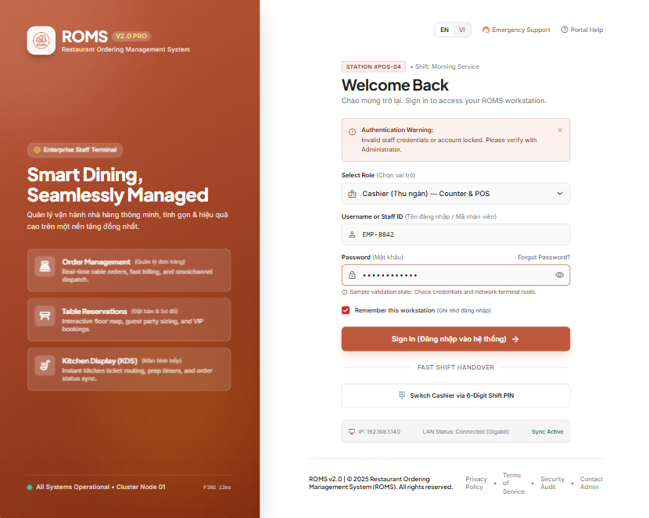
4. PROTOTYPE & USER INTERACTION
Staff Authentication & Role-Based Governance
Secure access control, shift token management, and executive analytics oversight
Staff Authentication & Assigned Role Dashboard
ADMINISTRATIVE GOVERNANCE
Shift-Based JWT Authentication
Staff authenticate via username/password. Password verified via BCrypt. Issued JWT token is valid for 8 hours (standard shift length).
Dynamic Role-Based Redirection
Waiters are routed directly to the Floor Table Map; Kitchen staff are routed to the KDS queue; Cashiers to Billing; Managers to Analytics.
Brute-Force Login Protection
Rate limits failed logins to a maximum of 5 attempts per minute per IP address, locking temporarily with HTTP 429 Too Many Requests.
Executive Analytics Dashboard
Provides real-time graphs for daily net revenue, active table occupancy rates, kitchen average preparation duration, and top revenue-generating dishes.

Slide 15
5. ENGINEERING QUALITY & MILESTONES
Non-Functional Requirements (NFR) & Quality Goals
Measurable engineering benchmarks ensuring enterprise-grade performance and security
Performance Benchmarks
• API Response Time: < 500 ms for core endpoints (menu, cart, order).
• QR Verification Latency: < 300 ms critical path response.
• KDS Ticket Sync: < 2 s latency over STOMP WebSocket or polling.
• Concurrency Target: 50 concurrent active users without degradation.
Security Standards
• Cryptographic QR: HMAC-SHA256 verification on all table requests.
• Role-Based Access Control: Strict JWT inspection on every API.
• Password Storage: BCrypt salted hashing with 10 rounds.
• Input Validation: Jakarta Validation annotations on all incoming DTOs.
Usability & Design
• Mobile-First Diner UI: Optimized for 360px - 414px smartphone screens.
• KDS Readability: 10-inch tablet optimized; min 16px font readable from 60 cm.
• Vietnamese Error Messaging: Friendly localized error toasts (no raw 500s).
• Action Confirmations: Confirm dialogs on irreversible actions (cancel/settle).
Reliability & Concurrency
• Idempotency Guarantee: UUID v4 header prevents duplicate order creation.
• Optimistic Locking: JPA @Version concurrency guards on OrderItem states.
• Operational Uptime: 99% availability during operating hours (09:00 - 22:00).
• Automated Schedulers: 5-min cron guarantees no missed reservation releases.

Slide 16
5. ENGINEERING QUALITY & MILESTONES
Sprint Roadmap & Proactive Risk Management
Tracking development progress against official SWP391 course milestones and mitigation strategies
SWP391 SPRINT TIMELINE & DELIVERABLES
Sprint 1-2 (Completed)
Vision, Scope, Use Cases, Analysis & Activity Diagrams. Deliverable: SRS v1.0 & Analysis Doc.
Sprint 3 (Completed / Current)
Database ERD (11 tables), API Specification, Spring Boot Architecture. Deliverable: Complete RDS Document.
Sprint 4 (Active Focus)
Customer Core Ordering (QR → Table → Session → Menu → Cart → Order). Milestone M3 Demo.
Sprint 5 (Next Focus)
Kitchen KDS touchscreen & Floor Waiter dish delivery. Milestone M4 Demo.
Sprint 6-7 (Upcoming)
Cashier Billing (Cash/VietQR), Table Reservation, Concurrency & Optimistic Lock testing. Deliverable: Test Report.
Sprint 8 (Final)
Cloud deployment, seed data, user manual, and final defense rehearsal.
RISK MITIGATION STRATEGY
Risk 1: Feature Scope Creep
Mitigation: Hard enforcement of Scope Matrix. Out-of-scope items (multi-tenant, loyalty points, AI recommendations) are strictly barred until core order-to-bill loop is 100% stable.
Risk 2: WebSocket Network Constraints
Mitigation: Built-in 2-second HTTP polling fallback architecture. If proxy/firewalls block STOMP WebSockets during live demo, the UI seamlessly polls status.
Risk 3: Concurrency Demonstration
Mitigation: Concurrency is coded and unit-tested for Duplicate Orders (Idempotency Key) and Double-Status Updates (Optimistic Locking @Version) with clear test logs.
Risk 4: QR Stand Security Vulnerabilities
Mitigation: Cryptographic HMAC-SHA256 signature verification guarantees that altered table IDs in QR URLs are immediately rejected with HTTP 403.

Slide 17
ROMS: EMPOWERING SMART RESTAURANT OPERATIONS
Thank You for Your Attention!
Project Summary & Achievements to Date:
✔ Comprehensive Requirements & Design Specification (RDS) established with 31 formal Use Cases.
✔ Robust relational data model with 11 tables centered on the Dining Session core hub pattern.
✔ Engineered security and concurrency controls: HMAC QR verification, Idempotency, and Optimistic Locking.
✔ Clear development roadmap aligned with SWP391 milestone deliverables.
We welcome questions, feedback, and architectural suggestions from our Lecturers and Mentors!

