Slide 1

ROMS
SMART RESTAURANT MANAGEMENT SYSTEM
Restaurant Ordering Management System
Real-time At-table QR Ordering & Online Table Reservation System
SWP391 · Software Development Project
FPT University · Fall 2026
Duong Trong
Pham Minh Duc
Ngo Viet Bao Huy
Team Leader
Team Member
Team Member
LIVE
roms-restaurant.duckdns.org
Notes:
[Duong Trong] Good morning, respected Committee members. Our team would like to present our SWP391 Capstone Project — ROMS, Restaurant Ordering Management System.
Our team consists of 3 members: Duong Trong (Team Leader), Pham Minh Duc (Backend & Database), and Ngo Viet Bao Huy (Frontend & Testing).
This presentation focuses on the two core operational pillars of the system: (1) Online Table Reservation and (2) Real-Time At-Table QR Code Ordering, followed by a live demonstration on our deployed production environment.

Slide 2
Three Major Restaurant Pain Points during Peak Hours
CONTEXT · PROBLEM
Paper-based and manual operations slow down guests, kitchen, and management
1
CUSTOMERS
2
KITCHEN
3
MANAGEMENT
Waiting for staff to bring menus and take orders during peak hours
Special requests (less spicy, no onions) are easily missed or mistaken
Unaware of cooking status; must wave hands to request the bill
Paper tickets easily get wet or lost; handwriting is hard to read
No clear FIFO queue → late tables receive food earlier than early tables
Out-of-stock items still ordered by guests; slow cancellation notice
Waiters running back and forth between tables, kitchen, and counter wastes labor
Reserved tables easily mistakenly assigned to walk-in guests
Manual item cancellation and bill settlement make auditing difficult
ROMS digitizes the entire chain: Table → Kitchen → Cashier — real-time, paperless
ROMS · Restaurant Ordering Management System · SWP391 · FPT University
2
Notes:
[Duong Trong] The motivation behind choosing ROMS stems from real-world F&B operational bottlenecks.
Customers face long waits for menus, frequent ordering errors, and no visibility into cooking status. Kitchen staff struggle with wet, lost paper tickets, unreadable handwriting, and the lack of a clear FIFO queue. Management loses labor as waiters constantly run back and forth, reserved tables get accidentally seated with walk-ins, and auditing manual bill cancellations is difficult.
ROMS digitizes the entire chain: Table → Kitchen → Cashier in real time.

Slide 3
ROMS: A Closed-Loop Digital At-Table Ecosystem
SOLUTION · POSITIONING
Comparison with Traditional Workflows and Conventional POS
Criteria | Traditional | Standard POS | ROMS Bistro
Table Ordering | Paper menu, wave hand to call staff | Staff enters order manually | Self-ordering via QR scan on mobile web
Guest Setup | None | Dedicated kiosk / proprietary app | Mobile web, zero app installation
Kitchen Link | Hand-delivered paper tickets | Thermal kitchen printer | Real-time KDS display (WebSocket)
Reservation | Handwritten logbook / Excel | Manual cashier entry | Online booking + pre-orders + safe lock
Recommendations | Floor staff | None | AI Assistant grounded on active menu
Zero-friction
Real-time
Strict Control
Intelligent
Scan & browse, no app download
Table ↔ Kitchen ↔ Cashier
Dynamic QR + waiter verification gate
AI suggestions & safe buffer lock
ROMS · Restaurant Ordering Management System · SWP391 · FPT University
3
Notes:
[Duong Trong] ROMS is far more than a standard cash register. Our key differentiators: guests self-order via mobile web (zero app installation required) protected behind waiter verification gates; orders dispatch to the kitchen in real time; online booking includes pre-ordering dishes with safe buffer time locking; and an AI Assistant recommends dishes strictly grounded on active restaurant menu items.

Slide 4
Project Scope: 10 Core Subsystems in Production
PROJECT SCOPE
Strategically setting boundaries to achieve depth over breadth
IN-SCOPE · 10 Completed Subsystems
OUT-OF-SCOPE
1
Staff Authentication & RBAC Authorization
6
Floor Waiter Map & Table Call Bells
Multi-tenant restaurant chains
Native iOS / Android mobile apps
Loyalty points, e-wallets, table deposits
Deep warehouse & raw ingredient inventory
2
Floor Plan, Zone & Dynamic QR Management
7
Cashier POS · 8% VAT · PayOS VietQR
3
Menu & Category Management
8
Online Reservation & Pre-ordered Dishes
4
Dining Session & Batch Ordering Lifecycle
9
Revenue Analytics · Staff Rostering & Shifts
5
Real-time Kitchen Display System (KDS)
10
AI Dining Assistant for Table Ordering
ROMS · Restaurant Ordering Management System · SWP391 · FPT University
4
Notes:
[Duong Trong] With a 3-member team over one semester, we prioritized building production-ready features rather than spreading too thin. All 10 in-scope subsystems are fully completed and running on Docker.
We deliberately scoped out: multi-tenant chains, native apps, loyalty wallets, and deep warehouse inventory — allowing us to focus intensively on real-time responsiveness, data consistency, and enterprise security.

Slide 5
Four Core Architectural Design Principles
DESIGN PHILOSOPHY
Every technical decision is anchored to these four core principles
1
2
3
4
Dining Session Centricity
Gated Dynamic QR Access
Real-time & Concurrency
Layered Architecture
Tables are static assets. Dining sessions aggregate guests, order batches, and exactly one final bill.
Dynamic rotating QR tokens; ordering privileges are granted only after waiter check-in.
STOMP pushes events instantly; @Transactional and @Version ensure data consistency.
Controller → Service → Repository; DTO decoupled from Entities; RBAC on every API.
TECH STACK
React 19 · Vite
Spring Boot 3.4
Java 21
Spring Security · JWT
SQL Server 2022
WebSocket · STOMP
Docker Compose
ROMS · Restaurant Ordering Management System · SWP391 · FPT University
5
Notes:
[Duong Trong] Four core design principles: (1) Dining Session Centricity — tables are static physical furniture, the session aggregates guests, order batches, and a single invoice. (2) Gated Dynamic QR Access — rotating tokens combined with waiter verification gates. (3) Real-time & Concurrency Control — STOMP broadcasts events instantly, while @Transactional and @Version maintain ACID integrity. (4) Layered Architecture — Controller, Service, Repository, DTO decoupled from Entities.
Tech stack: React 19 + Vite, Spring Boot 3.4 on Java 21, SQL Server 2022, packaged in Docker Compose.
Next, I invite Pham Minh Duc to present the system analysis and design.

Slide 6
System Actors & Role-Based Access Control (RBAC)
ANALYSIS · ACTORS & RBAC
5 Human Actors + 1 Automated System Actor
Actor | Device | Authentication | Primary Privileges
Customer | Mobile web | QR token + Dining JWT | View menu, call staff, ask AI, order food, call waiter, request bill; online booking
Waiter | Floor tablet | 6-digit PIN → JWT | Floor map, open table (grant QR access), proxy ordering, serve dishes (SERVED), transfer/merge tables
Kitchen | KDS screen | 6-digit PIN → JWT | Receive & cook dishes, toggle out-of-stock (86), rush urgent priority orders
Cashier | Counter POS | 6-digit PIN → JWT | Review bill, 8% VAT, VietQR / cash payment, shift end cash reconciliation
Manager | Dashboard | 6-digit PIN → JWT | Staff & shifts, tables & QR, menu, reservation approvals, revenue reports
System | Background daemon | Signed Webhook | Real-time event broadcasting, PayOS webhook processing, OTP email delivery
6-digit PIN hashed with BCrypt · Locked after 5 failed attempts · Daily shift schedule verification · Manager PIN recovery via Email OTP
ROMS · Restaurant Ordering Management System · SWP391 · FPT University
6
Notes:
[Pham Minh Duc] Greetings, Committee members. The system has 4 internal roles defined in UserRole enum: MANAGER, WAITER, KITCHEN, CASHIER, plus Customer and the automated System actor.
All staff (including Managers) authenticate using a 6-digit PIN hashed with BCrypt, automatically locked after 5 failed attempts; employees must have an active shift in staff_schedules for the current day to log in, backed by a 30s heartbeat. Managers can self-recover PINs via a 5-minute email OTP.
Guests access through dynamic QR tokens and only receive a Dining JWT once staff opens the table.

Slide 7
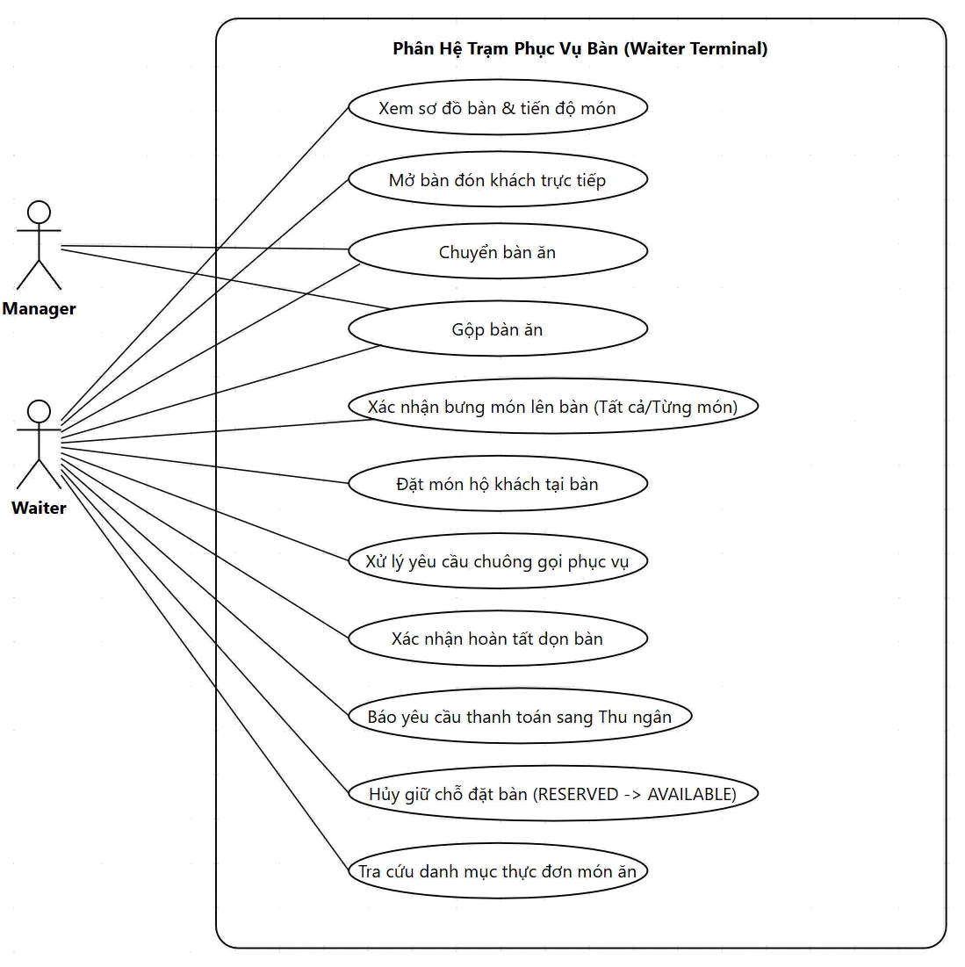
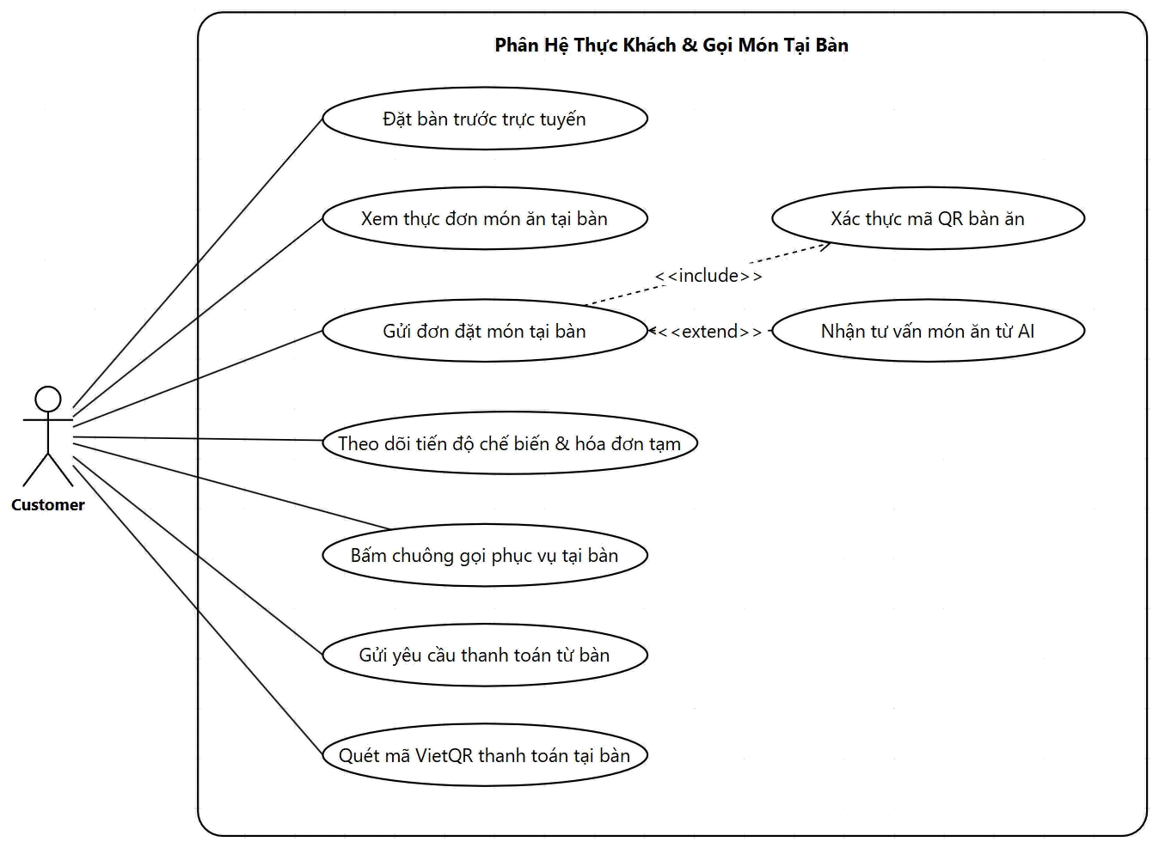
Use Case (1/3): Customer & Waiter Terminal
ANALYSIS · USE CASE 1/3
Front-of-House: Online booking, QR self-ordering, waiter table check-in, and dining service
ROMS · Restaurant Ordering Management System · SWP391 · FPT University
7
Notes:
[Pham Minh Duc] The system Use Cases are structured across 3 slides matching the operational lifecycle. Front-of-House: Customers can book tables online before arrival, or scan dynamic QR at the table to browse menu, consult AI Assistant, submit orders, ring call bell, and pay via VietQR. Alongside is the Waiter Terminal: live table status map, table check-in, transfer/merge tables, proxy ordering, serving confirmation, and table cleaning release.

Slide 8
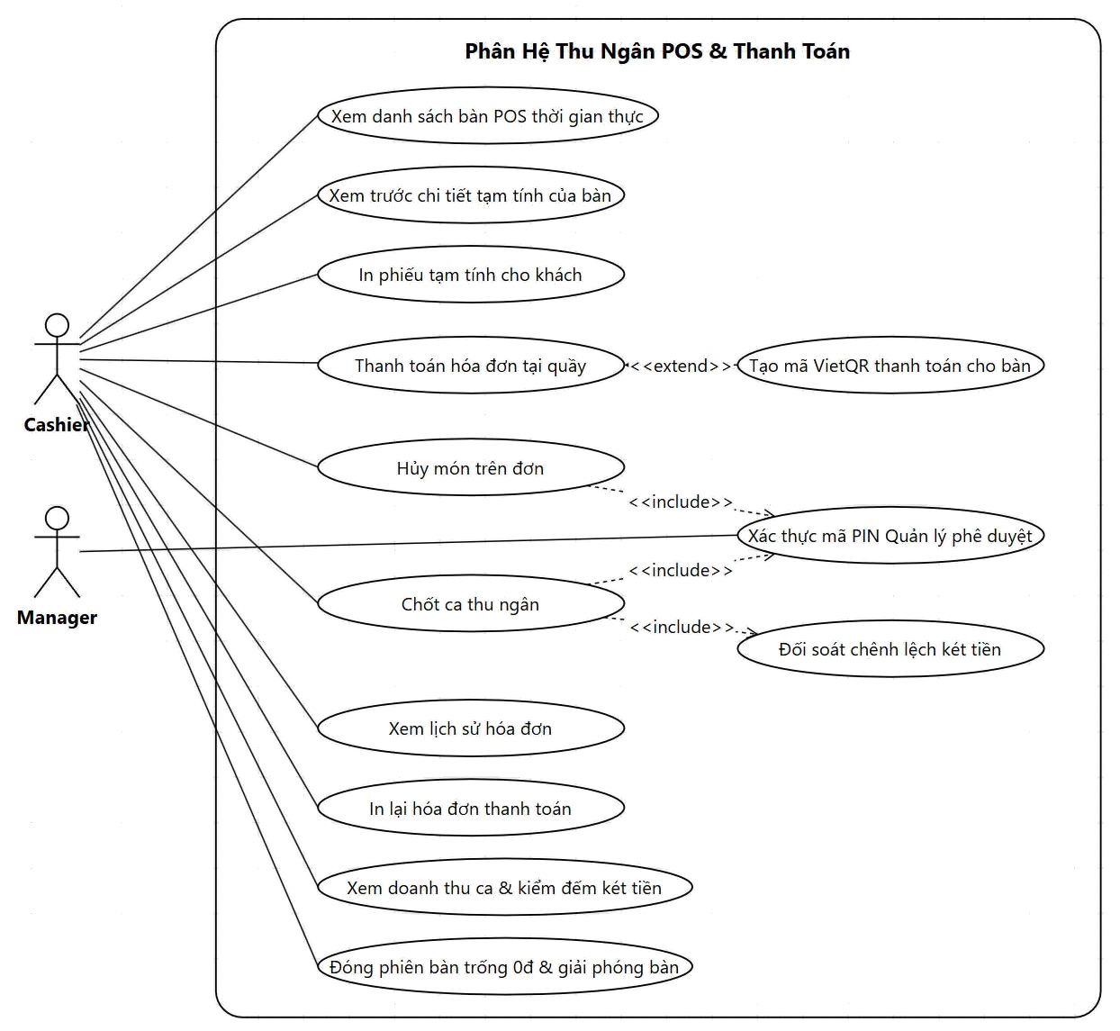
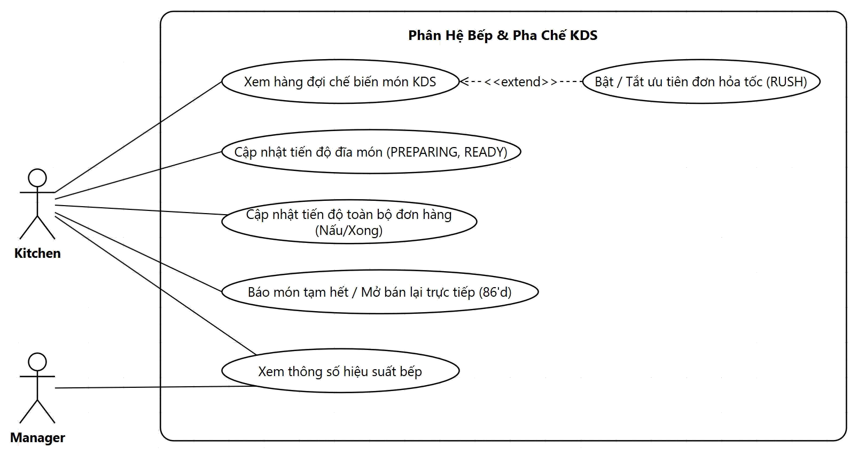
Use Case (2/3): Kitchen KDS & Cashier POS
ANALYSIS · USE CASE 2/3
Kitchen & Cashier: Kitchen order dispatching, 86 out-of-stock toggle, bill settlement & shift reconciliation
ROMS · Restaurant Ordering Management System · SWP391 · FPT University
8
Notes:
[Pham Minh Duc] The second group covers Kitchen and Cashier operations. On the Kitchen Display System (KDS), cooks monitor the prep queue, flag rush orders, update progress per item or batch, and actively 86 out-of-stock items directly at the station. At the Cashier POS, cashiers review bills, print pro-forma slips, process cash or PayOS VietQR, cancel dishes with Manager PIN approval, and perform end-of-shift drawer reconciliation.

Slide 9
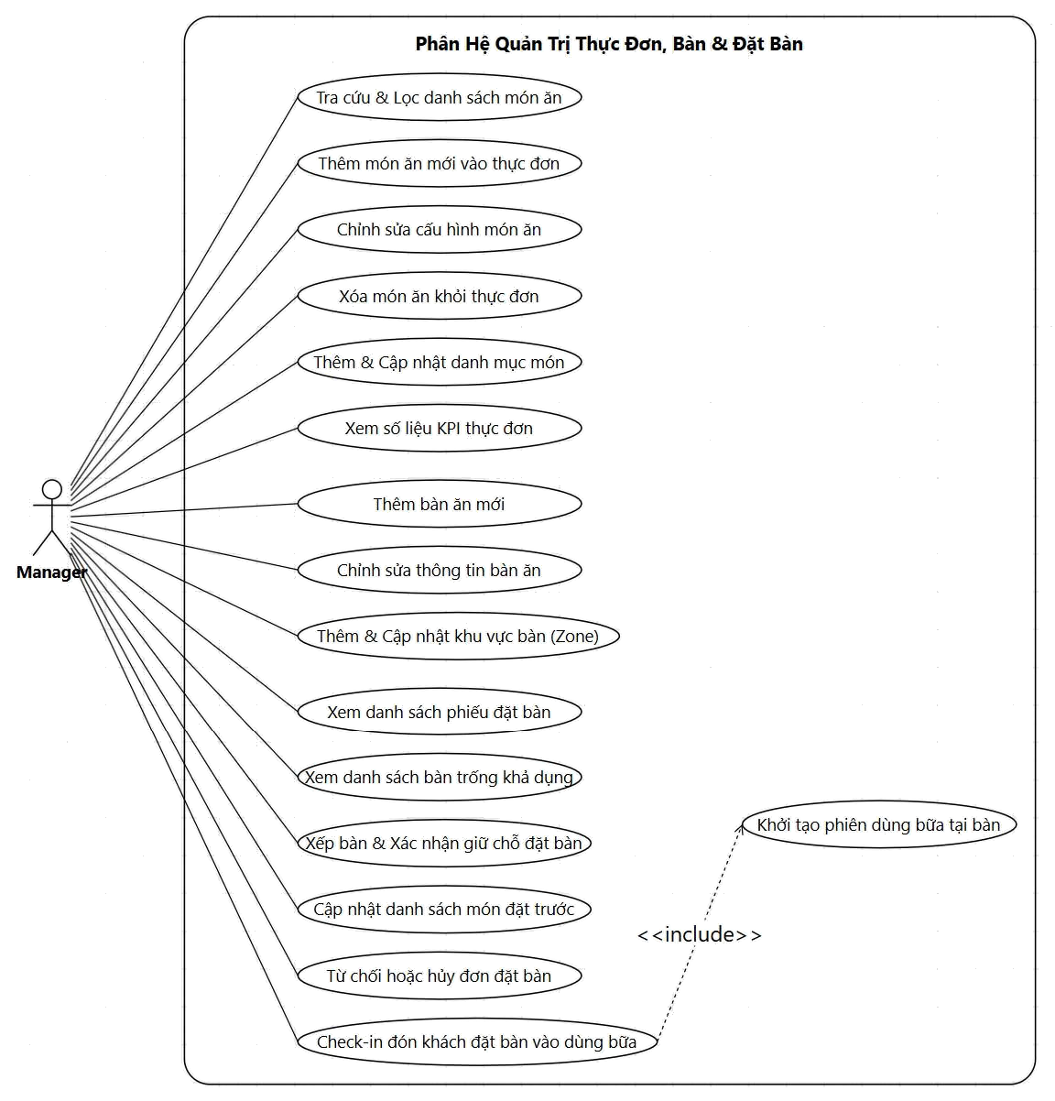
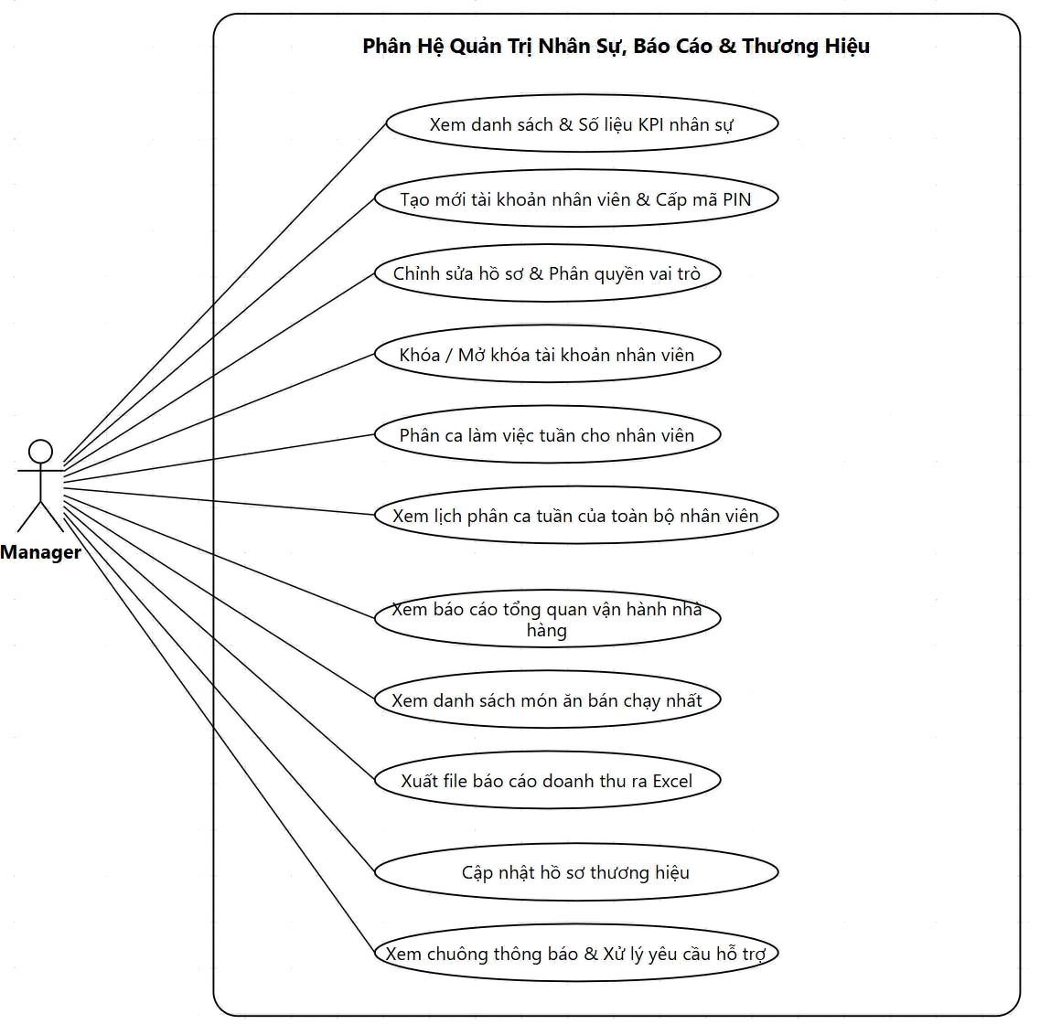
Use Case (3/3): Menu, Reservation & Staff Administration
ANALYSIS · USE CASE 3/3
Back-of-House: Menu configuration, table layout, reservation approval, shift rostering & revenue reporting
ROMS · Restaurant Ordering Management System · SWP391 · FPT University
9
Notes:
[Pham Minh Duc] The third group covers Restaurant Management (Back-of-House). On the left: menu administration, table layouts, zones, reservation approval workflow, available table assignment, and one-touch check-in. On the right: staff profiles, PIN provisioning, RBAC roles, weekly shift scheduling, restaurant brand configuration, and Excel revenue report exporting.

Slide 10
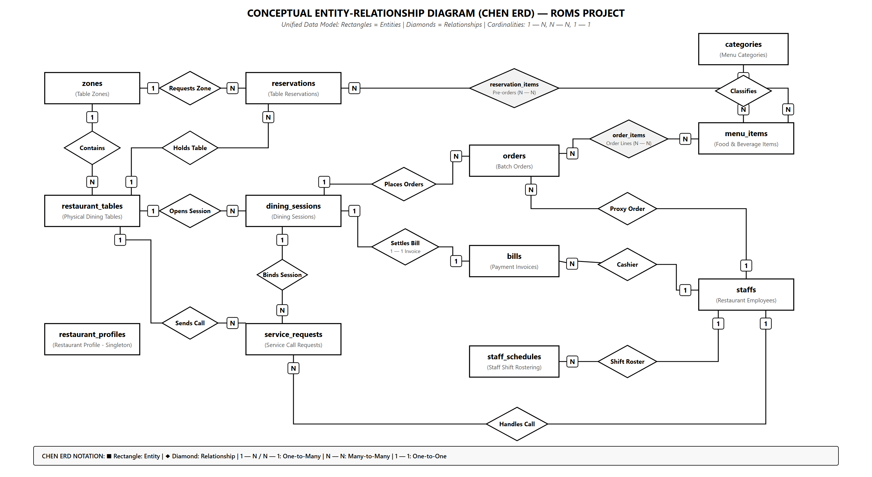
Project ERD (Conceptual Chen ERD)
ROMS · Restaurant Ordering Management System · SWP391 · FPT University
10
Notes:
[Pham Minh Duc] The project data model comprises 14 entities unified in a clean conceptual Chen ERD. Part 1 manages table spaces, menu items, and reservations, resolving the N — N relationship between reservations and menu_items via reservation_items. Part 2 tracks at-table operations with dining_sessions as the core hub connected 1 — 1 with bills, and 1 — N with orders and service_requests.

Slide 11
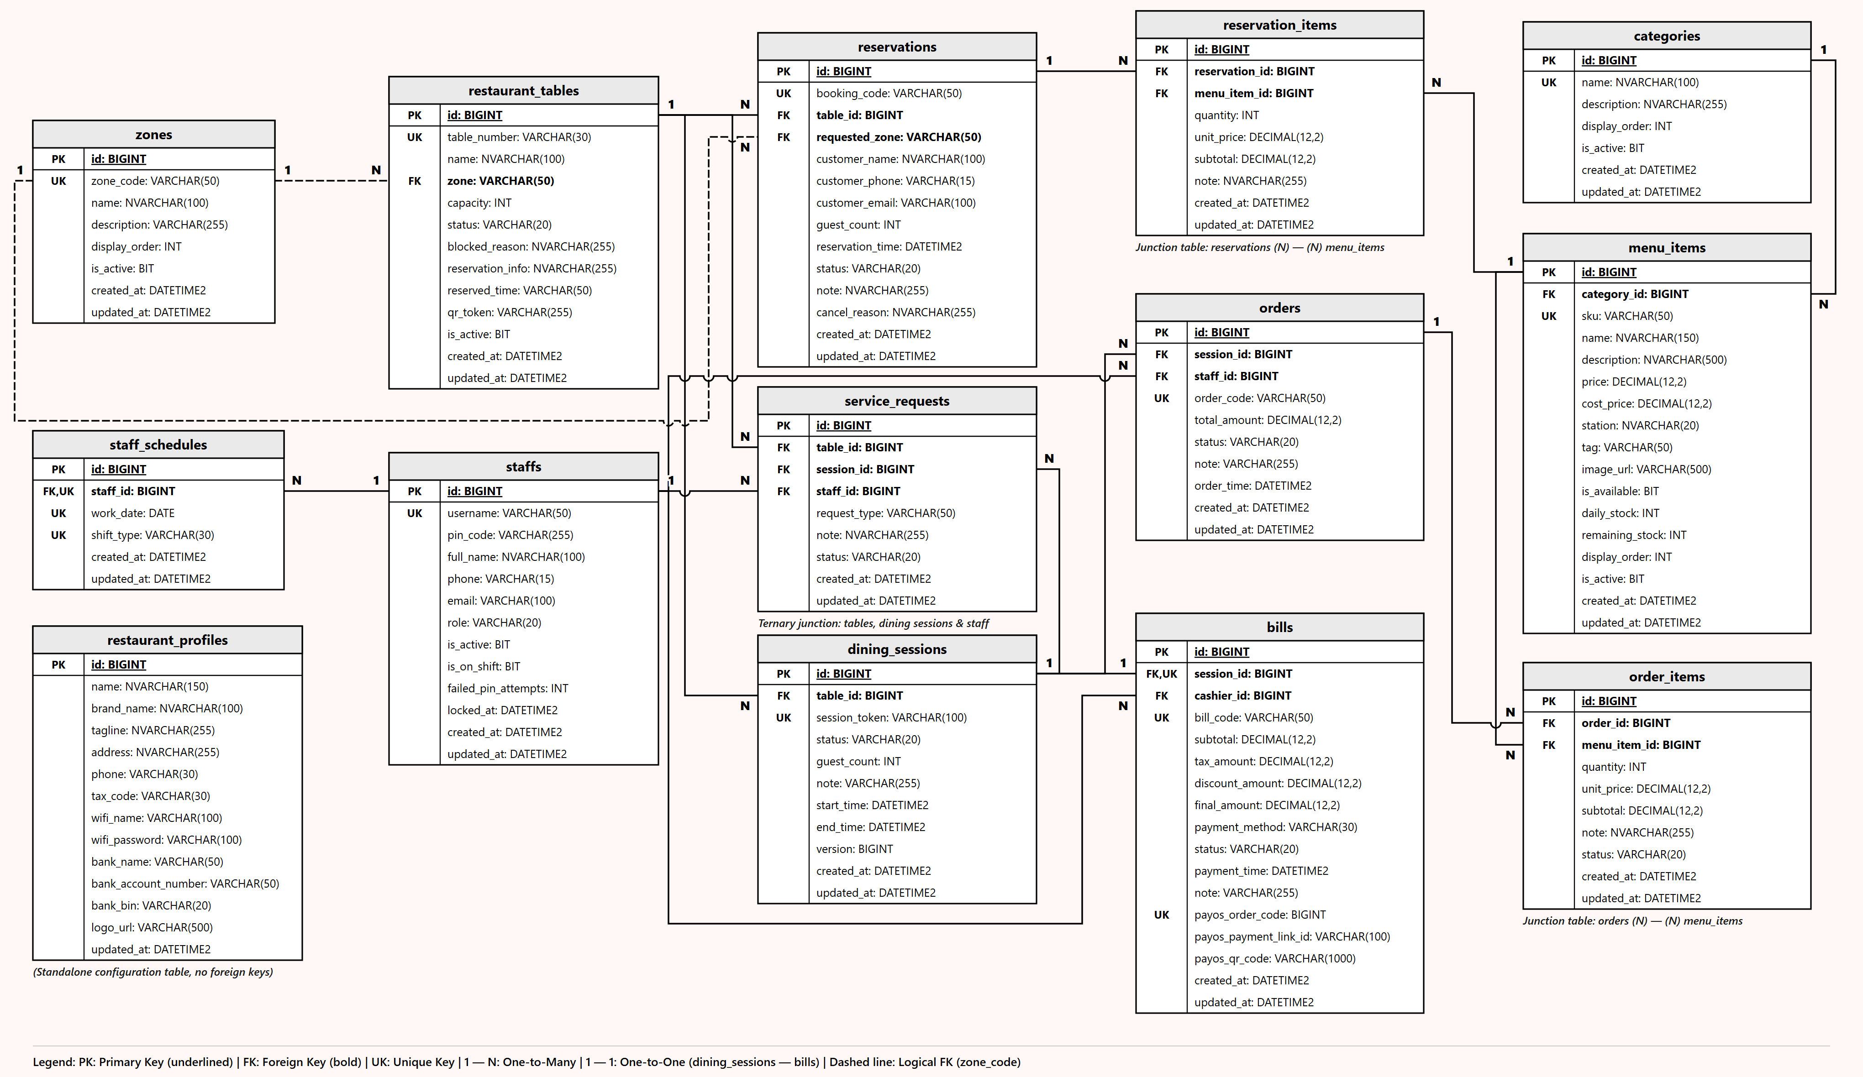
Physical Database Schema: 14 Normalized Tables
DESIGN · PHYSICAL ERD
Floor layout, reservations & menu catalog unified with QR dining sessions, batch ordering, billing & staff
ROMS · Restaurant Ordering Management System · SWP391 · FPT University
11
Notes:
[Pham Minh Duc] Here is our complete physical database schema in SQL Server comprising all 14 normalized tables.
On the left and top, we manage zones, tables, advance reservations, and menu items — where reservation_items resolves the many-to-many link and locks dish unit prices at booking time. Dashed lines from zones denote logical foreign keys storing zone_code, while solid lines represent physical foreign keys.
At the center and bottom right are our at-table operations anchored around dining_sessions: one session links to multiple order batches (orders, 1 — N) and service calls (service_requests, 1 — N), while enforcing a strict 1 — 1 relationship with bills. Order batches link to menu_items through order_items (N — N) to track preparation status per dish.

Slide 12
Business State Machines
DESIGN · STATE MACHINES
States strictly controlled by enums; every transition enforced by explicit business guards
Dish Item
PENDING
COOKING
READY
SERVED
CANCELLED
OrderItemStatus
Beverages (station = WAITER) → created directly as READY, alerting waiters to serve
Dining Table
AVAILABLE
OCCUPIED
DIRTY
AVAILABLE
RESERVED
BLOCKED
TableStatus
Post-payment table enters DIRTY; transitions to AVAILABLE only after staff finishes cleaning
Reservation
PENDING
CONFIRMED
COMPLETED
CANCELLED
ReservationStatus
PENDING: awaiting table · CONFIRMED: table assigned & locked · COMPLETED: guest checked in
Dining Session
ACTIVE
COMPLETED
Each table has at most one ACTIVE session at any given time (opened by waiter/manager)
SessionStatus
ROMS · Restaurant Ordering Management System · SWP391 · FPT University
12
Notes:
[Pham Minh Duc] Four primary lifecycles modeled as enums in code. Dish items: PENDING → COOKING → READY → SERVED, or CANCELLED. Beverages have station = WAITER, so they are created directly as READY alerting waiters without touching the kitchen. Tables: AVAILABLE → OCCUPIED → DIRTY → AVAILABLE; plus RESERVED and BLOCKED. Reservations: PENDING → CONFIRMED → COMPLETED or CANCELLED. Dining sessions: ACTIVE → COMPLETED.

Slide 13
Two Core Business Workflows
WORKFLOW OVERVIEW
The remainder of the presentation dives deep into each workflow
FLOW 1 · ONLINE TABLE RESERVATION
1
2
3
4
5
6
Guest books table online
Select pre-ordered dishes (optional)
Manager assigns table & confirms
Buffer Time Lock active T−60' → T+45'
One-touch check-in upon arrival
Pre-orders dispatched to kitchen
FLOW 2 · AT-TABLE QR CODE ORDERING
1
2
3
4
5
6
7
Scan dynamic QR at table
Waiter opens table · grants access
Browse menu & consult AI Assistant
Place order batches
Kitchen cooks dishes (KDS)
Waiter serves dishes
Settle bill via VietQR
ROMS · Restaurant Ordering Management System · SWP391 · FPT University
13
Notes:
[Pham Minh Duc] The entire system centers around two core business workflows. Flow 1 — Online Reservation: guest books online with optional pre-ordered dishes, manager assigns table, system enforces safe buffer lock from T-60' to T+45', one-touch check-in upon arrival dispatches pre-orders to kitchen.
Flow 2 — QR Ordering: guest scans dynamic QR, waiter opens table activating session in real-time, guest asks AI and places order, kitchen receives on KDS, waiter serves, VietQR settles bill.
Next, Ngo Viet Bao Huy will present the deep dive into each workflow.

Slide 14
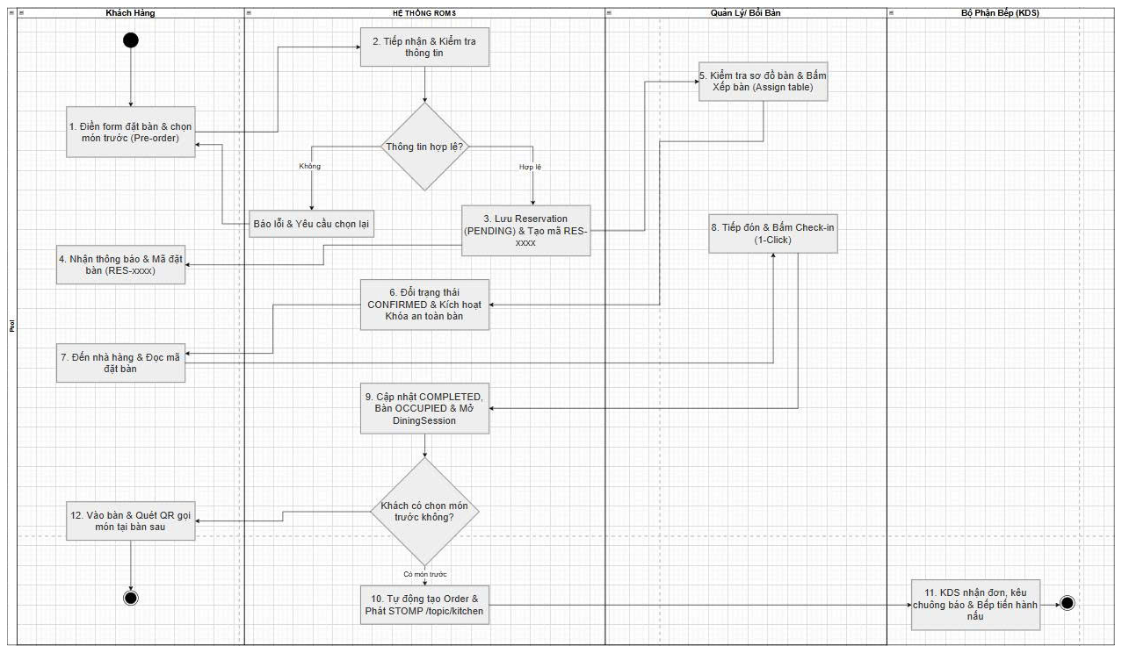
Workflow 1 — From Reservation to Table Check-in
FLOW 1 · RESERVATION
Swimlane Workflow: Customer → ROMS System → Manager / Waiter → Kitchen KDS
ROMS · Restaurant Ordering Management System · SWP391 · FPT University
14
Notes:
[Ngo Viet Bao Huy] Greetings, Committee members. I will present Flow 1 — Table Reservation.
Guests fill out the public booking form with optional pre-ordered dishes. The API creates a PENDING reservation with reservation_items, returning code RES-date-seq. The manager assigns an available table, transitioning status to CONFIRMED. When the guest arrives, the manager clicks check-in: reservation completes, table marks OCCUPIED, a DiningSession starts, and pre-ordered dishes automatically load into an Order pushed to the KDS via WebSocket.

Slide 15
Online Reservation with Pre-ordered Dishes
FLOW 1 · RESERVATION
Strict input validation, pre-ordered dishes isolated with locked pricing
Input Validation
Online Reservation
Real-time past timestamp rejection
Party size 1–20; larger groups directed to hotline
Pre-ordered items must be currently active
Full Name
Phone Number
Party Size (1–20)
Data Persistence
Date & Time
reservations + reservation_items (isolated tables)
unit_price permanently locked at reservation time
Reservation code RES-yyyyMMdd-xxxx · PENDING status
Preferred Zone
PRE-ORDERED DISHES
Grilled Beef Steak ×1 + Add dish
Business Value
Submit Reservation Request
Kitchen forecasts prep needs in advance
Dishes ready upon guest arrival, minimizing wait time
ROMS · Restaurant Ordering Management System · SWP391 · FPT University
Presenter: Ngo Viet Bao Huy
15
Notes:
[Ngo Viet Bao Huy] The reservation form captures: full name, phone number, email, party size, date/time, preferred zone, special notes, and pre-ordered dishes. The backend validates: booking time cannot be in the past; party size between 1 and 20 (larger groups directed to hotline); pre-ordered items must be actively sold.
Pre-ordered items are saved in reservation_items with unit price locked at booking time. This allows the kitchen to prepare in advance and guests receive food promptly upon arrival.

Slide 16
Safe Table Buffer Time Lock
FLOW 1 · RESERVATION
Guarding reserved tables against accidental walk-in allocation
Example: Table B02 reserved for 19:30
Available for Walk-ins
SAFE BUFFER LOCK — blocks walk-in allocation
Released
T − 60'
T · Scheduled Time
T + 45'
18:30
19:30
20:15
During Lock Window
Why It Matters
Opening for walk-ins rejected by backend (HTTP 400) with guest name & minutes remaining
Manager can force override with forceOverride = true
Table card badges 'Safe Lock' and pre-order count
Walk-in dining takes 60–90 min: misallocating table leaves reserved guest stranded
Time-based lock automatically expires after T + 45'
Rule enforced server-side with comprehensive unit tests
ROMS · Restaurant Ordering Management System · SWP391 · FPT University
Presenter: Ngo Viet Bao Huy
16
Notes:
[Ngo Viet Bao Huy] Real-world problem: a table is booked for 19:30, but at 18:45 staff sees it empty and seats walk-in guests; walk-ins dine for 60–90 minutes, so at 19:30 the reserved guests have no table.
Solution: when a table has a CONFIRMED reservation at time T, the system locks it from T-60 min to T+45 min. During this window, attempting to open the table for walk-ins is rejected with HTTP 400 with guest info and minutes remaining; only managers can force override with forceOverride=true. After T+45', the lock automatically expires and the table returns to normal.

Slide 17
Reservation Lifecycle & No-Show Handling
FLOW 1 · RESERVATION
Automatic lock expiration; proactive cancellation with audited reason
PENDING
awaiting table
CONFIRMED
table locked
COMPLETED
checked in
CANCELLED
with reason
Auto-Expiration
Manager Control
Future Roadmap
Buffer lock automatically releases after T + 45'
Table returns to walk-in pool, never locked indefinitely
Zero manual intervention required
Cancel reservation with mandatory cancel_reason
Floor staff can cancel directly on table card
Filter by status, date, and keyword
Automated scheduler transitioning expired bookings to CANCELLED
Automated SMS / Email confirmation and reminder
No-show rate and customer reliability reporting
ROMS · Restaurant Ordering Management System · SWP391 · FPT University
Presenter: Ngo Viet Bao Huy
17
Notes:
[Ngo Viet Bao Huy] Reservation lifecycle has 4 states: PENDING, CONFIRMED, COMPLETED, CANCELLED.
When guests no-show, the buffer lock automatically releases after T+45 minutes so tables are never held indefinitely. Managers or floor staff can cancel with a mandatory reason (cancel_reason) and search bookings by status, date, or keyword.
Future roadmap: automated scheduler auto-cancelling expired bookings and sending SMS/email reminders.

Slide 18
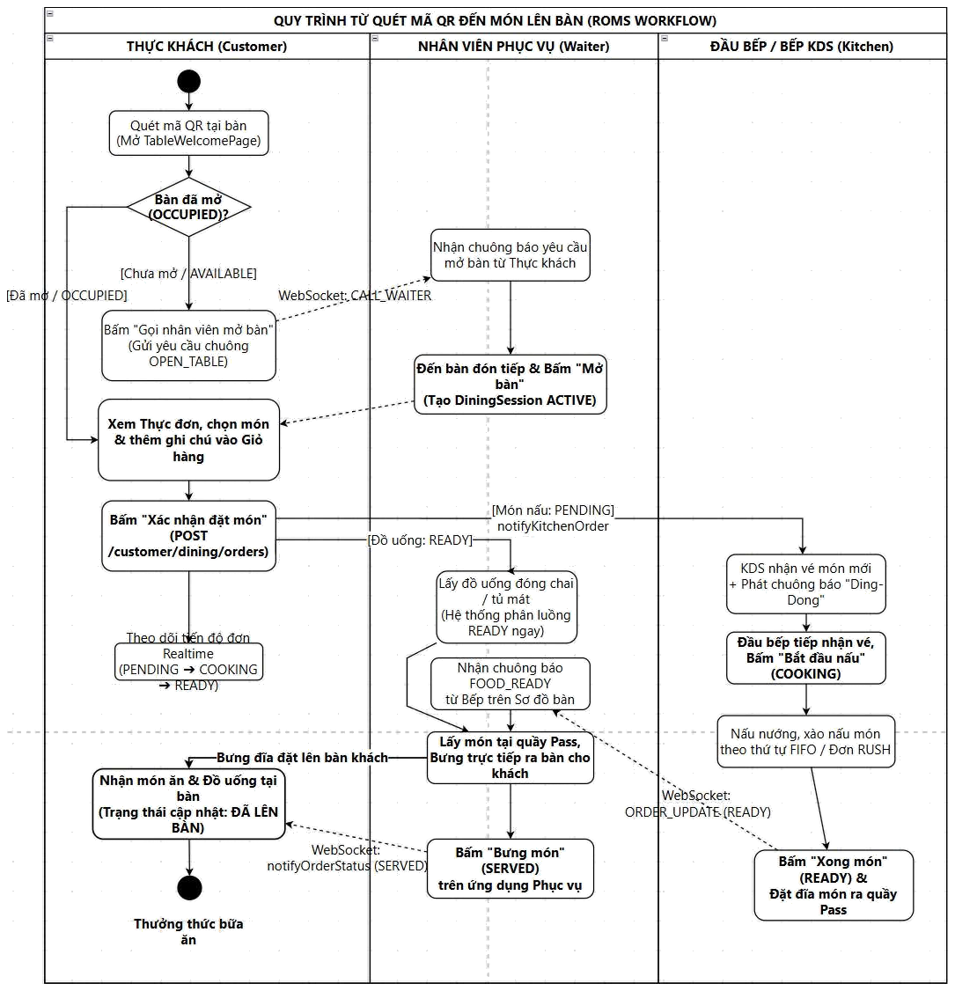
Workflow 2 — From QR Scan to Food Served
FLOW 2 · QR ORDERING
Swimlane Workflow: Customer Scans QR → Waiter Opens Table & Serves → Kitchen KDS Prepares
ROMS · Restaurant Ordering Management System · SWP391 · FPT University
Presenter: Ngo Viet Bao Huy
18
Notes:
[Ngo Viet Bao Huy] Flow 2 — QR Code Ordering. Guests scan the dynamic QR at table, app calls verify-qr. If the table is AVAILABLE, guests can preview the menu and tap 'Call Waiter to Open Table'. Once the waiter confirms the guest seated and opens the session (OCCUPIED), WebSocket events instantly unlock the customer's phone and grant a diningToken. Guests submit orders with diningToken — kitchen dishes start at PENDING, beverages route directly to READY. Kitchen receives orders via /topic/kitchen and phone updates in real-time.

Slide 19
AI Dining Assistant for Smart Table Ordering
FLOW 2 · QR ORDERING
Taste-tailored suggestions grounded in active menu with one-touch add to cart
ROMS Bot · AI Dining Assistant
1 · Grounded Advice — Active Menu Only
Aware of active daily menu and real-time inventory to recommend accurately.
Understands natural intent (party size, flavor profile, spice level) without hallucinating non-existent items.
Party of 2, we love savory grilled dishes, mild spicy. Please suggest something delicious!
Here are 2 bestsellers perfectly tailored to your palate:
2 · Interactive Dish Cards — One-Touch Add
Charcoal Grilled Pork Broken Rice
+ Add
Directly below recommendation are interactive cards showing item name, price, and category.
Guests tap '+ Add' to immediately add to cart without navigating back to menu.
50,000₫ · Savory
Special Shrimp & Pork Fresh Spring Rolls
+ Add
35,000₫ · Appetizer
3 · High Availability — Seamless Dining Experience
Suggest drink pairings
Browse desserts
Under network jitter or peak AI service loads, system gracefully falls back to top bestsellers.
Shortens ordering time for first-time guests and relieves repetitive staff consultation.
Guests tap '+ Add' to put items directly into the shared table cart
ROMS · Restaurant Ordering Management System · SWP391 · FPT University
Presenter: Ngo Viet Bao Huy
19
Notes:
[Ngo Viet Bao Huy] To help guests order quickly without waiting for staff recommendations, our team integrated the AI Dining Assistant ROMS Bot directly onto customer mobile devices.
The assistant strictly recommends active, in-stock dishes and understands natural preferences such as party size, taste profile, and spice tolerance, eliminating hallucinations. Each suggestion appears as a visual card with dish name and price; tapping '+ Add' puts the item straight into the table cart. Under network jitter or AI busy loads, the system gracefully suggests top bestsellers.

Slide 20
Food Serving, VietQR Settlement & Table Release
FLOW 2 · QR ORDERING
From SERVED to AVAILABLE: A tamper-proof closed loop
1
2
3
4
5
6
Serving
Request Bill
Review Bill
Generate VietQR
Webhook
Release Table
Waiter taps SERVED
Guest taps on phone; POS notified in real-time
Subtotal + 8% VAT − Discount
PayOS dynamic QR (or cash)
HMAC signature verified → bill PAID
Session COMPLETED · table DIRTY → AVAILABLE
Bill (Sample Calculation)
Business Safeguards & Guards
Subtotal
480,000₫
Pending/cooking items → warning blocks settlement (requires explicit forceCheckout confirmation)
Discounts >30% / >200k, POS item cancellation, or shift closing → requires Manager PIN
PAID bill locks against duplicate charges · Table close → DIRTY → AVAILABLE & revokes diningToken
VAT 8%
38,400₫
Discount
0₫
Total
518,400₫
ROMS · Restaurant Ordering Management System · SWP391 · FPT University
Presenter: Pham Minh Duc
20
Notes:
[Pham Minh Duc] After waiters serve dishes and tap SERVED, guests tap 'Request Payment' (request-payment) and the POS is alerted in real-time. Cashiers review the bill: subtotal plus 8% VAT minus discounts. The system generates dynamic VietQR via PayOS (or handles cash). Upon transfer, PayOS sends a webhook, the backend verifies HMAC-SHA256 signature and marks bill PAID, session COMPLETED, table DIRTY; once cleaned, the table returns to AVAILABLE.
To safeguard revenue: pending/cooking items block checkout unless explicitly confirmed with forceCheckout; discounts >30% or >200k, POS item cancellations, or end-of-day shift closures strictly require Manager 6-digit PIN.

Slide 21
Live Demonstration Environment
LIVE DEMO
Running on a live deployment with multi-device real-time synchronization
Environment
Devices & Roles
Scenario A · Reservation (~2 mins)
roms-restaurant.duckdns.org
Docker Compose (4 containers): SQL Server 2022 + db-init · Spring Boot (Java 21) · React + Nginx 1.27 Proxy
Production sample data: zones, tables, active menu
Customer books table + pre-orders dishes
Manager assigns table → table card 'Safe Lock'
One-touch check-in upon arrival
Kitchen automatically receives pre-ordered items
Smartphone
Customer · Table 05
Tablet
Waiter
KDS Screen
Kitchen
Scenario B · QR Ordering (~3 mins)
Counter POS
Cashier
Scan QR at Table 05 → Request table open → Waiter Check-in
Ask AI for recommendations · order 1 dish + 1 beverage
KDS receives order; beverage routes directly to READY
Cooked → served → VietQR payment → DIRTY → AVAILABLE
Laptop
Manager
What the Committee Will Witness
Table opening activates QR in real-time
Buffer lock secures reserved tables
Beverages bypass kitchen queue
VietQR payment auto-reconciles via webhook
ROMS · Restaurant Ordering Management System · SWP391 · FPT University
Presented by: Entire Team
21
Notes:
[Ngo Viet Bao Huy moderates, team operates] Demo runs on a live 4-container Docker Compose setup at roms-restaurant.duckdns.org (SQL Server 2022 + db-init, Spring Boot Java 21, React 19 + Nginx 1.27 Reverse Proxy).
Scenario A (~2 minutes): customer books table with pre-ordered dishes → manager assigns table → table card displays safe lock → one-touch check-in → kitchen receives items.
Scenario B (~3 minutes): scan QR at Table 05 → tap Call Waiter → waiter check-in unlocks customer screen in real-time → consult AI → order 1 dish + 1 drink → KDS receives food, drink routes to READY → cooked → served → VietQR payment → table DIRTY then AVAILABLE.

Slide 22
ROMS · Restaurant Ordering Management System
Thank You Very Much
SWP391 Evaluation Committee & Mentors
Team ROMS welcomes your questions and feedback.
Duong Trong
Pham Minh Duc
Ngo Viet Bao Huy
Scan to Experience
Team Leader
Backend · Database
Frontend · Test
Q&A · SWP391 Final Defense
LIVE
roms-restaurant.duckdns.org
Notes:
[Duong Trong] Our team sincerely thanks the Committee members and mentors for your dedicated guidance throughout the semester. We welcome your questions and feedback.

