Slide 1

GRPC
Third report from August 2015 GIF++ test beams
Disclaimer: all results are preliminary
Francois Lagarde, Maxime Gouzevitch, Imad Laktineh
on behalf of GRPC team from IPNL
GRPC team - 07/08/2015
Notes:
25/01/07
25/01/07
25/01/07

Slide 2
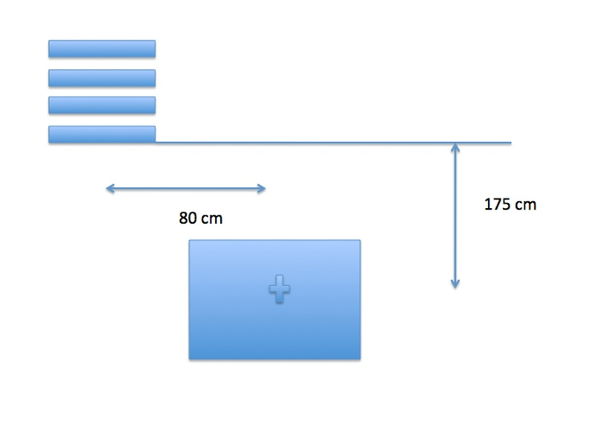
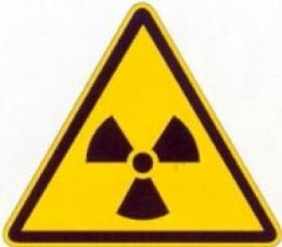
1) GRPC position : since Fri. 28/08/2015 at 3 pm
197 cm
91 cm
GRPC team - 07/08/2015

Slide 3
1) Radiation map method :
- Map * γ conversion factor
- Need to know the map γ, and the shadow effects.
2) Chambers rate method :
- Chambers rate when beam is off
- Substract noise (no beam no source run)
- Correct by efficiency (saturation effeciency)
3) Current method :
- Total current in the chamber divided by the surface and Charge/γ factor.
  We need YOUR input for comparison !!!
2) Rate estimation
GRPC team - 07/08/2015

Slide 4
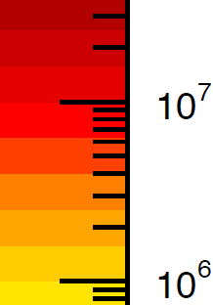
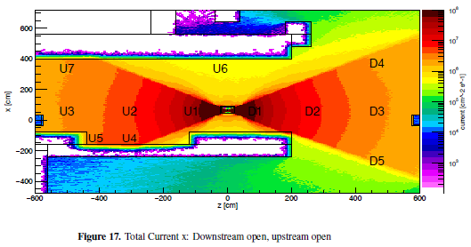
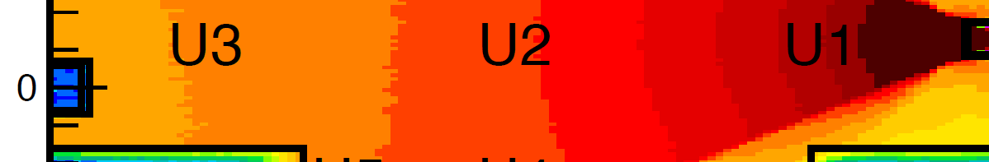
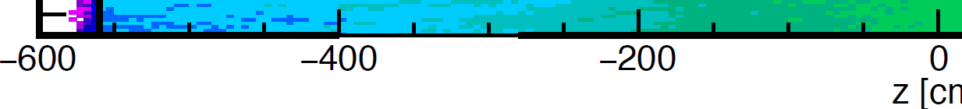
2.1) Rate estimate with simulation
GRPC
We think that the rate in our region is around :
7e6 – 1.5 e7 γ /cm2
GRPC team - 07/08/2015

Slide 5
2.2) Rate estimate with simulations
We think that the rate in our region is around : 7e6 – 1.5e7
We are in between U1 and U2.
Assuming a conversion factor f = 1e-3 :
R(predicted) ~ 0.7 – 1.5e4 = 7-15 kHz/cm2
GRPC team - 07/08/2015

Slide 6
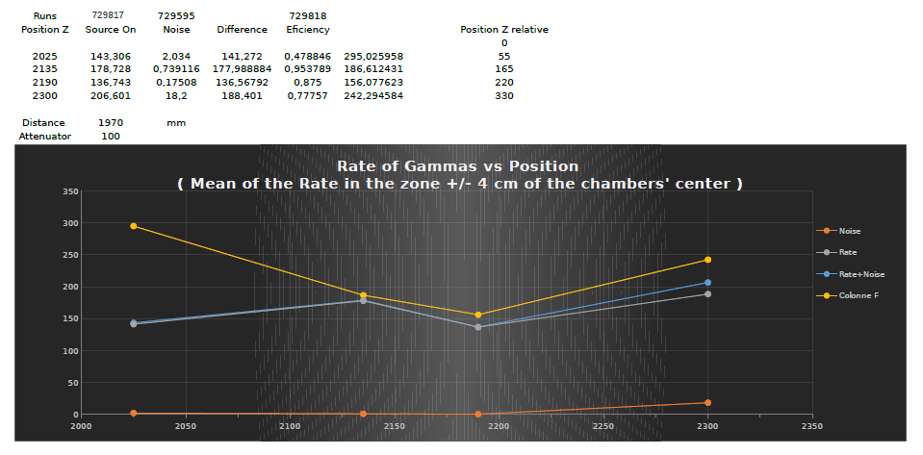
2.2) Rate estimate with chambers : source ATT = 100
(Rate-Noise)/eff
Z-axis position of the chambers wrt to the source in mm
Rate is estimated with chambers :
Rate(chambers) = (Total Rate – Noise )/eff
Comparison : estimation from Maps – 70-150 Hz/cm2
GRPC team - 07/08/2015

Slide 7
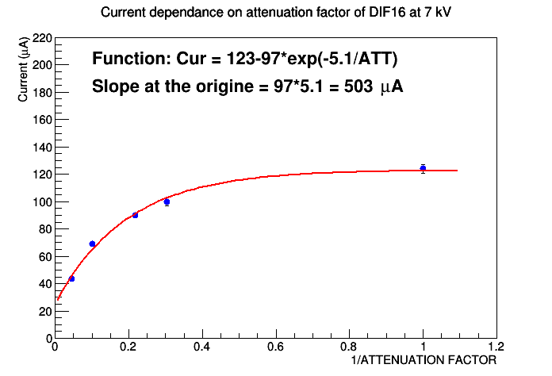
2.3) Current method
1) At ATT = 100 we are not in saturation regime.
GRPC team - 07/08/2015

Slide 8
2.4) Status summary
1) Radiation map method :
- Map * γ conversion factor ~ 7-15 kHz
- γ conversion factor need to be more investigated
- shadow of the Micromegas and our own chambers needs also to be understood
2) Chambers rate method :
- Chambers ~ 200-300/ATT = 20-30 kHz
- the ASICS thereshold impact on the rate counting shall be understood.
3) Current method :
- Charge/γ shall be measured.
  We need YOUR input for comparison !!!
GRPC team - 07/08/2015

Slide 9
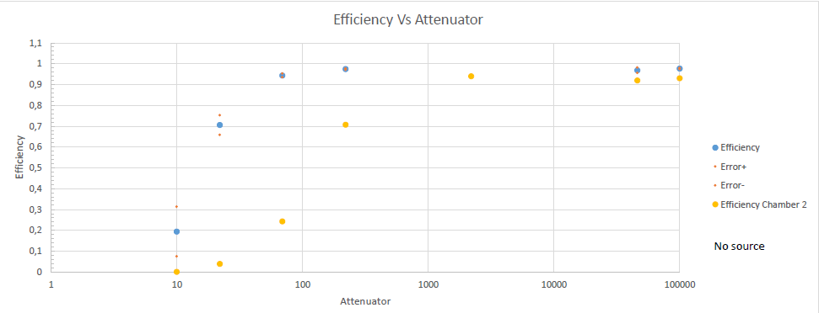
3) Efficiency curve (DIF16)
γ rate before conversion : ~10 kHz/cm2
GRPC team - 07/08/2015

