Slide 1


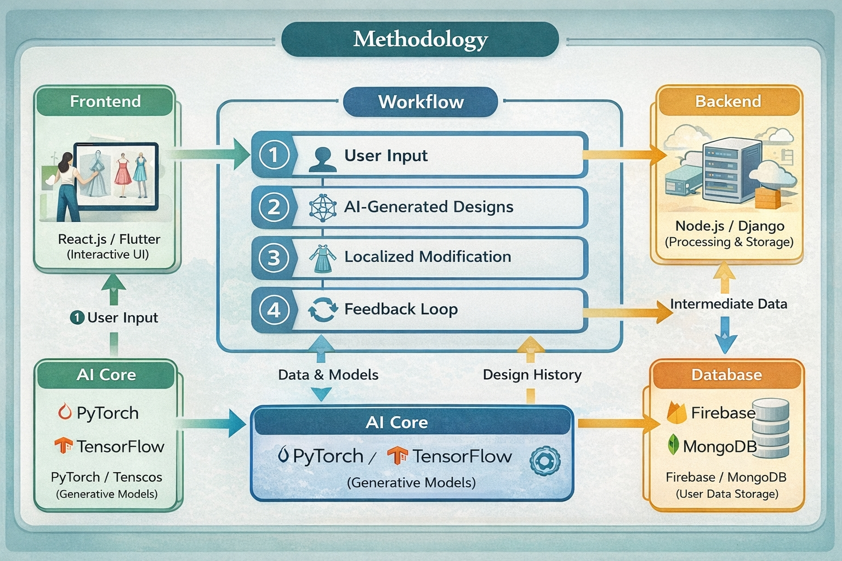
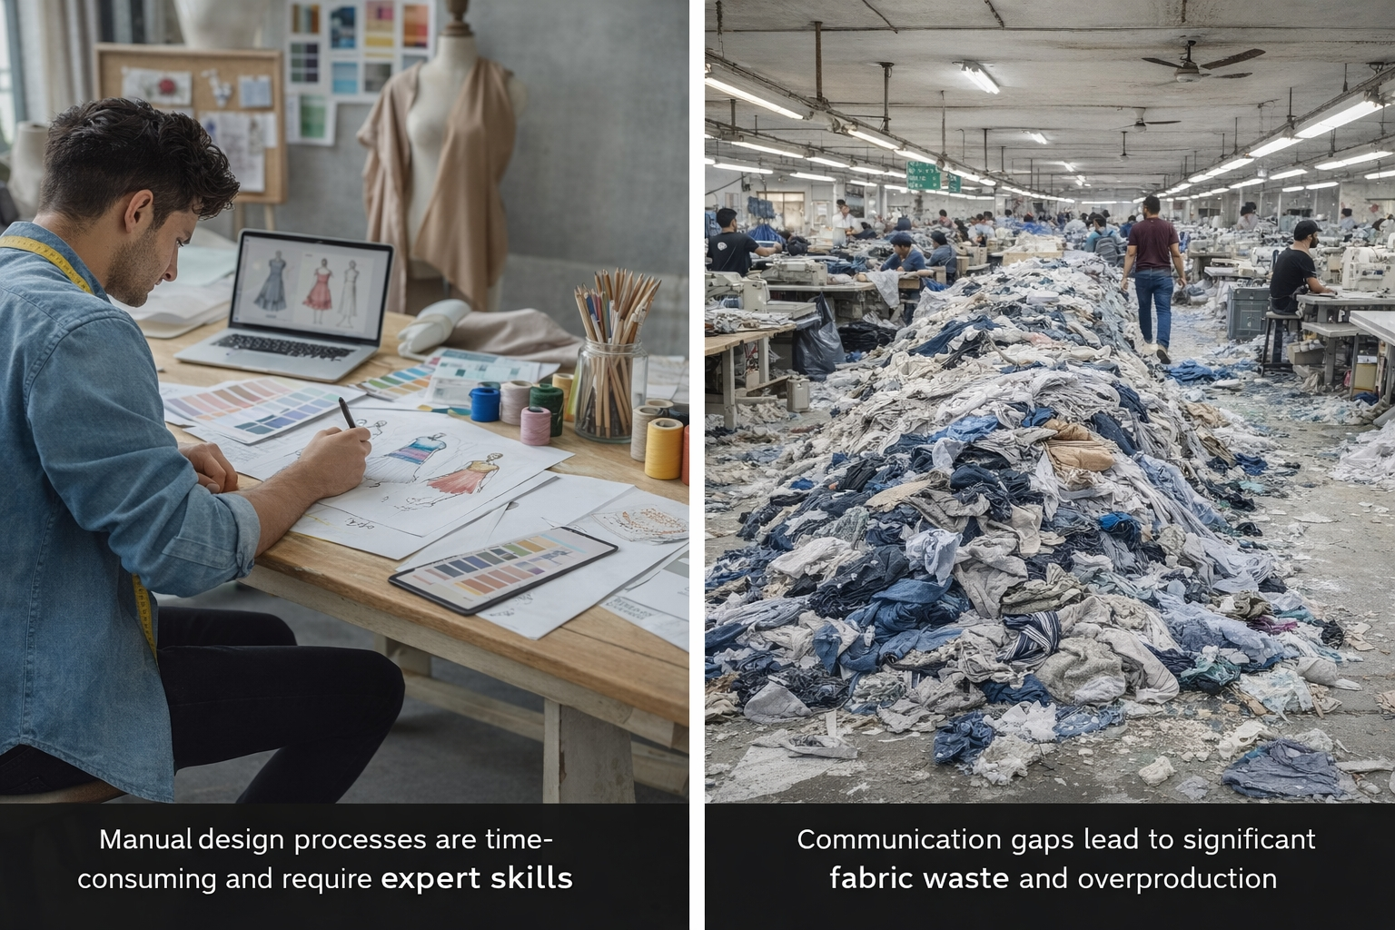
AI-Powered Interactive Dress Designer App
Md. Golam Rabbani
Supervised by Abdur Rab Dhruba
Department of CSE & CSIT, Shanto-Mariam University of Creative Technology
Abstract
Methodology
Traditional fashion design is often manual, time-consuming, and inaccessible to non-professional users, leading to inefficiencies and material waste. This project proposes an AI-Powered Interactive Dress Designer Application that enables real-time generation and customization of garment designs. Users can modify attributes such as fabric, color, sleeves, and neckline through an intuitive interface. The system utilizes advanced generative models, including Conditional GANs and diffusion-based techniques, to support localized design modifications while maintaining structural feasibility. By bridging creative design and manufacturable output, the proposed solution enhances accessibility, reduces overproduction, and promotes sustainable practices in the fashion industry.
The system follows a closed-loop AI-driven design methodology consisting of data collection, intelligent generation, and real-time user interaction.
System Architecture:
● Frontend: React.js / Flutter (interactive UI)
● Backend: Node.js / Django (AI processing & storage)
● AI Core: PyTorch / TensorFlow
● Generative Models: Conditional GANs & Diffusion Models
● Database: Firebase / MongoDB
Workflow:
1. User selects or generates a base dress
2. AI model generates design variations
3. Real-time localized modification using latent vector control
4. Continuous feedback and design refinement
Introduction
Fashion design plays a critical role in the global garment industry, particularly in countries like Bangladesh. However, the design-to-production pipeline often suffers from miscommunication, limited visualization, and high material waste.
Key Challenges:
● Manual and expertise-dependent design processes
● Limited real-time customization tools
● Poor alignment between design concepts and production feasibility
Existing digital design tools are complex and unsuitable for casual users, highlighting the need for an intelligent, user-friendly solution that supports both creativity and manufacturability.
Results
● Real-time AI-generated dress designs
● Faster design-to-production cycle
● Improved communication between designers and manufacturers
● Reduced overproduction and material waste
● Enhanced user engagement and personalization
Conclusion
Research Gap
This project introduces an AI-powered interactive dress designer that bridges the gap between creative design and garment manufacturing. By integrating generative AI with real-time customization, the system enhances accessibility, efficiency, and sustainability in fashion design. The proposed approach demonstrates strong potential for adoption in both educational and industrial environments.
1. Existing AI fashion systems lack precise localized design modification, making it difficult to alter specific garment parts independently.
2. There is a significant gap between AI-generated visual designs and production-ready, sewable garments.
3. Most platforms do not provide intelligent fashion guidance to assist users in selecting suitable fabrics, colors, and styles.
Future Scope
Objectives
● AR-based virtual try-on
● Integration with garment factories
● Cost estimation based on fabric selection
The primary objective of this project is to develop an intelligent AI-based fashion design system that simplifies and enhances the garment creation process.
Specific Objectives:
● Enable real-time dress generation and customization
● Support localized design modification
● Reduce fabric waste through accurate visualization
● Bridge creative design and manufacturing feasibility
● Improve accessibility for non-professional users
References
- Liu et al., DeepFashion: Powering Robust Clothes Recognition, CVPR
- Goodfellow et al., Generative Adversarial Networks
- Ramesh et al., Diffusion Models for Image Generation
- AI Applications in Fashion Design, IEEE Access

