Slide 1
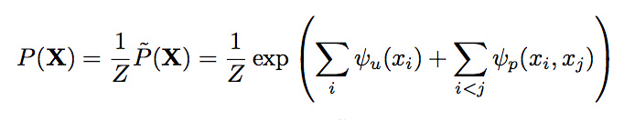
(MAP) Inference
CRF = P(X | I, Θ)
Exact: argmax P(X=x) NP-hard
Mean field aproximation O(N^2)
P(X)≅ Q(X) = ∏_{i}(Q_{i}(X_{i}))
Approximate argmax P(X)
By argmax Q_{i}(X_{i}=l)
Inference in O(N)
Nyquist theorem
Permutohedral laticce
Downsampling
Bluring
upsampling
Learning Θ={ unary, mu, kernelParam}
Piecewise training:
Unary terms: textonboost learned with joinboost (training set)
Binary terms:
Compatibility function: (validation set)
MLE.:
Mean Field approximation of the gradient
L-BFGS algorithm
W¹, θ_{𝛼} θ_{β} grid search on a hold out validation set
W² = θ ᵧ = 1
Learn all the parameters jointly
Minimize {θ} L(Q_i(θ))

Slide 2
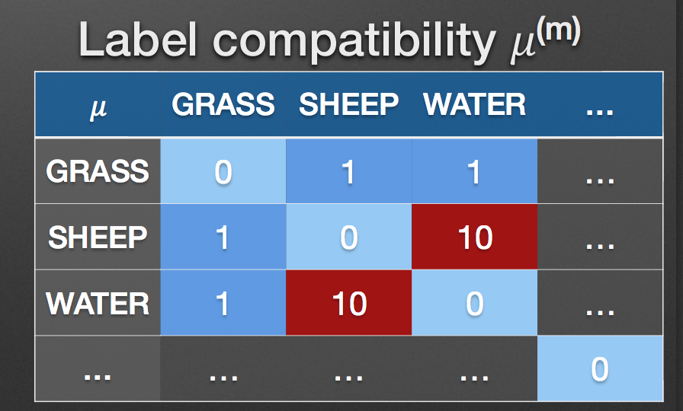

Slide 3
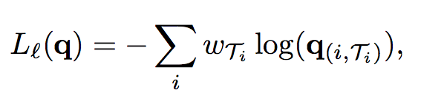
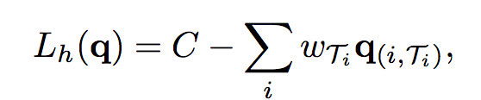
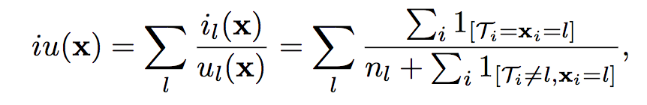
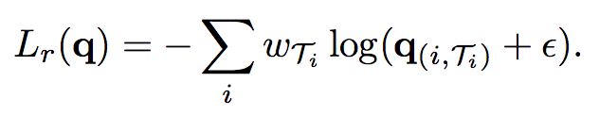
Loss functions
LOG-LIKELIHOOD
ROBUST LOGLIKELIHOOD
HAMMING LOSS
INTERSECTION OVER UNION

Slide 4
Key papers:
INFERENCE:
Krähenbühl et al Efficient Inference in Fully Connected CRFs with Gaussian Edge Potentials [paper and suplementary material]
Koller et al. Probabilistic Graphical Models: Principles and Techniques Chapter 11.5
Adams et al Fast High-Dimensional Filtering Using the Permutohedral Lattice
LEARNING
Shotton TextonBoost for Image Understanding: Multi-Class Object Recognition and Segmentation by Jointly Modeling Texture, Layout, and Context
Sutton et al Piecewise Training for Undirected Models
Krähenbühl et al Parameter Learning and Convergent Inference for Dense Random Field [paper and suplementary material]

