Slide 1

SMART INDIA HACKATHON 2026
AIR COMMAND
Problem Statement ID: SIH26250
Title: Air Power — Dynamic Air Operations & Resource Optimisation
Theme: Transportation & Logistics
Category: Software
Team: AIR COMMAND
Team ID: 139613

Slide 2
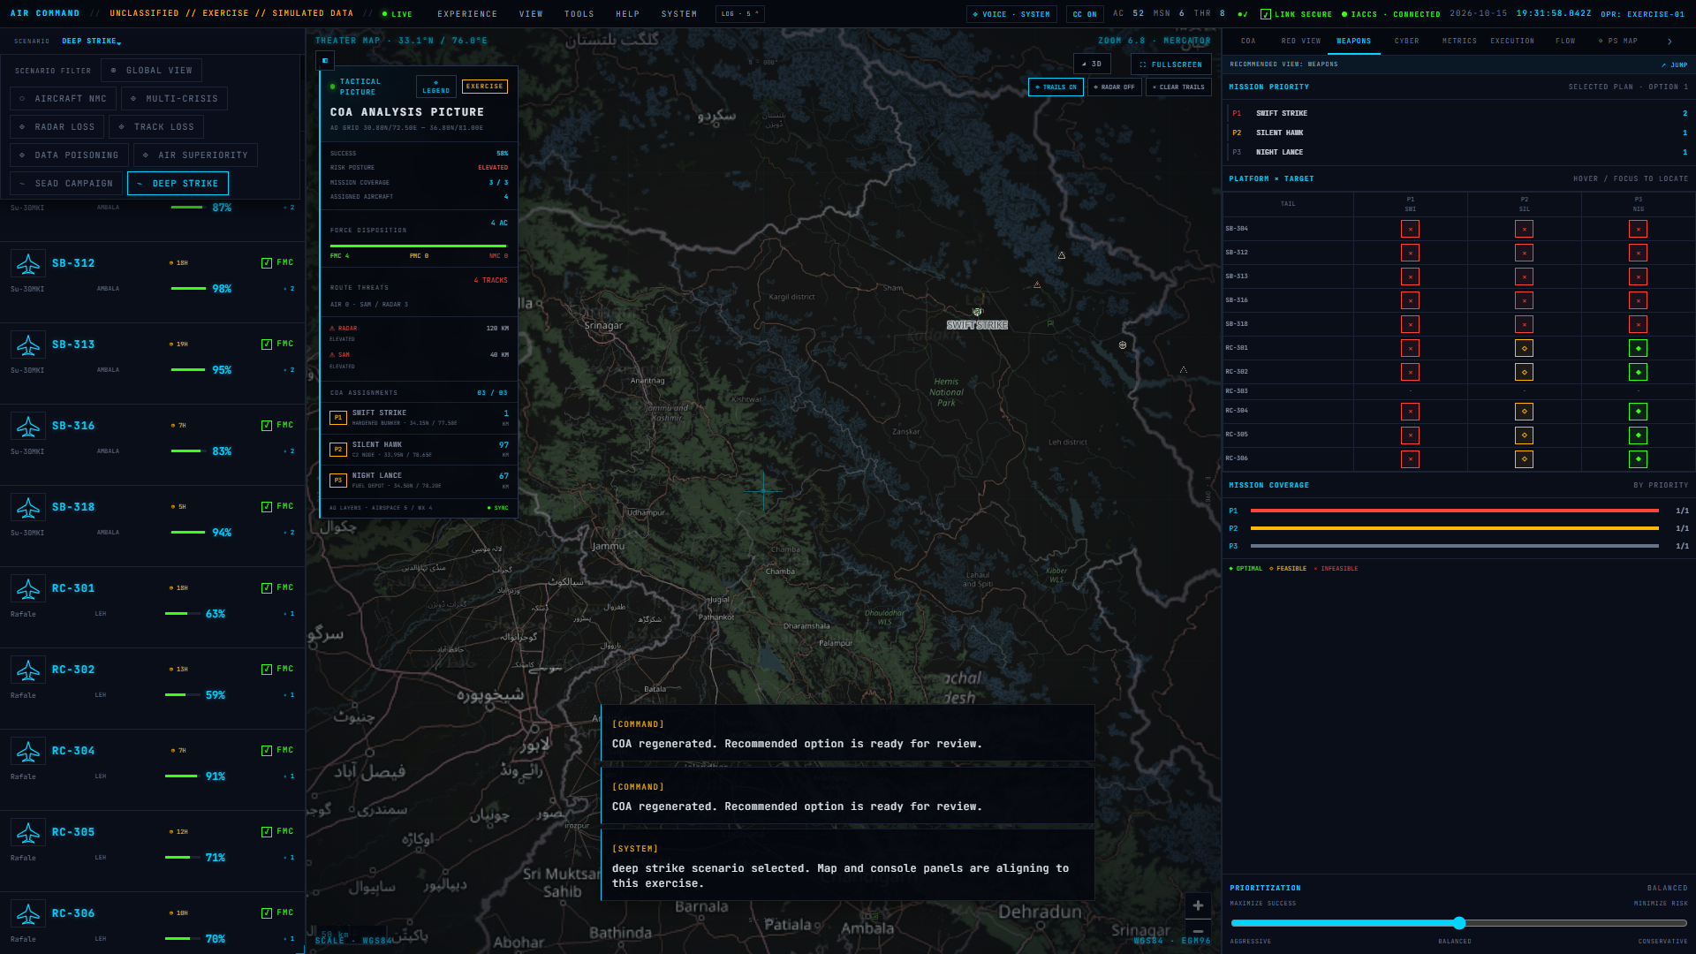
PROPOSED SOLUTION
AIR
COMMAND
A decision-support prototype for a structured air operations exercise.
1 Shared picture: seeded aircraft, missions, threats, airspace, weather and weapons.
2 Constraint-aware planning: compare three ranked force options with assignments, risk and modeled outcomes.
3 Human review: inspect the briefing, approve a local simulation, respond to decision gates and review the AAR.
CORE: recommendations include visible constraints and blockers.
Prototype console · seeded exercise state
All inputs, feed labels and outcomes are simulated. No live IACCS or sensor connection.

Slide 3
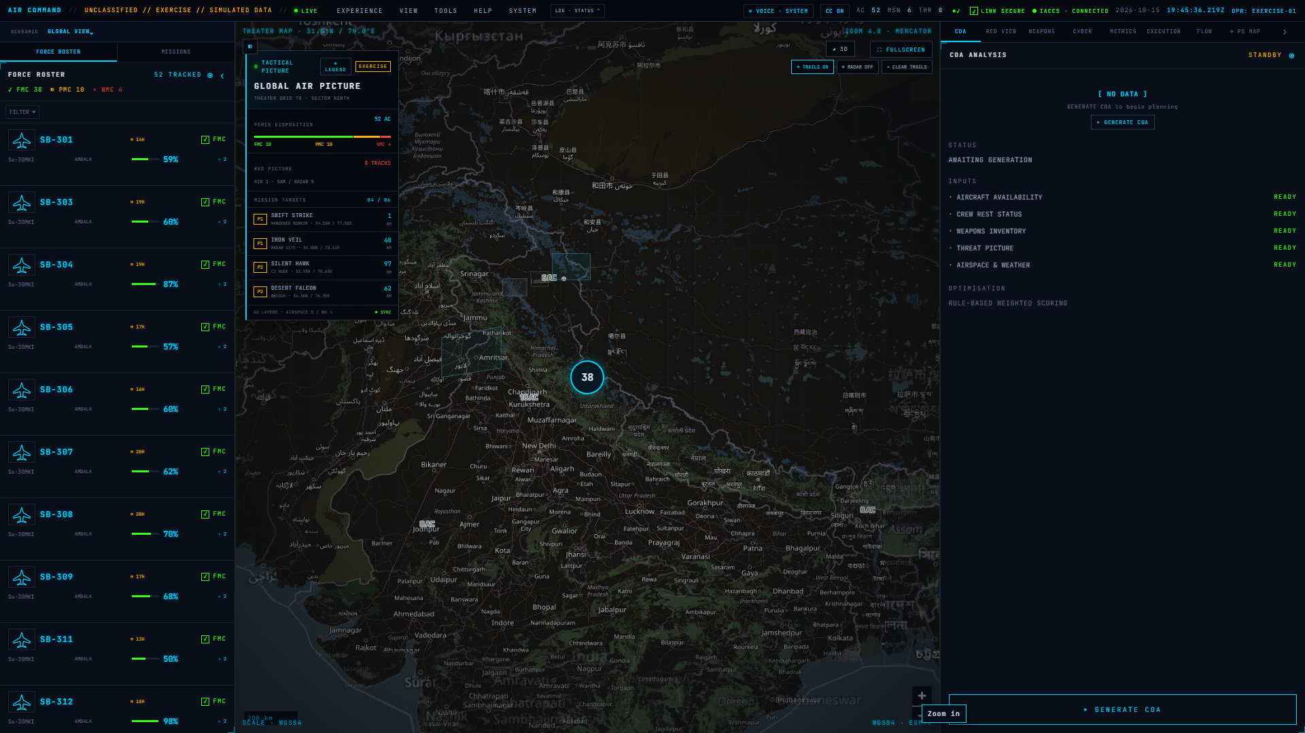
TECHNICAL APPROACH
AIR
COMMAND
Browser prototype | Local exercise data | Human-reviewed recommendations
APPLICATION FLOW
PROTOTYPE EVIDENCE
01
EXERCISE INPUTS
Seeded aircraft, missions, threats, weapons, airspace and weather.
02
SCENARIO VIEW
Roster, mission queue, map overlays and selected scenario.
03
CONSTRAINT CHECKS
Readiness, fuel, crew rest, weapon fit and range, route, airspace and weather.
04
COA RANKING
Weighted rules compare aggressive, balanced and conservative options.
05
HUMAN REVIEW
Review the briefing; approve or reject local exercise execution.
Prototype capture | Simulated exercise data
STACK
Svelte 5 + TypeScript + Vite | MapLibre + Turf | Three.js + Threlte
06
SIMULATED RUN + AAR
Modeled phases, decision prompts, event history and exercise outcome.
SCOPE
Seeded feeds and illustrative outcomes. No live IACCS/sensor links or operational ATO export.

Slide 4
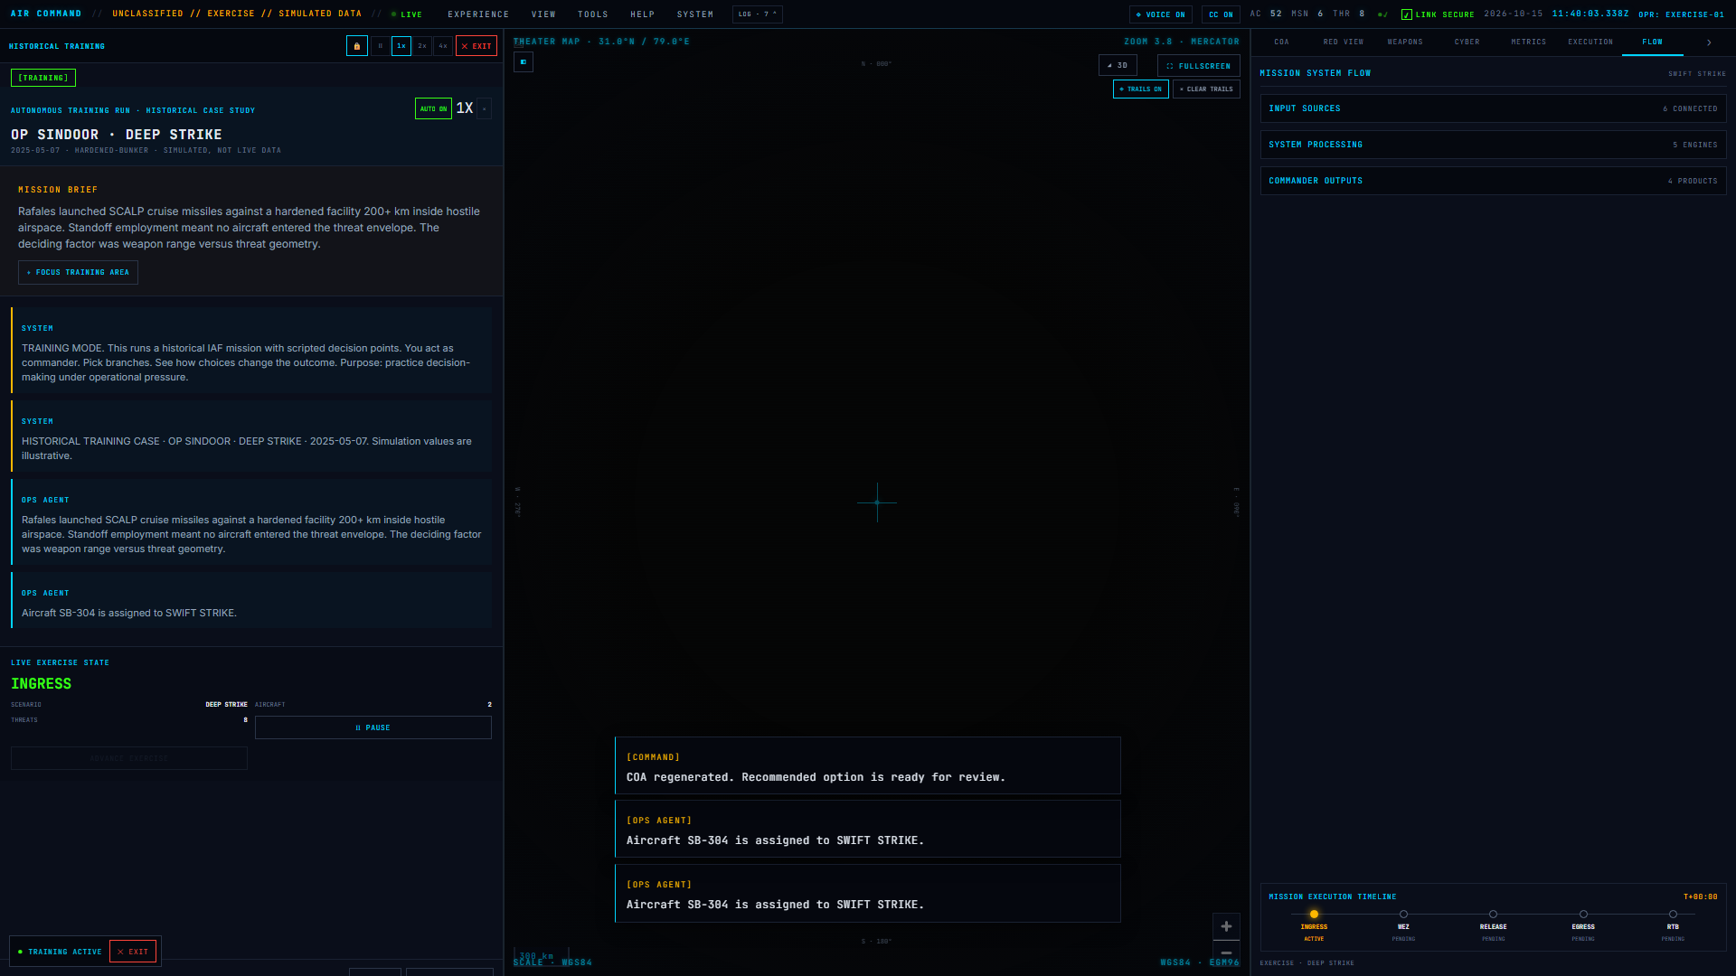
FEASIBILITY AND VIABILITY
AIR
COMMAND
Feasible now
Runs in a browser with local scenario data. The prototype does not depend on external operational systems.
Key limits
Synthetic inputs; heuristic scoring; unvalidated estimates; no live IACCS, radar, AWACS or base integration.
Next research and engineering
Validate rules with domain reviewers and approved exercise cases. Add data provenance, uncertainty display and audit controls. Consider authenticated adapters only in an authorized test environment.

Slide 5
IMPACT AND BENEFITS
AIR
COMMAND
Current prototype value
• Puts force status, scenario map and planning options in one exercise console.
• Makes planning trade-offs and constraint failures visible for human review.
• Lets trainees rehearse decision gates and review a consistent event trail.
Future value to validate
With representative data, expert review and authorized integrations, the workflow could support planning exercises, reduce repeated manual comparisons and improve after-action discussion. These benefits have not yet been measured.
Prototype boundary: not operational, not connected to live systems, and not validated for real-world tasking.

Slide 6
RESEARCH AND REFERENCES
AIR
COMMAND
Problem statement
SIH 2026 PS 26250 · Air Power — Dynamic Air Operations & Resource Optimisation · https://sih2026-ps-viewer.vercel.app/
Prototype and source
Live demo · https://ps2-sih-26250.vercel.app/ Source · https://github.com/GRammynotes/SIH26250
Implementation evidence in this repository
src/lib/engine/optimisation.ts · src/lib/engine/weaponeering.ts · src/lib/engine/missionExecutor.ts · docs/research/IAF_TASKING_REALITY.md
Framework references
Svelte · https://svelte.dev/docs MapLibre · https://maplibre.org/maplibre-gl-js/docs/ Three.js · https://threejs.org/docs/

