Slide 1


Slide 2
TUNNELLING
Introduction
Ground breaking
Muck disposal
Support & lining
Mechanised tunnelling
Tutorials

Slide 3
INTRODUCTION
Tunnels form an important role of everyday life.
Whether their role is for rail transport, highway traffic, as a subway, for water conveyance, sewer system, for cable transmission or housing generating plant or for general storage/disposal purposes as arise in civil engineering applications, they serve an important function.
In Mining practices, tunnels play an important role to gain access to the mineral reserve. Inclines, drifts and drivages all are different kinds of tunnels made with different purpose.
So in a way one can say that mining is basically a wide application of planned and designed tunnelling.
Method of excavation includes:
Design
Construction practice
Safety
Case studies
Choice of method
Range of application
Excavation practice

Slide 4
Role of Geology in tunnelling
Geology is probably the single most important factor governing the feasibility of a particular tunnelling project.
Geology differs in importance, extent and magnitude from site to site and can even be appreciably different at various positions along the same tunnel line.
Geological interpretation is a vital factor in the tunnel design, but equally important is the quality and amount of information upon which such interpretations are based.
Scope of tunnelling is to embrace convenience of direct transportation coupled with safety, efficiency and continuity of operation.
Advantages of Tunnel & underground space applications:-
Reduces need for elaborate structural features
Insulation
Large structures can be easily accommodated
Less environmental impact

Slide 5
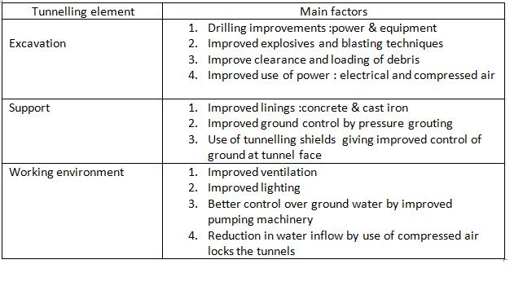
Factors contributing to significant improvements in tunnelling

Slide 6
Problems associated with tunnelling:
The impact of hazards in tunnelling has been brought to the forefront of attention in recent years following some tragic accidents in different parts of the world.
Tunnel stability continues to be an area requiring special attention particularly in deep mining conditions.
Particular attention needs to be focused on the occurrence of the methane hazard in tunnelling operations.
Future tunnelling considerations:
It is clear that for borings tunnelling can be very useful instead of drilling and blasting, especially if we are trying to make a good hole.
Cost of tunnelling drivages through TBMs can be reduced by use of road headers.
We need improved planning to avoid tunnelling hazards and to optimize tunnels to its fullest.
There are many companies like ROBBINS COMPANY in Seattle, Washington which are working on small bore tunnelling projects out of which the concept of micro tunnelling has emerged out.
This has opened new paths for specialised techniques that will some day help to gain access to the oil reserves.

Slide 7
Some important terms related to mining practices and tunnelling:
Chambers or rooms: These are workings with bigger dimensions in the cross-section as compared to the length.
HORIZONTAL WORKINGS
Adit: Adits are level or nearly level drifts driven from surface to access the seam.
The following conditions favour the opening up of a coal seam by adits:
The coal seam should occur in a hilly terrain and the topography should be such that level drift from the foot of the hill can cut the seam.
The coal outcrop should be above the level of the loading point; and
Sufficient space should be available at the mouth of the adit to facilitate the construction of coal preparation and handling plant.
Cross-cut:
An underground passage having no outlet to the surface
Usually driven perpendicular to strike in dead rocks
Used for transport of useful minerals, waste equipment material, delivery of air for ventilation and man riding.
Also known as cross measure drifts/ stone drifts

Slide 8
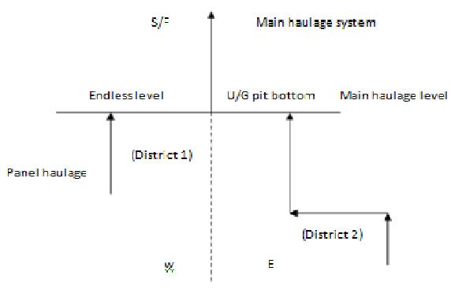
Some important terms related to mining practices and tunnelling:
Gate road: (roadway entry, strike gallery, drifts level)
Horizontal underground working without access to daylight driven along the strike on flat, inclined and steep seams and in any direction in horizontal seams.
Cross cut in the seam:
In thick seam between hang wall & foot wall
Other than strike or dip it is also known as cross cut.

Slide 9
Inclined workings:
Inclined workings include:
Inclined small shaft
Haulage rise/dip
Inclined man way/winze and raise
Development workings:
Driven as a rule in the seam
Intended for serving section of the mining area and being maintained during the mining area and being maintained during the period of extraction of a corresponding section (entry, haulage rise, haulage dip, inclined man way, etc.)
Narrow workings:
For splitting the developed sections of the mining area.

Slide 10
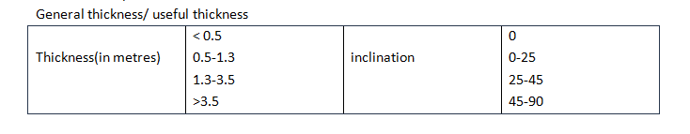
DRIVAGES OF EXTRACTION
Thickness of a bed:
It is the shortest distance between the hang wall and foot wall.
Thin layers of 0.3 to 0.4m are called layers of coal.
Thin layer of dead rock in the coal seam is called dirt band.
Drift – one or more small tunnels excavated within and ahead of the full cross-section.
Pilot tunnel- a small tunnel excavated over the entire length or over part of a tunnel , to explore ground conditions and assist in face excavation.

Slide 11
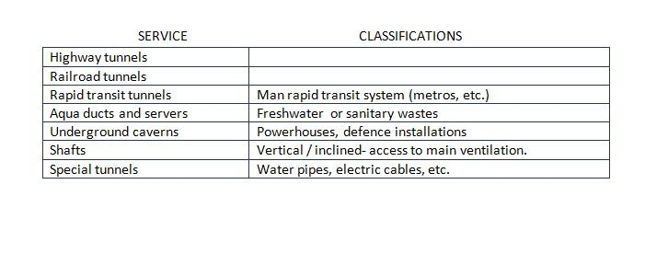
Tunnel service classification
Tunnel classifications: (As per locations )
Under ground tunnels | rivers , harbours | clearance requirement of land are difficult
Mountains tunnels | transport
Tunnels at smaller depth and under city streets – metros
Bored vs. Cut and cover tunnels ( shallow tunnels).
Tunnel types: (based on ground/geological conditions)
Rock tunnels
Soft ground tunnels: soft, plastic and non cohesive soils with and without the presence of water.
Mixed face tunnels: rain interfaces frequently weathered and difficult to construct.

Slide 12
Main Classifications of tunnels:
1) Traffic Tunnels:
Tunnel Applications:
Railway tunnels
Highway and road connections
Pedestrian tunnels
Navigation tunnels
Subway tunnels
2) Conveyance Tunnels:
Tunnel Applications:
Hydro-electric power plants/stations tunnels
Water supply tunnels
Public utilities: Intake and conduits
Sewer tunnels
Industrial plant: Transportation tunnels
3) Mining Tunnels:
Tunnel Applications:
Access and arterial tunnels (Long life)
Tunnels for exploration purposes (MECL)
Exploitation: drivages ,galleries and rooms (Short life)
Service tunnels
Drainage adits and relief tunnels

Slide 13
METHODS OF TUNNELLING
Manual:
Hammer and chisel
Splashing cold water onto fire-heated rock faces
Wedging of pre-existing cracks
Drilling and Blasting:
Tunnelling on stronger rock
Initially manual drilling and subsequently power drills revolutionized drivages
Tunnelling Shield:
Shield as a revolutionary development in treacherous ground or subaqueous conditions
Compressed Air Tunnelling:
Limitations:
2.4 to 2.7 bar above atmospheric pressure (Men are able to work)
Leakage in open water bearing gravels
Machine Excavation Of Rocks:
Advent of TBM, Road headers, Larger Shields
Heavy squeezing ground
Major influxes of water

Slide 14
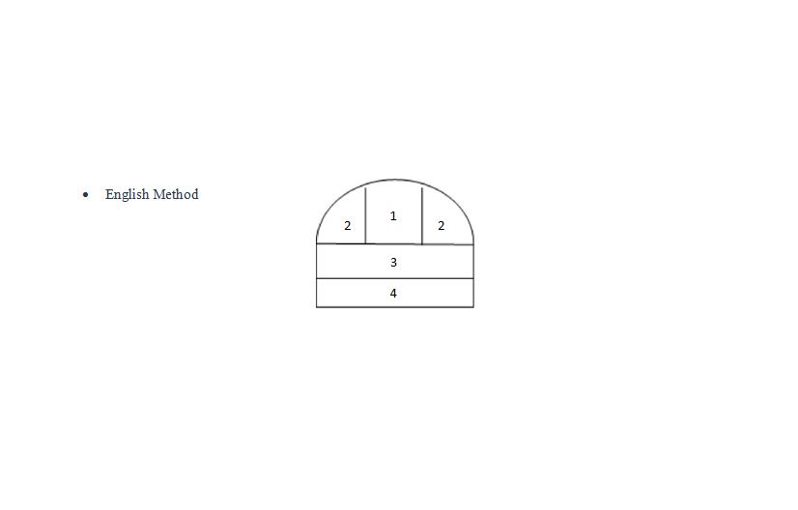
Layout/Sequence of Excavation.
The following patterns are the sequence in order shown in which they are excavated i.e., 1➔2➔3➔4 and so on.

Slide 15
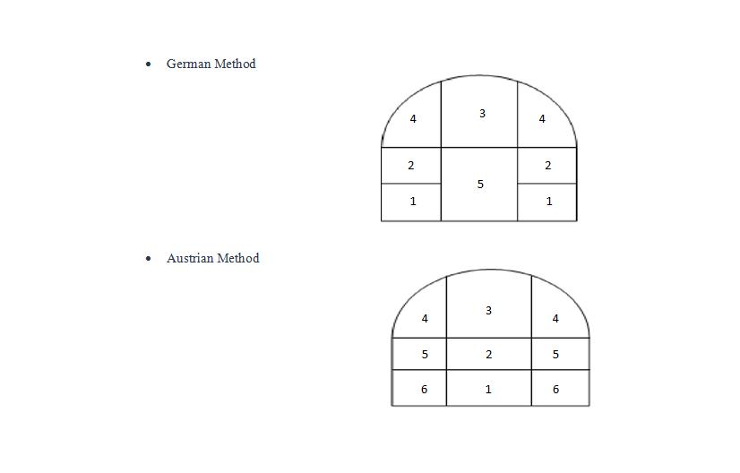

Slide 16
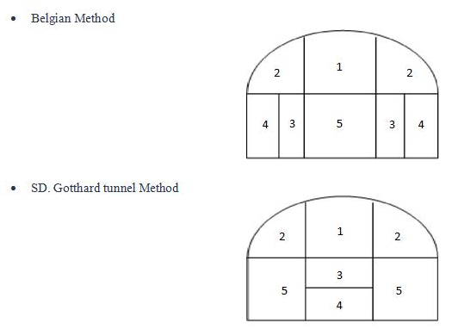

Slide 17
Exploration Program:
Before deciding upon tunnel course, alignment, method of tunnelling (excavation, support, ventilation, transport, etc).
Literature search
Aerial photographic study
Reconnaissance of surface geology
Geophysical survey
Exploration drilling:-
Geology, stratigraphy
Physical property of rocks
Fracture pattern data
Permeability and ground water
In-situ stress levels
Rock strength in relation to D&B or Mechanical Excavation
Data for probable support
Access for down-hole testing
Test pits and drifts
In-situ tests
Laboratory notes
Model testing
Actual construction
Post-construction monitoring and performance.

Slide 18
Choice Of Tunnel Method:
Ground Condition:
Soft
Rock condition
Mixed face conditions
Tunnel size:
9(micro) – 12 m (full face TBM’s)
Environmental aspects:
Urban areas D&B can be precluded
Ground water drainage pattern
Water and gas
Heat and humidity
Tunnelling by Drill & Blast:
Influence of rock strength
Tunnel size
Local variable conditions:
Tunnelling personnel (Skill)
Infrastructure
Physical location of the site

Slide 19
Choice Of Tunnel Method:
Blasting Cuts (patterns):
Burn cut
Wedge cut (Large tunnels)
Fan and drag cut (Small tunnels)
Blasting Efficiency:
Templates for accurate drilling
Detonator delay time variability
Time required for successive ejection of rock.
Computer Aided Drilling
Reduction in operator learning time
Fast and precise drilling with Single and Multiple rigs
Hole direction more precise
Scope for drill round optimization
Improved operational controls of booms
Longer holes with less deviation
20% Savings on drilling time
Analyzing, interpreting and assessing the effect of various parameters on the excavation cycle (Engineers purview)

Slide 20
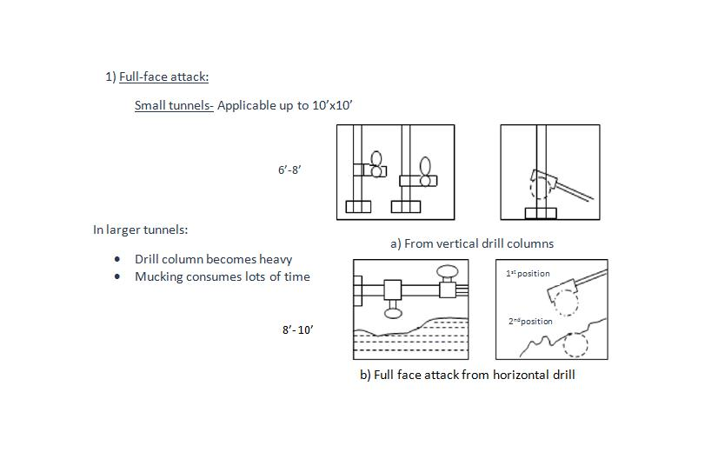
Method of tunnelling depends on:
Ground conditions
Equipment available
Extent of support
Scheme of mucking

Slide 21
Large tunnels
Drill carriage/jumbo makes a rotation:
A battery of drills mounted on the front end of the jumbo
Saving time in setting up drill columns and bars
Foldable platforms which can be folded while mucking is on
Same jumbos for supporting in weak ground conditions
1) Increase in size and need for quick completion further revolutionized the mining system by employing:
Truck mounted drill carriage/jumbos
Poclains for loading on to truck
Crawler/tire mounted jumbos (Atlas Copco,etc)
Tandsi
Koyna – Link, Lake Tap Tunnels. (M.S.)

Slide 22
DRILL JUMBO

Slide 23
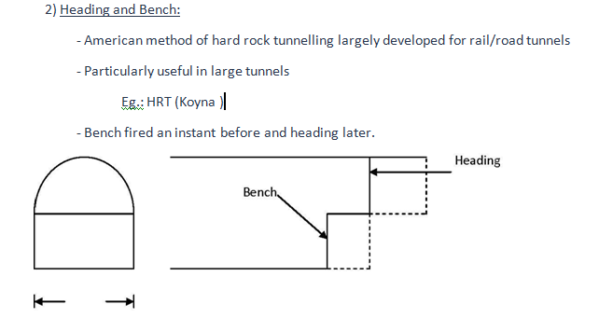
Large tunnels

Slide 24
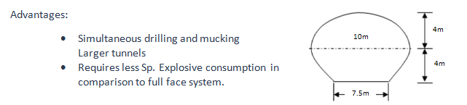
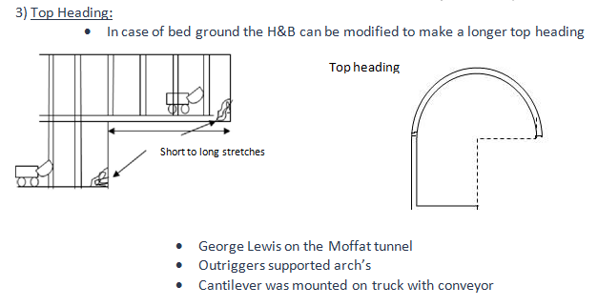
Large tunnels

Slide 25
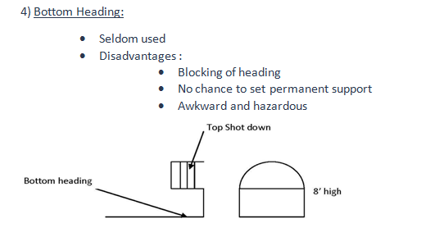
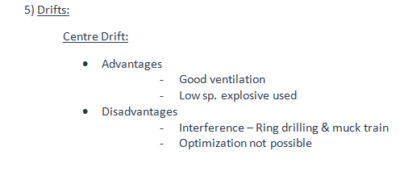
Large tunnels

Slide 26
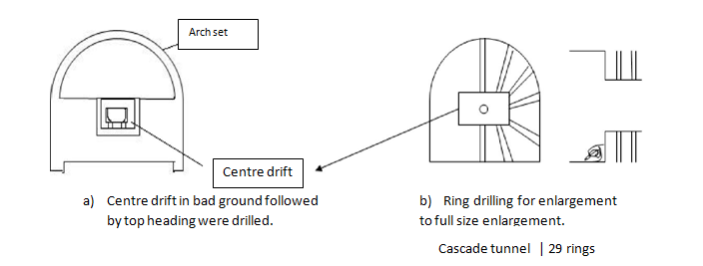
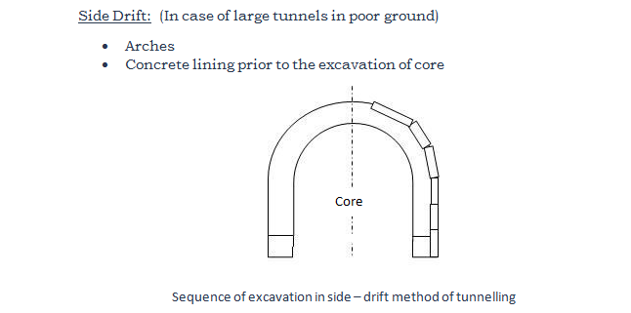
Large tunnels

Slide 27
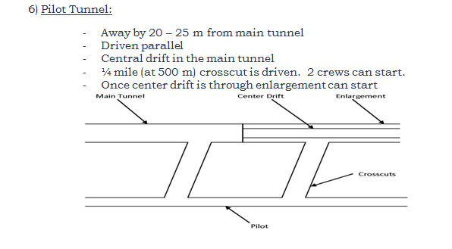
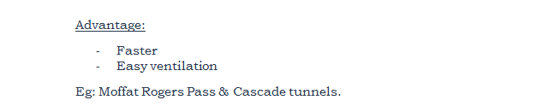
Large tunnels

Slide 28
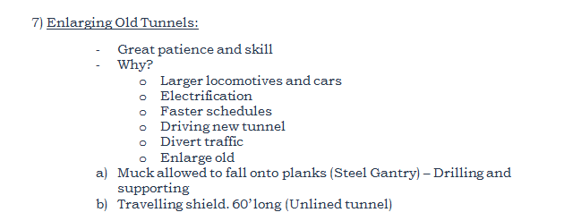
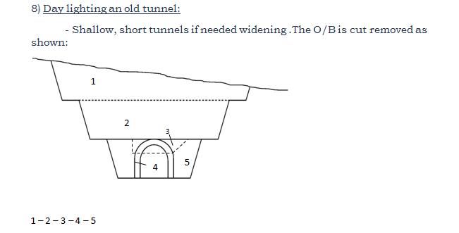
Large tunnels

Slide 29
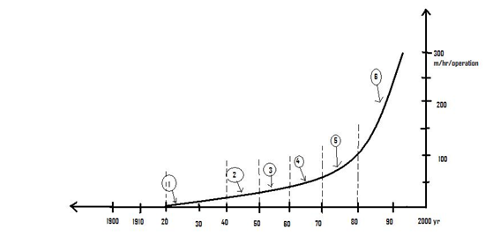
DEVELOPMENT OF DRILLS
Fire for heating <1900
The drill jack hammer 1900
The Swedish method- pusher leg drills 1940
Semi mechanized drills- light drills rigs 1950-1960
Mechanized drillers ,pneumatic rock drills 1960
Mechanized drilling ,hydraulic rock drills-first generation
Mechanised drilling , hydraulic rock drills-second generation

Slide 30
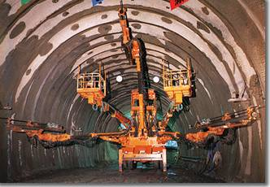
EQUIPMENTS FOR VARIOUS PUPOSES IN TUNNELING
PUSHER LEG ROCK DRILLS
Area – small 15-20m²
Hole diameter- 27-40mm
Working pressure – 4-6bar
Weight- 22-28 kg
Air consumed – 48-97 1/s
Penetration rate - 410-1000 mm/min.
(eg. granite -6bar/33mm)
TUNNELING JUMBOS
Rock drill – hydraulic/pneumatic
Area- 6-165 m²
No of boom -1-4 nos.
Hole diameter(blast)- 35-64mm
Hole depth-1.7-5.88m
Machine weight- 7-38 ton

Slide 31
DEVELOPMENT OF DRILLS
1).Compact pocket boomer (H 104) for mines
Boomer 250 ( medium size)
280 series => drifting
Boomer 322 => small mines needing high power.
2).High drilling performance / availability
3).Rocket boomer – fast drilling COP 1440( hydraulic rock drills)
4). 2-4 rock drills -13 m each
5).10-20kw power
PRODUCTION DRILLING
Simba H series - 40m long holes mechanized rod hand log
Simba 260 series-1TH drilling - Large area - Length upto 130m - Fully automatic
ROCK BOLTING
BOLTEC SERIES -remote controlled
-Fully mechanized
-Reinstallations (mechanical / cement / resin)
-Swelling for instant rock reinforcement (atlas copco)

Slide 32
EQUIPMENTS FOR VARIOUS PUPOSES IN TUNNELING
RAIL BOUND JUMBOS
Rock drill - hydraulic or pneumatic
Area - 6-45 m²
Track gauge - 600/750/900 mm
No. Of booms - 1-2 nos
Hole disc - 35-64 mm
Hole depth - 1.7-5.88m
Machine weight - 6-12 ton
ROCK BOLTERS
BBD41W or FALSON
Length of drill steel - 600/800 mm
Working pressure - 4-6 bar
Stroke length - 45mm
Weight - 39-40kg
Air consumed - 75 l/s
Penetration rate - 4 bar-350mm /min
( e.g. Swedish granite with 33 mm bolt) 6 bar -600mm/min

Slide 33
EQUIPMENTS FOR VARIOUS PUPOSES IN TUNNELING
FULLY MECHANIZED BOLTER
BOLTER RIGS
- rubber whacked
- diesel trammed
- Like boomer series
Bolt type -swelling | mechanically anchored | grounded | split set
Bolt length -1.5- 5.0m
Tunnel height -3-11m
Machine weight -9.8- 22tons

Slide 34
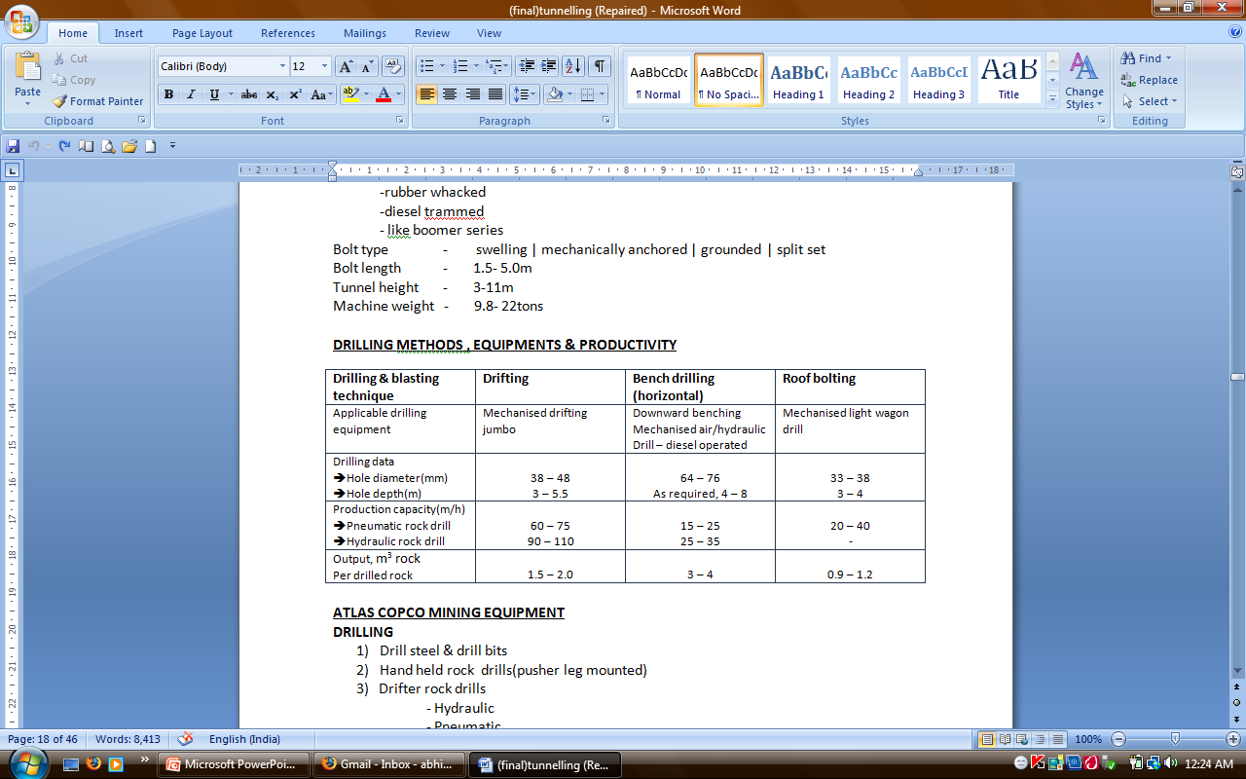

Slide 35
ATLAS COPCO MINING EQUIPMENT
DRILLING
1) Drill steel & drill bits
2) Hand held rock drills(pusher leg mounted)
3) Drifter rock drills (hydraulic & pneumatic)
4) Long hole rock drills (hydraulic & pneumatic)
5) Down - the - hole drills
6) Production drill rigs [fan drill( SLC) / ring(SLG) / bar and arm rigs (SLS)]
7) Drifting jumbos [Rail bound / Rubber tyred (air driven) / Rubber tyred(diesel)]
LOADERS
1) Overhead shovel – pneumatic / electric
2) Rubber tyred - pneumatic
3) Digging arm loaders
-Rail
-track (crawler)
-rubber
LHD LOADERS
1.LHD – double bucket – diesel
2.Auto loader
3.LHD – loaders – diesel | electric

Slide 36
ATLAS COPCO MINING EQUIPMENT
TRANSPORT
-Rail bound
-dumper(diesel)
MISCELLANEOUS
-pneumatic winches
DRILLING MACHINES
MAIN TYPES
1.Handheld rock drill
-versatility
-low weight
-Flexibility (small & large openings)
2.MECHANIZED DRIFTING JUMBOS
-Rail
-crawler
-tyre(diesel)
3.PRODUCTION DRILL RIGS
-Long hole drilling, SLS, VRS, SLC

Slide 37
MINING EQUIPMENTS
CRAM - WOMBAT ROOF BOLTER (Australia)
High speed drilling
Light weight
Balanced for case of handling
High strength, light weight, high thrust telescopic legs
Tough light weight moulded motor casing and drive head
KING COBRA CONVERSION KIT (DEEWELD LTD. CHESTER)
Stages - 2,3or4 stage ILC leg& adapter head piece
light weight – 33.5- 40 kgs (compact)
No shock loads
No hidden fractures
Leg expands from top / longer leg & seal life
stronger head piece
Increased thrust
Improved balance
HEIGHT- 1-4M
Low maintenance

Slide 38
MINING EQUIPMENTS
BOART DRILLING SYSTEM – HYDRAULIC ROCK DRILLS –HD SERIES
HD- 150
Percussion pressure - 170 bar ( max)
Rotary pressure - 140 bar( max)
Flushing pressure - 10 bar ( max)
Rotation rate - 0 – 550 rpm
Rotation torque - 425 nm
Air requirements
Lubrication ( at 2-3 bar) 2l/sec
Flushing 80-120lit/ sec (depending on bit size)

Slide 39
DRILLING
1) Drilling singly or with a jumbo
Tunnelling services:
1. water
2. Compressed air
3. Ventilation ducking
4. Power cables
2) No. of holes are directly proportional to rock strength, structural weaknesses & tunnel X^{n} shape & size.
Small tunnels need more holes to achieve same rate of advance.
US based experience on no. of holes m² weak strong
10 23-27 35-50
25 45-50 60-70 50 75-85 95-110
4) Burn Cut➔
125mm due holes parallel to tunnel line, near centre one or more proportional
to the size of tunnel.

Slide 40
DRILLING
5) Jack hammers➔
Economy, flexibility & ability to drill wide range of rocks strength. Jack legs for thrusting. Air legs or drilling jumbo platforms specially for large sections
6) Drilling jumbos
- Rail mounted on main haulage track ( small tunnels)
- straddle track jumbos large sections hand legs bards can be operated below them
-Trackless jumbos ( rubber tyred – crawler mounted)for truck haulage systems
7) Drill bits-
(a) TCT 22.5mm drill rods
38-41with air leg
Discarded after 120-300m length of drilling
(b) Detachable drill bits (32mm) /drill sizes are 38-48 mm.
Operational life of 90-120 m is hard rock granite.
(c) Bit sharpening every 12-15m of drilling.
8) Penetration rates up to 1.2m/min on hard rock moving and resetting the jumbo adds good amount of time.

Slide 41
Percussive drilling
-Percussion
-Feed
-Rotation
-Flushing
* Hydraulic oil as pressure medium – together with lighter impact frequencies – 50% more compared to compressed air.
ADVANTAGES:
Reduction in drill steel costs
Energy costs are lower
Noise is low
Better visibility
Automation & remote control is possible.
Improved reaction speed to charges in drilling conditions

Slide 42
BLASTING
Explosion(sq. meters) Quantity of explosive (kg/cubic meters)
Weak Strong
10 1-4 5-7
25 1-2.5 4-5
50 1-2 3-4
For optimum rock breakage and muck pile formation most appropriate blasting pattern with correct sequence of blasting is implemented.
Specific charge varies as per the location and type of hole.
Perimeter blasting is done using two technique:-
-Smooth blasting in which lightly charged holes are blasted at the end of the round.
-Pre splitting in which lightly charged holes are blasted before the main blast.
*Above techniques are also known as controlled blasting techniques.
Purpose of controlled blasting techniques:-
For giving smooth edge
For least damage to adjoining R/M
This is essential to minimize the R/M damage around the opening.
The depth of pull/round is dependent on rock condition & size of tunnel.
Blast vibration monitoring is essential to safeguard the structures nearby. This is accomplished by using a set of vibration monitoring equipment to record

Slide 43
BLASTING
a) PPV (peak particle velocities) (mm/s):
The Indian standards for damage due to blasting-
(Threshold limit of damage)
PPV➔ upto 50 mm/s (weak rock)
PPV➔ 70 mm/s (hard rock)
Q (maximum charge per delay) can be designed using PPV.
Total explosive is controlled by number of delays.
The more the number of delays the bigger is the round we can blast.
b) FREQUENCY:- The frequency of blast wave is also important particularly when it is low (below 24 Hz) because the structures normally possess a natural frequency almost in their range.
Premature explosion due to tightening, stray currents can be eliminated using NONEL detonators.
Sympathetic detonation:- It occurs when formation is cracked and the explosion is carried through the same to ignite prematurely the subsequent delays and that results in a poor blast, bad cut and waste of complete explosive charge.
The clearance of smoke after blast consumes approximately 15 minutes to ½ hour provided ventilation is good.

Slide 44
Processes after drilling & blasting
DEBRIS CLEARANCE (MUCKING):
Visual inspection and scaling (if loose from roof and sides)
Method of mucking is proportional to strength of rock, abrasive properties, size of the tunnel - cars / trucks / conveyors / pipe line (like slurry)
Large capacity that make smooth to function in the area
Direct scooping
Overhead discharge
Side discharge – minimize wear effect
LHD’s
GROUND SUPPORT:
Support erection – retain loosened rock
Temporary supports (usually necessary)
Steel arches | rock bolts – shortcrete |
Permanent lining (after the completion of entire tunnel)

Slide 45
FACTORS AFFECTING TUNNELING
CYCLE TIME IN TUNNEL CONSTRUCTION:-
Drilling & Blasting ----- 35 – 40 %
Loading & Hauling ----- 25 – 30 %
Scaling & Dressing ----- 10 %
Ventilation ----- 5 %
Support ----- 15 %
Set Up ----- 5 %
* Normally advance increases after scaling.
For obtaining longer pulls➔
(Requirements)
Drill rod adding must be available.
Very high drilling accuracy.
Suitable type of cut.
Accurately performed perimeter blasting.
Use of electronic delay detonators far progressive free face generation to avoid scattering and stray currents.
In a properly designed and executed blast, sealing operation is less.
Fragmentation is good and unaffected with longer pulls.

Slide 46
DRILL BITS
GOLD DRILL:- [ ISI CERTIFIED] (BGML)
Tungsten carbide tipped drilling rods
bit size:-40mm to 31mm
Length:-600mm to 4000mm
vibresist high carbon alloy steel
high fatigue strength
corrosion resistance
single chisel type bits are designed for:-
Carry sharpening
High rock penetration
Long life
Economy
Specially treated for corrosion and rust prevention
VARIOUS TYPES OF BITS:
Button type drifter bits WIDIA (INDIA) LTD.
Rotary bits SANDVIK ASIA
Cutter picks (Round and flat type)
Tungsten carbide tips and buttons

Slide 47
DRILL BITS
PICKS FOR TUNNELLING & ROAD HEADING MACHINES :
FLAT DESIGN: V- Type | DOSCO dint headers 7⁰- 9⁰ CA, 30⁰ cutting angle
LW-type| DOSCO dint headers RA 10⁰, CA 9⁰-11⁰, 100⁰cutting angle
Full faced | DOSCO road header CA – 7⁰- 9⁰
Full faced | DOSCO road header CA – 7⁰-8⁰
ROUND SHANK: ALPINE MINES
AM50, AM100 cutting angle 75⁰
TAPER SHANK : DOSCO Mk IIA
Total drill cost:
TDC=[B+(H*D)]/M
where B is purchase cost of drill bit
H is drill life, D is hourly ownership, M is life of bit in minutes
Average rate of pen (ROP):- M/H
TDC=(B/M)+(D/ROP)
BIT DESIGN:
(1) Micro cleanliness
(2) Location of holes
(3) Radii, undercuts and surfaces are free from tool marks
(4) Heat treatment

Slide 48
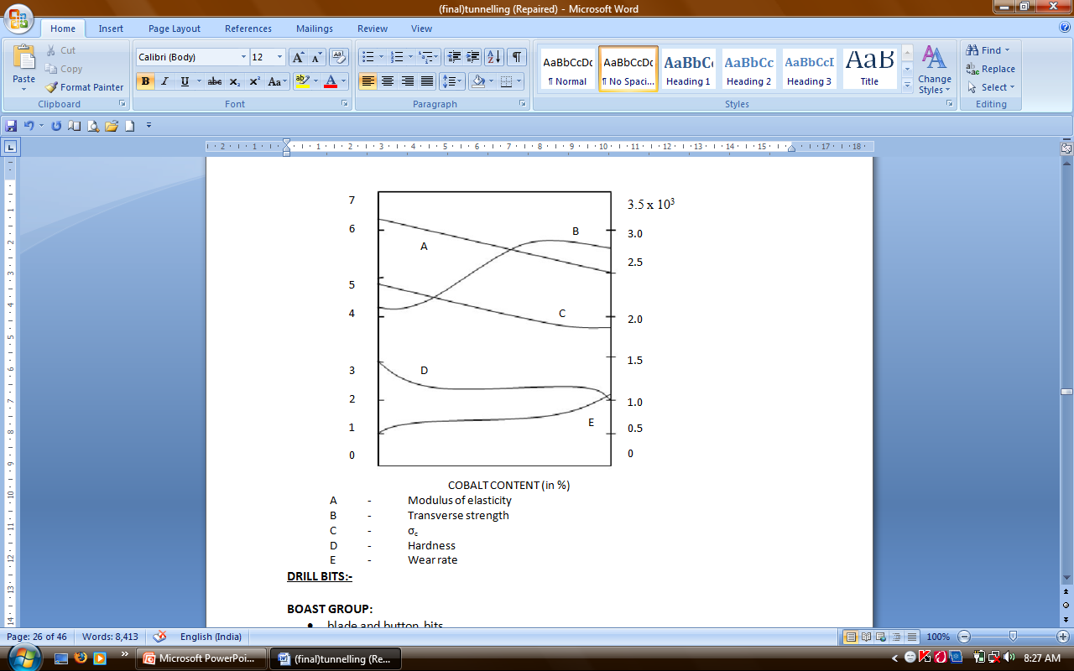
DRILL BITS
(5) Grain size/Cobalt ratio
(6) Dual property bits in sandvik (varying cobalt content from surface to centre residual stresses are favourably disturbed)
(7) Ballistic buttons
(8) Domed cylinders Better life in hard abrasive rocks

Slide 49
DRILL BITS
BOAST GROUP:
blade and button bits
tapered rods and bits for economical bit handling and sharpening
rotary drilling bits for coal and soft rocks
PCD(Thin discs of PCD fixed to steel bodies by brazing for methane drainage holes and or soft rocks)
KRUPP WIDIA GMbH:
Turbo bits-high penetration (20-30% above normal)
ballistic buttons
bit body made from wear resistant ,case hardened steel material
ROBIT OY:
Specialized in button bits
Optimized location of the flush holes and grooves
Insert shape size and positions
SANDVIK ROCK TOOLS AB:
DP bits slowed significant improvements in bit life and performance
50 to 116%
THROW AWAY BIT CORPORATION :
All range (including tapered bits)
Other companies are: UNIROCK AB, ATLAS COPCO, INGERSOLL, MITSUBISHI METAL CORPORATION & ROCBO.

Slide 50
DRILL BITS
BOART UK:
Improved tool design for reduced cycle time
development of hydraulic rotary percussive rock drill HD series Boart uk
polycrystalline Diamond bits known as Bora bits
a layer of polycrystalline diamond -high wear resistant
on a layer of tungsten carbide -high impact series
ADVANTAGES:-
greater penetration
longer life
self sharpening of the cutting edge
less noise
straighter holes
less pressure
lower drill metal costs
diamond edge remains sharpened through out
TUNNELING SPECIFICATION:-
new carbide grades:-B25N,B30N,B35N (15 to 30 micro grain size of tc)
higher quality steel(nickel steel bodies)
new brazing techniques
30 percent improved life

Slide 51
DRILL BITS
P AND V'S : Padley and Venables -through flush pick system
efficient water introduction system for dust suppression and reduce risk of frictional ignition
forward attack/radial /point attack
improved dust suppression
reduced frictional ignition
increased tool life by reducing heat effect on the tip
lowering moisture content in saleable product,
More efficient use of water supply
PCD BIT DESIGN
10 degrees to 20 degrees clearance angle is conductive for good ROP and life
sufficient clearance behind the cutter to flush away the cutting without leading to secondary communication
1.5m/min in abrasive rocks(eg)

Slide 52
MACHINE CUTTING
Objective :
Desired production rate
Minimum energy requirement ( sp. energy consumption kwh/m³ )
Minimum power
Reduced dust
Better coal size
Greater reliability of bits & cutting units.

Slide 53
MACHINE CUTTING
FACTORS TO SELECT M/C:
Rock index properties (strength and abrasiveness)
Rock structure (lithology, rock quality and discontinuities )
M/C performance depends on:-
EXCAVABILITY :-
Classification developed by Kristen (N) where N is rock excavability index.
STANDABILITY:- Roof should be able to stand without support.
Brittleness index = σ_{c}/σ_{t}
For determining the abrasivity
Cherchan index is used.
Schimagek index (based on grain size)
Los Angeles test
Efficiency of wining system depends on
Workability of coal
Relationship between cutting parameters and cutting tools
Cutting tool design for greater reliability
Cutting modes and placement of tools (cutterhead design)
Formulation of engineering methods for selection of rational operating parameters (stumping thrust, bit speed, drum speed etc.)

Slide 54
MECHANICAL EXCAVATION:
The methods that are used for rock excavation today employ either mechanical rock cutting tools or explosive charges.
Although many of the alternative methods for rock destruction, such as thermal or erosional, have been demonstrated as technically successful, most of these techniques are impractical either because they are extremely energy intensive, or they are not cost-effective.

Slide 55
MECHANICAL EXCAVATION:
The conical picks are mounted in the pick holders at an angle (30 – 40⁰ ). Whereas radial pick are fixed perpendicular to the pick holders.
Radial picks are affected quickly by wear in comparison to conical picks.
Normally radial picks are fixed type whereas conical picks are rotating type. This helps for self sharpening of the picks and long service life. The worn out picks consume excess of specific energy, creates dust and increases the probability of sparking.
Factors governing bit life:
Bit selection should be based on minimum wear and maximum fracture resistance.
Bit life depends on physical, mechanical and thermal properties of bit material
Mounting configuration of the bit
Depth of cut (depends on stumping force applied)
(In case of shearer- haulage width determines depth of cut)
Bit speed
Properties of material being cut

Slide 56
ROAD HEADER
It is a M/C used for cutting coal.
1978 (moonihdih – LW)
Advance technology mining (ATM):
Shearer (double ended ranging shearer – DERDS)
AFC (Armored flexible conveyor)
Powered support
4 legs, 2 legs
4 x 750 feet (capacity)

Slide 57
ROAD HEADERS
Reason for poor performance of a road header:
Lack of infrastructure – we don’t have proper plant & machinery at mine site for road header maintenance workshop facilities.
Skill/union problems/ training.
Mechanization culture.
M/C related problem
suitability of M/C to cut material
selection of M/C
Management

Slide 58
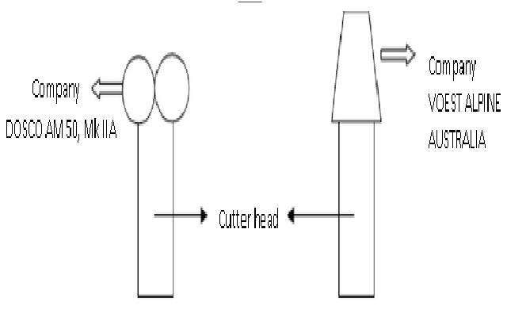
Subsystems
1) Cutting – road header
Type : (difference based on cutter head)
Transverse
Axial
2) Conveying
Conveyors
Bridge conveyor (13.5 m long)
Chain conveyor
3) Gate belt conveyor
4) Supporting (Roof)
Coal drill (electric type)
King cobra (air operated) – for roof bolting
Wombat (CRAN – Australia)
Simultaneous cutting & supporting:-
ABN – 20, 30
VOEST ALPINE (AUSTRALIA)

Slide 59
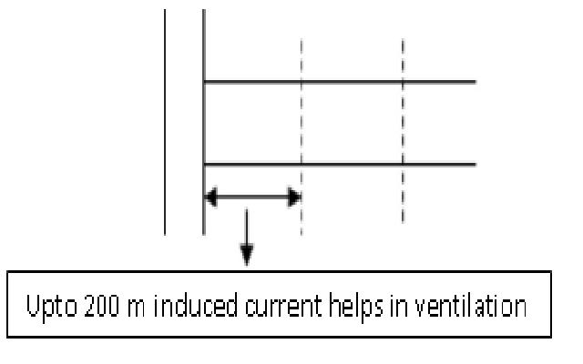
Subsystems
5) Ventilation (for 1km long panel)
For every 100 – 150 m => Q 15 HP fan is required.
After 700 m => for ventilation , in – line high water gauge centrifugal fan (90 kw) is used. (overlap ventilation is required)
Types of ventilation
1-Forcing
2-Exaust
3-Overlap (Forcing + Exhaust)
Pumping
make of water
mono pump is normally used
Lighting
safety
productivity
Monitoring System (Health of H/C and atmosphere)
Man power
Management

Slide 60
Support load estimation:
Bikmawsk’ s RMR ( 1979 ) has been modified by Dr. Venkateswarlu ( 1986 ) and CMRI Geo mechanical classification is being extensively used for design the support system in coal mines.
Parameters considered for RMR :
Layer thickness
Structural features
Weather ability LSD – 1 -- 1st cycle slake durability index
Strength of rock -- point load converted to ocs C_{o} = 14 Ipl
Ground water flow -- 1.8 hole water flow in mL/min
RMR | 0 - 10 | 10-20 | 20-30 | 30-40 | 40-50 | 50-60 | 60-70 | 70-80 | 80-90 | 90-100
Class | V A | V B | IV A | IV B | III A | III B | II A | II B | I A | I B
Descri-ption | Very poor |  | Poor |  | Fair |  | Good |  | Very good
Rock load = Span × Rock density × ( 1.7 – 0.037 RMR + 0.0002 RMR² )

Slide 61
Support Systems
1. Roof bolts:
Mild steel bar to bar -- ultimate strength from 16 – 31 kn.
Longer
Fully grouted instead of point anchor type:
effective stiffness of support system is increased.
Pre-tensioning ( convergence stops )
Clay release ( film type ) reduced load transfer
Self tapping type bolts ( 5 – 100 m pa )
Rock bolt type | Pullout bed
Resin bolt | 8.4
Cable bolt | 11.2
Square bolt | 13.5
Thread bolt | 14.2
Self tapping bolt | 17.1

Slide 62
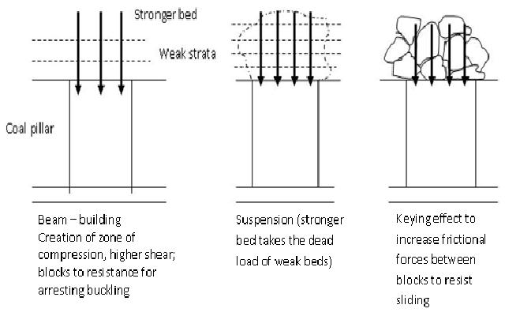
Support Systems
Support Systems
Roof Bolts
Rope Stitching
Roof Trusses
W-Straps
Wire Mesh
Shot Crete
Polyurethane – not in index
Self tapping bolts – not in index

Slide 63
Support Systems
Suspension Theory : Stronger beds take the dead loads of weaker beds
Beam building theory: Pinning together the team beds which increases the shear strength and horizontal stresses; Creation of zone of compression to withstand higher horizontal stresses which may cause beam buckling. In other words providing higher shear resistance for arresting fracture.
Keying effect theory: -Fractured zones- To inc. the frictional force between blocks to resist sliding.
Roof Bolt: Support capacity of a 1.5 m long roof bolt. - 6 tons.
Made up of mild steel with ultimate strength up to 31 tons.
The bolts are longer up to 2 - 4.5 m depending upon requirement.
Full counted with cement or resin.
Resin capsule is three times more stronger than cement capsules.
Ø of hole differs from 38 – 50 mm.
In a 1.5 m hole , 3 to 5 capsules are used.
In coal mines, bolts are called t-hooks.
In cement grouters, after 24 hours roof bolts take 6 tons.
DGMS guidelines - ½ - 2 tons , 3 – 4 tons, 24 hrs. – 6 tons, after installation of bolt.
Fully grouted cement grouts have higher stiffness and arrest shear movements.
Pretensioning of bolts – to arrest convergence and stiffness.
Presence of clay hinders the load transfer from bolt to rock.

Slide 64
Support Systems
5 parameters for RMR to design support system :
Layer thickness (m)
Structural Features
Weatherability (1st cycle)
Strength of the rock ( MPg)
Ground water flow (mm/ml)
Shot Crete : Concrete shots from the holes in two to three layers of one inch to four inch thickness with or without wire mesh . Common is civil engg. functions :
To arrest weatherability
To arrest the movement of key blocks
It is a Permanent Support System
Polyurethane : It is a recent addition of support system. Here two chemicals are mixed. They are Polymeric Isolynate and Polyol Resin. These have high expanding rate. They send it into grouters which get filled up and increase the stability.
Pump ( 100 – 200 bar )
Low initial viscosity to penetrate through cracks
WILKIT(Australian Comp.)
Self – tapping bolts: A bolt is screwed inside the roof.
Roof straps:
To accommodate dead load not taken up within the roof itself & transfer it to the bolts so that static equilibrium returned to the roof.
W – straps of 20 tons strength are being used.

Slide 65
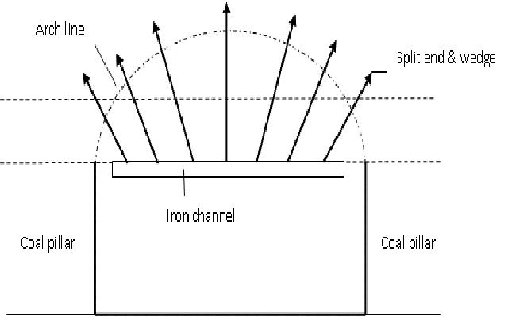
ROOF SUPPORT
Scope : To ensure a safe and mining environment
Approach : A systematic method to account for wide variations in strata & stress regimes
Weigel ( guidelines ) – 1943
Support weakened rock that falls below the natural arch line
Bolt early in the minory cycle
Bolt weak, thin strata together to create thicker stronger strata
Failure : Anchorage
Reasons :
Time delay
Increasing stress levels
Horizontal stresses

Slide 66
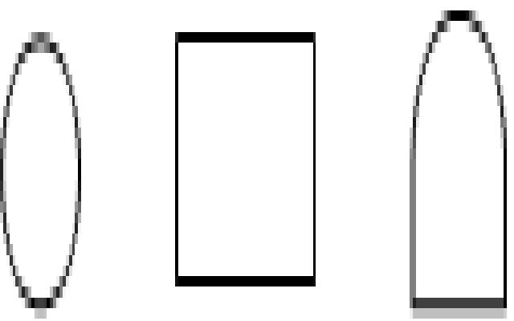
Drifting / Tunnelling using road headers
Selection of machine:
1) Type of strata :
Cuttability assessment
Compressive strength
Tensile strength (σ_{c} : 100 M. Pa)
Specific energy of the rock (σ_{t} : 10 M. Pa)
Abrasivity (if σ_{t} < 10 M. Pa)
Quartz, Grain size, Crystallization structure
Fracturing ( structure of rock )
2) Tunnel shape & size :
Several passes for layer section
3) Support system :
Lifting system for arches | roof bolter on m/c
4) Gradient :
In-line gradient : 14⁰
Cross gradient : 18⁰
5) Miscellaneous :
Ground pressure, dust, explosive gases, noises, high temp
Spares availability

Slide 67
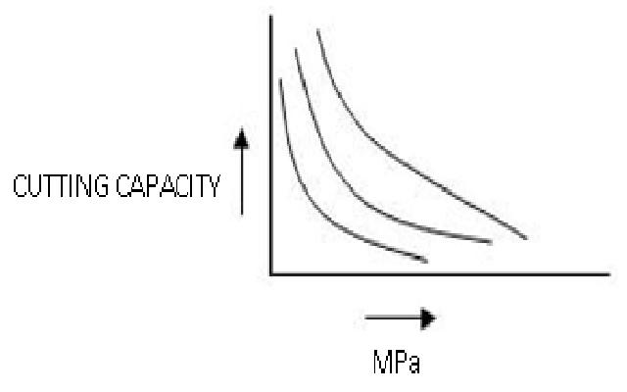
Equipment available
Utility type
< 30 tons | low power |
DOSCO MRIIA, LH100, 4m50
Traverse head 60 M. Pa
Axial head 100 M. Pa -- low dust.
Medium duty :
Higher power | 3 times the utility type
Arcing / lifting | 3 times ( froces )
30-50 tons DOSCO MKIIB, S1120, CH1300, Am75, Paurat E169
Hard cutting situation ( 120 MPa )
Heavy duty :
Hard strata more cost effective cutting
65-100 tons – long driveway
300 KW power
Arcing / lifting forces | 5 times the utility type
DOSCO Mk III, AM 100, Paurat E134 & E200
Power available matched with correct pick speed, correct arcing & lifting forces.

Slide 68
Equipment available
4) Cutting boom with circular shields :
Soft ground / cost iron segments
Mixed rock tunnels
Circular profile sliding base
Single boom ( 1.8 to 8 m dia )
Multiple boom ( 11.5 m dia )
Eg: DOSCO Tm 1800, SB400, SB600
5) Twin boom continuous miner:
Utilization of contra – rotating (rotating opposite to each other)
Cutting heads helps to obtain high arcing & lifting force.
Eg: TB600 DOSCO | wt. 70 tons to 120 tons | capacity = 400-600 tn/hrs.

Slide 69
UNDERGROUND TRANSPORT
New Developments:
1) Mineral Transport
Minimum delays
Cater for peaks ( when l/w is in full production phase)
Minimum degradation of coal/mineral
2) Material Transport
Direct transport to place of use with minimum unloading in between i.e., system should be continuous
Minimum change of prime mover
Capable of handling large and heavy objects
Maximum capacity and economy
3) Men transport
High speed and comfortable
Minimum waiting time for getting in and out
Safety
Easy supervision and control

Slide 70
Selection criteria for transport system
Layout of the mine
Nature of roof and floor
System continuity
Types of roadways available (c.s., shape)
Distances
Gradients
Bends
Variation in capacity
Rate of face advance
Amount of water influx
Illumination levels
Flexibility
High speed capability
Discrete bunkerage
Reliability
Indigenization
Spares availability
Techno-economics

Slide 71
INTRODUCTION TO ROPE HAULAGE
Pretty old
Other than mineral haulage transport mineral of supply and equipment…………………….
Proper track installation and maintenance can make rope haulage compete with other methods.
Mine tubs can be replaced by mine cars
Lubrication……………………….
Reduction of rolling resistance
Types of rope haulage
New developments:
Belt conveyors
Cable belt conveyors
Chain conveyors
Scrapper Chain
AFC ( used in l/w )
Stage loader (Mobile) ( l/w face)
Gate & Loader ( same as stage loader)
Plate conveyor
Disc conveyors
6. Locomotive/FSL ( free steered locomotives- tyre mounted vehicles in which weight up to 10 tones can be carried)
7. Shuttle cars
8. LHDs/SDLs ( mostly used in India)
9. Voest-Alpine’s continuous haulage system
10. Flaxo well

Slide 72
New developments in Haulage systems
Semi-mechanization:
It is mostly adopted in CIL, WCL. This uses SDL (Side discharge/dump loader) & LHD (capacity-1.5 cubic meter). They are coupled with scrapper chain &belt conveyor.
1) Rope hauled systems
Ground mount system
Conventional rail track system
Special system with capacity vehicles (PIKROSE Company - U.K.)
mono rail system
2) Conveyors
Mainly used for mineral transport and occasionally for men transport.
3) Locomotive ( Both battery, diesel operated )
monorail locomotive
coolie car locomotives
4) U/6 supply vehicles ( USV or PSV )
Flexible, continuity, capability to carry high loads, minimum labor, lower hazard level
Elmco
Gullick bobson (to operate on side of belt conveyor)

Slide 73
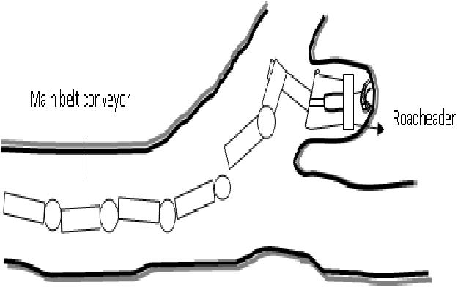
New developments in Haulage systems
Special Equipments
Flaxowell
Voest-Alpine’s continuous haulage system (five units of small conveyor which can be put at any desired angle)
SPECIFICATIONS:
5-9 pieces of conveyors
Length of each lies in the range 37-67 m
Belt width is 2 m
Speed – 2 m/min
Rate capacity – 900T/hr
Hydraulic transport systems
Voest alpine’s continuous haul system

Slide 74
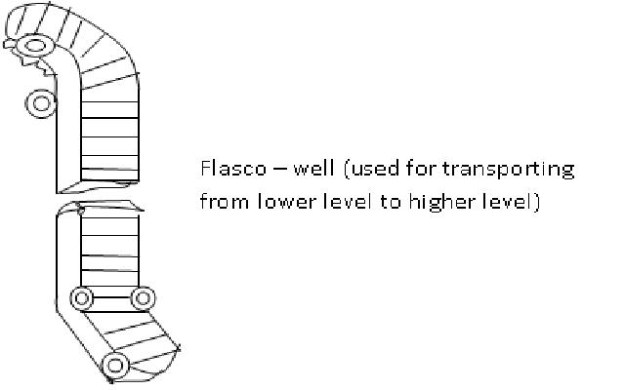
New developments in Haulage systems Special Equipments

Slide 75
Pros & cons of various methods
Conveyor transport:
Pros :
Uninterrupted production
Used when space prohibits other method at transporter
Can also be used for men transport (safety device)
Applicable in moderate grades
Cons :
Heavy &bulky lords cannot be handled
Severe changes of gradient &direction cannot be negotiated
After effected by bad road & floor
High manpower for material handling
Conveyor extension is costly
Maintenance is very high
Locomotives:
Rope hauled system and conveyors have limited capacity on steep gradients and are not safe for man transport productivity too is less with more manpower engaged in extension.
monorail locomotive improved productivity considerably
Pros :
Reduced ventilation requirement
Reduced heat emission
Lower noise levels

Slide 76
TUNNEL BORING MACHINE (TBMs)
A TBM is a device for excavating a tunnel in such a way that the material to be removed is disintegrated by the continuous rotation of a group of cutting tools thrust against the surface of the material at the working face.

Slide 77
TUNNEL BORING MACHINE (TBMs)
COMPONENTS:
Full circular cutting head with cutting tools embedded on it
Machine body (stationary) while cutting is capable of moving itself and cutting head to continue excavation.
Equipment to provide necessary thrust and torque
Muck removed by no. of buckets on cutting head dropped on to a conveyor belt. Series of conveyors transport the material to the back of the machine.
APPLICATIONS:
Normally soft ground.
Medium strength ground can also be excavated, whereas very hard rock needs drilling & blasting.
TYPE OF CUTTERS (ON TBM):
Drag cutter – for soft rock
Disc cutter – for medium hard rock
Roller cutter – for hard rock
POSITION OF CUTTERS
Central cutters – roller cutters
Face cutters – disc/roller/drag cutters (soft rock)
Gauge cutters – extreme edge of the cutter head : disc/roller
Normally combination of these cutters is used. Roller cutter is made up of WC inserts for tackling highly abrasive rock.

Slide 78
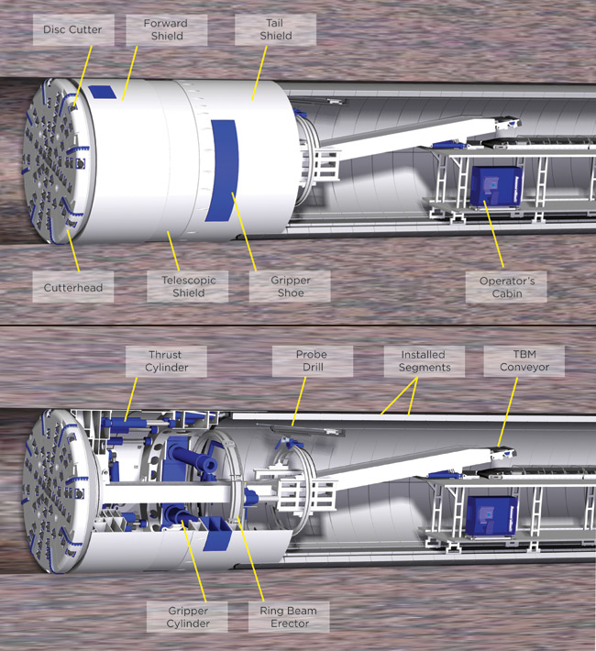
TUNNEL BORING MACHINE (TBMs)
FIXATION FACTOR:
To account for location of hole and confinement of explosive charge, a constant developed known as fixation factor.
ROBBINS COMPANY OF SEATTLE, WASHINGTON ➔(50 m/shift)

Slide 79
REFERENCES
Barbara stack: handbook of mining and tunnelling machinery, john Wiley and sons.
Hartman H. L. : SME mining engineering handbook (2nd ed. , vol. I & II), SME
Pokrovsky N M : driving horizontal workings and tunnels
Megaw T M & Bartlett V : tunnels – planning design and construction, vol. I & II.
Whittaker, B N and Frith, R C : tunnelling – design, stability and construction.
JOURNALS
Tunnels and tunnelling, world tunnelling and mine tech (CMPDIL publication)

