Slide 1
Case Study - 4
Cost Prediction On Aquiring Customer

Slide 2
List of participants:
SHARDUL KULKARNI, Student IIIT Delhi, P.G.D. CS&AI
KARAN BHUTANI, Student IIIT Delhi, P.G.D. CS&AI
GULAM RASOOL, Student IIIT Delhi, P.G.D. CS&AI
MALLIKA YETURI, Student IIIT Delhi, P.G.D. CS&AI
DEVI CHARAN GUDURU, Student IIIT Delhi, P.G.D. CS&AI
USHNA AHMED, Student IIIT Delhi, P.G.D. CS&AI
ANWESH REDDY PADURI, Sr.Data Scientist, GREAT LEARNING

Slide 3
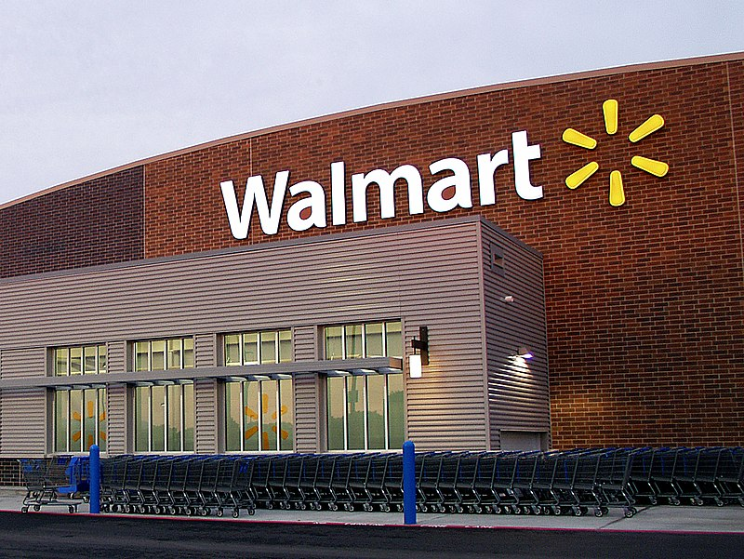
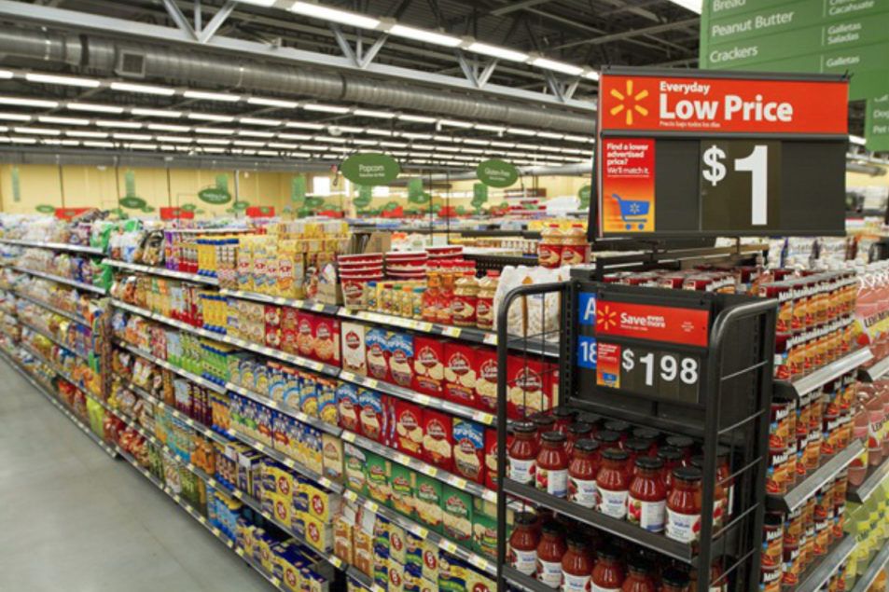
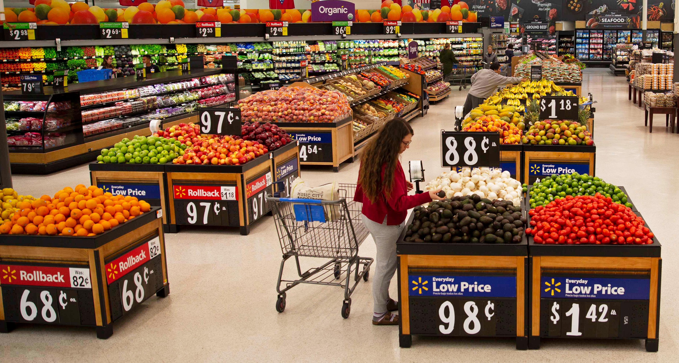
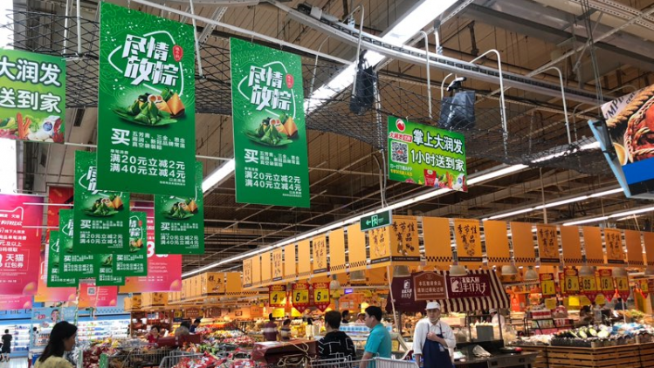
Have you ever visited any Food Mart ?

Slide 4
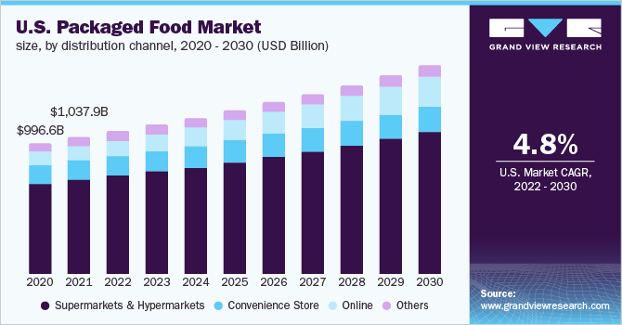
What these trends indicate ?

Slide 5
Problem Statement :
Food mart X is a chain of convenience stores in the United States. The private company’s headquarters are in Mentor, Ohio, and currently, approximately 325 stores are in the US. Convenient food mart operates on the franchise system.
Machine Learning helps retailers to predict the future through simulating scenarios that predetermine the outcomes and identify the crucial action areas.
In Cost prediction on acquiring customers, we need to predict the cost of media campaigns in food mart of USA. In this challenge, you’re required to build an ML model to predict the media cost based on the customer’s details, product details, promotion details, and store details.

Slide 6
Literature Review :
In the literature review conducted for the project, various regression models were explored to forecast the cost of customer acquisition. The initial choice for the base model was Linear Regression, given its suitability for predictive modeling. However, due to the complexity of the data and the non-linearity between dependent and independent variables, alternative models were considered. These alternative models included Multiple Linear Regression, Polynomial Regression, Gradient Boosting Regression, Decision Tree Regressor, Random Forest Regressor, and Support Vector Regression (SVR).
The project assessed the performance of these models using key metrics such as Mean Absolute Error (MAE), Mean Squared Error (MSE), Root Mean Squared Error (RMSE), and R2 Score. Among these models, Decision Tree and Random Forest emerged as top performers, demonstrating high accuracy levels, particularly when tuned with specific hyperparameters.

Slide 7
Literature Review :
The literature review highlights the growing significance of CAC prediction in marketing and the various methods employed for estimating acquisition costs. Traditional regression techniques provide a foundation for cost prediction, while machine learning methods offer advanced capabilities for modeling complex relationships and improving accuracy. The choice of method depends on the specific dataset and the goals of the analysis. As marketing continues to evolve, the integration of machine learning and data science into CAC prediction remains a dynamic area of research.

Slide 8
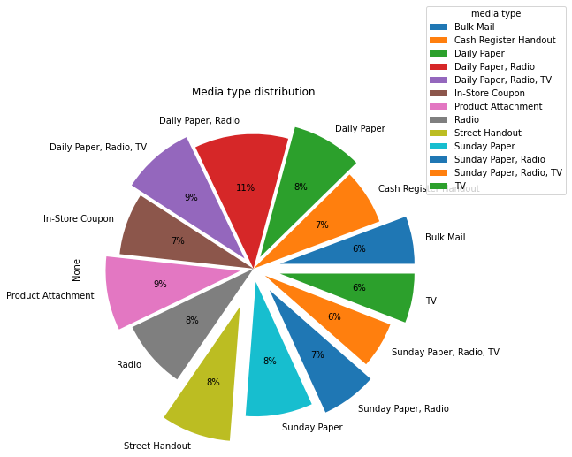
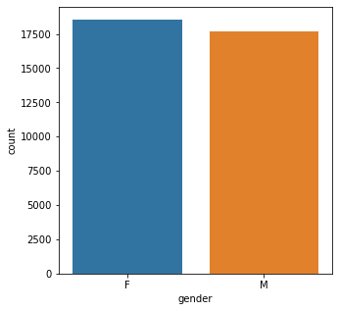
Exploratory Data Analysis :

Slide 9
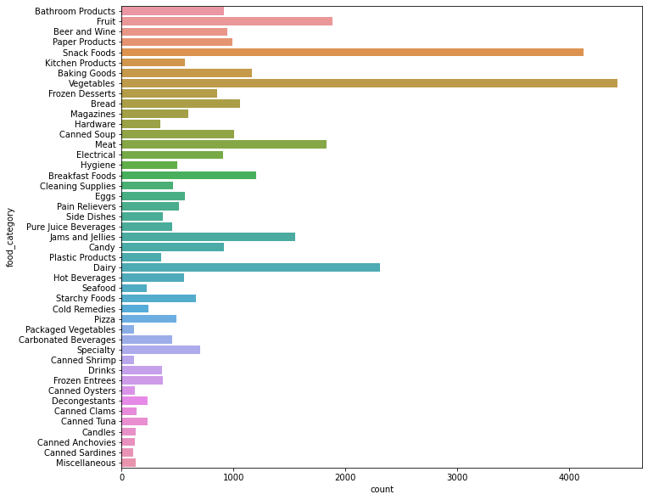

Slide 10
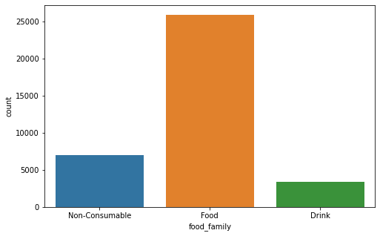

Slide 11
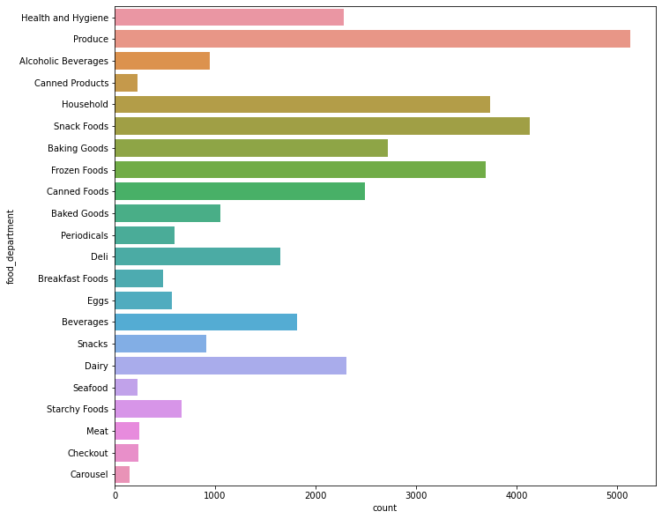

Slide 12
Tentative List Of Algorithms:
Linear Regression
Decision Tree Regressor
Random Forest Regressor
Support Vector Machines
Gradient Boosting Regressor
Multi-linear Regression using ANN

Slide 13
Steps involved :
Import necessary libraries
Extract data into pandas dataframe .
Data Preprocessing (Missing value imputation, duplicate records removal , encoding)
Exploratory Data Analysis
Data Sampling
Model Building
Performance evaluation
Deployment

Slide 14
Performance Evaluation :
We will consider following performance evaluation parameters to compare performance of different regression models :
R2 Score : R-squared (R²) is a statistical measure that represents the proportion of the variance for a dependent variable that’s explained by an independent variable in a regression model.
Mean Absolute Error : It represents difference between predicted value and actual value.
Mean Square Error : It measures amount of error in statistical models.
Root Mean Square Error : It provides an estimation of how well the model is able to predict the target value (accuracy).

Slide 15
Results :
ML Algorithm | R2 Score | MAE | MSE | RMSE
Linear Regression | 0.3286 | 20.0369 | 605.4526 | 4.4762
Decision Tree Regressor | 0.9773 | 0.3015 | 20.4103 | 0.5491
Random Forest Regressor | 0.9869 | 0.3224 | 11.7422 | 0.5678
Support Vector Machine | 0.0489 | 24.9563 | 857.6918 | 4.9956
Gradient Boosting Regressor | 0.5066 | 17.6681 | 444.8648 | 4.2033
Multi Linear Regression using ANN | 0.9862 | 0.8848 | 12.5542 | 0.9406

Slide 16
Conclusion :
Various Machine Learning techniques can be implemented for predicting customer acquisition cost (CAC). It includes tradional,modern and quantitative methods.
We implemented linear regression as traditional method, for which we obtained very less R2 Score. So we decided to implement some advance machine learning algorithms such as Decision Tree regressor,Random Forest,,SVM,Gradient Boosting regressor.
Decision Tree and Random Forest resulted into good R2 Score which is almost 0.98, so we can consider them as best algorithms for CAC prediction analysis.
We can also consider quantitative methods such as ANN for prediction, but hyperparameter tuning can be a challenging part for obtaining good results.
In this way we conclude that Machine Learning can be implemented for prediction as well as classification of different real world use cases which helps to analyze data and influence decision accordingly.

Slide 17
References :
[1] McVey, H. On-line Financial Services, presentation by Morgan Stanley Dean Witter, August 2000.
[2] Chen, Pei-Yu, and Lorin Hitt. "Switching cost and brand loyalty in electronic markets: Evidence from on-line retail brokers." ICIS 2000 Proceedings (2000): 13.
[3] Klemperer, Paul. "Price wars caused by switching costs." The Review of Economic Studies 56.3 (1989): 405-420.
[4] Reinartz, Werner J., and Vita Kumar. "The impact of customer relationship characteristics on profitable lifetime duration." Journal of marketing 67.1 (2003): 77-99.
[5] Thorleuchter, Dirk, Dirk Van den Poel, and Anita Prinzie. "Analyzing existing customers’ websites to improve the customer acquisition process as well as the profitability prediction in B-to-B marketing." Expert systems with applications 39.3 (2012): 2597-2605

Slide 18
Thank You

