Slide 1

ProcessSync Module 1
Foundations of R-Process Management
“AI doesn’t fix broken workflows — define, fix, then automate.”
Notes:
Welcome to RewmoAI ProcessSync Module 1. This is the foundation for learning how to define, fix, and then automate workflows. AI won’t fix broken or unclear workflows — they must be defined, measured and improved first. In this module you will learn what quality means, how quality relates to processes, the different ways to achieve quality, and why the pursuit of quality is important for you and your business.

Slide 2
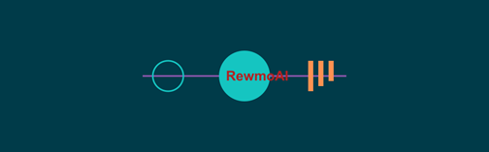
Learning Objectives
By the end of Module 1, learners will be able to:
• Define a workflow/process/system in their own business.
• Explain why customers — not owners — define quality.
• Identify one broken or unclear workflow.
• Contrast inspection vs. improvement.
• Understand the quality chain reaction.
Notes:
Introduce the learning objectives. This Introduction version focuses on practical takeaways: defining workflows, customer-driven quality, and the chain reaction model.
Define process: You will learn the definition of process and that everything we repeatedly do involves processes.
Explain how the customer defines the quality of a product or service: You will learn why it is difficult to define quality and why it is important the customer defines the quality of the products and services provided by the organization.
Identify one broken or unclear workflow. Examples can be simple or more in depth.
Contrast two approaches to quality: You will learn the difference between inspection and process improvement as ways to achieve quality.
Describe the chain reaction for quality improvement: You will learn about DON’s chain reaction for quality improvement and how quality relates to cost and productivity.

Slide 3
Hook
“AI doesn’t fix non-existent or broken workflows.
You must define and fix them before you can automate them with AI.”
Notes:
Many small businesses don’t realize they already have workflows.
Examples: invoicing, sales funnels, customer service, product fabrication etc.
Ask: what workflow do you do every day without thinking?

Slide 4
What is a Workflow?
A repeatable set of steps that produces an outcome.
Also called process, system, or operations.
A series of operations or steps that results in a product or service
A set of causes and conditions that work together to transform inputs into an output
Notes:
Define workflow in simple terms. Industry uses different labels: workflow, process, system, operations. Emphasize: if you can’t describe it, you can’t improve it.
What is a Process?
Let's now look at what a process is and how it relates to quality. Deming said the focus should be on the processes by which work gets done. If we only focus on the quality of the finished product, it
is too late. Quality is created by a process.
What is a process? Every service or product you produce in your organization is the result of some process, but most of us do not fully understand what this means.
We need to think about processes in two ways.
A series of operations or steps that results in a product or service
We generally think of a process as a sequence or series of operations (steps, tasks, activities) that result in a specific output.
The output may be either a product (e.g., an aircraft or a subcomponent of an aircraft such as the nose wheel landing gear) or a
service (e.g., a personnel record entry). There is another way to look at a process.
A set of causes and conditions that work together to transform inputs into an output
It is also important to think of a process as a set of causes and conditions that work together to transform inputs into outputs.
The production of an operationally ready aircraft (output) requires the coordination of inputs -- machines, methods, materials, and people. The blending of four variables: machines, methods,
materials, and people is the process that results in transforming the inputs into outputs. (Often you can include environment as a fifth variable). There can be several stages to the process, or each
stage can be considered a process. The aim of workflow management is to ensure the outcome of a process meets the customer's needs.
In some of the readings, you will find output and outcome used synonymously to mean a product or service, or the result of inputs.
In RewmoAI Process Management (R-PM), we use the term output to refer to a product or service and outcome to refer to the customer's perception of the product or service.

Slide 5
Examples
☕ Coffee shop: order → payment → delivery
🎨 Freelancer: lead → contract → deliverables → invoice
More examples:
Arranging travel - Preparing a report Processing payments
Admitting patients – Starting equipment
Purchasing supplies - Plating metal - Training people
Preparing a budget – Transporting - hazardous materials
Notes:
Walk through simple, relatable examples. Every business has workflows, even if they don’t call them that.
Prompt: What’s one or two examples in your own business?
Take a minute or two and write down two or three of the more important processes in which you are currently involved.
What are the inputs? What are the outputs? How do you think your customer perceives the outcome of your product or service?

Slide 6
What is Quality?
Quality = fitness for use, meeting customer needs today & in the future.
Websters Dictionary:
Peculiar or essential character
An inherent feature or property
A distinguishing attribute or characteristic
The degree of excellence which a thing
Possesses
RewmoAI:
The extent to which a product or service meets
or exceeds customer requirements and
expectations
Notes:
Deming’s definition: Quality is defined by the customer. Example: a perfect coffee isn’t good quality if it’s late, cold, weak etc. Ask what are the qualities they expect?
List 3 customer expectations in their business' product or service.
It’s your job to know what the customer expects and exceed it…you may have to teach the customer what he wants.
Synonyms: Property, character, attribute
- Quality is a general term applicable to any trait or
characteristic whether individual or generic.
- Property implies a characteristic that belongs to a thing's
essential nature and may be used to describe a type of
species.
- Character applies to a peculiar and distinctive quality of a thing
or a class;
- Attribute implies a quality ascribed to a thing or a being.

Slide 7
Two Approaches to Quality
Quality through Inspection
• To detect and remove poor quality
Quality through Process Improvement
• To build in quality
Notes:
Two Approaches to Quality
Currently there are two general approaches used by organizations to achieve quality.
Quality through Inspection
To detect and remove poor quality The first approach, inspection for defects, has traditionally been the dominant method used in the DON. This method is product
focused. All outputs (or a sample of outputs) are inspected after production to see if they pass some specified criteria.
Quality through Process Improvement
To build in quality:
The second approach, process improvement for the prevention of defects, provides a better way to assure quality. This method is process focused and is becoming more prominent in the DON as
more commands implement TQL. You are going to go upstream to analyze the process, to take it apart and see how it affects the product downstream. Let's look at these approaches in more
detail.

Slide 8
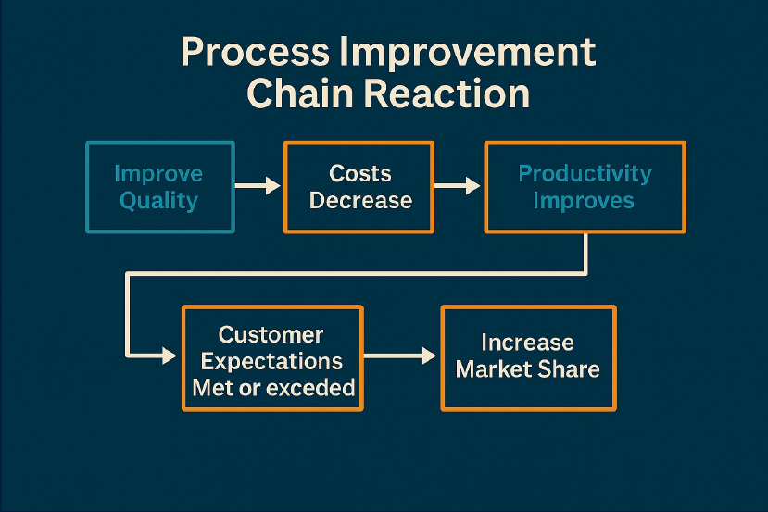
The Quality Chain Reaction
Notes:
Explain Deming’s chain reaction: better workflows reduce costs, increase productivity, delight customers, and grow market share. Use small business examples to illustrate.
The Chain Reaction in Business
The premise of the customer-based process improvement approach to quality is: As quality improves, costs decrease and productivity increases. With lower costs and higher quality,
potential exists for increased market share and growth. This diagram is like the economic module Deming took to Japan. By improving quality, this chain of events will occur.
Let's look at how the chain reaction applies to your company. This chain reaction model also predicts that as quality improves, costs decrease and productivity increases. Lower costs and higher quality lead to improved
mission readiness. Ultimately, improved customer satisfaction that remains strong.
In the past, most American organizations, have focused on improving productivity through inspection and reducing costs. In the R-PM approach, where the focus of leadership is on improving quality, productivity increases
because costs are lowered. Lowered costs result because there is less rework, fewer delays, a better use of equipment, and more efficient use of time.

Slide 9
Quick Quiz
1. Who defines quality?
2. What’s better: inspection or improvement?
3. What happens when quality improves first?

Slide 10
Video
📺 Watch: Prophet Unheard (YouTube)
Learn how Deming shaped the quality revolution.
Notes:
What This Is:
A BBC production from 1992, titled "Deming 'A Prophet Unheard'", featuring insights into Dr. W. Edwards Deming’s philosophy and why his ideas were overlooked in the U.S.YouTube
“This documentary shows how Deming was nearly invisible in the U.S. despite shaping global manufacturing through quality. Watch for the insight on how true quality leadership beats inspection.”

Slide 11
Wrap Up
🎉 Bronze R-Process Learner Unlocked
You’ve completed Module 1!
Notes:
Congratulations on completing Module 1.
Next:
Module 2: PDCA + Pareto 80/20 tools.

