Slide 1
Introduction to RewmoAI Process Management
Course Overview

Slide 2
Course Mission Statement and Objectives
To provide the student with an awareness of RewmoAI Process Management principles and techniques
By the end of this course the student will have a basic awareness of the following:
The RewmoAI Quality Approach
The Quality Improvement Teams
The System of Profound Knowledge
The Fourteen Obligations of Management Basic Process Improvement Tools

Slide 3
Course Structure and Schedule
Module 1 – The RewmoAI Process Management Approach - 2 Hrs
Module 2- Quality Improvement Teams - 1 Hr
Module 3 - System of Profound Knowledge - 2 Hrs
Module 4- The Fourteen Points - 1 Hr
Module 5- Basic Process Improvement Tools - 2 Hrs

Slide 4
Approach to Quality Management

Slide 5
Introduction to RewmoAI Process Management
Module 1
Quality Approach

Slide 6
Definition of Quality qual.i.ty (kwal e ti), n.
Websters Dictionary:
Peculiar or essential character
An inherent feature or property
A distinguishing attribute or characteristic
The degree of excellence which a thing
Possesses
RPM Definition:
The extent to which a product or service meets
or exceeds customer requirements and
expectations

Slide 7
Dimensions of Quality
Performance
Timeliness
Reliability
Durability
Aesthetics
Personal
interface
Reputation
Ease of use
Features
Consistency
Uniformity
Accuracy
Conformance to
specifications

Slide 8
Quality Depends On:
The context in which it is used
The customer’s perception
The needs and wants of the customer

Slide 9
What is a Process?
A series of operations or steps that results in a product or service
A set of causes and conditions that work together to transform inputs into an output

Slide 10
Examples of Processes
Automated Bill Pay & Budgeting
Meal Planning & Grocery Shopping (with Amazon Fresh)
Subscription Review & Cancellation
Automated Savings & Investing
Energy Use & Utility Optimization
Travel/Commute Cost Reduction
Vendor & Supply Management (Amazon Business, Office Depot)
Subscription & SaaS Audit
Payroll & Contractor Automation
Client Billing/Receivables Process
Inventory Replenishment/Stock Control
Automated Expense Tracking

Slide 11
Two Approaches to Quality
Quality through Inspection
To detect and remove poor quality
Quality through Process Improvement
To build in quality

Slide 12
Quality through Inspection

Slide 13
Inspection Example

Slide 14
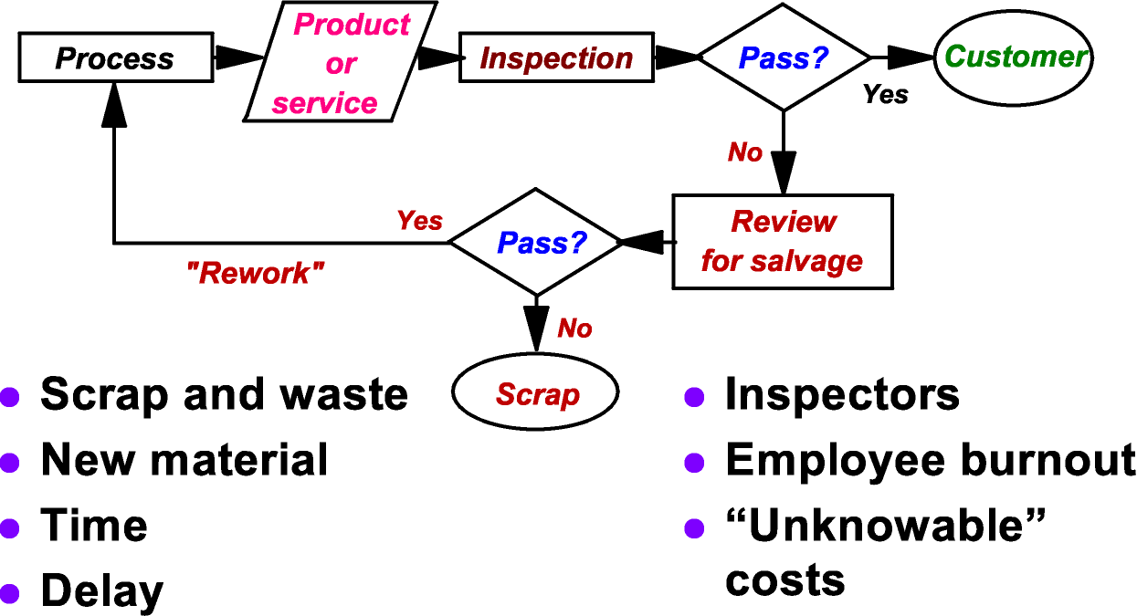
Costs of Inspection

Slide 15
Quality through Process Improvement
A continual effort to learn about the cause system
Process improvement is not problem solving

Slide 16
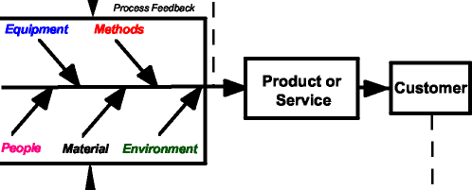
Investments in Process Improvement
Education and training
Improving processes and systems
Measurement and analysis
Investment in innovation

Slide 17
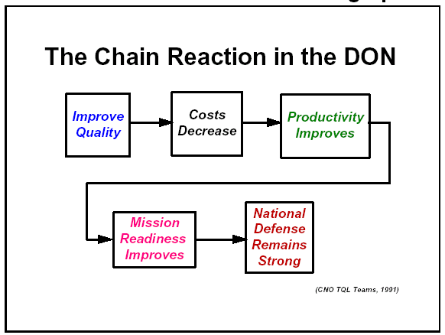
The Chain Reaction in the Process
Process

Slide 18
Why Focus on Quality?
The we need to maintain mission readiness
There is a new direction for RPM
The aim should be add value
We needs to continue to improve its competitiveness in the world marketplace

Slide 19
Benefits of Focusing on Quality
Improves operational readiness for our family and business
Improves organizational efficiency and effectiveness
Eliminates waste, reduces costs, and increases productivity
Enables everyone to make meaningful contributions to their work

Slide 20
RewmoAI Process Management
The application of quantitative methods and the knowledge
of people to assess and improve:
Materials and services supplied to the organization
All significant processes within the organization and
Meeting the needs of the end-user, now and in the future

Slide 21
RewmoAI Process Management Model
Rewmo AI Model

