Slide 1
SEPNT
-
INTRODUCTION
-
PART 1

Slide 2
Coverage
Table of Content
Process
Notation
Tool
Framework
Model
Meta-Model
Context
Artifact
Abstraction
Process Model
ETVX Model
SEPNT Introduction

Slide 3
Process
Concept
  A unit of work that takes input(s), performs task(s) and gives output
SEPNT Introduction

Slide 4
Process
Theory
  Examples
  Paying
  Receiving
  Loan Processing
  Depositing
  Withdrawing
  Drilling
  Piping
  Measuring
  Controlling
  Ticketing
  Costing
SEPNT Introduction

Slide 5
Process
To-Do
  Identify a few processes
SEPNT Introduction

Slide 6
Notation
Concept
  A system of figures or symbols used in a specialized field to represent some meaning.
SEPNT Introduction

Slide 7
Notation
Theory
  Examples
  Speaking
    English, Latin, French etc
  Software Engineering
    Booch, UML
SEPNT Introduction

Slide 8
Notation
To-Do
  Identify a few notation(s)
SEPNT Introduction

Slide 9
Tool
Concept
  The mechanised or automated support to assist in execution of any process or task thereof.
SEPNT Introduction

Slide 10
Tool
Theory
  Examples
  Writing
    Pen, Pencil
  Software Engineering
    IDE, Visual Designer
    Sparx Enterprise Architect
    IBM Rational Software Architect
    Eclipse
SEPNT Introduction

Slide 11
Tool
To-Do
  Identify a few software tools to engineer and/or deploy the systems
SEPNT Introduction

Slide 12
Framework
Concept
  A skeletal structure designed to enclose a concept, logic or physical thing.
SEPNT Introduction

Slide 13
Framework
Theory
  Few Examples
  Computers
    Software
      AJAX
      Spring
    Architecture
  Government
    Legal
    Development
  Education
    National Curriculum
SEPNT Introduction

Slide 14
Framework
To-Do
  Identify a few software framework(s) to engineer and/or deploy systems.
SEPNT Introduction

Slide 15
Model
Concept
  Simplification of Reality
SEPNT Introduction

Slide 16
Model
Theory
  Helps to understand the working of a system before building it
  Enables us to specify the structure or behavior of a system
  Gives a template that guides us in constructing a system
  Documents the decisions we have made
  Right & left side of the human brain
  Improves communication between team members
  Manage complexity
SEPNT Introduction

Slide 17
Model
Theory
  Types
  Graphical
    Drawn in the form of diagrams with symbols and accompanying text, to illustrate a meaning.
    Improves communication in the design Team, as the design is formed and reviewed, allowing the reader to reason about the design, and it provides an unambiguous basis for implementation.
  Text
    Written in a specific language
SEPNT Introduction

Slide 18
Model
Theory
  Examples
  Domain View
    Mathematics
      3D
      Statistical
    Computer Science
      Design
      Analysis
  Types
    Static
    Dynamic
SEPNT Introduction

Slide 19
Model
To-Do
  Identify a few business / software model(s)
SEPNT Introduction

Slide 20
Meta-Model
Concept
  A Model that describes a Model
SEPNT Introduction

Slide 21
Meta-Model
Theory
  Examples
  Meta-Data (Data Meta-Model)
  Meta-Process (Process Meta-Model)
SEPNT Introduction

Slide 22
Meta-Model
To-Do
  Identify a few Meta-model(s)
SEPNT Introduction

Slide 23
Context
Concept
  A perspective consisting of structure and/or behavior, with reference to which a subject is considered for study or application.
SEPNT Introduction

Slide 24
Context
Theory
  Provides a well defined meaning to a subject
  Provides relevance to a subject
SEPNT Introduction

Slide 25
Context
Theory
  Examples
  A Doctor views a human being from the perspective of treating a body with Organs & Systems.
  A Sports Trainer views a human Being from the perspective of skills
SEPNT Introduction

Slide 26
Context
To-Do
  Define context during your understanding and analysis of myABC
SEPNT Introduction

Slide 27
Artifact
Concept
  Entities of data, information and instructions which are produced and/or consumed by lifecycle activities or tasks in a process.
SEPNT Introduction

Slide 28
Artifact
Theory
  Final or intermediate work Products
  Used to capture or convey some Information
SEPNT Introduction

Slide 29
Artifact
Theory
  Examples
  Use Case Model
  Design Model
  Vision Document
  Business Plan
  Change Request
  Code
SEPNT Introduction

Slide 30
Artifact
To-Do
  Identify a few Artifacts
SEPNT Introduction

Slide 31
Abstraction
Concept
  Dealing With Essentials
SEPNT Introduction

Slide 32
Abstraction
Theory
  A number of views of a Subject
  Each view has Information that is unique to that view
  Each view has Information that appears in other views
  The Information that is common between views is consistent
  Looking only at the Information that is relevant at the time
  Hiding details so as not to confuse the bigger picture
  Process of taking away or removing characteristics from something to reduce it to some set of essential characteristics.
SEPNT Introduction

Slide 33
Abstraction
Theory
  Examples
  Out of the universe of all Human Features & Functions, a Coach is interested only in relevant ones such as Skills, Strength, Flexibility, Willingness To Learn etc.
SEPNT Introduction

Slide 34
Abstraction
To-Do
  Identify a few Abstraction (s) in your understanding of myABC
SEPNT Introduction

Slide 35
Process Model
Concept
  Representation Of A Process
SEPNT Introduction

Slide 36
Process Model
Theory
  Is a visual depiction of the flow of work and tasks for specific goals
SEPNT Introduction

Slide 37
Process Model
Theory
  Examples
  Design Process
  Customer Service Process
  Marketing Process
  Billing Process
  Shipment Process
SEPNT Introduction

Slide 38
Process Model
To-Do
  Identify Process Model s
SEPNT Introduction

Slide 39
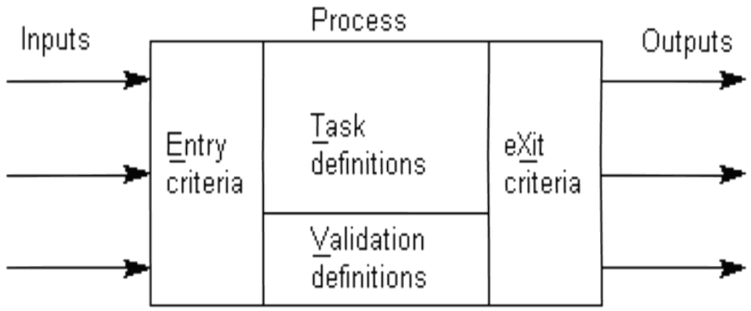
ETVX Model
Concept
  Introduced by IBM in 80's to document their processes
SEPNT Introduction

Slide 40
ETVX Model
Theory
  For any Process
  Entry Criteria (Pre-Condition)
  Task(s)
  Validation Rule
  Exit Criteria (Post-Condition)
SEPNT Introduction

Slide 41
ETVX Model
Theory
Examples
  Sale Process
    E
        Customer has identified product to buy
        Product is available
    T
        Customer gives Sale Order to Sales executive
        Sales Executive Sends Order To Stores
        Stores Issues Item(s)
        Executive Hands Over Item(s) To Customer
    V
        Item(s) should have been inspected to be working
    E
        Item(s) have been approved for delivery
SEPNT Introduction

Slide 42
ETVX Model
To-Do
Create a few ETVX elements for any process
SEPNT Introduction

Slide 43
SEPNT
-
INTRODUCTION
-
PART 1
-
END

