Slide 1
DOCTOR APPOINTMENT SYSTEM

Slide 2

The Console-Based Online Doctor Appointment System is a simple Java application designed to facilitate the process of booking appointments with doctors. This system enables patients to view available doctors, select a preferred doctor, and book an appointment for a specific date and time.

Slide 3
01
USER INTERFACE
The console interface provides a simple menu-driven design for intuitive user interaction.
System
Design
02
DATABASE
The MySQL database schema includes tables for doctors, patients, and appointments.

Slide 4
FEW CODE AND OUTPUT SNIPPETS

Slide 5
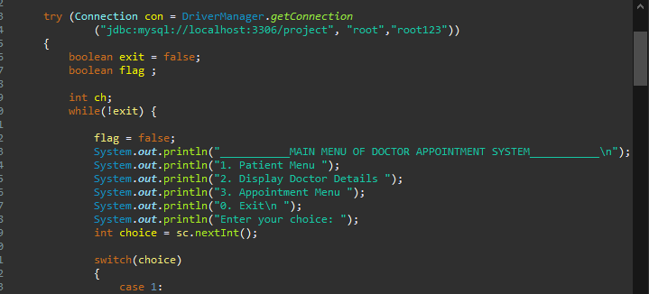
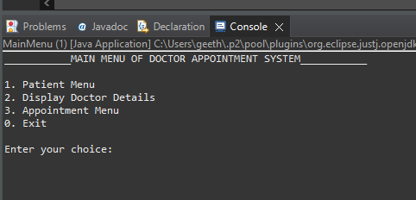

Slide 6
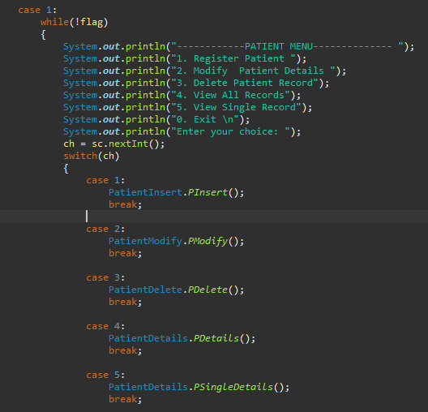
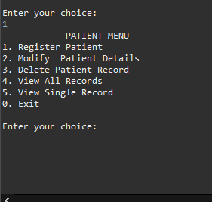

Slide 7
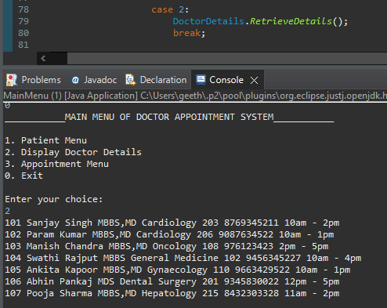

Slide 8
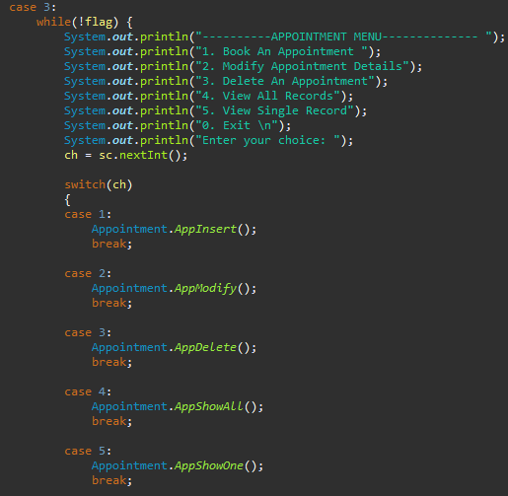
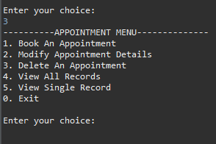

Slide 9
DEMO
DEMO

Slide 10
THANK YOU

