Slide 1
NASA Section 889 SAM Tool
October 17, 2022

Slide 2
NASA Section 889 SAM Tool
Requirements and Motivation
NASA SAM Tool Review
NASA SAM Tool Demo
Comparison with other available tools
How the NASA SAM Tool Works

Slide 3
Requirements & Motivation
Requirement: Generate record showing 889 compliance for vendor
Motivation:
Reduce overhead costs to meet the requirement
Multiple manual checks on Sam.gov for every single order (Time = Money)
Low-cost tool development
Increase Compliance
Humans are inconsistent and each requires training
Tools produce rapid, reliable, and reproducible results
Target User-Base: Users requesting a credit card purchase (However, access isn’t limited to a specific group of users)

Slide 4
NASA 889 SAM Tool Review
Users search vendors to check for Section 889 Compliance in a vendor’s SAM record
Users can download the vendor’s compliance record as a PDF if:
889 Compliant: “DOES NOT” selected for both part (1) and (2) of FAR 52.204-26(c) (OCT 2020)
No Active Exclusions
Registration status is “Active”

Slide 5
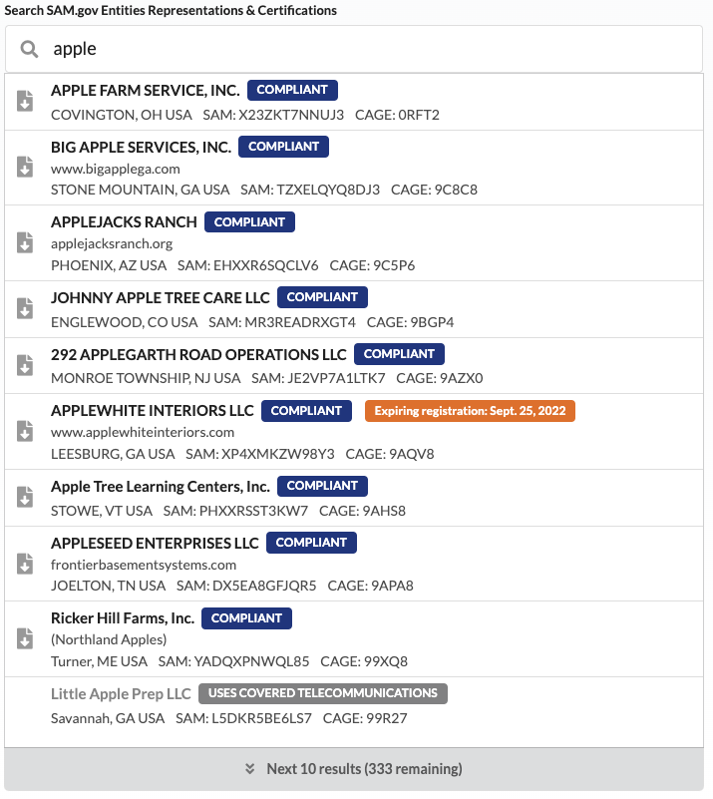
NASA 889 SAM Tool Review
Search by Vendor’s Name, Website, SAM UEI, or CAGE Code
Search by vendor name, website, SAM UEI, or CAGE code
Click a compliant vendor to download a summary report
Warning if a vendor’s sam.gov registration is expiring soon
Providing the “doing business as” name and website make selecting the correct vendor easier
Summary of why they are marked as non-compliant
Provides covered telecommunications
Uses covered telecommunications
Provides and uses covered telecommunications
Outdated FAR (no part (C)(2))
No reps and certs
Has exclusions
Non-compliant vendors are not clickable.

Slide 6
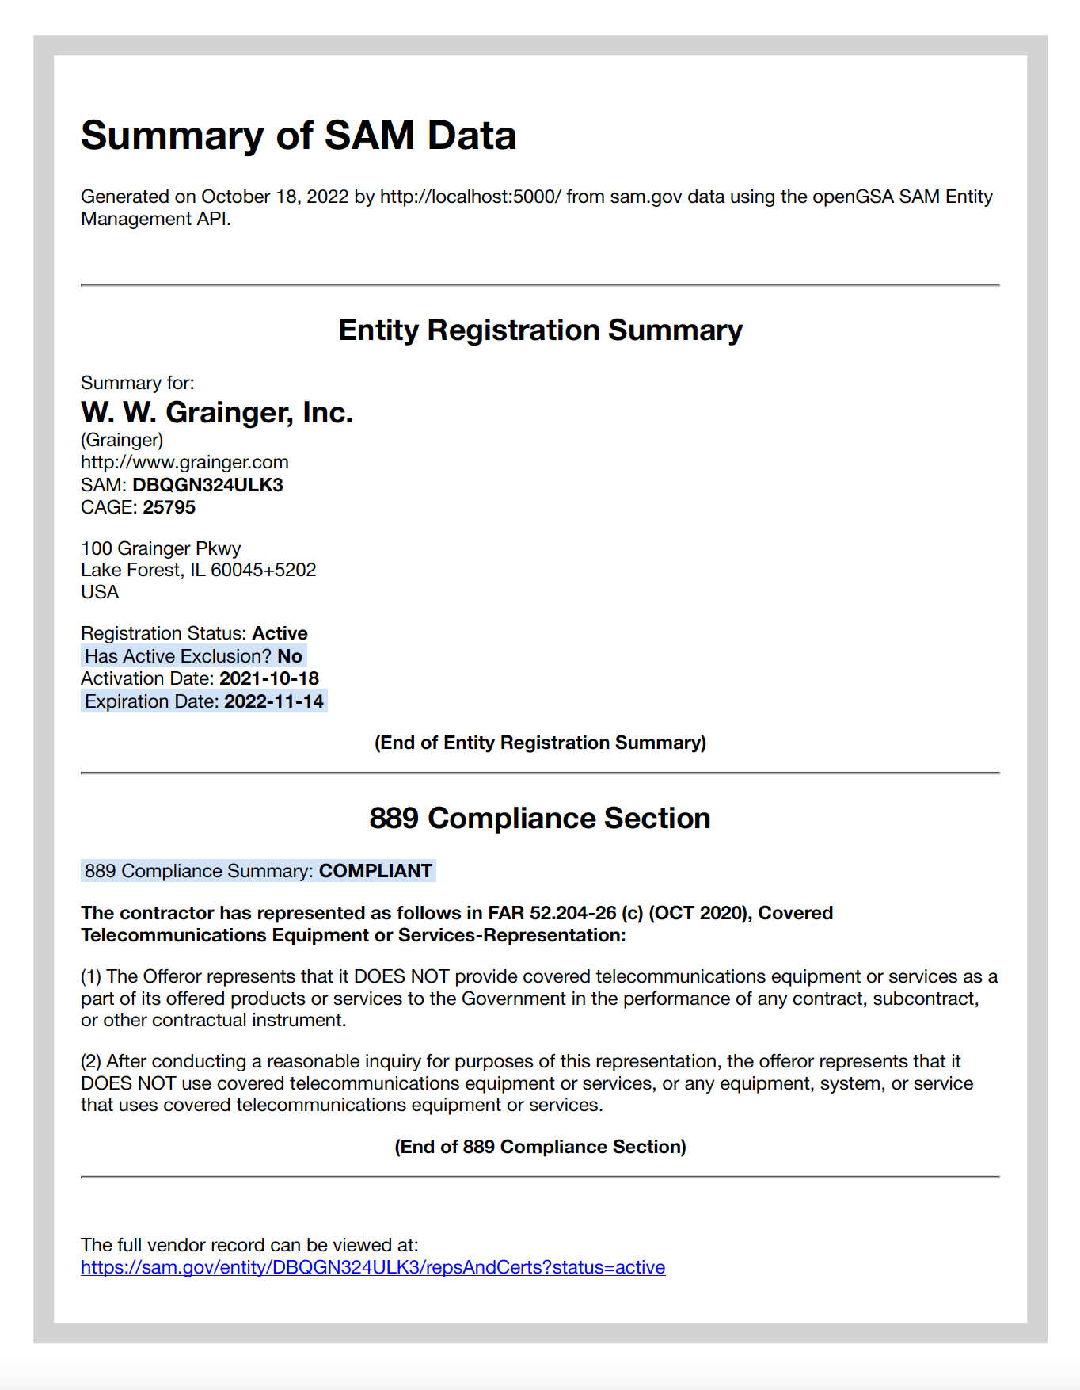
NASA 889 SAM Tool Review
View of a Downloaded Vendor’s Compliance Record
Date the summary was generated
Entity registration information
Exclusions and SAM record expiration date
Flags as compliant if a vendor has selected “Does not” for FAR 52.204-26(c) (1) and (2)
Entity representation for FAR 52.204.26(c)

Slide 7

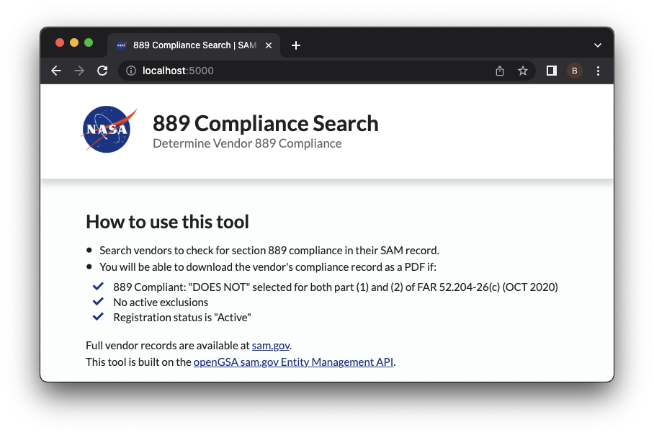
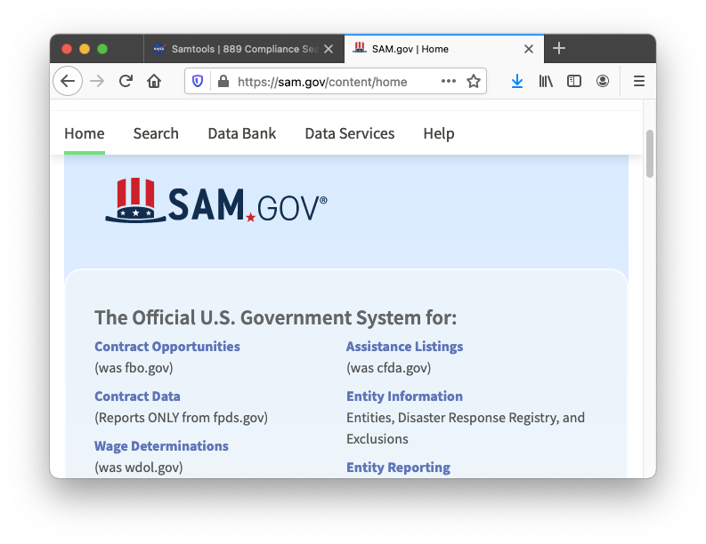


Comparison with other available tools
SAM DATA
SAM Entities API
SAM website interface
NASA 889 SAM Tool
Search for vendors
Select compliant vendor to generate record of 889 compliance
Sam.gov
Log in to sam.gov
Find entities-search feature
Search for vendors
Select vendor of unknown compliance
Find 889 Reps&Certs section
Manually compare section to NASA rules
If compliant, download 50-page record of all reps and certs
!
50-page PDF
1-page PDF

Slide 8
Comparison with other available tools
Features | NASA 889 SAM Tool | Sam.gov
Vendor search capability | ✓ | ✓
Provides vendor FAR 52.204-26 certifications | ✓ | ✓
Identifies the section needed for 889 | ✓ | ✗
Flags if vendor is compliant | ✓ | ✗
Timestamp the record was generated | ✓ | ✗
Can be used by non-procurement experts | ✓ | ✗
Generates record of 889 compliance | ✓ | ✗

Slide 9
How the NASA 889 SAM Tool Works
Utilizes the OpenGSA Entities Management API to access SAM records directly
Software is NASA-developed and uses open-source libraries
Does not license proprietary technology
Can be deployed on typical web servers
Low operating cost cloud (e.g., Amazon Cloud, Google Cloud) or internal servers
Occasional updates required as changes are made to SAM
E.g., removal of references to DUNS codes after April 3rd, 2022

Slide 10
Collecting Usage Metrics
Usage logs can be processed to produce valuable information.
Usage of the tool
Total number of searches
Total number of PDF downloads
Business intelligence data
Top search terms
Top downloaded entities
Difference between top searches and downloads can identify entities that may benefit from SAM registration.
Etc.

