Slide 1
Measuring Accessibility: Implementing & Leveraging Section 508 Key Performance Indicators (KPI)
IT Accessibility Community Meeting
GSA Government-wide IT Accessibility Team | 15 APR 2025

Slide 2
Introduction & Objectives
Overview of Strategic Plans
Elements of a Strategic Plan
Understanding Key Performance Indicators (KPI)
Understanding IT Accessibility KPIs
Implementing IT Accessibility KPIs in Your Organization

Slide 3

Strategic Plans Across the Enterprise, in General
Convey mission, vision, and organizational direction due to:
Part of regular update (generally every 3 to 5 years)
React to issues in your environment or organization
New leadership or significant change in mission, organization and organizational direction
First time creating an official strategic plan (or first time in a long time)
Lay out primary activities that the organization will execute
Define roles and responsibilities for the primary activities of the organization
Improve performance, productivity, efficiency, etc. through definition of the things that matter for the organization

Slide 4

Overview of Accessibility-Related Strategic Plans [1/2]
Reasons to create one:
Achieve Compliance & Accountability – Ensure adherence to Section 508 requirements and assign clear responsibilities for accessibility efforts.
Integrate Accessibility into Operations – Embed accessibility into procurement, development, and governance processes for long-term sustainability.
Measure & Improve Performance – Establish KPIs to track progress, identify gaps, and drive continuous improvement.
Enhance User Experience – Make digital content and technology accessible to all users, including people with disabilities.

Slide 5

Overview of Accessibility-Related Strategic Plans [2/2]
Agencywide vs. Accessibility Specific
Agencywide approach: Embeds accessibility into all operations, making it a shared responsibility across teams, ensuring long-term sustainability and compliance.
Accessibility specific approach: Establishes a dedicated team to drive compliance, provide expertise, and address accessibility challenges efficiently.
Timelines
Establish clear milestones and deadlines to track progress, ensure accountability, and drive continuous accessibility improvements.
Updated Thinking/Process
Shift from a compliance-only mindset to a proactive, user-centered approach, integrating accessibility into all stages of planning, development, and operations.
Notes:
<a href="https://www.flaticon.com/free-icons/strategic-plan" title="strategic plan icons">Strategic plan icons created by Satawat Anukul - Flaticon</a>

Slide 6

Elements of a Strategic Plan
Goals/Priorities
Align organizational resources with long-term vision by setting clear objectives, prioritizing high-impact initiatives, and ensuring cross-functional coordination.
Drive sustainable growth and innovation through data-driven decision-making, investment in capabilities, and continuous evaluation of performance metrics.
Objectives
Identify organizational accessibility goals
Ensure KPIs are SMART (Specific, Measurable, Achievable, Relevant, Time-bound)
Collaborate with key stakeholders to align expectations
Initiatives
Implement targeted actions and programs that drive progress toward strategic goals, ensuring measurable impact and continuous improvement.
KPIs
Define measurable indicators to track accessibility progress, assess compliance, and drive continuous improvement within the strategic plan.

Slide 7
Conceptual Hierarchical Flow of a Strategic Plan
Goal 1
Objective 1.1
Objective 1.2
Initiative 1.1.1
Initiative 1.1.2
Initiative 1.2.1
Initiative 1.2.2
KPI 1.1.1
KPI 1.1.2
KPI 1.2.1
KPI 1.2.2

Slide 8
Notional Example of a Strategic Plan Goal
1. Effectively Manage Solicitations For All Offices
1.1 By Q4, FY26 Develop A Fully Accessible Pre-Solicitation Process
1.2 By Q1 FY27, Truncate the Timeline to Solicitation Award by 5%
1.1.1 Update All Market Research Documents to Include Accessibility
1.1.2 Update the Review Process To Include Accessibility As A Primary Success Criterion
1.2.1: Review Contract Management System for Efficiencies
1.2.2: Review, Update and Implement Acquisition Training
KPI 1.1.1: Create Base Language and Include in All New Market Research by Q4 FY25
KPI 1.1.2: Update Relevant Acquisition Policies with Base Language by Q4 FY25
KPI 1.2.1: Review and Streamline or Replace 25% of System Modules by Q3 FY27
KPI 1.2.2: Update or Replace 25% of Acquisition Courses by Q2 FY26

Slide 9

Understanding Key Performance Indicators (KPI)
What is it? – A Key Performance Indicator (KPI) is a measurable value that tracks progress toward a specific goal, and generally aligns with a specific initiative or set of initiatives.
How to create them? – Define clear objectives, choose relevant metrics, set targets, and ensure data availability for tracking.
How are they aligned? – KPIs should align with strategic objectives, ensuring they support broader business goals and initiatives.
Why use KPIs? – Track progress; identify areas of improvement or areas that are doing well; prioritize investment; realize efficiencies

Slide 10

Understanding IT Accessibility KPIs
Where did the accessibility KPIs come from?
In support of technical assistance efforts of the Gov-wide IT Accessibility team
Aligns to recommendations from the Governmentwide Section 508 Assessment
Provide methods and the need for tracking progress across organization
Official guidance such as OMB Circular A-123
Defined from criteria and dimensions from the Governmentwide Section 508 Assessment
What are the categories of Accessibility KPIs?: Three broad categories
Procurement KPIs: Ensuring accessibility in acquisition processes
Testing & Remediation KPIs: Tracking compliance and improvements in digital content
Organizational Commitment KPIs: Measuring training, policies, and leadership engagement
Where to find accessibility KPIs on Section508.gov
Home » Policy & Management » Organizational IT Accessibility Key Performance Indicators (KPI) or section508.gov/kpi/

Slide 11
Example of an IT Accessibility KPI
KPI ID | KPI Short Name | Draft Generic KPI | Draft KPI | Primary Aligned Dimension
1 | Dedicated Section 508 PM Time | In FYXX, the organization's Section 508 program manager spends at least XX hours a pay period doing strictly ICT accessibility work. [i.e. 1/2 time or 0.5 FTE.] | In FY26, the organization's Section 508 program manager spends at least 40 hours a pay period doing strictly ICT accessibility work. [i.e. 1/2 time or 0.5 FTE.] | General Information

Slide 12
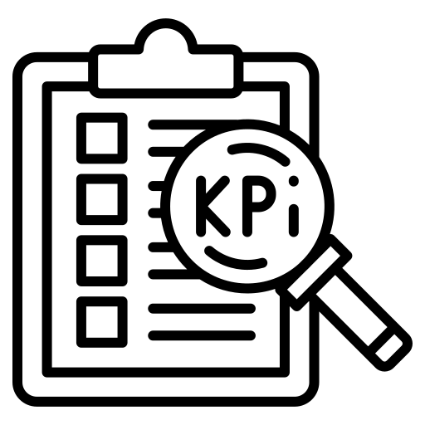
Implementing IT Accessibility KPIs in Your Org [1/2]
How should you employ A11y KPIs, and how many should you employ?
Alignment to agency strategic plan/agency mission
Alignment to leadership performance plans
Fits context of assessment and your Section 508 team goals (fills known gap areas)
Should not over do it with KPIs. Pick a few (3-5) and track them at first
Goal is not to measure everything, just metrics that align to your highest priorities within the organization

Slide 13
Implementing IT Accessibility KPIs in Your Org [2/2]
Alignment and tracking
Which team is responsible for providing tracking, and at what frequency?
Tools and methods for tracking KPIs (e.g., automated testing, audits, user feedback)
Creating accessibility reports for leadership
Establishing accountability measures
When to close a KPI
When metric has been met
When metric is well under way, is stable and there other other significant areas to address
Change in priorities indicate a need for shifting tracking
Initiative KPI is complete, even though full metric may not have been met (i.e. only a percentage of the KPI is achieved, but determined to be a “win” for the organization)
Evaluate its impact, adjust strategies if needed, and establish new KPIs for continuous improvement

Slide 14
Contacts Us
Government-wide IT Accessibility Program
General Services Administration
Section.508@gsa.gov
Credits: Icons from flaticon.com

Slide 15
Questions?

Slide 16
GSA Office of Government-wide Policy, Office of Technology Policy

