Slide 1

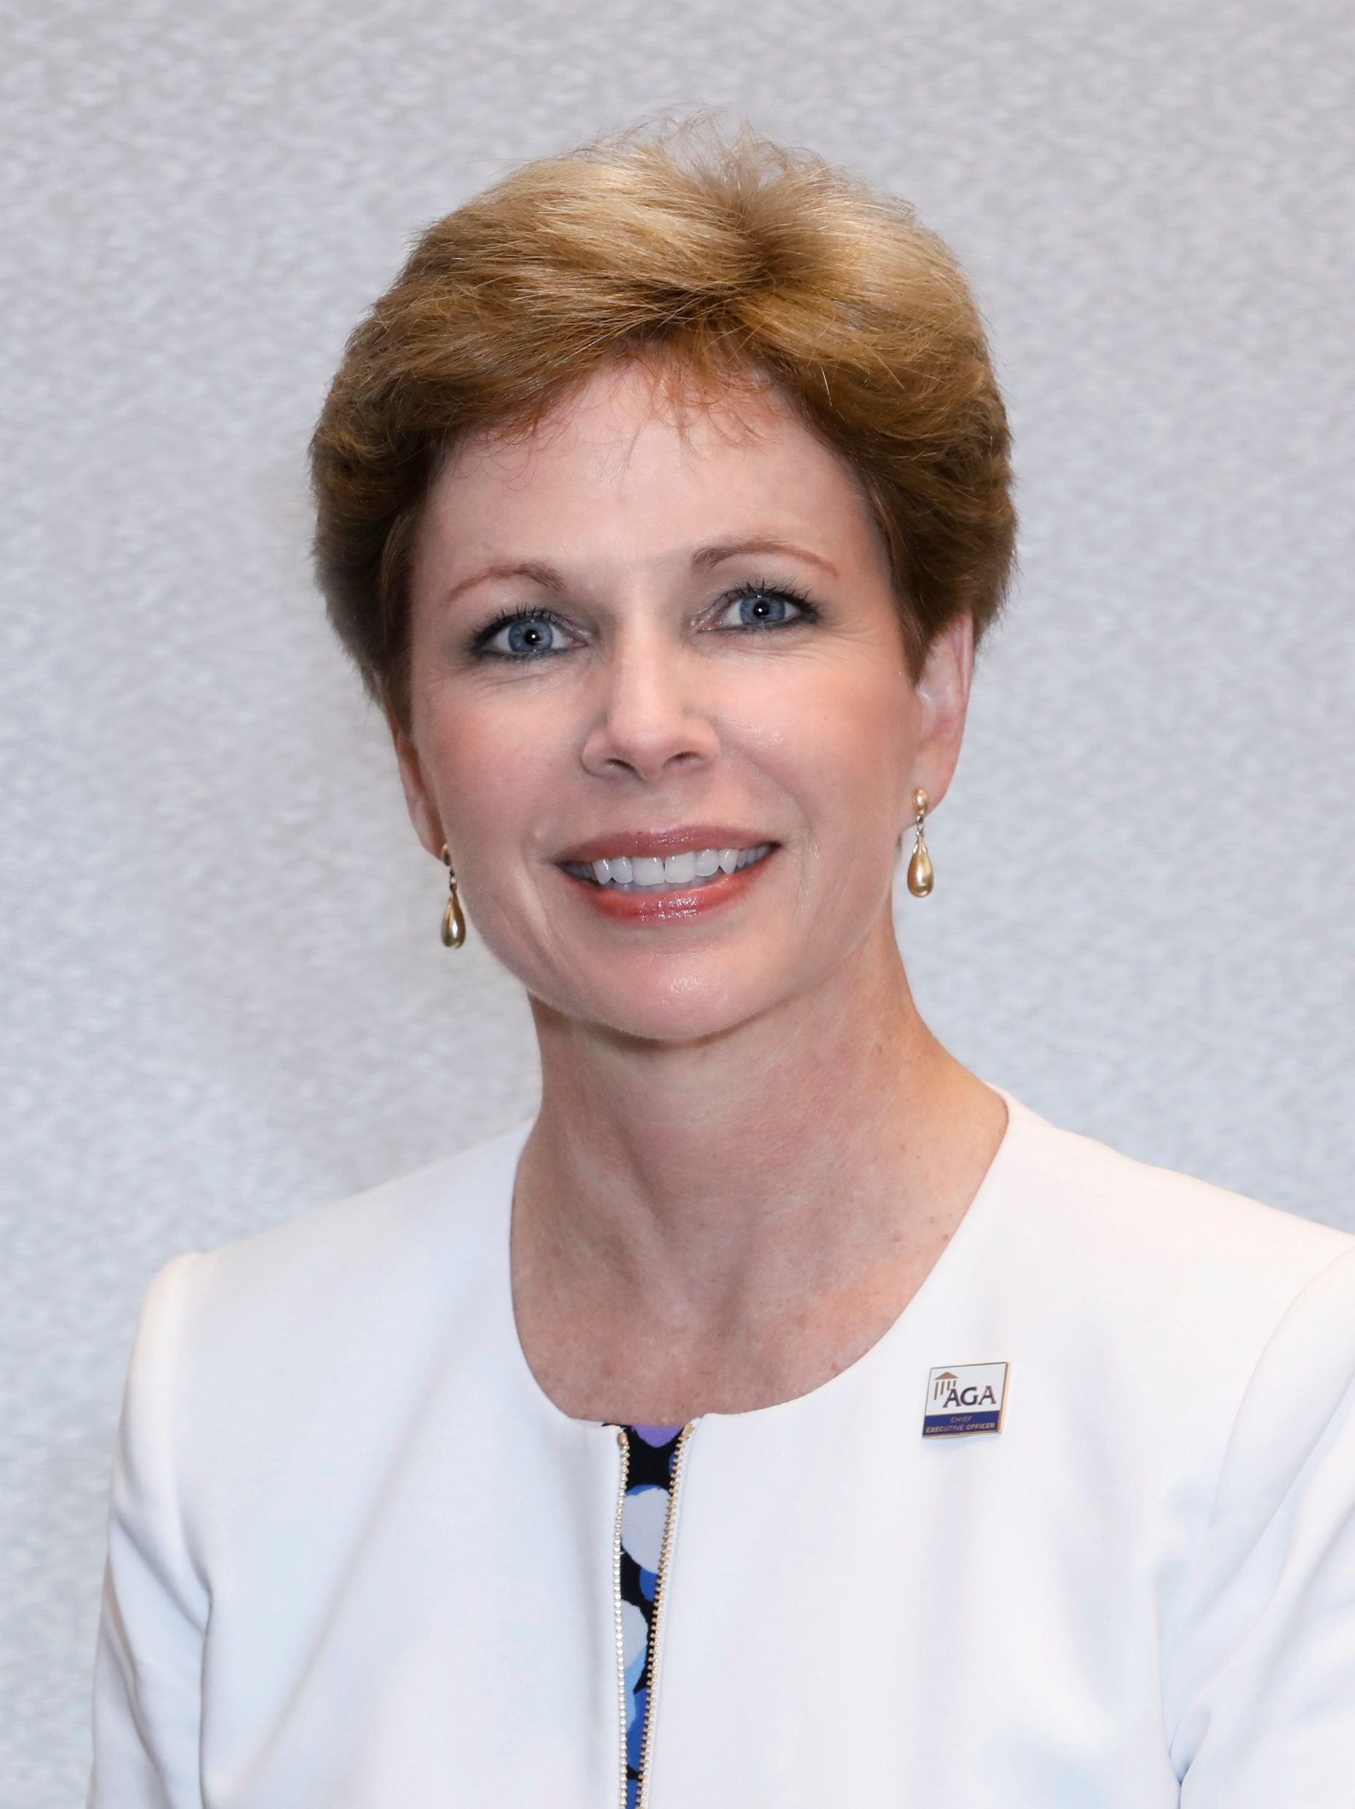

AGA is a non-profit association made up of financial professionals at all levels of government. Our mission is to support those who support government financial management through education, research, networking and certification. While membership is encouraged, it is not required to participate in our training and events.
Training Delivery Options:
In-person training events in Washington, D.C., with a hybrid component for a national audience
Monthly live, virtual courses and/or webinars
Group training, on-site or virtually
Self-paced courses for individuals
Certification
AGA is the creator of the Certified Government Financial Manager® (CGFM®) credential—the only professional certification 100% focused on government financial management at the federal, state and local levels. Financial professionals can increase their knowledge and professional confidence in governmental accounting, auditing, internal controls, performance measurement, financial reporting and budgeting by earning this credential.
AGA is the only authorized organization to offer CGFM preparation training.
Why AGA? AGA members are people like YOU, dedicated to serving the public. AGA staff is committed to providing you with timely information and the resources you need to excel in the execution of your duties.
A Word from the CEO
Ann Ebberts, MS, PMP
Whether an employee of the federal workforce wants an in-person, multi-day training; self-paced course; onsite group training; or just study materials, AGA can confidently say, “We’ve got that!” We are small enough to be agile and responsive to this community, while big enough to deliver training to an unlimited number of federal workforce members.

Slide 2
National Events
Each year, AGA offers numerous seamless, in-person events in Washington, D.C., accommodating hundreds of attendees. For our members and federal workers living outside of the D.C. metro area, we offer our largest training event at various locations around the country. Those who are unable to travel or who prefer the convenience of training at their home or office, can attend AGA events virtually.
Professional Development Training (PDT)
National Leadership Training (NLT)
Internal Controls and Fraud Prevention Training
Technology and Transformation Summit
CGFM Preparation Options
Live, virtual courses for individuals
Self-paced (on-demand) courses for individuals
Group training for your staff on-site or virtually (up to 30 people)
Online and printed study guides
Online practice exams
Our Instructors
AGA course instructors are respected existing and retired government financial professionals with extensive experience working for and with the federal government, and stay current in the field.
Federal Financial Management Courses Library
Created and taught by a former FASAB chairperson, these 1.5- to 2-hour self-paced courses will get new federal hires up to speed quickly or serve as a refresher for seasoned employees.
Payment Options
Depending on the event or course selected, AGA accepts:
SF-182/POs
Government credit cards
Personal credit cards
Online Course Catalog
Filled with courses to help your team reach its educational goals, AGA’s group-training catalog covers the relevant topics needed by today’s government financial professionals.
Monthly Webinars
Live, virtual sessions featuring experts speaking on emergent issues, designed to keep the federal workforce current in governmental auditing, ethics, governmental accounting, internal controls, performance and more – individuals or groups can purchase webinars.

