Slide 1
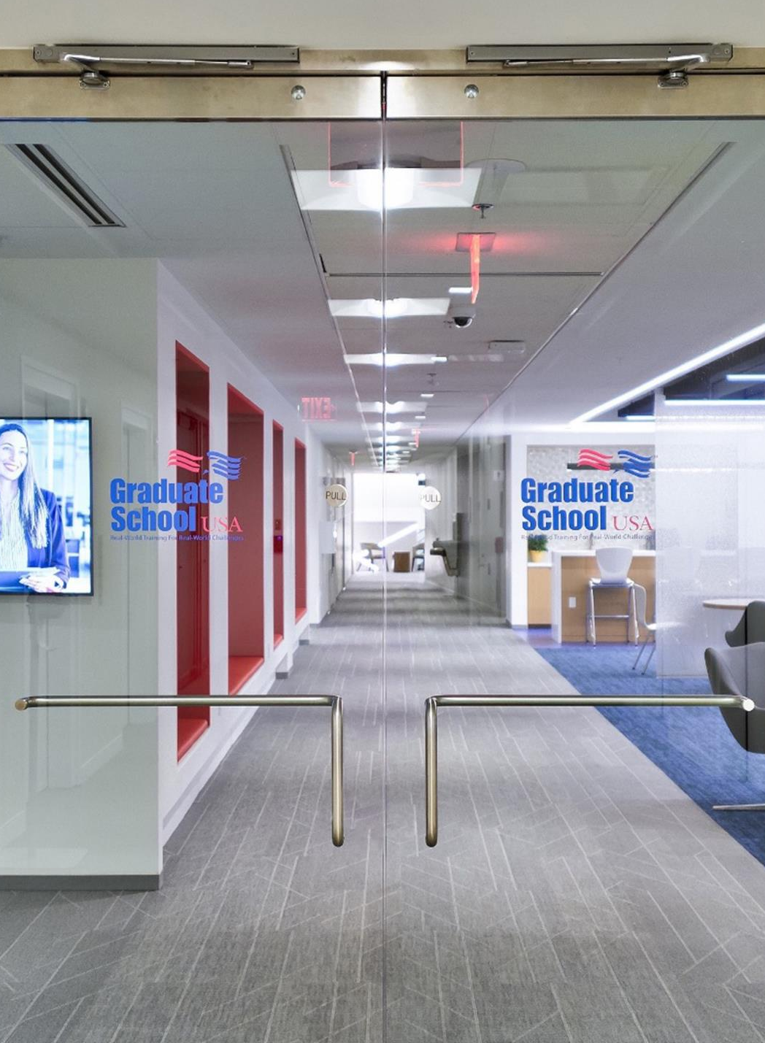

Why Graduate School USA?
With over 100 years of experience, Graduate School USA (GSUSA) is an experienced training and professional development provider for federal government employees. We design our comprehensive range of courses to meet the evolving needs of government professionals, elevating individual careers and overall public sector effectiveness.
As a top Financial Management (FM) training provider, to date, the Department of Defense (DoD) mapped over 200 GSUSA courses to their Financial Management Certification Program competencies, all found in the Career Planning & Training Tool.
Expertise and Recognition
GSUSA diligently reviews and updates curricula based on participant feedback, new regulations, and policy directions, resulting in relevant and actionable content.
Comprehensive Curriculum
GSUSA employs a blend of traditional and modern teaching methods, including case studies, real-world scenarios, and project-based learning, enhancing participant engagement and knowledge retention.
Innovative Learning Approaches
Graduate School USA
600 Maryland Ave SW, Washington, DC 20024
(202) 314-3300
www.graduateschool.edu
info@graduateschool.edu
1

Slide 2
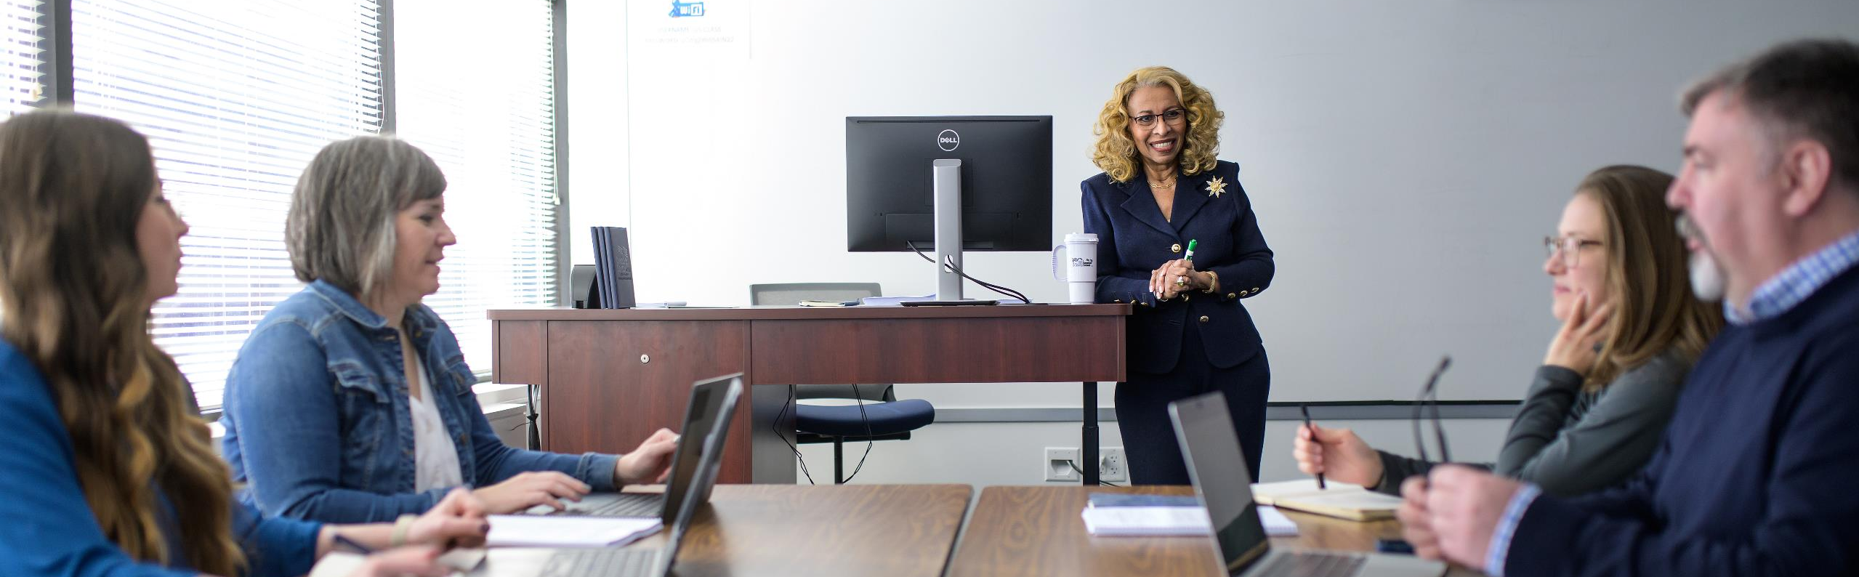
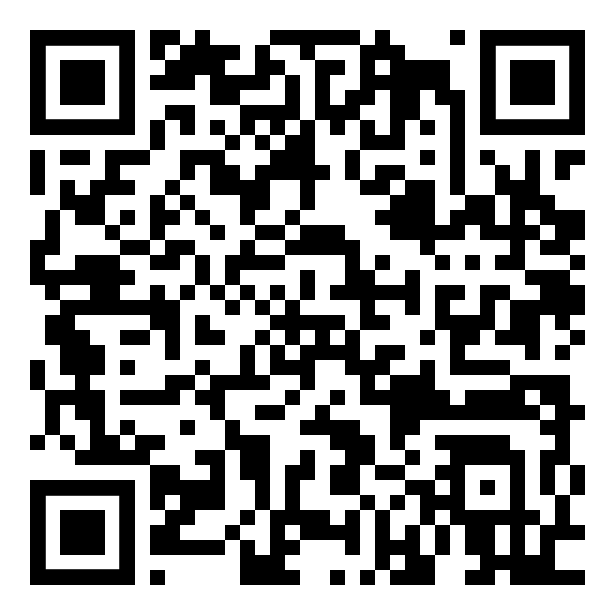
Client Experience
Specialized Curriculum Services
In-House Training Facilities
Learning Modalities
Boasts a recently renovated training campus located just off the National Mall
25 classrooms and seminar spaces with state-of-the-art technology
Well-appointed lounge areas with kitchens to reenergize during break periods
In-Person Instruction
Virtual Instructor-Led Sessions
Self-Paced Learning with Instructor Support
We can create training tailored to the specific needs of an agency or organization
Our curriculum configurations allow us to pull and combine content for quick and cost-effective customization
Scan QR code To Learn More

