Slide 1

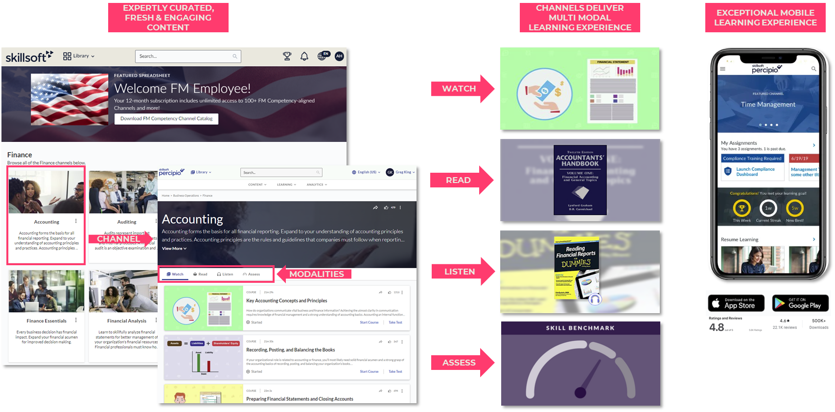


BUILDING A FUTURE-READY FEDERAL WORKFORCE
Skillsoft’s offering through the Career Planning and Training Tool (CPTT) is an all-inclusive, specialized bundle of expertly curated Percipio Channels deeply aligned to the 55 FM Competencies and associated Performance Levels.
LEARN MORE AT https://www.skillsoft.com/federal-government
WHAT’S INCLUDED? | Your annual subscription provides 12-months unlimited access to 100+ competency-aligned channels, providing an easy and economical way to support your career development while maximizing your budget spend.
WHAT’S IN A CHANNEL? | Channels offer topic-organized learning assets across a variety of modalities, including self-paced courses, videos, digital books, audiobooks, and skill assessments. Technology-focused channels also feature hands-on interactive courses and labs that let you practice.
WHAT’S THE COST? | $369.00 for 12-months unlimited access to all 100+ FM competency aligned channels and more.
HOW DO I GET STARTED? | STEP 1: Go to CPTT, filter and select Skillsoft to view a Percipio channel description page STEP 2: On the description page, click Get Started STEP 3: Setup your account and pay by PCard. You’ll receive a welcome email with instructions.
WHO DO I CONTACT? | We’re here to help and answer your questions. Contact us at feds140K@skillsoft.com
100+ FM COMPETENCY ALIGNED CHANNELS

