Slide 1
Federal Accountability and Information The Past, Present, and Future
JFMIP Financial Management Conference
May 9, 2016

Slide 2


Slide 3
Milestones
1789 – Congress establishes the Treasury Dept,
First Monthly Treasury Statement
1790 – Nation’s financial health report
1872 – Annual Report of Receipts and Outlays
1894 – Dockery Act
1895 – First Daily Treasury Statement
1933 – Centralize payment functions, create regional disbursing offices
1945 – Convert from paper to punch card checks
1950 – Budget Accounting and Procedures Act
1960 – Electronic check processing
1975 – Prototype Financial Report of the U.S. Government

Slide 4
Common Themes
Chief Financial Officers (CFO) Act of 1990
“The purposes of this Act are the following:
Bring more effective general and financial management practices to the federal government.
Provide in each agency systems of accounting, financial management, and internal controls to assure the issuance of financial information.
Provide for the production of complete, reliable, timely, and consistent financial information.”
Digital Accountability and Transparency Act (DATA ACT) of 2014
“…[Agencies shall disclose] direct Federal agency expenditures and [link] Federal contract, loan, and grant spending information to programs of Federal agencies to enable taxpayers and policy makers to track Federal spending more effectively.
Establish Government-wide data standards for financial data and provide consistent, reliable, and searchable Government-wide spending data that is displayed accurately for taxpayers and policymakers.
GPRA Modernization Act (GPRMA) of 2010
The head of each agency shall make available on a public website…an update on agency performance. Each update shall compare actual performance achieved with the performance goals established in the agency performance plan.

Slide 5
CFO ACT THRUSTS
Organization
Systems
Audited financial reporting

Slide 6
CFO ACT Implementation
Financial management organization
Financial management personnel
Financial accounting standards
Financial systems
Internal controls
Asset management
Communication with state and local government grantees
Audited financial reporting

Slide 7
An Agency CFO shall…
develop and maintain an integrated agency accounting and financial management system which provides for the systematic measurement of performance.
prepare and submit timely performance reports

Slide 8

CFO Opinion History
Unmodified:
Modified:
Disclaimer:
“Clean"- reasonably sure the financial statements are free of material errors. Financial statements are clean except in a specific area. Auditor's unable to obtain sufficient evidence or have enough time to form an opinion.

Slide 9
Auditor-Reported Weakness
Material weakness is a reportable condition in which the design or operation of one or more of the internal control components does not reduce to a relatively low level that the risk misstates, in amounts that would be material in relation to the consolidated financial statements being audited, may occur and not be detected within a timely period by employees in the normal course of performing their assigned functions.

Slide 10
FRUSG: Then & Now
Financial Report of the U.S. Government Selected Data | 1997 | 2015
Budget Deficit | 15 b | 439 b
Tax and Other Revenue | 1.6 t | 3.3 t
Net Operating Cost | 15 b | 520 b
Total Assets | 1.6 t | 3.3 t
Public Debt + Accd Int | 3.8 t | 13.2 t
Total Liabilities | 6.6 t | 21.5 t
Social Insurance Net Expenditures | 1.8 t* | 41.5 t
*Required Supplementary Stewardship Information
Unqualified/Unmodified Audit Opinion? | No | No

Slide 11
Sustainability Reporting
SFFAS 17 (2000)
Social Insurance
SFFAS 25 (2005)*
Reclassification of Stewardship Responsibilities
*SFFAS 28 deferred to 2006
SFFAS 26 (2009)
Presentation of Significant Assumptions
SFFAS 36 (2010)*
Long-Term Projections for the U.S. Government
*”Basic” deferral to FY 2015
SFFAS 37 (2011)
Additional Social Insurance Requirements

Slide 12
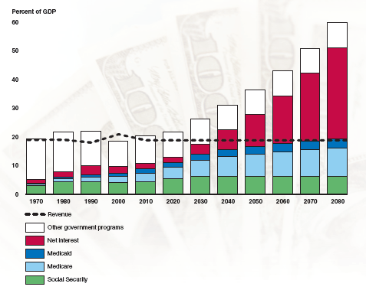
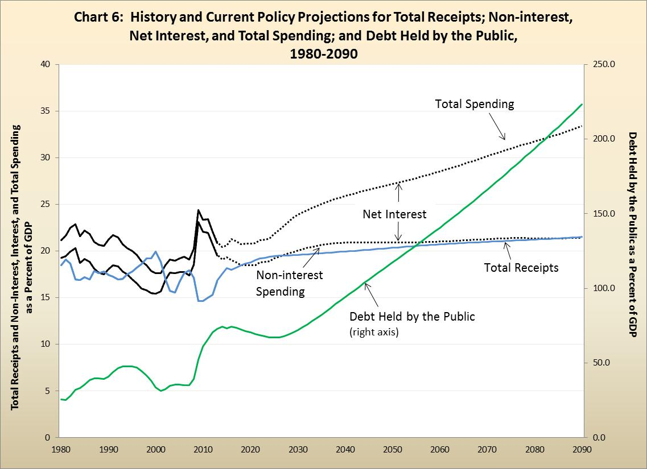
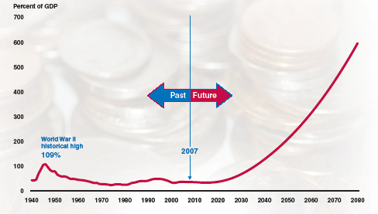
Long-Term Fiscal Projections
FY 2007
FY 2015

Slide 13
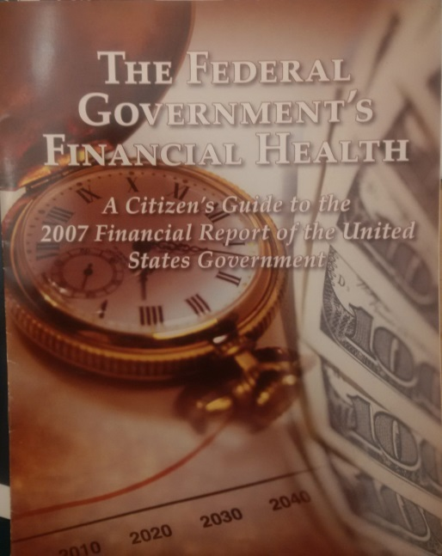
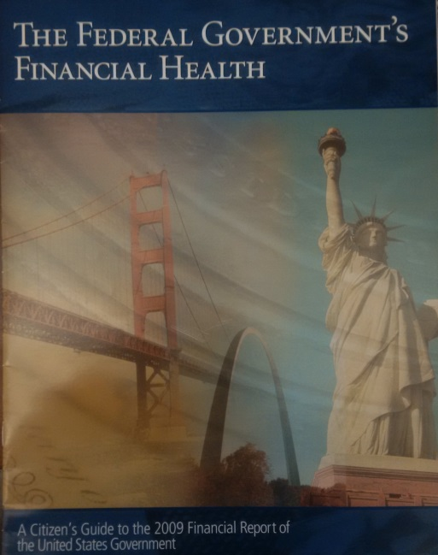
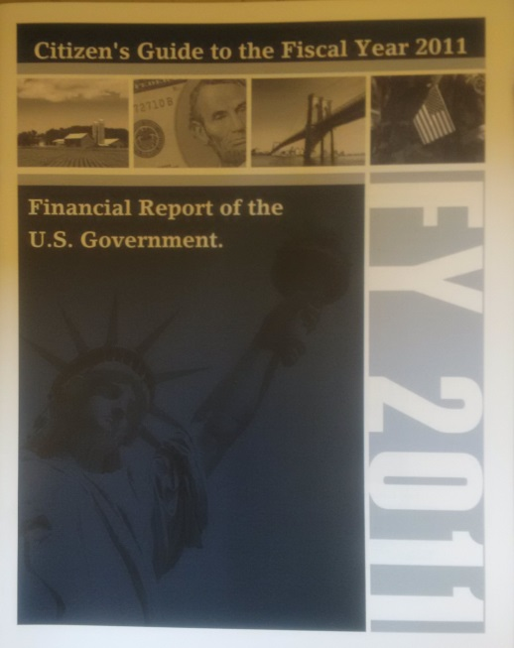
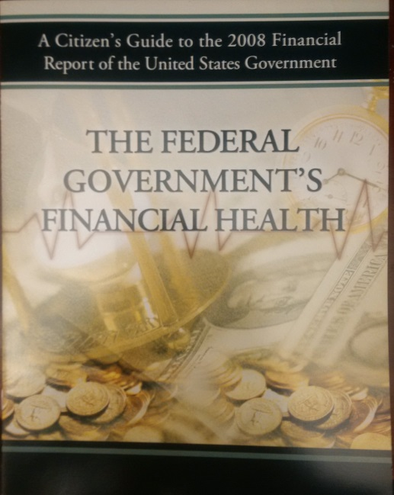
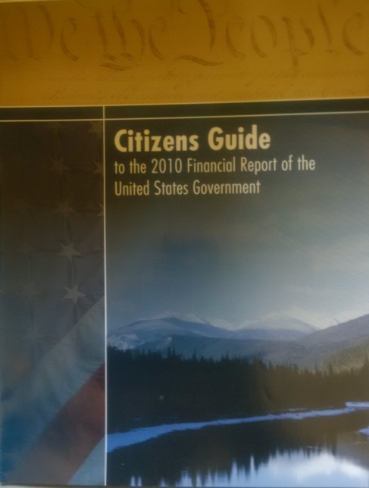
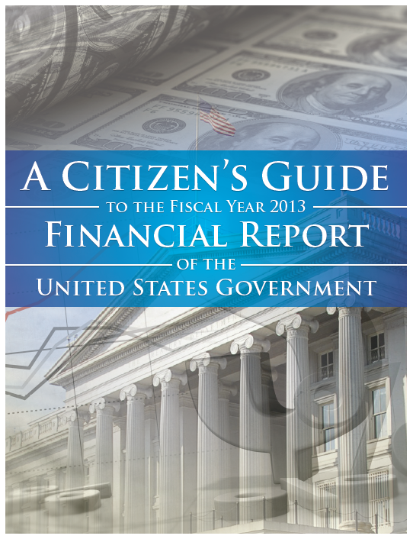
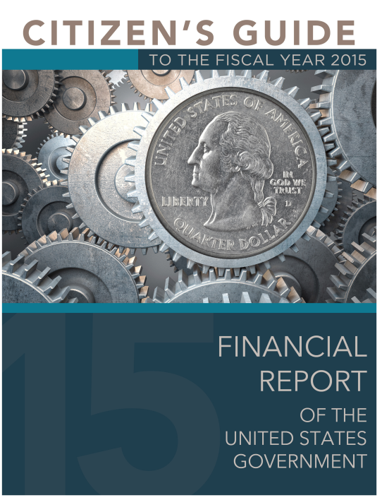
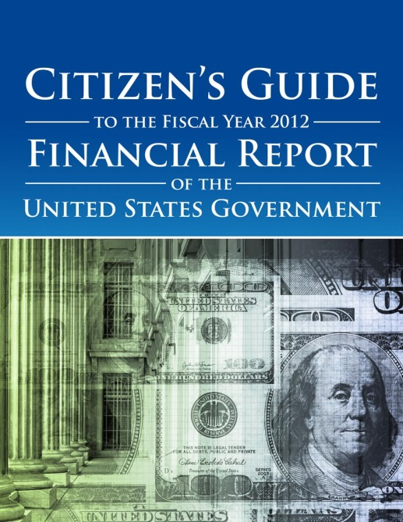
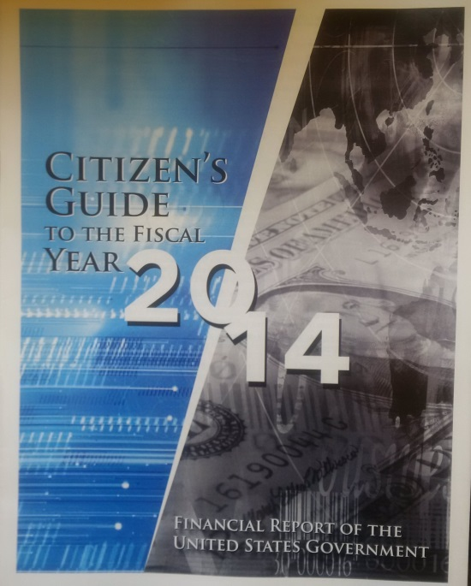
Connecting with the Citizens

Slide 14
On the Audit Horizon
Intragovernmental Scorecards and Corrective Action Plans
General Fund
SFFAS 47 – Federal Entity
GTAS - GFRS

Slide 15
Spending Transparency Background
Federal Financial Accountability and Transparency Act– established USASpending.gov in 2006
Publish data for contracts, grants, other financial assistance
USAspending.gov management moved to Treasury in 2014

Slide 16
Digital Accountability and Transparency Act of 2014 (DATA Act)
Expands USAspending.gov to include agency expenditures
Requires consistent data standards
Enable the data to be used by multiple communities

Slide 17
DATA Act Requirements:
Expanded data reporting on USAspending.gov for agency expenditures:
Appropriations Account
Budget authority appropriated
Obligation
Outlay
Unobligated balance
Other budgetary resources
Program Activity & Object Class
Obligation
Outlay
Link the financial and award data.

Slide 18
Spending Transparency Goals
Get the data: collect data from across government in a standard format
Display the data: develop a new website that will provide the data to the public in clear, consistent manner
Use the data: provide access to the data that meets the users needs

Slide 19
Using the Data
Federal executives and program managers
Federal CFOs
State and local policy-makers and managers
Private entrepreneurs
Academics/ researchers
General public
Oversight entities

Slide 20
Reflections of Jefferson…
“To state the facts frankly is not to despair the future nor indict the past. The prudent heir takes careful inventory of his legacies and gives a faithful accounting to those whom he owes an obligation of trust.” – John F. Kennedy
“It is incredibly important in this budget environment to have reliable financial data to support the tough spending decisions that Congress will have to make in the coming years. ” – Senator Mark Warner
“…Washington should be doing all it can to track how taxpayer dollars are spent. Better visibility and public disclosure of our government’s…spending is critical to identifying and eliminating waste.” – Senator Rob Portman

