Slide 1
DATA Act Information Model Schema (DAIMS) Version 1.0 Briefing
May 9, 2016

Slide 2
Agenda
Introduction
DATA Act Overview
DAIMS
Reporting Files
Information Flow
Components
DATA Act Broker – Description and Plan of Action
Next Steps

Slide 3
DATA Act Requirements
Expanded data reporting on USAspending.gov for agency expenditures:
Appropriations Account
Budget authority appropriated
Obligation
Outlay
Unobligated balance
Other budgetary resources
Program Activity & Object Class
Obligation
Outlay
Link the financial and award data.

Slide 4
DATA Act Overview
The purpose of the DATA Act is to establish government-wide financial data standards and increase the availability, accuracy, and usefulness of Federal spending information.
Improve Quality
Common Data
Standards
DATA Act
Implementation
Expand Information
Improve User Experience

Slide 5
Introduction
Delivered DATA Act Schema v 1.0
Released April 29th
Reflects the reporting architecture decision
Incorporated over 600 agency feedback items on clerical errors, areas requiring additional guidance, and potential problem areas in the data schema
30+ meetings with 20 individual agencies
Briefed government-wide councils
Finalized feedback document and responses posted to MAX
Held 15 workshops to solicit agencies-specific concerns and questions
Focus Remains on DATA Act Objectives
Improve Federal spending data quality by holding Federal agencies accountable for the completeness and accuracy of the data submitted
Establish government-wide data standards and provide consistent, reliable, and searchable Federal spending data
Connect layers of spending data by disclosing direct Federal agency expenditures and linking contract, loan, grant, and insurance spending information to programs of Federal agencies

Slide 6
DATA Act Information Model Schema (DAIMS)
The DATA Act Schema provides a standardized definition and conceptual model for the information relevant to the domain and public reporting of U.S. Federal spending.
The Schema informs:
How data providers select and organize information to submit
What information is collected, processed, and how it is related
How consumers can access and interpret information

Slide 7
DATA Act Schema Components
Reporting Submission Specification (RSS) – includes a listing of the data elements with specific instructions for federal agencies to submit content in the appropriate format.
Interface Definition Document (IDD) – contains a listing of the elements, with supporting metadata to understand what data will be pulled from government-wide systems and from agency financial assistance systems.
Information Flow – provides an overview of the reporting timeframes and sources of the data.
DAIMS Diagrams – visual representations of how the data elements from the RSS and IDD fit together in context.
Online Data Dictionary – a comprehensive list of data elements with definitions and minimal metadata, like definition and data category.
XBRL Schema Files – machine-readable version of the data standard that includes accounting-related and award-related content.

Slide 8
DATA Act Schema Components
DATA Act
FFATA
RSS - Agency submitted content
(A) Appropriations Account
(B) Object Class and Program Activity
(C) Award Financial
IDD - Extract from Existing Systems
(D1) Award & Awardee Attributes (Procurement)
(E) Additional Awardee Attributes
(F) Sub-award Attributes
(D2) Award & Awardee Attributes (Financial Assistance)
File A through F are aligned to the DATA Act objectives
File A contains appropriation summary level data that are aligned to the SF133 reporting
File B includes obligation and outlay information at the program activity and object class level
File C reports the obligations at the award and object class level
File D1 and D2 report the award and awardee details that are linked to File C
File E includes the additional prime awardee attribute.
File F includes sub-award information

Slide 9
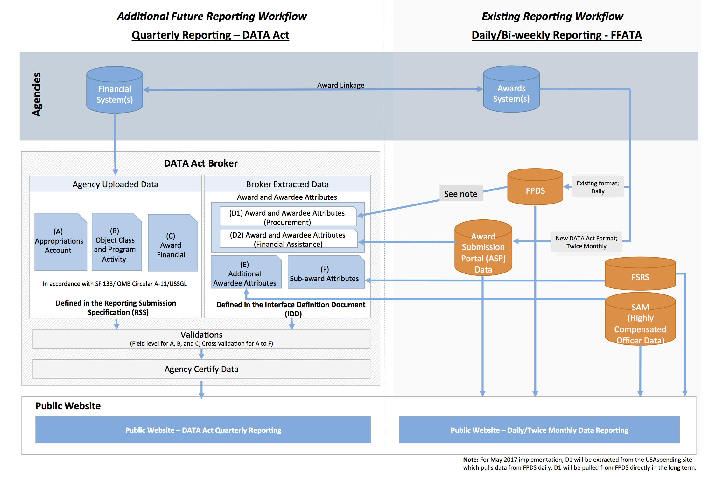
Information Flow

Slide 10
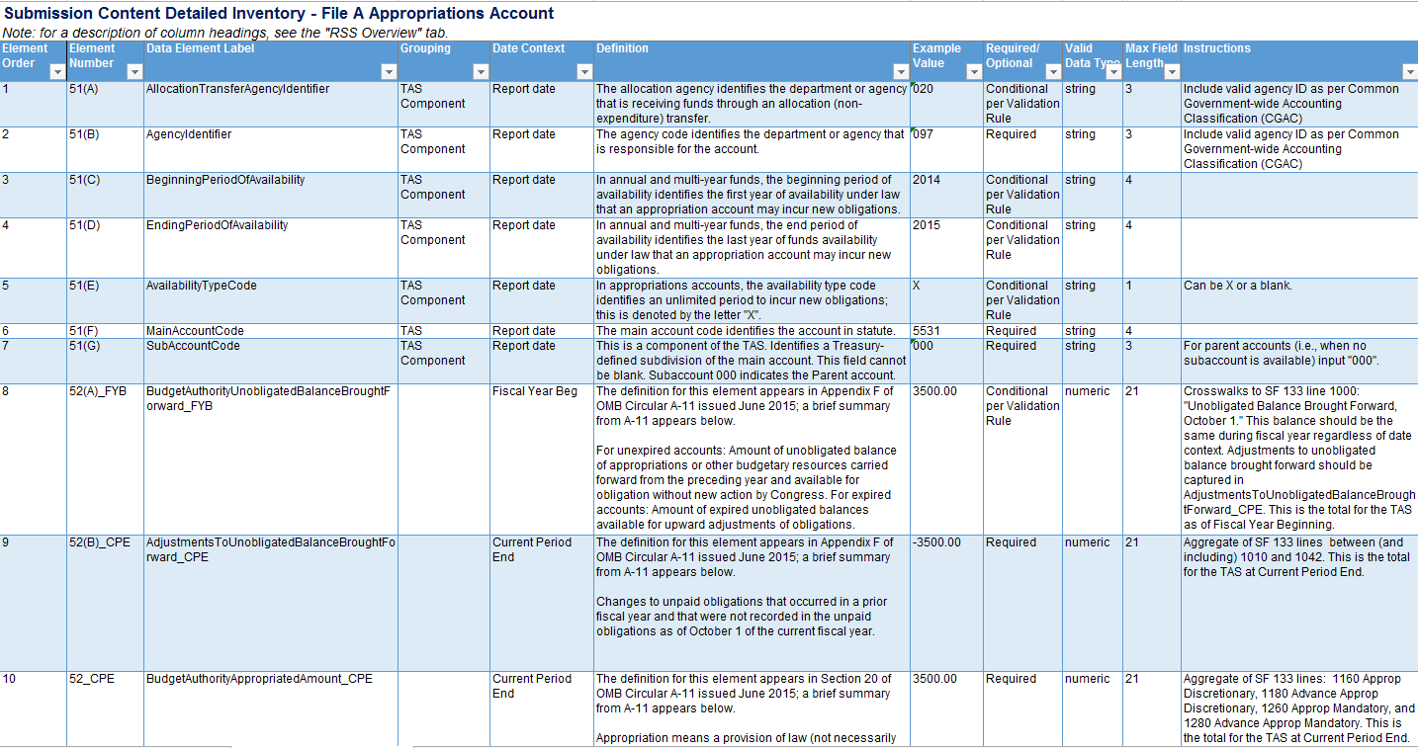
DATA Act Schema Components – File A

Slide 11
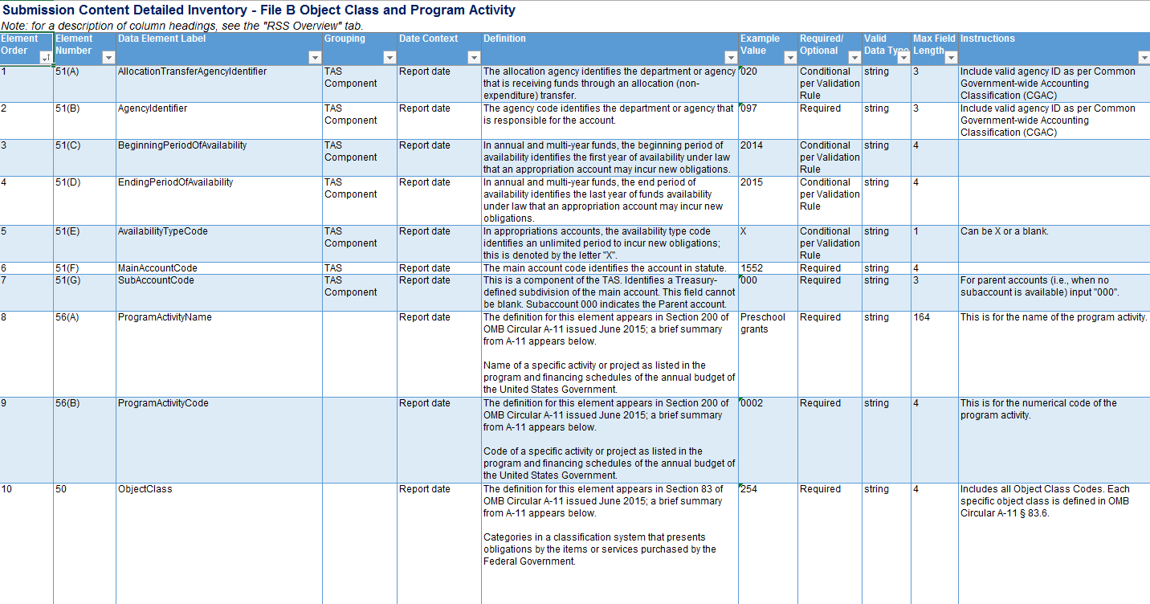
DATA Act Schema Components – File B

Slide 12
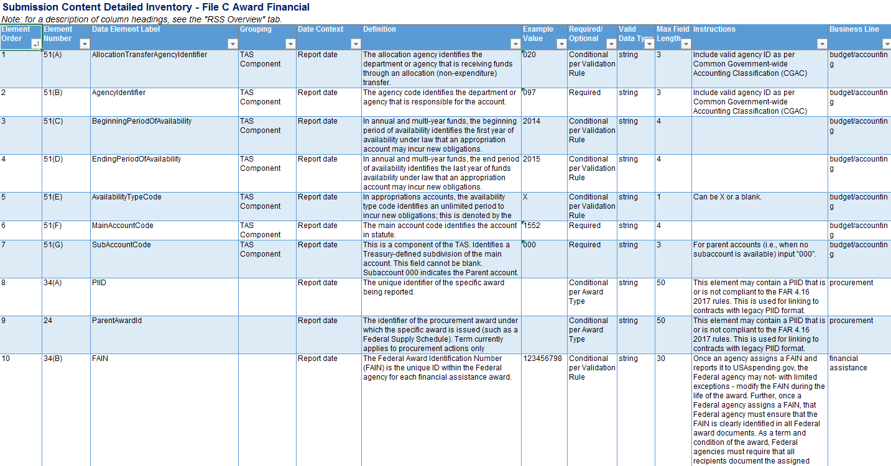
DATA Act Schema Components – File C

Slide 13
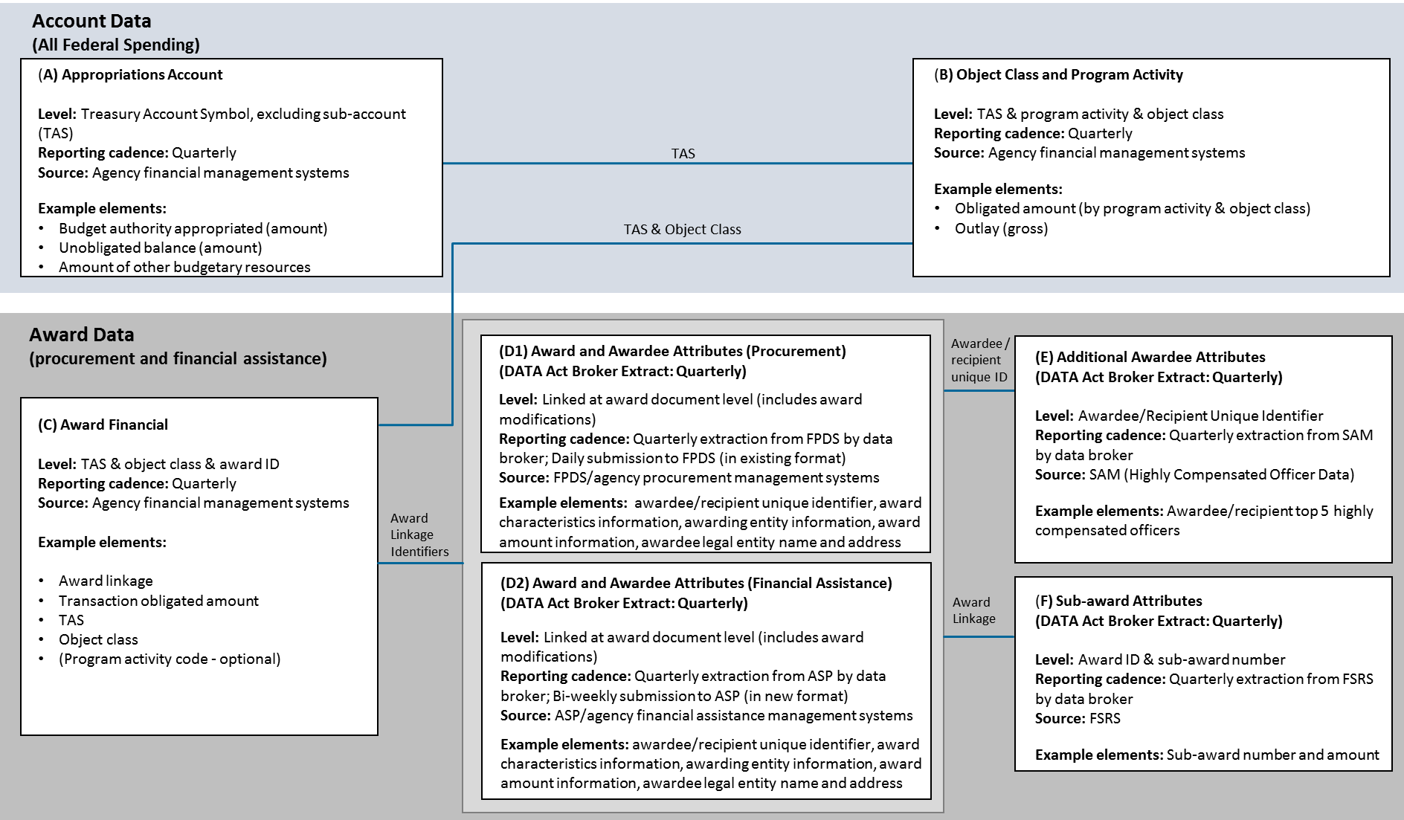
DATA Act Element Relationships

Slide 14
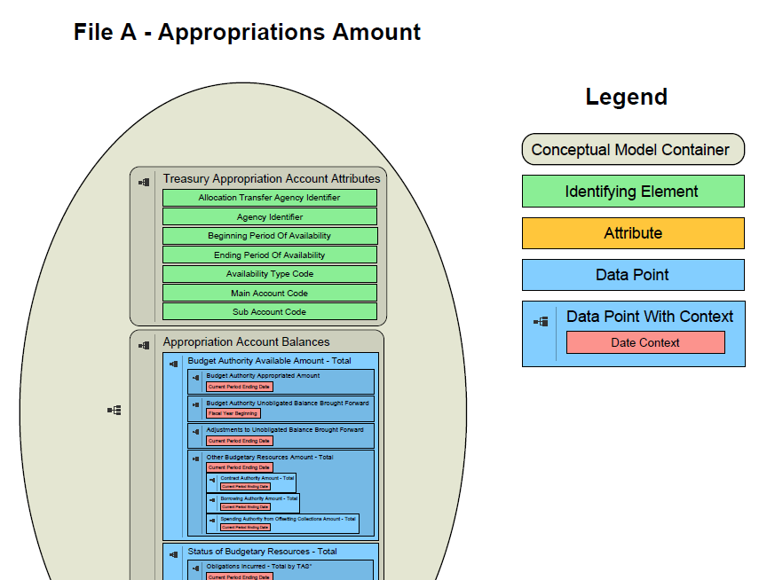
DAIMS Diagram Example

Slide 15
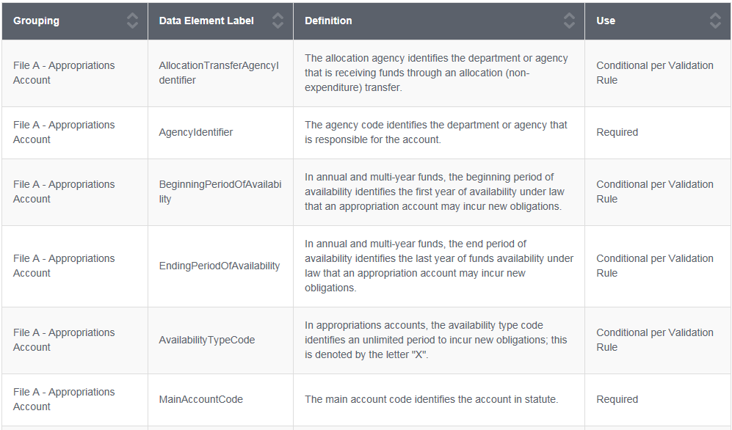
Online Data Dictionary – Example

Slide 16





DATA Act Broker
Web Interface
Outbound API
(standardized, validated data)
DATA Act Broker
Links
Validates
Standardizes
Inbound API
USAspending.gov
Agency Users
Public Users

Slide 17
Federal Agency Next Steps
Update the mapping between agency data to the DATA Act reporting requirements
Understand/inventory where data (or gaps) exist against the DATA Act reporting requirements
Close gaps/capture data required in the DATA Act reporting requirements
Ensure data is complete, accurate, and assess for overall data quality
Prepare and test linked data from source systems
Fix incorrect data in government-wide source systems (e.g. FPDS, ASP, SAM, FSRS)

Slide 18
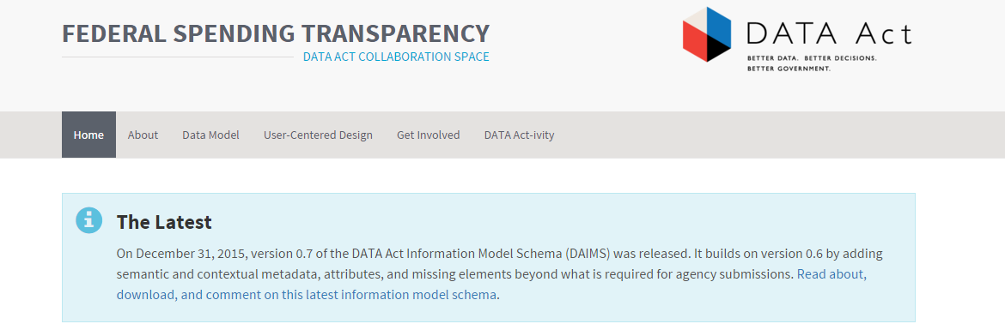
For More Information
https://fedspendingtransparency.github.io/

