Slide 1
IMPROPER PAYMENTS: Emerging Strategies in Federal Financial Management MAY 9, 2016
2016 JFMIP Federal Financial Management Conference

Slide 2
Speakers
Beryl Davis, Director, Financial Management and Assurance, Government Accountability Office DavisBH@gao.gov Gloria Jarmon, Deputy Inspector General, Department of Health and Human Services, Gloria.Jarmon@oig.hhs.gov Frank Rokosz, Deputy Assistant Inspector General, Department of Housing and Urban Development, FRokosz@hudoig.gov Moderator: Asif Khan, Director, Financial Management and Assurance, Government Accountability Office

Slide 3
Improper Payments
2016 JFMIP Conference
May 9, 2016
Beryl H. Davis, Director, Financial Management and Assurance

Slide 4
Improper Payments – Current Status
The FY 2015 government-wide improper payment estimate totaled $136.7B, an increase of $12B from the prior year
The cumulative amount of reported improper payments since FY 2003 now exceeds $1 trillion

Slide 5
FY 2015 Government-wide Improper Payment Estimates by Program
Total - $136.7 billion
Notes:
Improper payment estimates for the Medicare, Medicaid, and Earned Income Tax Credit (EITC) programs accounted for more than 76% of the fiscal year 2015 improper payment estimate.

Slide 6
FY 2015 Improper Payment Estimates: Top 10 Programs by Dollar Amount
Program | Agency | Reported Improper Payment Estimates
 |  | Dollars (in billions) | Error rate (percent of outlays)
Medicare Fee-for-Service (Parts A and B) | HHS | $43.3 | 12.1%
Medicaid | HHS | $29.1 | 9.8%
Earned Income Tax Credit (EITC) | Treasury | $15.6 | 23.8%
Medicare Advantage (Part C) | HHS | $14.1 | 9.5%
Old Age, Survivors, and Disability Insurance (OASDI) | SSA | $5.0 | 0.6%
Supplemental Security Income (SSI) | SSA | $4.8 | 8.4%
Unemployment Insurance (UI) | Labor | $3.5 | 10.7%
Supplemental Nutrition Assistance Program (SNAP) | USDA | $2.6 | 3.7%
Medicare Prescription Drug Benefit (Part D) | HHS | $2.2 | 3.6%
VA Community Care | VA | $2.1 | 54.8%
Source: GAO analysis of agencies’ fiscal year 2015 agency financial reports.
Notes:
Programs with Estimates that Increased from FY 2014 to FY 2015
Medicaid ($17.5 -> $29.1)
Medicare Part C ($12.2 -> $14.1)
OASDI ($3.0 -> $5.0)
SNAP ($2.4 -> $2.6)
Medicare Part D ($1.9 -> $2.2)
VA Community Care ($0.3 -> $2.1)
Programs with Estimates that Decreased from FY 2014 to FY 2015
Medicare Parts A and B ($45.8 -> $43.3)
EITC ($17.7 -> $15.6)
UI ($5.6 -> $3.5)
SSI ($5.1 ->$4.8)

Slide 7
FY 2015 Programs with Error Rates in Excess of 10%
Program | Agency | Reported Improper Payment Error Rate (percent of outlays)
Purchased Long Term Services and Support | VA | 59.1%
VA Community Care | VA | 54.8%
Earned Income Tax Credit (EITC) | Treasury | 23.8%
School Breakfast Program (SBP) | USDA | 23.0%
Farm Security and Rural Investment Act Programs | USDA | 22.0%
National School Lunch Program (NSLP) | USDA | 15.7%
Disbursements for Goods and Services | SBA | 13.5%
Medicare Fee-for-Service (Parts A and B) | HHS | 12.1%
Unemployment Insurance (UI) | Labor | 10.7%
Source: GAO analysis of agencies’ fiscal year 2015 agency financial reports.
Notes:
Nine risk-susceptible programs reported improper payment error rates exceeding 10%, accounting for more than 50% of the government-wide improper payment estimate (in FY 14 ten programs exceeded 10%, accounting for 58% of total)
Programs Reporting Improper Payment Error Rates > 10%
The following programs were below the 10% threshold in FY 2014, but exceed it in FY 2015 (new for FY 2015):
VA – Purchased Long Term Services and Support
VA – VA Community Care
SBA – Disbursement for Goods and Services
The following programs exceeded the 10% threshold in FY 2014, but were below it in FY 2015 (dropped in FY 2015):
HHS – Disaster Relief: ACF Social Services Block Grant
HHS – Disaster Relief: SAMHSA
SBA – Disaster Loan Disbursements
USDA – FSA Loan Deficiency Payments

Slide 8
Issues/Obstacles –
Internal Control Weakness
GAO’s report on the Fiscal Year 2015 Financial Report of the United States Government continued to report a material weakness in internal control related to improper payments
The federal government is unable to determine the full extent to which improper payments occur and reasonably assure that appropriate actions are taken to reduce them
Challenges:
Certain risk-susceptible programs do not report improper payment estimates
Risk assessments may not accurately assess risk
Estimation methodologies may not produce reliable estimates

Slide 9
Risk Susceptible Programs Not Reporting Estimates
Not all agencies have developed improper payment estimates for all programs and activities identified as susceptible to significant improper payments
Three agencies did not report estimated improper payment amounts for five risk-susceptible programs in FY 2015
Example: Temporary Assistance for Needy Families (TANF)
HHS reported statutory limitations prevent the agency from requiring states to estimate TANF improper payments
TANF program outlays were $16.2 billion in FY 2015; TANF is considered to be susceptible to significant improper payments by OMB
HHS’s OIG recommended that the agency develop an improper payment estimate for TANF and, if necessary, seek statutory authority to require state participation

Slide 10
Risk Assessments May Not Accurately Assess Risk
Agencies conduct their own risk assessments to determine which programs are susceptible to significant improper payments
Issues related to certain agencies’ risk assessments call into question whether these agencies are identifying all programs susceptible to significant improper payments
Example: Additional Child Tax Credit program (TIGTA 2014-40-093)
IRS designated the Additional Child Tax Credit Program as low risk
TIGTA estimated improper payments from 25.2 to 30.5 percent, or $5.9 billion to $7.1 billion
TIGTA reported that IRS’s risk assessment process did not provide a valid assessment of improper payments in certain IRS programs and did not adequately address specific risks commonly associated with verifying refundable credit claims

Slide 11
Risk Assessments May Not Accurately Assess Risks (continued)
Example: Department of Energy’s Risk Assessment Should be Strengthened
Based on GAO’s evaluation of the DOE’s FY 2011 risk assessment process (GAO-15-36):
DOE did not prepare risk assessments for all programs, and the quantitative information reported was not reliable; and
DOE’s risk assessments did not fully evaluate other relevant risk factors.
Because DOE found its programs to be at low risk for significant improper payments in FY 2011, the department was not required to prepare risk assessments again until FY 2014.

Slide 12
Risk Assessments May Not Accurately Assess Risks (continued)
CFO Act Agencies with No Programs Reported Susceptible to Significant Improper Payments
U.S. Agency for International Development
Department of Energy
Department of State
National Science Foundation
Nuclear Regulatory Commission
CFO Act Agencies Reporting Only Sandy-related Estimates
Department of Commerce
Department of the Interior
Department of Justice
NASA
Notes:
Once Sandy funds are exhausted, Commerce, DOI, DOJ and NASA will be in the same position as the five agencies with no programs susceptible to significant improper payments (assuming no other programs are determined to be risk-susceptible).

Slide 13
Estimation Methodologies May Not Produce Reliable Estimates
Flexibility in how agencies implement improper payment estimation requirements can contribute to inconsistent or understated estimates
Example: TRICARE vs. Medicare (GAO-15-269)
DOD uses a less comprehensive methodology for estimating TRICARE improper payments than the methodology used in Medicare estimates
DOD did not exam medical records to support each payment
TRICARE’s methodology is likely to understate its improper payment rate compared to Medicare’s methodology
TRICARE – FY 2015: Outlays: $19.7B, Error rate: 0.8%
Medicare FFS – FY 2015: Outlays: $358.3B, Error rate: 12.1%
Without a robust measure of improper payment rates in TRICARE, DOD cannot effectively identify root causes and take steps to address improper payments.
Notes:
TRICARE and Medicare are similar programs in that they pay providers on a fee-for-service basis and depend on contractors to process and pay claims.
Compared to TRICARE, Medicare’s methodology more completely identifies improper payments beyond those resulting from claim processing errors, such as those related to provider noncompliance with coding, billing, and payment rules.
Corrective actions for TRICARE do not address issues related to medical necessity errors—a significant contributor to Medicare improper payments.
For fiscal year 2015, estimate error rates were 0.8 percent for TRICARE and 12.1 percent for Medicare Fee-for-Service

Slide 14
Working Together
There is a need for coordination between GAO, IGs, and CFOs to continue the efforts towards reducing improper payments.
A number of strategies across government could help reduce improper payments:
Designing and implementing effective preventive controls can serve as a frontline defense against improper payments
Implementing detective controls to identify improper payments, accompanied by recovery audits to recover overpayments
Robust root cause analysis can help agencies target effective corrective actions

Slide 15
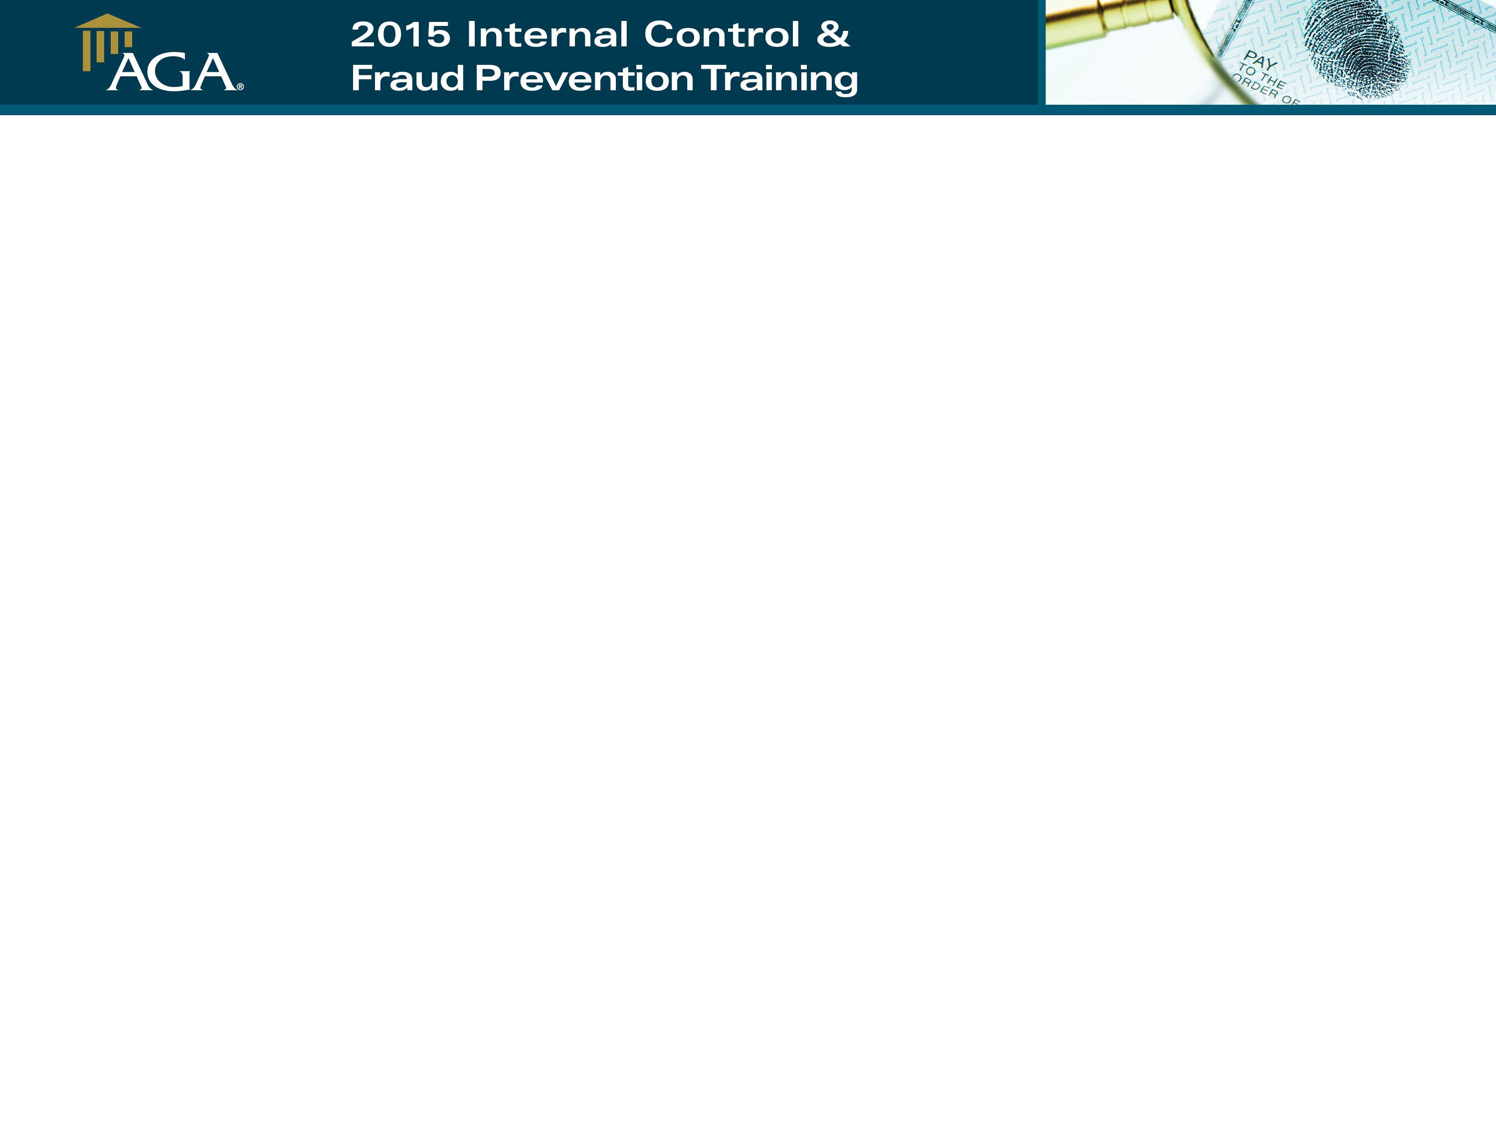

Improper Payment Oversight in the Federal Government
Improper Payment Oversight in the Federal Government
Gloria Jarmon
Deputy Inspector General for Audit Services
U.S. Department of Health & Human Services

Slide 16

Gloria L. Jarmon
Deputy Inspector General for Audit Services
CPA, CGFM
U.S. Department of Health and Human Services
Gloria.Jarmon@oig.hhs.gov

Slide 17

In FY 2015, HHS reported $89.8 billion in improper payments

Slide 18
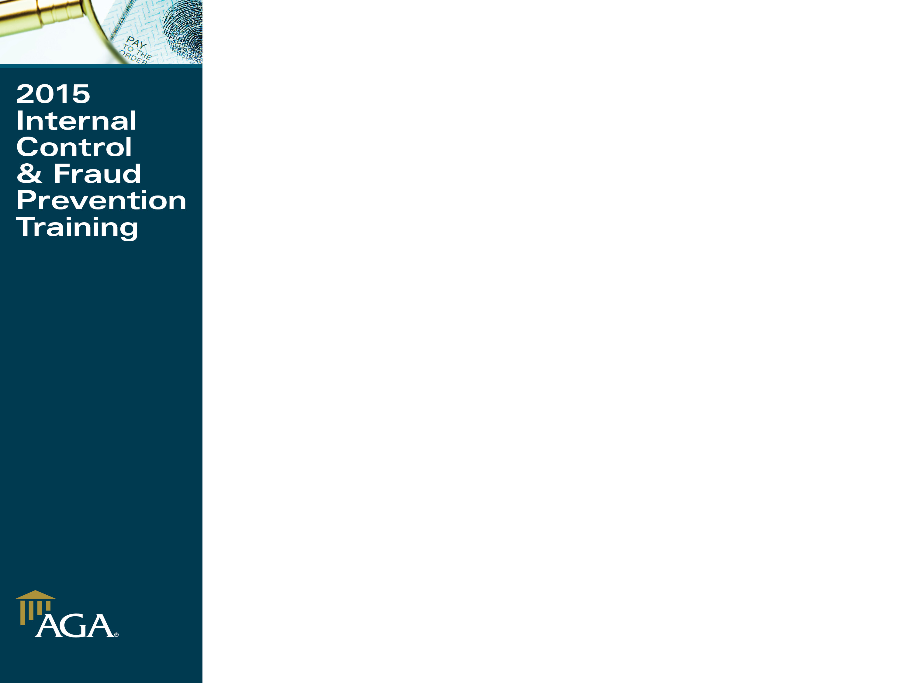
Programs Susceptible to Significant Improper Payments
Improper Payment Oversight in the Federal Government
Program | FY2015 Improper Payment Estimate Dollars (in millions)
Medicare FFS | $43,326
Medicare Advantage | $14,117
Medicare Prescription Drug Benefit | $2,234
Medicaid | $29,125
Children’s Health Insurance Program (CHIP) | $632
Temporary Assistance for Needy Families (TANF) | N/A
Foster Care | $30.7
Child Care and Development Fund (CCDF) | $311.1
Disaster Relief Appropriation Act Programs (DRAA) | $1.4
Notes:
The Office of Management and Budget (OMB) identified eight HHS programs as susceptible to significant improper payments.
HHS continued to address and report improper payments impacted by Superstorm Sandy. DRAA required any programs that receive funds under this act must report Improper Payment Estimates. DRAA Programs Include:
Administration for Children and Families (ACF) Head Start; ACF Social Services Block Grant; ACF Family Violence Prevention and Services; Assistant Secretary for Preparedness and Response (ASPR) Research; Centers for Disease Control and Prevention (CDC) Research; Substance Abuse and Mental Health Services Administration (SAMHSA) Grants; and the National Institutes of Health (NIH) Research Grants)

Slide 19
OIG Objectives
Improper Payment Oversight in the Federal Government
1) Determine whether HHS complied with the IPIA for FY 2015 in accordance with OMB guidance
2) Evaluate HHS’ assessment of the level of risk and the quality of the improper payment estimates and methodology for high-priority programs
3) Assess HHS’ performance in reducing and recapturing improper payments
Notes:
IPIA – Improper Payments Information Act
Improper Payments Elimination and Recovery Act of 2010 requires OIG to review and report on agencies’ annual improper payment information included in their Agency Financial Reports (AFRs)

Slide 20


Specific Requirements Measured
Issues that must be reported to ensure IPIA compliance:
Appropriate publishing of AFRs
Conducting program-specific risk assessments
Developing improper payment estimates for programs and activities identified as risk- susceptible
Publishing corrective action plans (CAPs)
Establishing and meeting annual reduction targets for risk-susceptible programs
Reporting gross improper payment rates of less than 10%
Notes:
The below numbers correspond with the bullets in the slide:
In terms of compliance with IPIA and OMB Reporting Guidance, HHS only fully met the requirement for publishing and posting the agency financial report (AFR). While they did not fully meet all other requirements, many were met partially, but not fully:
1) HHS complied with the requirement to publish and post the agency financial report
HHS did not fully meet the requirements for the following:
2) conducted a program-specific risk assessment of 12 programs that were not deemed susceptible to significant improper payments by OMB as part of an ongoing 3-year cycle to identify those programs or activities that might have been susceptible to significant improper payments. These 12 programs do not include assessments of payments to employees and charge card payments
3) published improper payment estimates for 7 of the 8 programs that OMB deemed to be susceptible to significant improper payments and all 7 programs deemed susceptible to significant improper payments under the Disaster Relief Appropriations Act (DRAA; Hurricane Sandy legislation). No estimate for TANF.
4) published Corrective Action Plans (CAPs) for 7 of the 8 programs that OMB deemed to be susceptible to significant improper payments and all 7 programs deemed susceptible to significant improper payments under the DRAA. No CAP for TANF.
5) published and met annual reduction targets for 3 of the 7 programs (Medicare Fee-for-Service, Medicare Prescription Drug Benefit and Foster Care programs) for which it reported reduction targets in the FY 2014 AFR. The requirement to meet reduction targets was not applied to the 7 programs deemed susceptible to improper payments in the DRAA because it is the second year reporting improper payments for these programs. As previously noted (future year) estimates were not made based on the results in year one. Estimates for 5 of the 7 DRAA programs for next year. Two programs ACF Family Violence Prevention and Services & CDC Research did not report a target rate for next year –as they have measured all their Hurricane Sandy expenditures. Consequently, these two programs will not have any additional improper payment results to measure and report.
6) reported an improper payment rate of less than 10 percent for 6 of the 8 programs that OMB deemed to be susceptible to significant improper payments; Medicare Advantage, Medicare Prescription Drug Benefit, Medicaid, CHIP, Foster Care and CCDF and all 7 of the programs deemed susceptible to significant improper payments under the DRAA.
[ NOT an improper payment rate of less than 10% for Medicare FFS)]
[No improper payment estimate for TANF, no CAP for TANF]

Slide 21

Improper Payment Oversight in the Federal Government
In FY 2015, HHS Failed To:
1) Perform risk assessments of payments to employees and charge card payments
2) Publish an improper payment estimate for TANF that OMB determined to be susceptible to improper payments
3) Publish a CAP for TANF
4) Meet reduction targets for four of the seven programs for which HHS reported reduction targets in the FY 2014 AFR
5) Report an improper payment rate of less than 10 percent for Medicare FFS
Notes:
The below numbers correspond with the numbers in the slide:
Despite departmental efforts to reduce improper payments, OIG has found vulnerabilities in HHS' ability to identify and eliminate improper payments.
1) Payments to employees and charge cards payments were not included among the programs that received risk assessments for FY 2015. HHS is planning to conduct qualitative risk assessments of employee pay and charge cards for FY 2016.
2)
A. HHS stated in its FY 2015 AFR that it did not report an improper payment estimate for TANF because it is a State-administered program and statutory limitations prohibit HHS from requiring States to participate in a TANF improper payment measurement. OMB has designated TANF as a Federal program susceptible to significant improper payments. The Act requires agencies to review all of their programs to identify those that may be susceptible to significant improper payments; The Department is required to estimate and report improper payments for TANF.
B. In FY 2011, OIG recommended HHS take steps to develop improper payment estimates for TANF
C. In the FY’s 2012 through 2015 AFRs, HHS did not report an improper payment estimate for TANF
3) No CAP for TANF. Although HHS did publish a series of actions that States could take to assist States in reducing improper payments for TANF, HHS did not conduct a root-cause analysis on the improper payments. Therefore, they may not be effective in reducing improper payments.
4) The specific programs that HHS failed to meet improper payment rate reduction targets for were: Medicare Advantage, Medicaid, CHIP, and Child Care Development Fund
A. Medicare Advantage – improper payment rate of 9.5% exceeded target of 8.5% → HHS officials noted that the increase was due to a reduction in the magnitude of risk-adjusted diagnoses that were not submitted by Medicare Advantage Organizations for payment.
B. Medicaid - the primary reason for the higher rate was difficulties experienced by States bringing systems into compliance with new requirements. For example: all referring or ordering providers to be enrolled in Medicaid, screening providers under a risk-based screening process prior to enrollment, and the inclusion of the attending provider National Provider Identifier on all electronically files institutional claims.
C. Child Care Development Fund - the primary reason that the error rate increased is that the segment of states measured in this cycle had a higher improper payment rate as compared to their previous measurement. This segment of states identified changes or updates in policies and procedures and additional training as actions to address the improper payments [We do not generally identify the states in our review].
5) HHS did not report an improper payment rate of less than 10 percent for Medicare FFS. According to HHS, the Medicare FFS rate decreased from 12.7 percent in FY 14 to 12.1 percent in FY 15, however, insufficient documentation continues to be an issue.

Slide 22
Notes:
Grouping by Program:
Within each Program group reported actual rates and FY 15 target rate:
Color Scheme:
FY 13 Actual Reported Rate – Light Blue (Column - Far Left)
FY 14 Actual Reported Rate – Light Gray (Column - Second from the Left)
FY 14 Reported Target for FY 15 – Blue (Column – Second from the Right)
FY 15 Actual Reported Rate – Dark Blue (Column – Far Right)
Meeting the target (Medicare Prescription Drug Benefit program) – OMB Circular A-123, Appendix C, II.A.3, FN 13 – “A program will have met a reduction target if the improper payment rate for that program in the current year falls within plus or minus 0.1 percentage points of the reduction target set in the previous year’s AFR.”

Slide 23
Notes:
Grouping by Program:
Within each Program group reported actual rates and FY 15 target rate:
TANF – has not reported actual or target improper payment rates
Color Scheme:
FY 13 Actual Reported Rate – Light Blue (Column - Far Left)
FY 14 Actual Reported Rate – Light Gray (Column - Second from the Left)
FY 14 Reported Target for FY 15 – Blue (Column – Second from the Right)
FY 15 Actual Reported Rate – Dark Blue (Column – Far Right)

Slide 24

Other Issues
Medicare FFS program has not achieved a improper payment rate of less than 10 percent for 3 consecutive years
HHS has not published an improper payment estimate and other required information for TANF for 5 consecutive years
Notes:
The IPERA requires agencies to: 1) periodically review all programs and activities and identify those that may be susceptible to significant improper payments, 2) take multiple actions (including establishing an improper payment estimation methodology) when programs and activities are identified as susceptible to significant improper payments, and 3) annually report information on their improper payments monitoring and minimization efforts for programs and activities that are identified as susceptible to significant improper payments.
Where to report: The IPERA, Pub. L. No. 111-204, requires Offices of Inspectors General to review and report on agencies’ annual improper payment information included in their Agency Financial Reports to determine compliance with the Improper Payments Information Act of 2002, Pub. L. No. 107-300, as amended by the IPERA as well as the Improper Payments Elimination and Recovery Improvement Act of 2012, Pub. L. No. 112-248.
Additional Talking Points:
Noncompliance in TANF (no estimate of improper payments and failure to meet other IPIA requirements) for 5 consecutive years.
Noncompliance with Medicare FFS (failure to achieve an improper payment rate of less than 10 percent) for 3 consecutive years.
This determination of noncompliance with IPIA for 3 consecutive fiscal years for the same program or activity requires the agency head to submit to Congress either reauthorization proposals for each program or activity that have not been in compliance for 3 or more consecutive FYs or propose statutory changes necessary to bring the program or activity into compliance. To address this requirement, the Department said it is engaging with OMB to explore potential options to develop an alternative approach that could bring TANF into compliance with the law and reporting requirements.

Slide 25
OIG Recommendations
1) Develop and establish an improper payment estimate for TANF
2) Reduce improper payment rates to below 10 percent and achieve established improper payment target rates
3) Conduct risk assessments of payments to employees and charge card payments
Notes:
In our prior report, we summarized the status of all our prior recommendations from Improper Payment reports from FY 2011 through 2013. Many of the recommendations had been addressed – such as the recommendation to ensure that amounts used in the computation for reporting overpayments are accurate and complete. All of the recommendations (listed above) above remain open, although the program that they are applicable to may have changed. In last year’s report: Risk assessments of payments to employees and charge card payments is in the planning stages of performing qualitative risk analysis at the Program Support Center and select Operating Divisions.
Additional Talking Points:
OIG’s Recommendations for HHS:
HHS should develop and establish an improper payment estimate for the TANF program.
HHS should reduce improper payments to below 10 percent for various programs and achieve their established improper payment target rates.
HHS should conduct risk assessments of payments to employees and charge card payments.
With respect to IPIA, the Department had stated in its comments on our IPIA-compliance audit report pertaining to the Department’s FY 2013 AFR that it would submit a legislative proposal to Congress that would allow for a TANF error rate measurement. The Department, however, did not do so. Instead, the Department has reported that it submitted legislative proposals to Congress to improve TANF’s program integrity. Specifically, the Department noted that ACF’s FYs 2015 and 2016 Budget requests for TANF included $10 million for program improvement initiatives, including technical assistance on strengthening State program integrity efforts. The requests also proposed to prohibit the use of non-governmental third-party expenditures in meeting State maintenance-of-effort (MOE) requirements, and limiting the expenditure of TANF and MOE funds to benefits and services to needy families. The Department asserts that both of these proposed legislative changes would strengthen State accountability to the purposes of the TANF statute The Department stated that it would seek Congressional authority for TANF improper payment measurement, but did not do so.
The Department needs to develop an improper-payment estimate for TANF and submit a legislative proposal to Congress to require State participation in such a measurement. In addition, the Department needs to meet improper-payment reduction targets, and reduce improper payments to less than 10 percent for all programs. The Department needs to conduct thorough root cause analyses of significant improper payments and develop robust corrective action plans that target identified causes. The Department also needs to conduct a risk assessment of payments made to employees and charge cards. The Department should resolve all financial control weaknesses identified by OIG, the GAO, and other internal and external auditors.

Slide 26


Questions
Stay Connected:

Slide 27

JFMIP Management Conference
Washington, DC | May 9, 2015

Slide 28
Frank Rokosz, Deputy Assistant Inspector General for Audit
Washington, DC | May 9, 2015

Slide 29

Overview
JFMIP Conference May 2016
OMB Designated HUD Programs High Error
HUD’s First Study of Rental Assistance
HUD’s Enterprise Income Verification
Historical Improper Payment Rate
Current Status
Contact Information

Slide 30
OMB Designated 16 Federal Programs as “HIGH ERROR”
JFMIP Conference May 2016
HUD’s Rental Housing Assistance Programs(RHAP) are #12 on OMB’s List
Total payments $32 billion
Improper payment amount $1.3 billion
Improper payment rate 4%

Slide 31
JFMIP Conference May 2016
HUD’s Office of Policy Development and Research contracted for a study to provide national estimates on the extent, severity, costs, and sources of rent errors for the public housing and Section 8 programs in 2000.
The Quality Control for Rental Assistance Housing Determinations study found errors in rental calculations. (available at: http://www.huduser.org/publications/pubasst.html)

Slide 32
56% of households had rental calculation errors in 2000
JFMIP Conference May 2016

Slide 33
PD&R Study
JFMIP Conference May 2016
HUD incorrectly paid $2.3 billion in annual housing subsidies.
$1.7 billion was paid to households paying too little rent.
$600 million in subsidies went unpaid for households who paid too much rent.

Slide 34
GAO RISK ASSESSMENT
JFMIP Conference May 2016
HUD’s Section 8 rental subsidy overpayments are one of HUD’s high risk areas.

Slide 35
Progress to Reduce Improper Rental Payments
JFMIP Conference May 2016
56% of households had rent calculation errors in 2000
40% of households had rent calculation errors in 2003

Slide 36
Rental Housing Integrity Improvement Project
JFMIP Conference May 2016
Secretarial initiative designed to reduce income and rent errors and improper payments in the administration of both public housing and Section 8 programs.
At the core of the initiative is the Enterprise Income Verification (EIV) system

Slide 37
Enterprise Income Verification
JFMIP Conference May 2016
EIV provides a comprehensive online system for the determination and verification of various resident information and income that housing authorities and owners use in determining rental subsidy. Additionally, EIV collects supplemental employment and benefit information through data sharing agreements with the Social Security Administration (SSA) and the U. S. Department of Health and Human Services (HHS).
These agreements, in combination with HUD’s PIC system and EIV reports, provide an analysis of income and benefit information that the EIV team monitors in order to assist housing authorities and HUD to identify and resolve certain regulatory deficiencies and to implement proactive measures to effectively mitigate risk and program waste, fraud, and abuse.

Slide 38
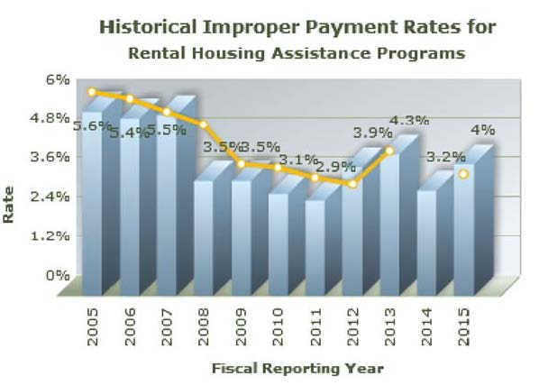
JFMIP Conference May 2016
Notes:
2005 $1.5 Billion
2006 $1.5 billion
2007 $1.5 billion
2008 $1.0 billion
2009 $1.0 billion
2010 $0.9 billion
2011 $1.0 billion
2012 $1.2 billion
2013 $1.3 billion
2014 $1.0 billion
2015 $1.3 billion

Slide 39
Current Status
JFMIP Conference May 2016
For the third consecutive fiscal year, HUD did not fully comply with IPERA.
Of the six criteria, HUD failed to comply with two criteria. Areas of noncompliance were related to HUD’s failure to (1) conduct its annual risk assessment in accordance with OMB guidance and (2) meet its annual improper payment reduction target.
HUD continues to have weaknesses in OCFO’s and FHA’s risk assessment processes and HUD’s continued inability to address all of the root causes of improper payments for RHAP.

Slide 40
Frank Rokosz DAIGA
frokosz@hudoig.gov
Office of Audit
Visit the HUD Office of Inspector General Web site at www.hudoig.gov

