Slide 1

JFMIP Management Conference
Washington, DC | May 9, 2015

Slide 2
Frank Rokosz, Deputy Assistant Inspector General for Audit
Washington, DC | May 9, 2015

Slide 3
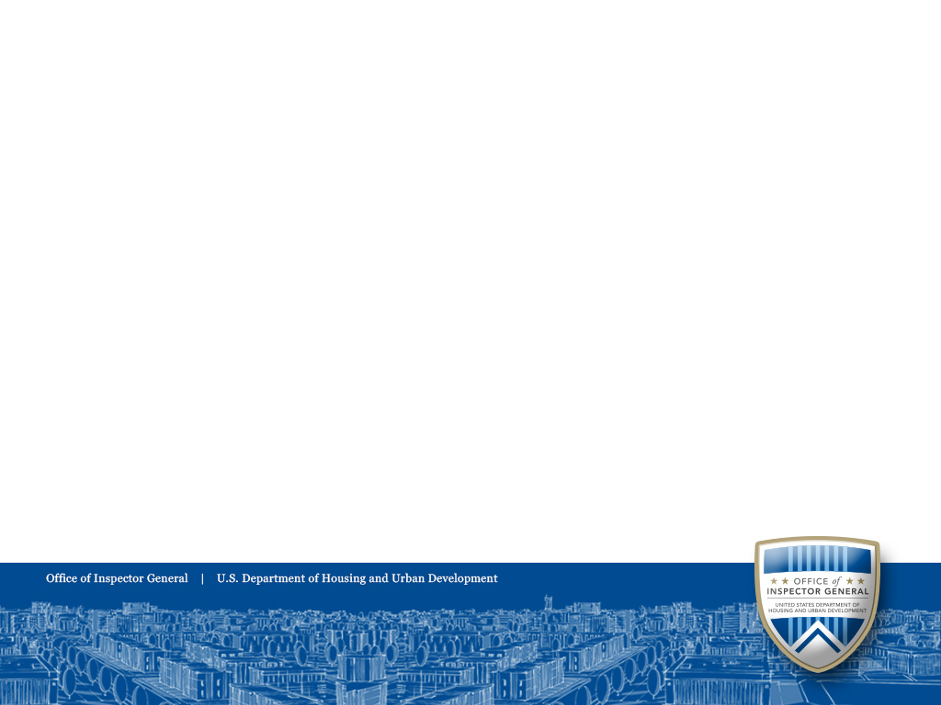
Overview
JFMIP Conference May 2016
OMB Designated HUD Programs High Error
HUD’s First Study of Rental Assistance
HUD’s Enterprise Income Verification
Historical Improper Payment Rate
Current Status
Contact Information

Slide 4
OMB Designated 16 Federal Programs as “HIGH ERROR”
JFMIP Conference May 2016
HUD’s Rental Housing Assistance Programs(RHAP) are #12 on OMB’s List
Total payments $32 billion
Improper payment amount $1.3 billion
Improper payment rate 4%

Slide 5
JFMIP Conference May 2016
HUD’s Office of Policy Development and Research contracted for a study to provide national estimates on the extent, severity, costs, and sources of rent errors for the public housing and Section 8 programs in 2000.
The Quality Control for Rental Assistance Housing Determinations study found errors in rental calculations. (available at: http://www.huduser.org/publications/pubasst.html)

Slide 6
56% of households had rental calculation errors in 2000
JFMIP Conference May 2016

Slide 7
PD&R Study
JFMIP Conference May 2016
HUD incorrectly paid $2.3 billion in annual housing subsidies.
$1.7 billion was paid to households paying too little rent.
$600 million in subsidies went unpaid for households who paid too much rent.

Slide 8
GAO RISK ASSESSMENT
JFMIP Conference May 2016
HUD’s Section 8 rental subsidy overpayments are one of HUD’s high risk areas.

Slide 9
Progress to Reduce Improper Rental Payments
JFMIP Conference May 2016
56% of households had rent calculation errors in 2000
40% of households had rent calculation errors in 2003

Slide 10
Rental Housing Integrity Improvement Project
JFMIP Conference May 2016
Secretarial initiative designed to reduce income and rent errors and improper payments in the administration of both public housing and Section 8 programs.
At the core of the initiative is the Enterprise Income Verification (EIV) system

Slide 11
Enterprise Income Verification
JFMIP Conference May 2016
EIV provides a comprehensive online system for the determination and verification of various resident information and income that housing authorities and owners use in determining rental subsidy. Additionally, EIV collects supplemental employment and benefit information through data sharing agreements with the Social Security Administration (SSA) and the U. S. Department of Health and Human Services (HHS).
These agreements, in combination with HUD’s PIC system and EIV reports, provide an analysis of income and benefit information that the EIV team monitors in order to assist housing authorities and HUD to identify and resolve certain regulatory deficiencies and to implement proactive measures to effectively mitigate risk and program waste, fraud, and abuse.

Slide 12
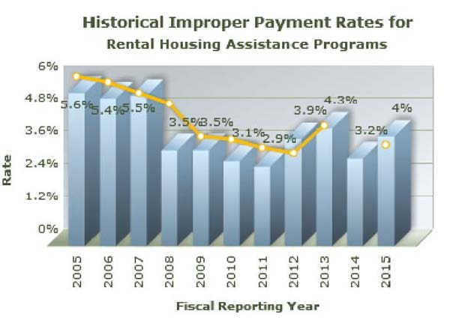
JFMIP Conference May 2016
Notes:
2005 $1.5 Billion
2006 $1.5 billion
2007 $1.5 billion
2008 $1.0 billion
2009 $1.0 billion
2010 $0.9 billion
2011 $1.0 billion
2012 $1.2 billion
2013 $1.3 billion
2014 $1.0 billion
2015 $1.3 billion

Slide 13
Current Status
JFMIP Conference May 2016
For the third consecutive fiscal year, HUD did not fully comply with IPERA.
Of the six criteria, HUD failed to comply with two criteria. Areas of noncompliance were related to HUD’s failure to (1) conduct its annual risk assessment in accordance with OMB guidance and (2) meet its annual improper payment reduction target.
HUD continues to have weaknesses in OCFO’s and FHA’s risk assessment processes and HUD’s continued inability to address all of the root causes of improper payments for RHAP.

Slide 14
Frank Rokosz DAIGA
frokosz@hudoig.gov
Office of Audit
Visit the HUD Office of Inspector General Web site at www.hudoig.gov

