Slide 1
Intragovernmental Transaction Material Weakness & G-Invoicing
Kirstie Pottmeyer
Keith Jarboe
May 9, 2016

Slide 2
Agenda
IGT Material Weakness
IGT Accomplishments
IGT by the Numbers
G-Invoicing Update
Final Thoughts
Questions

Slide 3



IGT Material Weakness
History of Material Weakness for the U.S. Government
As it has for each of the past 19 fiscal years, the U.S. Government Accountability Office (GAO) issued a disclaimer of opinion on the FY 2015 Financial Report of the U.S. Government. In its report, GAO cited the government's difficulty to "adequately account for and reconcile intra-governmental activity and balances between federal entities" as a material weakness and a major impediment to expressing an opinion.
Three Primary Impediments
DoD
Compilation
IGT
Disclaimer

Slide 4
IGT Material Weakness
The Issue
The Simplicity of the IGT Issue:
“If two federal entities engaged in an intragovernmental transaction do not both record the same intragovernmental transaction in the same year and for the same amount, the intragovernmental transactions will not be in agreement, resulting in errors in the consolidated financial statements.”
- FY 2015 U.S. GOVERNMENT ACCOUNTABILITY OFFICE INDEPENDENT AUDITOR’S REPORT

Slide 5
IGT Material Weakness
Accomplishments
Treasury has taken the lead in developing a plan to mitigate and eliminate the IGT material weakness finding. Key efforts include:
Quarterly IGT Metrics and Scorecards
Journal Vouchers (JVs)
General Fund Reporting
Root cause analysis and corrective action implementation monitoring
Preventative controls to identify and prevent agency misstatements during the closing package reporting process.
Dispute Resolution process improvements
IGT Chapter in the Treasury Financial Manual (TFM) – TFM Chapter 4700 and Appendices 7 and 10 updates
Transfer logic model publication
With these foundational elements in place, Treasury is well positioned to measure IGT accountability and compliance
Notes:
Journal Vouchers to report General Fund and Legislative/Judicial balances in the Consolidated Financial Statements (CFS)
Enhanced dispute resolution process for reporting entities to resolve disputes

Slide 6
IGT Material Weakness
Accomplishments
Policy and Procedures
Updated TFM Chapter 4700, including Appendix 7 and Appendix 10
New TFM 2-4700 Root Cause and Corrective Action Plan Policy
Expanded TFM guidance for reporting with the General Fund
IGT Metrics and Scorecards:
Continued use and expansion of Quarterly scorecards to measure progress government-wide and by agency
Publication of Quarterly scorecards on OMB Max (Q1 FY 2016)
Audit Requirements:
CFO Sign-off (Material Difference Reports) and CFO Representation
Closing Package audit procedures on GFRS Module GF004 Federal Trading Partner Note

Slide 7
Completing the IGT Model
IGT Accomplishments – Trend Analysis

Slide 8
Buy/Sell by the Numbers
Total IGT Differences– FY2015 (Year End)
Notes:
Of the Other IGT Differences, Buy/Sell makes up 75% of the total.

Slide 9
Buy/Sell Fundamentals
Buy/Sell activities are transactions between agencies managed through an interagency agreement, often called a reimbursable agreement.
Agreements typically cover:
Exchange related to goods and services rendered
Accounts receivable and other assets
Accounts payable and other liabilities
Advances
Prepayments from/to
Deferred Credits
Buy/Sell eliminations occur in three Reciprocal Categories (RC):
RC 22 – Accounts Receivable / Accounts Payable, and Other Liabilities
RC 23 – Advances to Others and Prepayments / Advances from Others and Deferred Credits
RC 24 – Buy/Sell Costs / Revenues

Slide 10
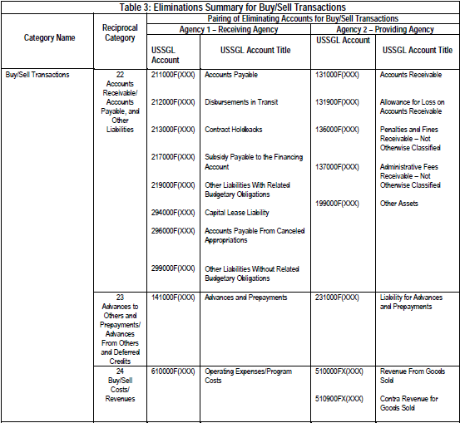
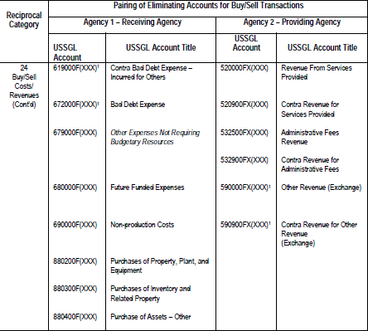
Buy/Sell Fundamentals
USSGL Accounts in each Reciprocal Category can be found in Appendix 7 of I TFM 2-4700 (Table 3):

Slide 11
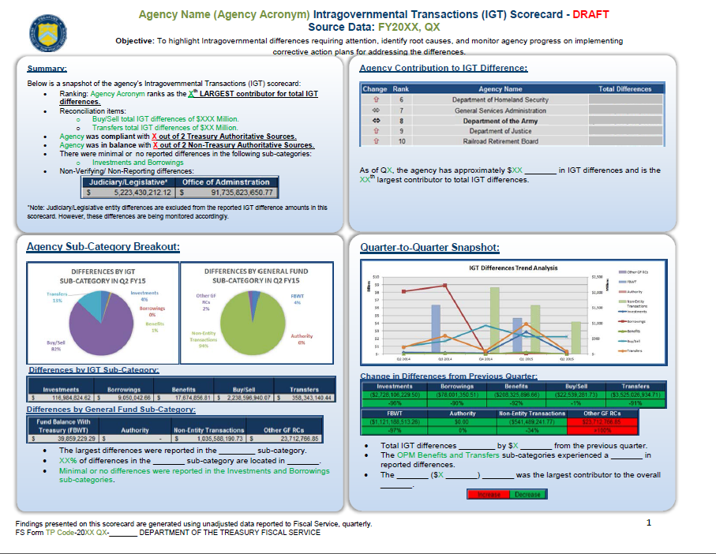
Buy/Sell by the Numbers
Agency IGT Scorecard and Metrics

Slide 12
Buy/Sell Fundamentals
Accurate reporting of buy/sell balances and proper elimination of buy/sell activity depends largely upon….
COMMUNICATION

Slide 13
Government Invoicing
(G-Invoicing)
Joint Financial Management Improvement Program (JFMIP)
Annual Conference
May 9, 2016

Slide 14
Fact Sheet
G-Invoicing is an application which supports the brokering of Intragovernmental Buy/Sell Transactions by Federal Trading Partners
The application will enable users to manage the processing and approval of General Terms and Conditions, Orders and Invoices
Data collected through workflow activities will initiate IPAC transactions to perform fund settlement

Slide 15
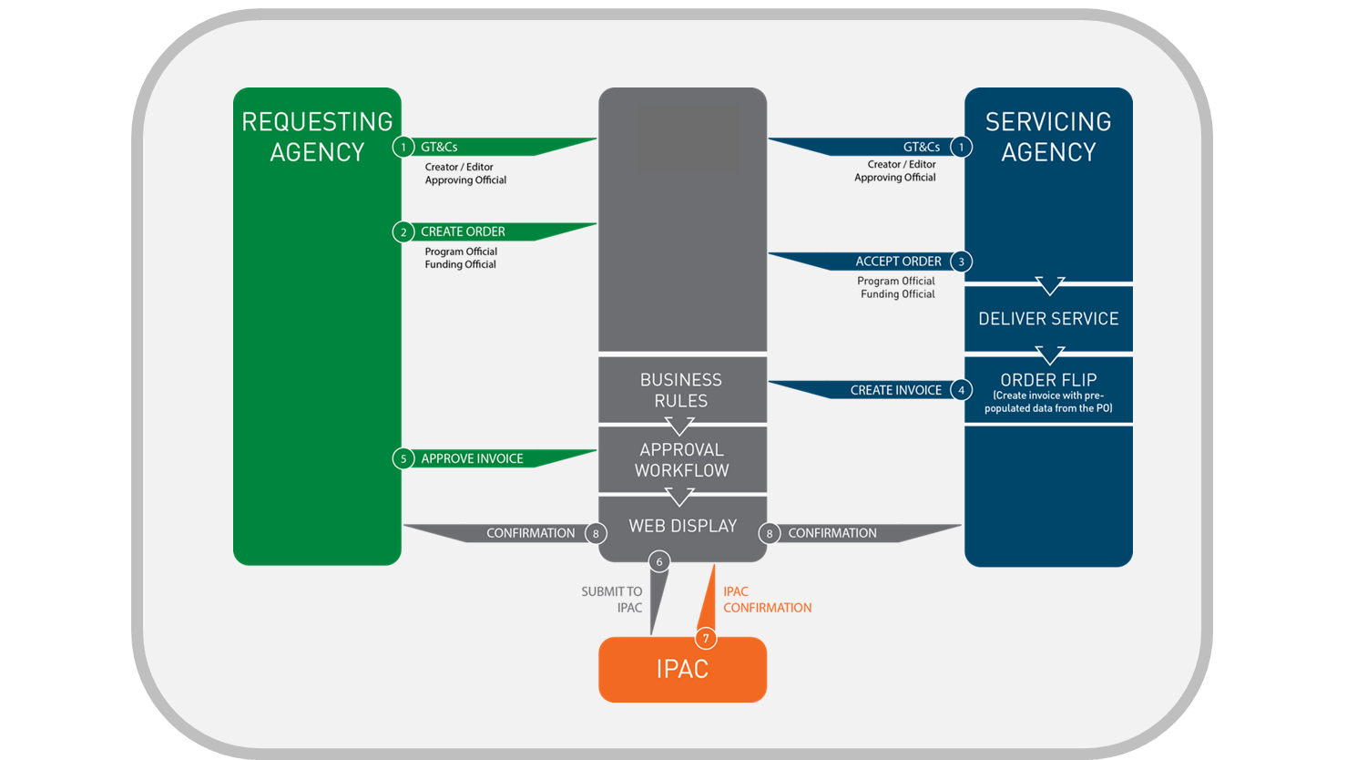

IGT Information Flow

Slide 16
Current System Offerings
IPP-IGT - Invoice Processing Platform - Intragovernmental Transactions Buy/Sell Module
Originally implemented in support of DoD
Being re-branded in September 2016 as G-Invoicing
IPAC - Intra-Governmental Payment and Collection System
Settlement mechanism for Buy/Sell transactions
Will operate in conjunction with G-Invoicing to accomplishment the movement of funds

Slide 17
System Development Activities
G-Invoicing 1.0 – September 2016
Separates IPP (E-Invoicing) and IPP-IGT (Buy/Sell)
Rebrands the application to G-Invoicing
Only active Users and GT&C data will be migrated / converted as part of the 1.0 Release
G-Invoicing 2.0 – Mid-FY 2017
Focus will be on enhancements to begin positioning G-Invoicing for a Governmentwide rollout
Continue to address change requests relating to security and enhanced permissions logic to control/limit user data access
Subsequent Releases
Align enhancements by core functions (GT&C, Order, Invoice)
Address requirements to facilitate Agency onboarding and implementation of data standards

Slide 18
Impact to the IGT Buy/Sell Difference
How will the G-Invoicing Application help to resolve the material weakness relating to IGT Buy/Sell in the Financial Report of the United States Government?
What G-Invoicing will be:
Agreement Broker
Workflow Enabler
Data Exchange Platform
What G-Invoicing will not be:
Not an Accounting System
Not a Procurement System
Not a replacement for talking to your trading partner

Slide 19
IGT Policy Standardization
Inter-Agency Agreement (IAA)
FMS Form 7600A – General Terms and Conditions (GT&C)
FMS Form 7600B – Order
Joint effort by OMB, FSIO / FMLoB, Fiscal Service, CFO Council, and many participating Agencies
Implemented in the IPP-IGT system
Minimum Accounting Data Elements (MADES)
2013 Treasury Financial Manual (TFM)
Chapter 4700, Appendix 10

Slide 20
Intragovernmental Data Standard
The Intragovernmental Transactions Working Group (ITWG)
Re-instituted under Fiscal Service’s leadership in August 2015 with the mission to define Federal IGT Buy/Sell Data Standards for Agreements, Orders and Invoices
Upcoming Publication Milestones
Fiscal Service Data Registry Updates – May 2016
GT&C, Order, Invoice
TFM Bulletin – May 2016
New Data Standards and rescission of MADES
TFM Chapter 4700, Appendix 10 Publication – May 2017

Slide 21
Key Stakeholder Engagement
Department of Defense
Partnering with DoD’s Business Integration Office (BIO)
Directly supporting DoD Piloting of the current IPP-IGT System along with continued training and onboarding of users
Ongoing sessions with BIO and their development team to discuss system enhancement requests and data standard alignment
Monthly participation in the Collaborative Agency Working Group chaired by BIO to discuss progress on G-Invoicing development and the data standards
Intragovernmental Data Standards Working Group Participants
Commercial Vendors
Establishing a working group to bring together key partners from ORACLE, SAP, and CGI Momentum to share results of our data standardization effort and discuss G-Invoicing rollout strategies
BEP | CIA | DOC | DoD | DOJ | DOL | Education
Energy | EPA | FBI | GPO | GSA | HHS | NASA
NRC | NSA | ODNI | OPM | Treasury | USDA | VA

Slide 22
Final Thoughts
Remediating the Material Weakness
Ultimate goal is to eliminate IGT differences at the governmentwide level for the Consolidated FR.
“Resolving the intragovernmental transactions problem remains a difficult challenge and will require a strong and sustained commitment by federal entities to timely resolve differences with their trading partners”
- FY 2015 U.S. GOVERNMENT ACCOUNTABILITY OFFICE INDEPENDENT AUDITOR’S REPORT

Slide 23

Contact Information
Kirstie Pottmeyer
Manager
Fiscal Accounting
Bureau of the Fiscal Service
(304) 480-5304
Kirstie.Pottmeyer@fiscal.treasury.gov

Slide 24
Contact Information (cont.)
For IGT Program Management and Agency Outreach Support
Matt Conrad
Manager, Intragovernmental Branch
Bureau of the Fiscal Service – Fiscal Accounting
304-480-1004
matt.conrad@fiscal.treasury.gov
Keith Jarboe
IGT Agency Outreach – Project Support Division
Bureau of the Fiscal Service – Fiscal Accounting
202-874-7818
keith.jarboe@fiscal.treasury.gov
For Intragovernmental Transactions Working Group Information
IGT@fiscal.treasury.gov
Alex Abshire (alexander.abshire@fiscal.treasury.gov)
Wesley Vincent (wesley.vincent@fiscal.treasury.gov)
https://community.max.gov/x/OYJ1Ng

