Slide 1
Using GAO’s Fraud Risk Management Framework
Joint Financial Management Improvement Program (JFMIP) Conference
May 9, 2016
Erin A. McLaughlin
Senior Analyst, Forensic Audits and Investigative Service (FAIS)
U.S. Government Accountability Office

Slide 2
What is the Fraud Risk Management Framework?
GAO published A Framework for Managing Fraud Risks in Federal Programs (GAO-15-593SP) in July 2015.
The Framework
provides guidance to aid federal program managers in strategically managing fraud risks, and
describes leading practices and conceptualizes these practices into a risk-based framework.

Slide 3
Why Did GAO Develop the Framework?
Fraud poses a significant risk to the integrity of federal programs and erodes public trust in government.
Based on our prior reviews, we saw a need for federal managers to take a more strategic, risk-based approach to managing fraud risks.
Effective fraud risk management helps to ensure that federal programs’ services fulfill their intended purpose, funds are spent effectively, and assets are safeguarded.

Slide 4

How Did GAO Develop the Framework?
To develop the Framework, we
conducted three focus groups with antifraud professionals;
interviewed eight federal Offices of Inspector General, three national audit institutions, the World Bank, the Organisation for Economic Co-operation and Development, and antifraud experts representing private companies, state and local audit associations, and nonprofit entities;
conducted an extensive literature review; and
sought input from federal program officials to independently validate leading practices.

Slide 5
How Does the Framework Relate to Existing Federal Efforts to Combat Fraud?
The Framework complements existing federal efforts, including
the revised Standards for Internal Control in the Federal Government (effective for Fiscal Year 2016);
improper-payments legislation; and
Office of Management and Budget guidance, including guidance on improper payments (OMB Circular A-123, Appendix C).
However, the Framework is fraud-specific and applies to nonfinancial, as well as financial, fraud risks.

Slide 6

How Can Program Managers Use the Framework?
Federal program managers can use the Framework’s leading practices as a guide when developing or enhancing efforts to combat fraud in a strategic, risk-based manner.
Managers can use the Framework to help implement Principle 8 of Standards for Internal Control in the Federal Government—“Assess Fraud Risks.”
Managers can tailor the Framework to their programs’ operations and environment, including existing risk management efforts.

Slide 7
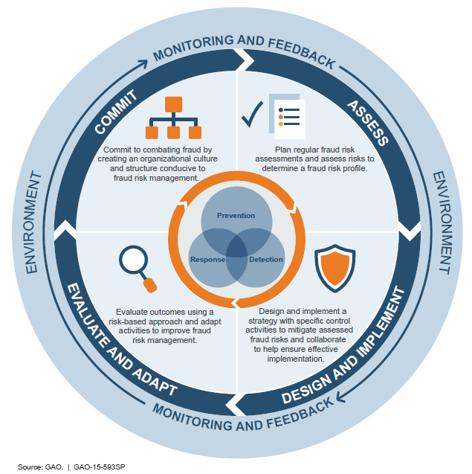
The Fraud Risk Management Framework
The Framework
encompasses control activities to prevent, detect, and respond to fraud, with an emphasis on prevention;
recognizes environmental factors that influence or help managers achieve their objective to mitigate fraud risks; and
highlights the importance of monitoring and incorporating feedback.

Slide 8
What Are the Components of the Framework?
Commit: Commit to combating fraud by creating an organizational culture and structure conducive to fraud risk management.
Demonstrate a senior-level commitment to combating fraud.
Involve all levels of the program in setting an antifraud tone.
Designate an entity to design and oversee fraud risk management activities (not the OIG).

Slide 9
What Are the Components of the Framework? (cont.)
Assess: Plan regular fraud risk assessments and assess risks to determine a fraud risk profile.
Tailor the assessment to the program and involve relevant stakeholders.
Assess the likelihood and impact of fraud risks, determine risk tolerance, and examine existing controls.
Document the program’s fraud risk profile, including risk tolerance, prioritization of risks, and other key findings and conclusions.

Slide 10
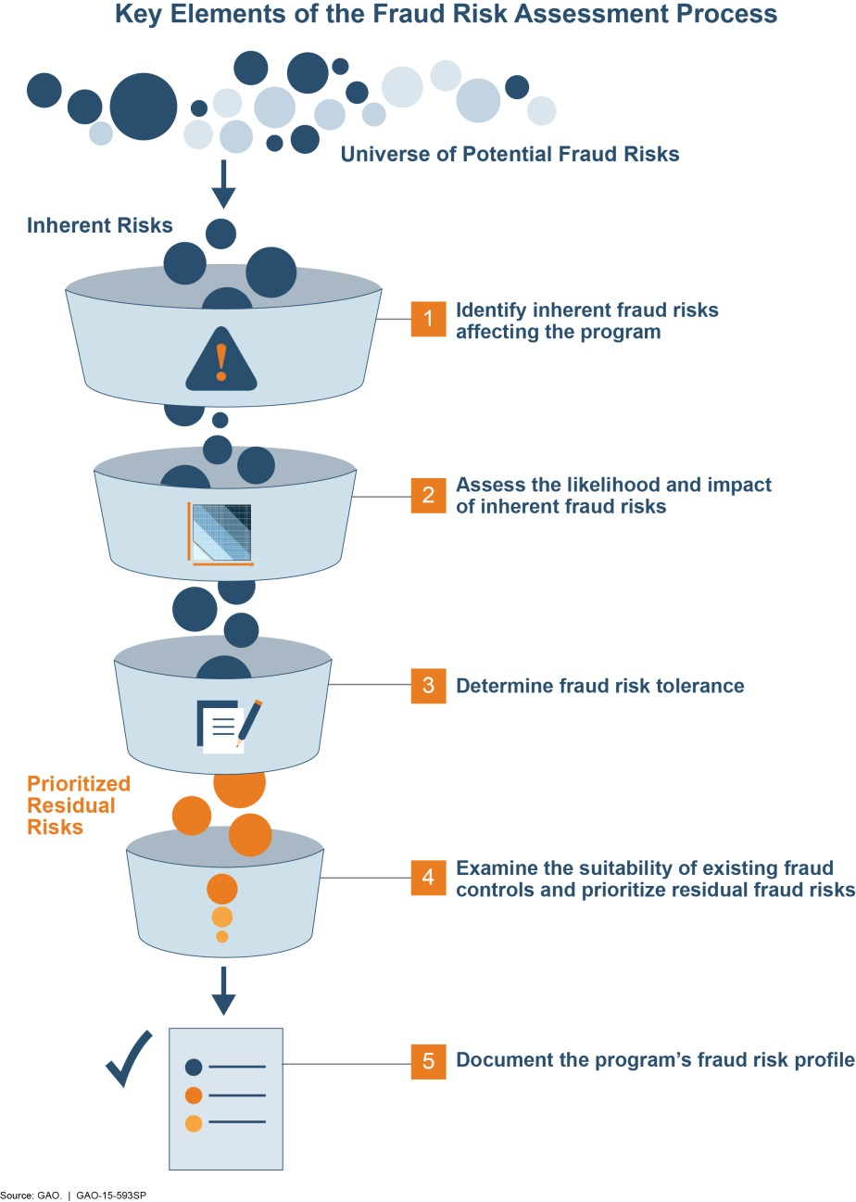

Slide 11
What Are the Components of the Framework? (cont.)
Design and Implement: Design and implement a strategy with specific control activities to mitigate assessed fraud risks and collaborate to help ensure effective implementation.
Develop, document, and communicate an antifraud strategy.
Consider the benefits and costs of controls to prevent and detect potential fraud, and develop a fraud response plan.
Establish collaborative relationships (such as working groups) and create incentives.

Slide 12
What Are the Components of the Framework? (cont.)
Evaluate and Adapt: Evaluate outcomes using a risk-based approach and adapt activities to improve fraud risk management.
Conduct risk-based monitoring on an ongoing basis and conduct evaluations periodically.
Collect and analyze data on instances of detected fraud to monitor fraud trends.
Use results of monitoring, evaluation, and investigations to improve prevention, detection, and response.

Slide 13
Next Steps
Federal program managers can begin using the Framework immediately to develop or improve fraud risk management efforts.
However, fraud risk management is an iterative process. Managers may focus on one or two components to start.
Over time, as the fraud risk management program evolves, managers will be more likely to effectively address all key elements.

Slide 14
Questions?
For further information:
A Framework for Managing Fraud Risks in Federal Programs is available online at: http://www.gao.gov/products/GAO-15-593SP.
Contact:
Linda Miller (202) 512-6124 millerls@gao.gov
Erin McLaughlin (202) 512-5481 mclaughlinea@gao.gov

Slide 15
GAO on the Web
Web site: http://www.gao.gov/
Congressional Relations
Katherine Siggerud, Managing Director, siggerudk@gao.gov (202) 512-4400, U.S. Government Accountability Office 441 G Street, NW, Room 7125, Washington, DC 20548
Public Affairs
Chuck Young, Managing Director, youngc1@gao.gov (202) 512-4800, U.S. Government Accountability Office 441 G Street, NW, Room 7149, Washington, DC 20548
Copyright
This is a work of the U.S. government and is not subject to copyright protection in the United States. The published product may be reproduced and distributed in its entirety without further permission from GAO. However, because this work may contain copyrighted images or other material, permission from the copyright holder may be necessary if you wish to reproduce this material separately.

