Slide 1
Joint Financial Management Improvement Project – Human Capital Panel
Monday, May 9, 2016
10:50am-12:00pm
Ronald Reagan Conference Center / Hemisphere Room
Presented by Anita Blair
Department of the Treasury

Slide 2
Kotter’s “8 Steps” to Leading Change | Treasury Human Capital Community
Establish a sense of urgency | Voice of the Customer (VOC) interviews of 100 operations leaders/managers helped identify critical gaps in HR technical & general business skills (2011)
Create a guiding coalition | Human Capital Community Executive Steering Committee (HCC-ESC) formed to oversee transformation (2011)
Develop vision and strategy | Human Capital Strategic Plan (HCSP) (2008-2013) included goal to transform human capital practitioners into strategic partners; expanded in 2014-2017 HCSP to include organizing other mission-critical occupations Roles-Based Competency Model provided HR career concept (Technical Specialist / Advisor / Strategic Partner roles at Beginner to Expert levels) Community-Based Workforce Planning (WFP) provides common basis for agency-wide competency and career development
Communicate change vision | HC Community Website is central source for information and interaction, including new member orientation video (2012-)
Empower broad action | Treasury Competency Assessment Project (TCAP) identifies skills gaps as basis for individual development plans (2011, 2013, 2015) Occupational Series Career Guides assembled by specialty leaders
Achieve short-term wins | Flash Mentoring sessions in DC, Philadelphia, Atlanta, Dallas Focus Days concurrent agency-wide training on key topics (professionalism, metrics)
Solidify gains | Strategic Partner Certification Program recognizes the up-and-coming community leaders across US in HR, Learning, EEO/D&I, and emerging disciplines (e.g., analytics)
Anchor in culture | 20+ Certified Strategic Partners (CSPs) voluntarily manage special projects, including organizing other Human Capital Practice Groups Cycle of Review and Renewal through updates of VOC, HCSP, WFP, TCAP updates; continuing oversight through HCC-ESC and HRStat

Slide 3
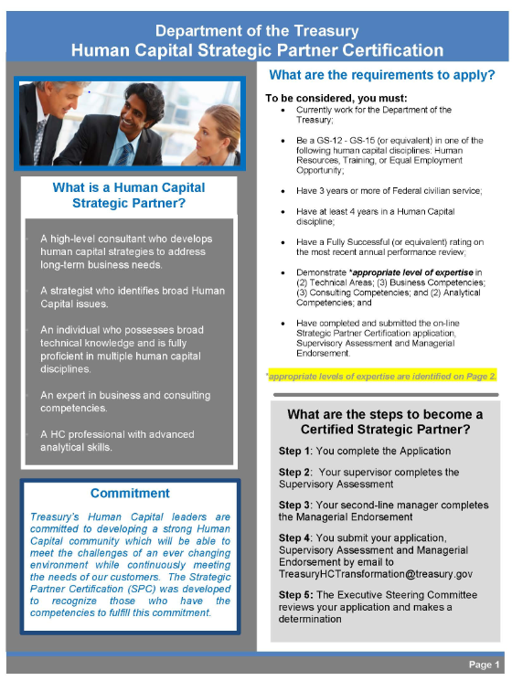

Slide 4
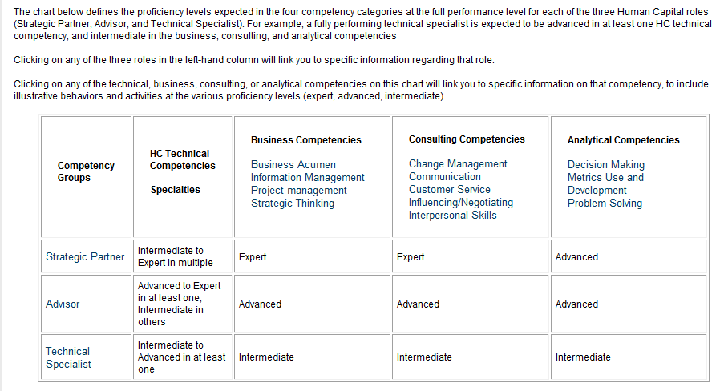
Treasury HC Professional Competency Model

