Slide 1
Joint Financial Management Improvement Program (JFMIP)
DATA Act Section 5 Grants Pilot
May 9, 2016

Slide 2
Presenters
Karen Lee
Nicole Martinez Moore
Office of Management and Budget (OMB)
Christopher Zeleznik
Department of Health and Human Services
DATA Act Program Management Office (DAP)

Slide 3
Purpose & Discussion Topics
Purpose
To provide a summary of the DATA Act and Section 5 Grants Pilot.
Discussion Topics
DATA Act Overview
Section 5 Grants Pilot
Opportunities for Involvement
Data-Centric Vision

Slide 4



DATA Act Overview
Establish Government-Wide Data Standards
Simplify Reporting
Improve Quality of Data
In May 2014, Public Law 113-101 Digital Accountability and Transparency Act of 2014 (DATA Act) was signed into law with the purpose to establish government-wide financial data standards and increase the availability, accuracy, and usefulness of federal spending information.

Slide 5


DATA Act Overview - Section 5 Pilot Requirements
The goal of the Pilot is to implement Section 5 of the Digital Accountability and Transparency Act (DATA Act) of 2014, Pub. L. No. 113-101, which requires the Federal Government to, “establish a pilot program with the participation of appropriate Federal agencies to facilitate the development of recommendations for:
(A) standardized reporting elements across the Federal government (§5(b)(1)(A));
(B) the elimination of unnecessary duplication in financial reporting (§5(b)(1)(B));
(C) the reduction of compliance costs for recipients of Federal awards (§5(b)(1)(C)).”
The Office of Management and Budget (OMB) has partnered with HHS to serve as the executing agent for the Section 5 Grants Pilot.

Slide 6
DATA Act Overview - Section 5 Legislative Timeline
The following is a list of key activities and deadlines outlined in Section 5 of the DATA Act legislation.
Activity | Deadline
Section 5: Establish Pilot program that will generate recommendations to standardize reporting, eliminate duplication and unnecessary reports, and reduce compliance costs. | Establish 1 year after enactment Complete within 2 years after Pilot established May 2015 – May 2017
Section 5: Report on results of Pilot. | 90 days after Pilot completion August 2017
Section 5: Guidance to agencies on how data standards can reduce burden and simplify reporting requirements/eliminate duplication. | 1 year after Report August 2018

Slide 7
DATA Act Overview - One Pilot, Two Tracks
While Federal awarding and reporting processes have similarities, there are unique burden areas that merit exploration for burden reduction. To accommodate those award-specific areas, two tracks are underway:
Federal
Grants
Federal Procurement
The Office of Management and Budget (OMB) has partnered with HHS to serve as the executing agent for the Section 5 Grants Pilot.
Notes:
The S5P has two tracks: contracts and grants

Slide 8
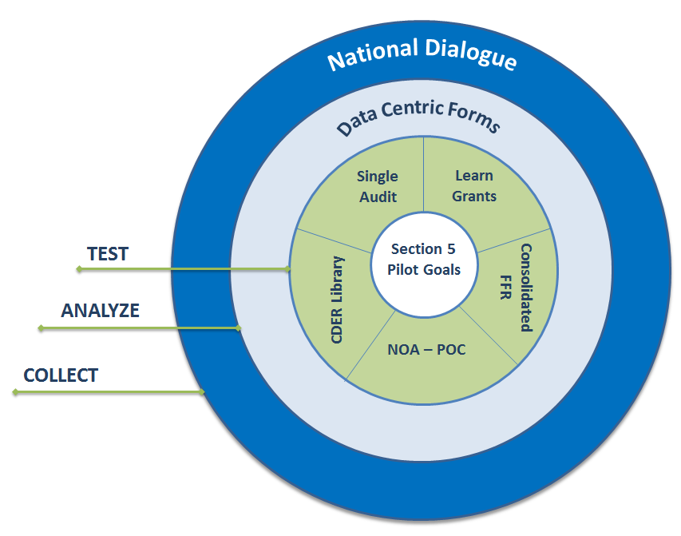
Section 5 Grants Pilot – Approach & Framework
HHS DAP created the Section 5 Grants Pilot Framework, which takes a holistic approach to meeting the Section 5 Pilot Goals by:
Collecting feedback through the National Dialogue (https://cxo.dialogue2.cao.gov/).
Analyzing data centric forms.
Testing models like the CDER Library, Consolidated FFR, Single Audit, NOA – POC, Learn Grants, and other models as appropriate.
Each component of the Framework interacts with and informs the others.
Section 5 Grants Pilot Framework
Section 5 Pilot Goals
Standardize reporting elements.
Eliminate unnecessary duplication.
Reduce compliance costs for Federal award recipients.

Slide 9
Section 5 Grants Pilot - Test Model Topics
Single Audit
Single Audit is an organization-wide financial statement and federal awards’ audit.
Learn Grants
Learn Grants is a tab on the Grants.gov website that provides grant recipients access to federal grants lifecycle information.
Consolidated Federal Financial Reporting (FFR)
Federal Financial Report (FFR) is a form that federal grant recipients are required to fill out and submit to their grant-awarding agency.

Slide 10
Section 5 Grants Pilot - Test Models Topics
Notice of Award – Proof of Concept (NOA – POC)
NOA – POC is a document containing information a grant recipient needs in order to perform routine accounting and finance operations.
Common Data Element Repository (CDER) Library
CDER Library is designed to be a federal-wide, online repository for grants-specific data standards, definitions, and context.

Slide 11
Section 5 Grants Pilot - Single Audit Test Model
Single Audit, previously known as the OMB Circular A-133 audit, is an organization-wide financial statement and federal awards’ audit of a non-federal entity that expends $750,000 or more in federal funds in one year. It is intended to provide assurance to the Federal Government that a non-federal entity has adequate internal controls in place, and is generally in compliance with program requirements. Non-federal entities typically include states, local governments, Indian tribes, universities, and non-profit organizations.
Compare
Current and new forms and processes.
Survey
Auditors, auditees, and federal agency report users to identify reduction in compliance costs and other benefits.
Engage
Stakeholder feedback.
Report
Recommendations to OMB.
Test: Provide non-federal entities with the draft 2016 expanded Single Audit Concept Form (SF-SAC only), and collect participant feedback on a more streamlined approach for SF-SAC/SEFA reporting.
Discussion: Present the draft expanded Single Audit form and allow participants to comment upon the SF-SAC changes in a live setting.

Slide 12
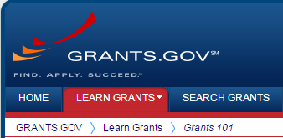
Section 5 Grants Pilot - Learn Grants Test Model
Learn Grants is a tab located on the Grants.gov website, which promotes knowledge sharing among the grants community by providing access to grants lifecycle information, grant opportunities, and application tracking capabilities.
Fosters greater public transparency into the grants lifecycle and community engagement.
Designed to reduce stakeholder burden associated with trying to learn, find, and apply for federal grants.
Provides a comprehensive point of reference to access federal grants lifecycle information.
Access Learn Grants: http://www.grants.gov/web/grants/learn-grants.html
Since May 2015, Learn Grants has received, on average, 57,000 visits. On average, at least 60% of responding users continue to rate the tool 8 out of 10 or higher in its ability to answer their questions.
Test: Determine users’ level of understanding on the grants lifecycle before and after using Learn Grants.

Slide 13
Section 5 Grants Pilot - Consolidated Federal Financial Reporting (FFR)
The Federal Financial Report (FFR) is a form that federal grant recipients are required to fill out and submit to their grant-awarding agency. The Consolidated FFR will allow grant recipients to submit all information related to the FFR in one system, rather than in multiple entry points. The Consolidated FFR test model will identify reductions in burden for both grant recipients and the Federal Government. This will allow for a single point of data entry, earlier validation of FFR data, and a potential future streamlining of the close-out process.
Test: Provide grant recipients with one consolidated process for submitting the FFR to identify potential time savings and/or improved accuracy by entering all information through one system.
Discussion: Work with selected participants who have used the Consolidated FFR submission process to determine perceived or actual efficiencies gained. Walk participants through the changes to the FFR and allow for questions/feedback.
The GRIP June 2013 recommends a pilot using standard data elements for the FFR/SF-425 to further test the objective of centralized reporting for grant recipients. HHS will work with PMS, ACF, and ACF grant recipients to execute this related model.

Slide 14
Section 5 Grants Pilot - Notice of Award – Proof of Concept (NOA – POC)
The NOA is a document that contains information that grant recipients need in order to perform routine accounting and finance operations. NOAs often differ in format and content across both departments and agencies. For grant recipients with funding from various government sources, this becomes a burden when searching for information across awards.
Data from the NOA – POC test model may inform ways to increase efficiency and reduce grant recipient reporting burden.
Grants information into a standard NOA.
Grant recipient ability to complete data collection tool with and without standard NOA.
Grant recipients about their experience.
Consolidate
Compare
Survey
Test: Provide grant recipients with a standard NOA –POC cover sheet for federal awards to populate a data collection tool. Identify how standardizing the NOA could result in efficiencies for grant recipients.
The standard NOA – POC will be used for testing purposes only and is not intended to be adopted for Government-wide use.

Slide 15

Section 5 Grants Pilot - Common Data Element Repository (CDER) Library
The Common Data Element Repository (CDER) Library is designed to be a federal-wide online, searchable repository for grants-specific data standards, definitions, and context. The CDER Library provides a forum to engage federal and public stakeholders in further defining federal financial and business terms/definitions inclusive of agreed-upon standardized data elements. Through the Section 5 Grants Pilot, we will test the utility of the CDER Library to:
Provide access to agreed upon data standards.
Improve financial transparency.
Promote consistency of Federal Financial business terms and definitions.
Assist the Federal Government in creating information collection instruments.
Access the CDER Library: https://repository.usaspending.gov/poc-tool/
Test 1: Provide grant recipients with data element definitions to identify potential changes in accuracy and speed of grant lifecycle form completion.
Test 2: Identify form duplication and update/reduce forms to reduce grant recipient burden.

Slide 16
Section 5 Grants Pilot - Update
On March 30th and 31st, DAP conducted its inaugural test at the NGMA 2016 Annual Grants Training.
On April 26th, DAP began outreach efforts to enlist participants in the Pilot test models.
May
2015
September 23
November 2
November 20
January
2016
April 2016
May 2016
May 2017
August 2017
2015
2016
2017
Pilot Activities Begin
OMB Concurs on Test Models
Federal Register Notice Published*
Section 5 Grants Pilot Town Hall
Design Effectiveness Pretest Meeting
Select Pilot Participants
Begin Collection of Pilot Data
Pilot Data Collection Ends
Submit Report to Congress
Paperwork Reduction Act (PRA) Review*
November 2
August
2016
Upcoming Conferences
AGA (Anaheim, CA) – July
NCURA (Washington, DC) – August
Present time
*The Federal Register Notice is a component of the PRA Review.

Slide 17
Data-Centric Vision
The Section 5 Grants Pilot provides an opportunity to identify areas for streamlining the grants reporting process by testing models that address both government and grant recipient reporting processes to achieve a long-term goal of a data-centric vision.
3
NOA - POC
Single Audit
Learn Grants
Government
Process
Grant Recipient Reporting Process
Data-Centric Vision
Consolidated
FFR
CDER
Library
Partnership
Section 5 Grants Pilot
Recommendations
Long-term Goal
Standardize Reporting, Eliminate Duplication, and Reduce Reporting Burden

Slide 18







Opportunities for Involvement
There are several ways to participate in DATA Act activities.
Send inquiries and feedback to DATAActPMO@hhs.gov.
Visit the DAP Website at www.hhs.gov/dataactpmo.
Follow DAP on Twitter at www.twitter.com/HHS_DAP.
Access Learn Grants at http://www.grants.gov/web/grants/learn-grants.html.
Visit the CDER Library at https://repository.usaspending.gov/poc-tool/.
Join the National Dialogue at https://cxo.dialogue2.cao.gov.
For more information on the DATA Act, visit https://www.usaspending.gov/Pages/Data-Act.aspx.

Slide 19
Key Contacts Information
Karen Lee, Office of Management and Budget:
Karen_F._Lee@omb.eop.gov, and (202) 395-8083
Nicole Martinez Moore, Office of Management and Budget:
Nicole_M_Martinez-Moore@omb.eop.gov, and (202) 395-7552
Michael Peckham, DAP Executive Director:
Michael.Peckham@hhs.gov, and (202) 205-9452
Christopher Zeleznik, Intergovernmental and Public Engagement Lead:
Christopher.Zeleznik@hhs.gov, and (202) 205-3514
Debbie Kramer, CDER Library Technical Lead:
Debbie.Kramer@hhs.gov, and (202) 260-6184
Ada Adams, Program Analyst / Section 5 Pilot Communications Lead:
Ada.Adams@hhs.gov, and (202) 401-2767

