Slide 1


CoE MPP
An introduction
Accelerating IT Modernization
An open source procurement process
using a purchase card.

Slide 2

Our vision
Accelerating IT Modernization
The CoE MPP will allow agile project teams to obtain professional services from traditional and new-to-the-government vendors, completely in the open, through a process that leverages the $10,000 micro-purchase threshold and FAR Part 13 in a scalable and sustainable way. This will save the government time and money while making these types of procurements that much easier.

Slide 3
What is the CoE MPP?
Accelerating IT Modernization
1. An overview

Slide 4
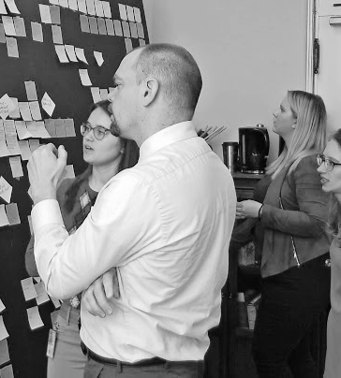
What is the problem?
Accelerating IT Modernization
What is the CoE MPP?
In any IT-related procurement, there will be tasks that arise during execution of the project that could not have been predicted at the start of a project.

Slide 5
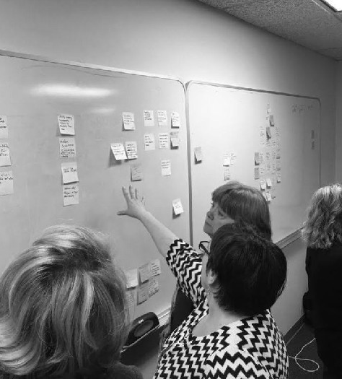
What does this solve?
Accelerating IT Modernization
What is the CoE MPP?
As a result, there will always be user stories that will be out of scope of a supporting procurement or beyond the capacity of the project team.

Slide 6




GSA Centers of Excellence
Accelerating IT Modernization
What is the CoE MPP?
What are we doing now?
Issuing a new procurement
This is a process that can often take months, time our projects simply don’t have.
Internal staffing requests
Finding internal staff will be dependent on availability, not necessarily capability..
Modifying contracts
Each CO/KO will handle this differently, resulting in no consistency or scalability..
Working around the problem
Some teams simply drop features that they’d otherwise want or need.
Notes:
Each Acquisition shop has its own set of rules, which adapt and change based on who is managing the work (PM), who is overseeing the buys (CO/KO/1102), how finances are worked (their Finance team and ours), and agreements that need to be put in place before anything can begin (their OGC and ours). In the past, and presently, these factors have driven up PALT times and created fatigue on the project teams for accomplishing work in an agile way.

Slide 7
GSA Centers of Excellence
Accelerating IT Modernization
What is the CoE MPP?
All good ideas...
The 18F Micro-purchase Marketplace was successful in theory, but not a practical solution due to the micro-purchase threshold in place at the time.
cloud.gov built on those ideas with their own version.
The Department of Veterans Affairs (VA) developed their own platform as well.

Slide 8
GSA Centers of Excellence
Accelerating IT Modernization
What is the CoE MPP?
...build on those before them.
Through the development of the CoE MPP, we’ve built on all of these efforts, using the lessons learned from our experiences with agency and industry partners.
Notes:
Using the new $10k limit, we can allow teams to actively participate in the procurement process. Through the use of the CoE MPP, their needs are met quickly while adhering to Agile principles throughout, ensuring the procurement process itself grows and iterates alongside the project team’s needs.

Slide 9
How does the CoE MPP work?
Accelerating IT Modernization
2. The prototype

Slide 10
GSA Centers of Excellence
Accelerating IT Modernization
How does the CoE MPP work?
5 simple steps, from new idea to archived file.
1
2
3
4
5
Identifying a user story
Advertising the request
Issuing an award
Approving deliverables
Closing out the buy

Slide 11




GSA Centers of Excellence
Accelerating IT Modernization
How does the CoE MPP work?
What are the components?
Standard formatting
A standard response format will make the process easy for vendors, while mandating SAM.gov registration.
Public GitHub repos
For each project using the CoE MPP, a public repo will keep their needs and community feedback organized.
Internal management
A centralized project board will be used to organize and manage buys on all CoE MPP public repos.
Emphasis on transparency
By doing everything in the open, continuous improvement and protest risk mitigation is built in.

Slide 12
GSA Centers of Excellence
Accelerating IT Modernization
How does the CoE MPP work?
A scalable solution
Discrete user stories
Public repos
Internal board
Awards
CA
CoE MPP
CX
DA
Notes:
The public repos don’t have to be just at the team level, they can get down to the team or even project level. For example, each CoE agency partner can have a separate public repo for each CoE. It’s the use of a singular Google Form for intake purposes that allows the TTS MPP team to keep themselves organized internally.

Slide 13
Dive deeper into the CoE MPP
Accelerating IT Modernization
3. Learn more

Slide 14
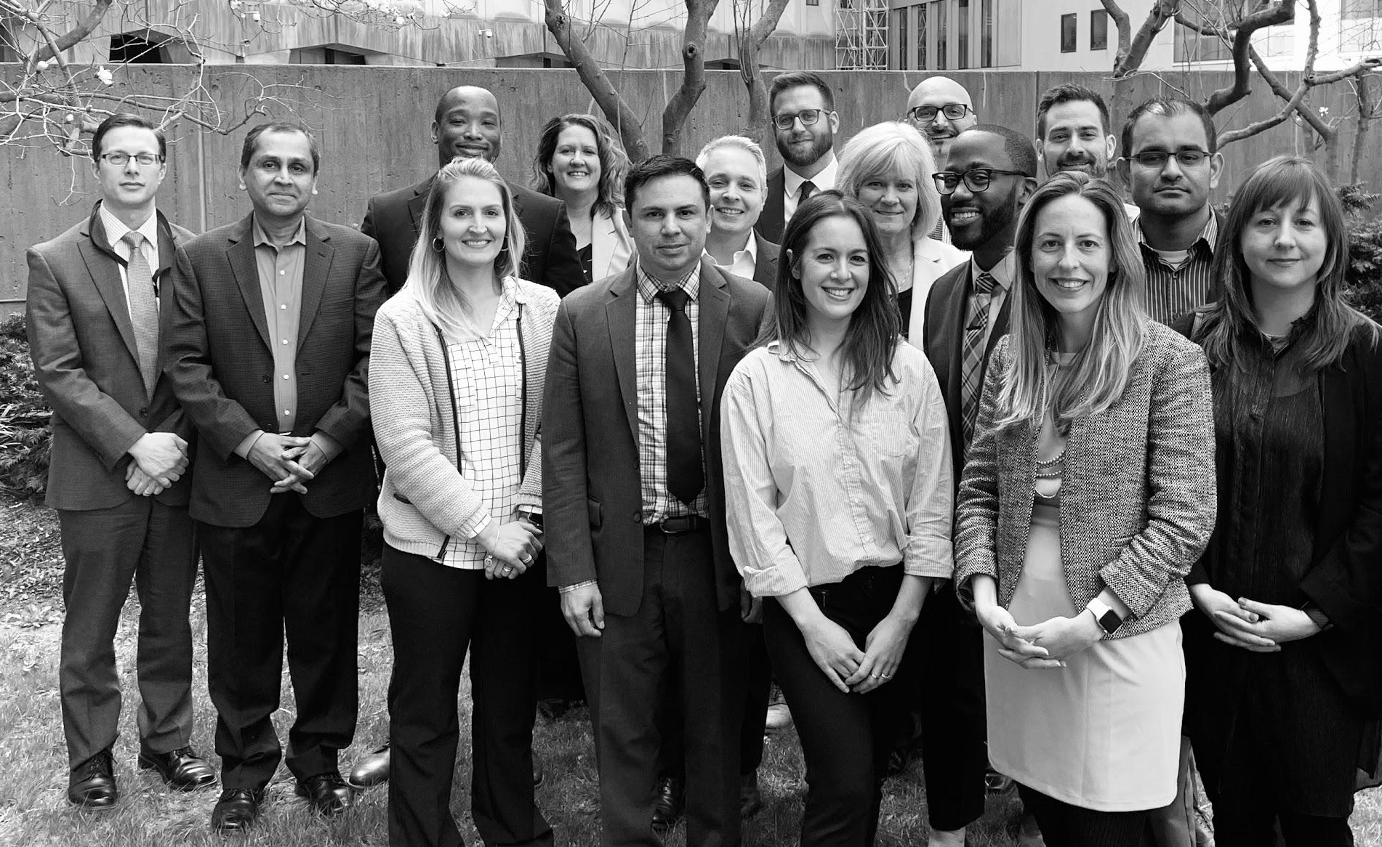
Where can you learn more?
Accelerating IT Modernization
Dive deeper into the CoE MPP
You can always contact us to learn more. We also have the following public resources available:
CoE template repo
CoE process repo
CoE acquisition repo
CoE website
CoE Twitter
Notes:
Note that that CoE MPP process (prototype) description says it is the repo for a CoE MPP, not the CoE MPP. Remember: this process should be repeatable and utilized by as many project teams necessary with one central repository of all the information gathered from each of those project teams.

Slide 15

Thank
you.
Accelerating IT Modernization
GSA Centers of Excellence
connectcoe@gsa.gov

