Slide 1

A New Look at ART & SRT
Presented by: Laura Boniello Miller, Ann Levin, Collin Schreyer, Michael Horton
May 21, 2025

Slide 2
Introduction to the Accessibility Requirements Tool (ART)

Slide 3

Today’s Agenda
What is Section 508?
Why Accessibility Matters
Your Role in Section 508 Requirements
ART Enhancements & Demo
Questions?

Slide 4

What is Section 508?

Slide 5




Why Accessibility Matters
Remediation
Modification
Deliverables
Lawsuits
Notes:
Why does Accessibility Matter? - It is all of our responsibility to ensure 508 requirements make it into our requirements for Information Communication Technology (ICT). The compliance with Section 508 falls primarily on the ordering level CO/CORs/PM’s. However I want to stress that it is everyone’s responsibility to ensure that any products/services are compliant. The other reasons 508 matters is because it is practical, reduces your workload, saves the government money, and is just the right thing to do to ensure everyone is able to their complete tasks, and are able to get the job done!
By using the ART Tool you are able to avoid and reduce the following four cost areas:
Remediation: 508 should be considered from the get-go, because if it’s not, remediation is then required. And unfortunately, it also increases the agency’s cost by up to 50% more than the original purchase, in order to course correct mid-project. This leads to my next point.
Modification: When section 508 requirements are included from ART in the beginning the need for Modifications of contract language are reduced. Saving you from having to spend added time and efforts on this purchase.
Deliverables: Including 508 language from ART ensures that deliverables are accessible and can be used by everyone, this includes federal employees and taxpayers who need to use our ICT that we procure.
Including Section 508 language provided by ART will ensure we reduce the amount of lawsuits the government receives, which also saves us money.
Next Slide

Slide 6

Your Role In Section 508 Requirements
Ensure that all ICT procurements meet Section 508 standards.
Ensure Section 508 standards are considered in the acquisition planning documents and procurement requirements for ICT
Include appropriate Section 508 accessibility standards in requirements and acquisition planning documents and agreements.
Assess and validate that deliverables meet the accessibility standards.

Slide 7
ART Enhancements & Demo

Slide 8
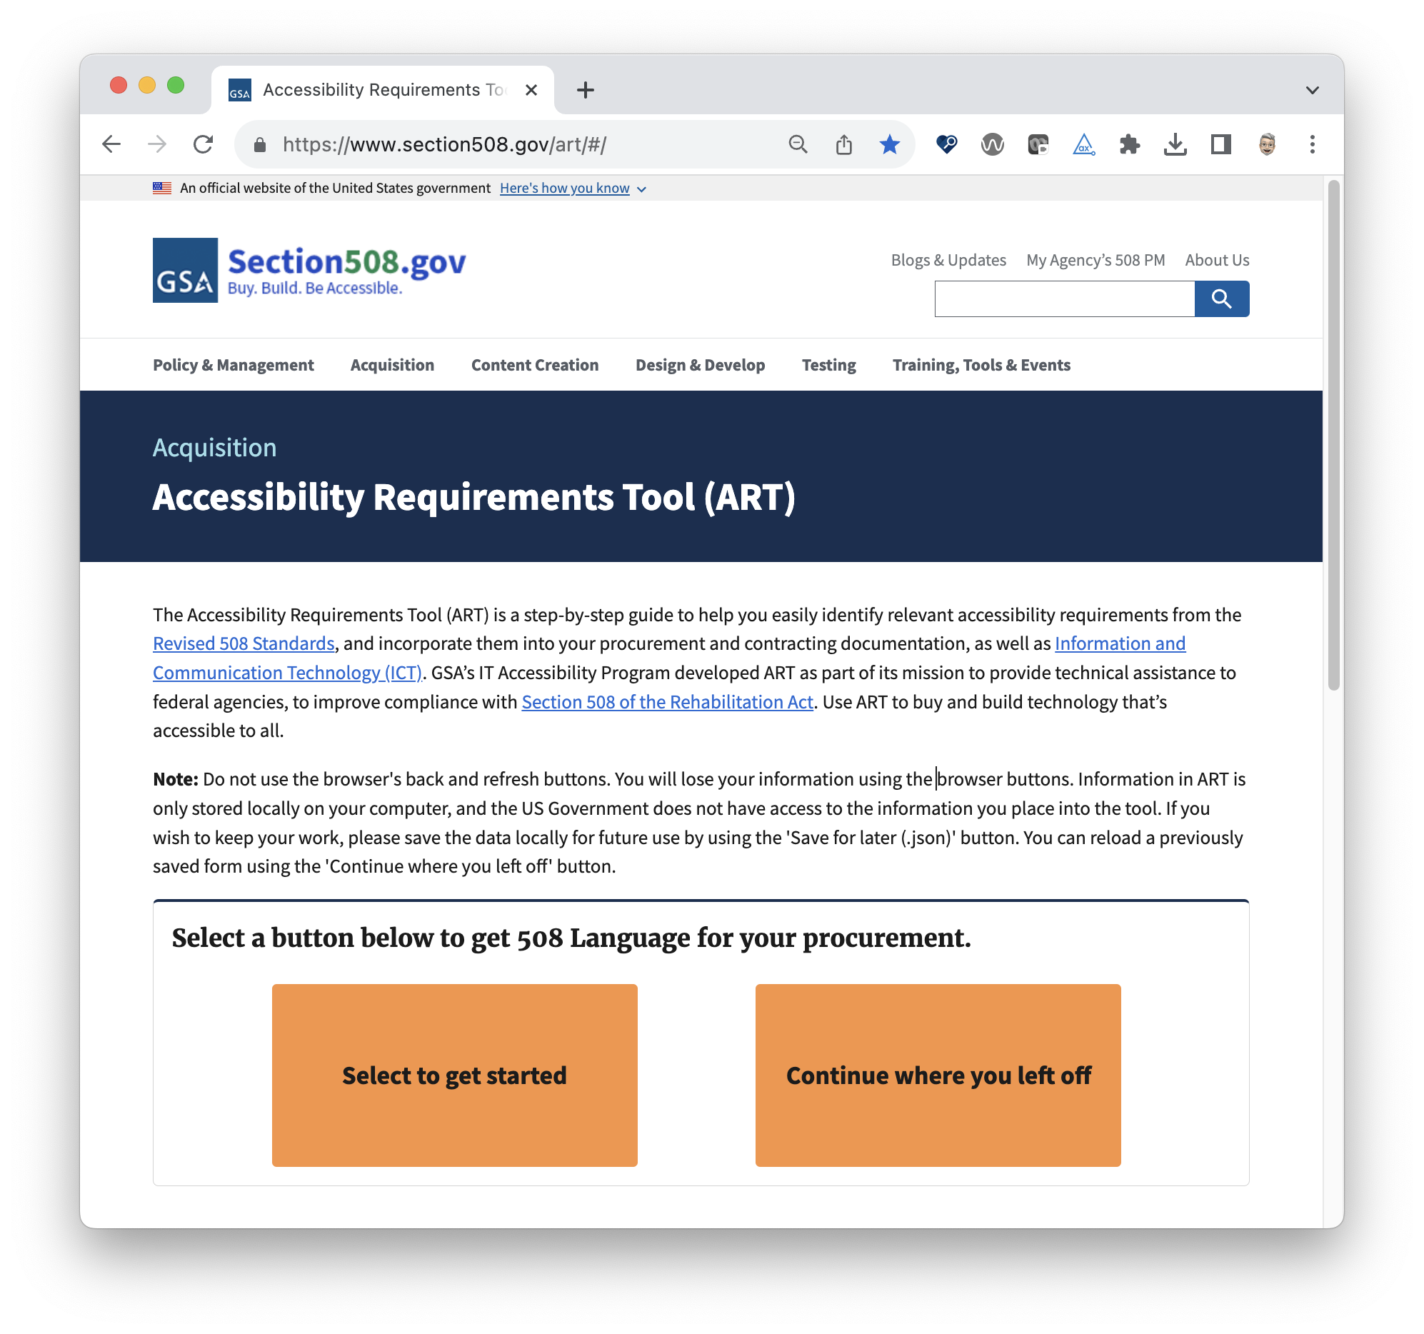
What is ART?
ART stands for:
Accessibility
Requirements
Tool
*No, not our former colleague, Arthur

Slide 9

ART Enhancements
Built with Angular 15 and available open-source on GitHub.
Accessible via Section508.gov and hosted on Cloud.gov Pages.
Fully mobile-friendly for access across devices.
Allows saving completed forms in multiple formats—DOCX and JSON.
Supports resuming work by uploading a saved JSON file.
Includes a data dictionary of Section 508 requirements for each category.
Designed for easy integration with other platforms and software.
Cut procurement flow completion time by 50%.

Slide 10

ART Demo – Live!
Section508.gov/art
Notes:
Section508.gov/art

Slide 11

Incorporating Your Feedback
Since it’s refresh in 2023, we’ve continuously improving ART post launch:
Demos to over 1,400 federal employees across 13 agencies
Conducted User Acceptance Testing and have incorporated user requests, feedback, and corrections into ART
Implementation of user requests to make ART user friendly, useful, and meaningful to generate Section 508 language for solicitations
Implementation of an Application Programming Interface (API) — a structured way for systems to communicate and share data, enabling faster, more secure, and scalable integration between applications.

Slide 12
ART API Server
Our team developed an Application Programming Interface (API) for ART to enable integration with other systems and provide Section 508 requirements language. The API offers endpoints to:
Retrieve Section 508 accessibility requirements.
Manage and update accessibility requirement data.​
Integration & Use
To request integration, contact your agency’s contract writing system owner.
GSA is piloting with the Solicitations Review Tool (SRT) — Fall 2025.

Slide 13

Questions?
To access and start using ART, visit Section508.gov/art
For information on the ART API Server, visit art-api.section508.gov
To ask questions or share your feedback about ART, email us at art@gsa.gov
To contact the Government-wide IT Accessibility Program, email us at section.508@gsa.gov
Notes:
To access and start using ART, visit Section508.gov/art
For information on the ART API Server, visit art-api.section508.gov
To ask questions or share your feedback about ART, email us at art@gsa.gov
To contact the Government-wide IT Accessibility Program, email us at section.508@gsa.gov

Slide 14
Introduction to the Solicitation Review Tool (SRT)

Slide 15







Agenda
What is the SRT?
How to Access SRT
Logging in to the SRT
Daily Reports
Uploading Solicitations Pre-Release
How does the SRT work with ART?
Next Steps
Notes:
This is an introduction to the SRT – and while some of you may be familiar with the SRT, we will quickly cover, what it is, how to access it, where you would go to log in, what information is available and new features such as pre-checking solicitations before release, and what’s next.

Slide 16
What is the SRT?
Developed to help agencies assess & improve the accessibility compliance of solicitations.
SRT scans SAM.gov every 24 hours and eBuy.gov manually 1/month or more.
Checks to see if a solicitation is ICT related.
Checks to see whether the solicitation includes Section 508 compliance requirements.
Notes:
SRT scans for the absence or presence of sufficient Section 508 languages (specific regulatory requirements) in all ICT posted on SAM.gov (https://www.sam.gov/) EXCEPT FOR types of solicitations with 0 documents, non-machine-readable solicitations, pre-solicitations, sources sought, special notices, award notice and intent to bundle requirements. SRT will provide results for each scanned solicitation with Compliant or Non-compliant (Action Required) status. If the solicitation does not require the inclusion of section 508 language, for example, you are purchasing an ICT part or your solicitation is a sources sought, you are able to click not applicable, to resolve conformance.
SRT does a daily night scan to pull the data from Sam.gov. Ebuy is updated manually.

Slide 17

Who can access the SRT
The SRT is available to agency procurement officials and Section 508 PMs
Send a request to srt@gsa.gov
Notes:
SRT provides value to federal agencies’ Section 508 Program Managers, Chief Information Officers, Contracting Officers, and Contracting Officer Representatives. It provides assistance on agencies’ procurement process to ensure compliance. User access is restricted to those who have email addresses of .gov, .mil, .edu, and .us.
SRT is a private platform for agencies to manage their own solicitations. You will only be able to see your agency’s solicitations and, conversely, only those authorized can see your agency’s solicitations and results.
For access, send a request to srt@gsa.gov which will be added to chat.

Slide 18
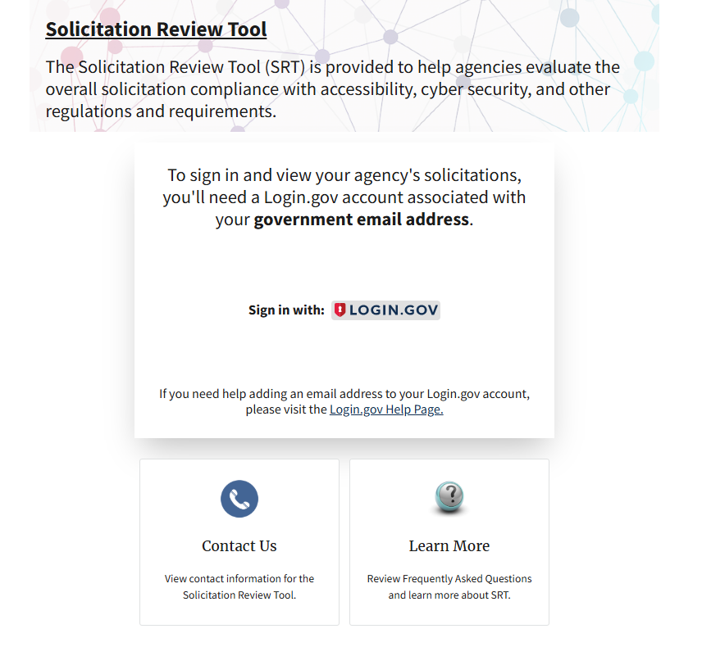
SRT Login
Use the Login.gov account associated with your government email address.
Notes:
One granted access you will be able to use your login.gov account associated with your government email address. A user is required to request access to the tool in order to obtain the SRT data.

Slide 19
Section 508 PMs using SRT
Section 508 PMs go into the platform to review the results of all solicitations from his or her agency and provide feedback on the prediction results.
Notes:
The Solicitation Review Tool (SRT) was developed to help agencies assess and improve the accessibility compliance of solicitations.
The SRT is built with open-source technology and uses artificial intelligence (AI), natural language processing, text mining, and machine learning to automatically detect whether new solicitations posted on federal acquisition platforms are for Information and Communication Technology (ICT). If a solicitation is identified as ICT-related, the SRT then checks whether it includes adequate Section 508 compliance requirements to support accessibility in federal IT.
As mentioned, SRT scans the SAM.gov and eBuy.gov every 24 hours, across all solicitations and delivers:
A report on all the new ICT solicitations for the previous day
A report of ICT solicitations flagged for manual review
A portal for agency SMEs to perform manual reviews of flagged solicitations
Trending data of flagged solicitations by agency and government-wide

Slide 20
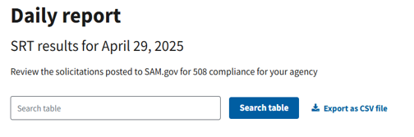
The SRT Daily Report
Current daily report allows you to view all solicitations reviewed for your agency.
Review results include:
Compliant
Non compliant
Cannot evaluate
Notes:
Compliant: The ICT solicitation contains sufficient Section 508 requirements. Non-compliant: The ICT solicitation may not contain sufficient Section 508 requirements.
Cannot evaluate: The ICT solicitation is not in a machine readable format. A manual review is required
Solicitation number, Title, Notice Type (Solicitation, Combined Synopsis/Solicitation,) Date, Review Result, Latest action Date are also currently displayed in the daily report.
S

Slide 21
What Information is Collected
Data Analytics
Non machine readable files, pre-solicitations, award notices, and N/A solicitations (non ICT) are excluded from the data.
Shows the number of solicitations manually reviewed by 508 Coordinators.
Can also show:
# of Emails sent to POC
# of Updated Solicitations
# of Updated Compliant Solicitations
# of new solicitations added per day
#’s by agency
#’s of N/A
#’s Cannot Evaluate
Notes:
Solicitations with 0 documents, non-machine-readable solicitations, pre-solicitations, sources sought, special notices, award notice, intent to bundle requirements, and not applicable solicitations (See ‘What are “Not Applicable Solicitations”?’) are excluded.

Slide 22
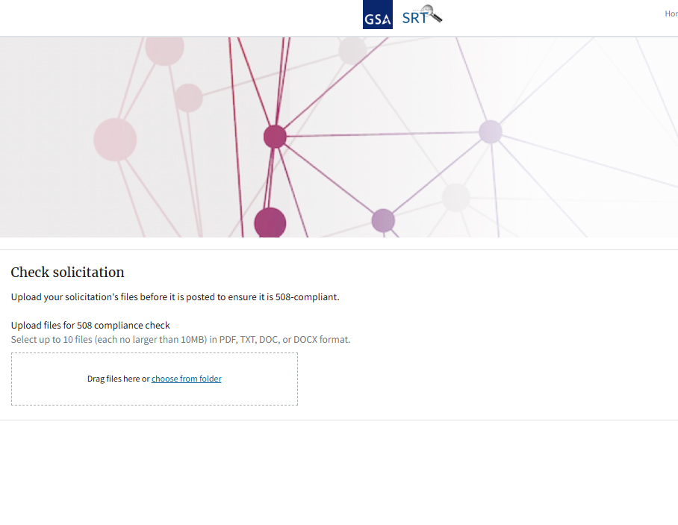
Upload Solicitations
Check solicitations before they are released

Slide 23
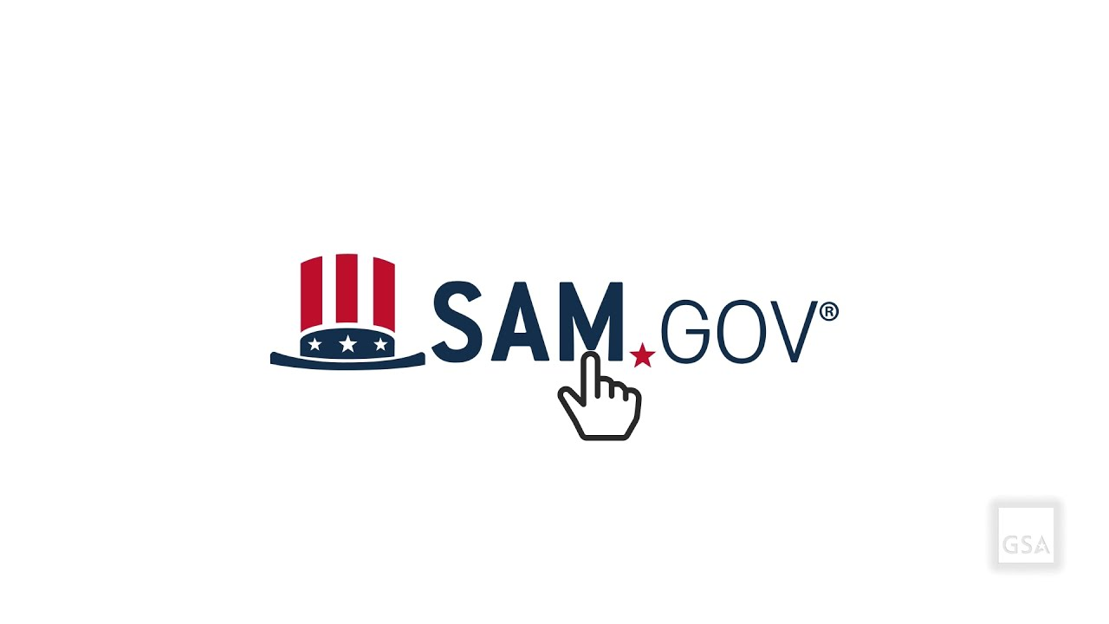

Data Sources
Current Sources
Notes:
Future development opportunities would be in expanding to other data sources.
Let’s open up to ask for potential additional sources.
Can I mention FedConnect, Grants.gov, DISA, GSAAdvantage, NITAAC?)
SAM.gov is checked every 24 hours while eBuy is uploaded as needed (typically monthly).

Slide 24
Existing Methodology
Existing Model
Current Model is a machine learning backend that automatically marks solicitations as compliant or non-compliant.
Keyword Matching
Manual Updates
Binary Classification
Semantic Understanding
Notes:
What is the description of the existing model? Traditional Machine learning relies on Keyword matching for predictions. Static rule sets need frequent manual updates to remain effective. Binary classification methods often lack explanatory power. Limited semantic understanding hampers the model’s effectiveness. The compliance rate is relatively low.

Slide 25
Methodology Issues
RAG Model
Contextual understanding of solicitation documents
Missing Context
Implementation of Retrieval Augmented Generation
No digital components
Intelligent Section 508 application determination
Rigid Keyword Matching
Better at identifying ICT for applicability
Notes:
Retrieval augmented generation is applied for specific section 508 information. This allows for contextual understanding of solicitation documents and intelligent Section 508 applicability determination. It is better at identifying ICT.
What is the future model (RAG)

Slide 26
Methodology Improvements
RAG Model
Similarity search
Nuanced compliance determination
Contextual understanding of solicitation documents
Implementation of Retrieval Augmented Generation
Remediation Guidance
Intelligent Section 508 application determination
Updated Reports
Improved detection capability
Accessibility Guidance
Better at identifying ICT for applicability
Notes:
Retrieval augmented generation is applied for specific section 508 information. This allows for contextual understanding of solicitation documents and intelligent Section 508 applicability determination. It is better at identifying ICT.
What is the future model (RAG)

Slide 27
Subject Matter Capabilities
Accessibility
Security Requirements
Equal Opportunity
Cybersecurity
Contractor Default
Environmental
Data Protection
Subcontractor Requirements
Payment
Cloud Services
Foreign Sourcing
Notes:
How Accessibility as a topic works. What is next?

Slide 28
ART Integration
How SRT works with ART
An API is used for integration with the Accessibility Review Tool (ART). Results will provide solution (suggested content) for ‘non-compliant’ solicitations
https://art-api.section508.gov/
Notes:
SRT works with ART using an API. If solicitation requires compliance language, then ART can provide the correct language via Application Programming Interface (API) which would receive a request and provide language based on request from SRT
https://art-api.section508.gov/

Slide 29
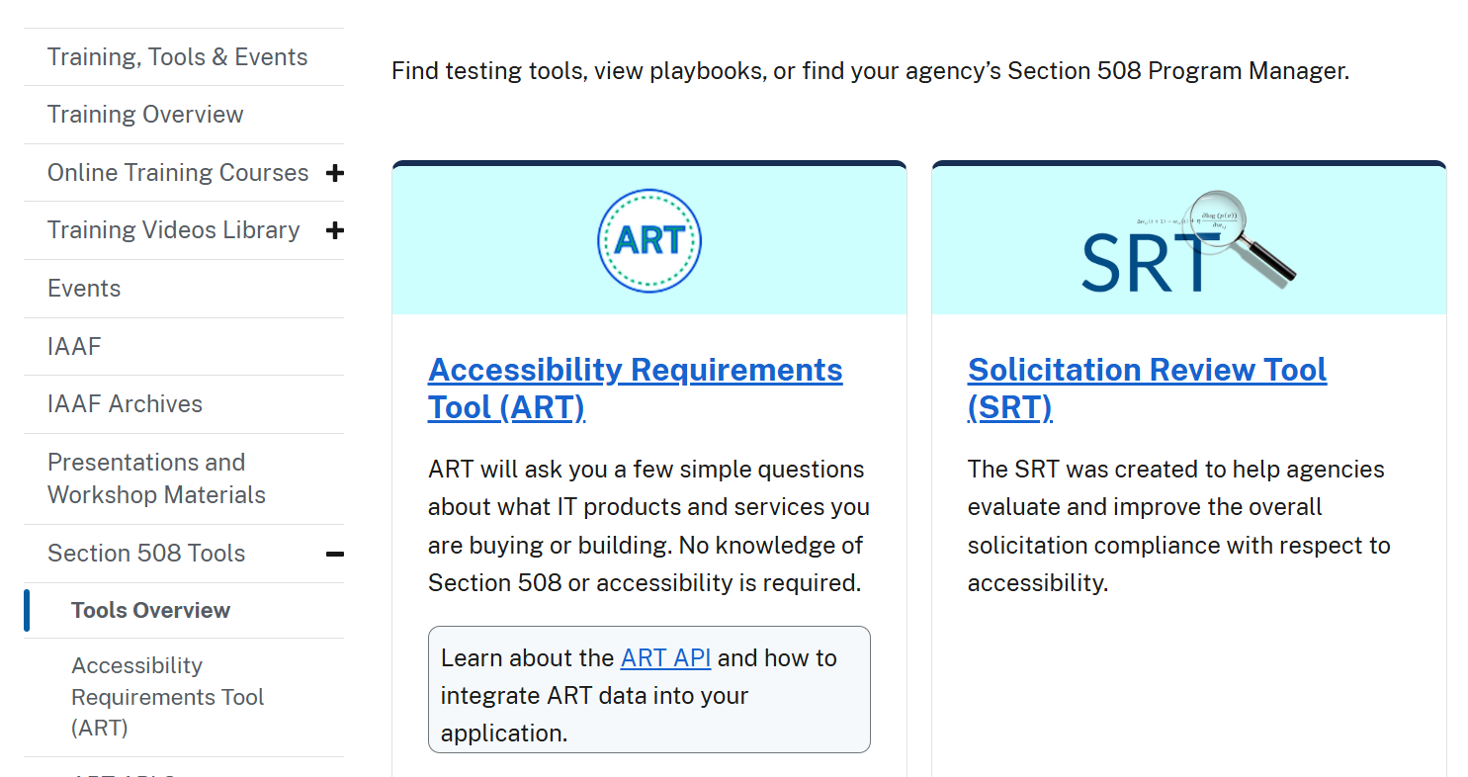
Finding ART & SRT
Training, Tools & Events OR Acquisitions
https://www.Section508.gov
Notes:
SRT works with ART using an API. If solicitation requires compliance language, then ART can provide the correct language via Application Programming Interface (API) which would receive a request and provide language based on request from SRT
https://www.Section508.gov

Slide 30

Questions?

Slide 31

Thank you!
Laura.b.miller@gsa.gov SRT@gsa.gov
Notes:
Laura.b.miller@gsa.gov SRT@gsa.gov

