Slide 1
EPA’s Section 508 & Authority to Operate (ATO) Integration Process
August 5, 2025
Notes:
Good afternoon, Everyone.
My name is Psyche Lewis. I’m with the Environmental Protection Agency’s Section 508 Program.
I’ve been with the program for 5-years and found my passion here.
I love what we do for the agency and the public.
I’d like to thank Michael Horton for inviting EPA to present on the EPA’s Section 508 and Authority to Operate Process.
I’d also like to thank Jenny Brondyk for all her support with helping us prepare for todays presentation.
Thank you both for the opportunity to share this information.
Now for introductions of this wonderful team.
Next slide.

Slide 2
Introductions
Psyche Lewis
Section 508 Alternate Program Manager
Sarah Sorathia
Section 508 Program Manager
Jennifer Nelson
Office of Mission Support, Certified Trusted Tester
Michael La
Office of Mission Support, Certified Trusted Tester
Notes:
I’ve already introduced myself, however I am not alone.
I’ve brought a phenomenal team with me that are passionate about 508 compliance and testing.
First, we have Sarah Sorathia, She’s the Section 508 Program Manager for EPA. Many of you already know her. She’s been with the Section 508 Program for nine years. She’s a wealth of knowledge and a delight to work with.
Next we have Jennifer Nelson our Office of Mission Support, inaugural Certified Trusted Tester. She helped to pilot and bring this process to fruition.
And last but not least, we have Michael La, our 2nd Office of Mission Support Certified Trusted Tester. He has come on board and jumped right to test and make OMS systems, training, etc. compliant.
Everyone, please say hello.
Let’s get started with our agenda.

Slide 3

Agenda
True or False?
Authority to Operate (ATO) Process
Why Integrate with Section 508?
Explained
Resources
Questions
Notes:
Now that introductions are out of the way,
We’ll get started with a True or False to see what you already know.
I’ll ask you to answer true or false in the chat.
Will we be able to see the chat from the public?
We will provide you with how we got to this process and why integrate into other agency processes. We’ll provide background and explain the process in detail.
We will provide you with some resources and give you time to get any questions answered.
Questions
Next slide.

Slide 4
Poll Question: True or False?
A FISMA system passes Section 508 testing requirements when it has <5 failed test conditions.
Jeopardy Game Jingle
Notes:
https://youtube.com/clip/Ugkx9shG2nV6_85Iug0OzD2YucVvijqZUecE?si=cgjEmo0tq83BCDgz
I’m going to give you about 15 seconds to put your answers in the chat. That’s long enough for us to get through the Jeopardy jingle.
Check the chat.
Will they have the opportunity to put their answers in the chat?

Slide 5
Poll Question Answer
False.
There must be ZERO failures for a system to receive a passing result.
Notes:
If you answered False, you are spot on.
Next slide.

Slide 6

Section 508 and ATO Alignment
2018 Launched Compliance & Remediation Plan (CARP)
Inventory and track Section 508 Compliance
Documentation self reported (hoping to get test results)
Found a large backlog of untested existing systems and applications
2022 study found in house Department of Homeland Security (DHS) Certified Trusted Tester (CTT) most effective
The CIO determined to use the Authority to Operate (ATO) as a control gate to increase the agency’s rate of 508 compliance.
In collaboration with EPA’s Section 508 Program, Security Office, and Information Management Officers we developed a process to integrate 508 into the ATO.
Notes:
CARP used data based on the agency system of registries READ – Registry of EPA Applications Models and Data Warehouse
The Section 508 Program tracked agency systems for compliance. Compliance was based on self-reporting. The Program found that this was insufficient to encourage compliance; as existing systems were not compliant.
The Section 508 Program then started encouraging the program offices and regions to get their systems, training, and webpages compliant. Each program office and region was asked to select two individuals to take the free Department of Homeland Security (DHS) Certified Trusted Tester (CTT) training to help the agency reduce its number of non-compliant systems, trainings, and web sites and pages.
The CIO was the game changer. When the CIO determined that we would use the ATO process to encourage, compliance, things really started to change.
The 508 Team, security office, and information management officers joined forces and developed the 508 – ATO integration you’re about to see.
Next slide

Slide 7

ATO Overview
Authority to Operate (ATO) is required for systems or applications operating within the EPA enterprise environment.
ATO is a formal declaration by the security official that accepts responsibility for the operations of a system and officially declares that the system is authorized to operate.
Notes:
All EPA systems, and their component applications, must comply with the EPA Section 508 Policy and EPA Section 508 Testing Procedure. Every application will need to either be tested or be approved for an exception or exemption. A tested system or application will be required to pass a test performed by a Department of Homeland Security-Certified Trusted Tester before it is certified as compliant.
I mentioned that our CIO determined to use the Authority to Operate (ATO) as a control gate to increase the agency’s rate of 508 compliance.
I can’t stress enough that senior leadership must get behind compliance.
If it doesn’t come from the top, it is an uphill battle to come from the bottom.
I’ve included on the resource slide, the CIO memo. It’s small, but you can read it at your leisure.
Next slide.
Jennifer and Michael begin here.
***** Quick definition of the difference between an ATO and an ATU.

Slide 8
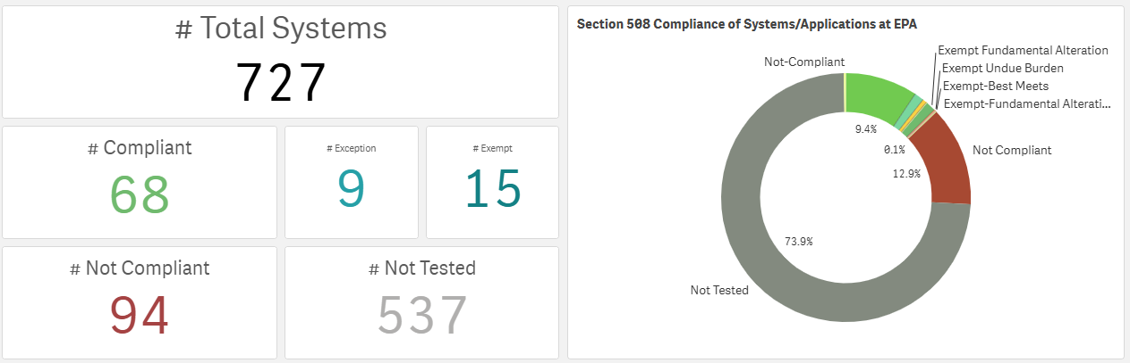
CARP Dashboard
Notes:
I mentioned that the 508 Program tracked agency systems for compliance.
We created a Qlik dashboard that is populated by an extensive Excel spreadsheet.
The process is currently manual, but it does automatically upload any new data on a weekly basis.
This tracks our progress.
Since the inception of this process, the agency systems that have been tested has increased by 22.6 percent.
And almost 10 percent of the agency’s systems are now compliant.
Next slide.

Slide 9
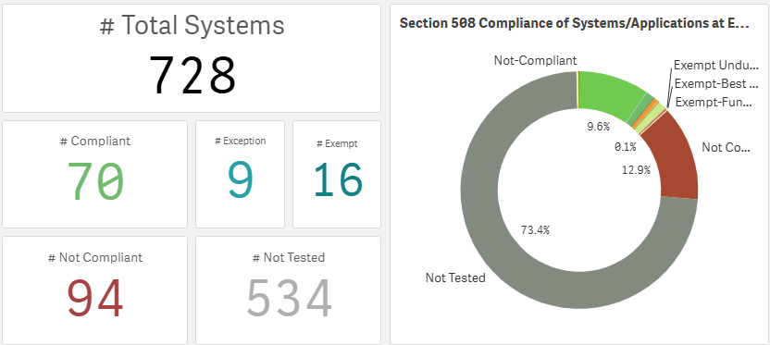
CARP Dashboard: Current
Notes:
Since July 21st, when I sent our draft presentation to Jenny, I want you to note a few things in the database. This will be a bit of back and forth; so you can see the changes.
July 31, 2025
The Total Systems has increased by 1.
The ATO process identifies systems that have never been identified before. This is a benefit of the integration process.
# Compliant have increased by 2 systems.
# Exempt have increased by 1.
# Not Tested have decreased by 3.
Uploading the data is a manual process, but it has been very effective in increasing compliance throughout EPA.
Next slide.

Slide 10
Office of Mission Support 508 & ATO Process
EPA has 13 HQ offices and 10 Regions that manage systems and their associated ATOs and 508 compliance
In 2023, the CIO initiated a pilot with the Office of Mission Support (OMS) to align Section 508 compliance requirements with the ATO
OMS leads the agency’s core mission support functions, including information technology, human capital, contracts, grants and facilities
OMS manages the majority of the agency’s systems, including enterprise systems that support the agency’s operations
The process is currently being rolled out to EPA’s other HQ offices and regions
Notes:
Before we go into more detail about the integration of 508 compliance into the ATO process, I’d like to provide you with an overview of how the EPA is organized.
EPA has 13 HQ Offices and 10 regions that manage their systems and associated 508 compliance
In 2023, the CIO initiated a pilot with the Office of Mission Support, which is one of the HQ offices, to align Section 508 Compliance requirements with the ATO process.
The Office of Mission Support leads the agency’s core mission support functions for the agency, including information technology, human capital, contracts, grants and EPA facilities. While the EPA Program Offices and Regions have their own systems, OMS manages the majority of the agency systems, including the enterprise systems that support the agency’s operations.
Today Jennifer Nelson and Michael La who are trusted testers in the Office of Mission Support are going to provide an overview of the process the Office of Mission Support has implemented to integrate 508 into the ATO process for their 61 systems, which is the process that is being rolled out to EPA’s other 12 HQ offices and 10 regions.

Slide 11
ATO Process Explained: Roles and Responsibilities
Role | Function | Interaction
Information System Security Officer (ISSO) or Information Security Officer (ISO) | Validates that the application(s) within the FISMA system are scheduled for Section 508 testing. | The ISSO’s or ISO’s main point of interaction is with the IMO and the FISMA system application owner.
Information Management Officer (IMO) or designee | Serves as Liaison between ISSO/ISO, system/application owner, and trusted tester. Notifies system owner and CTT of upcoming ATO activity. | Coordinates information between the trusted tester, system/application owner, ISSO/ISO, and Section 508 Program.
System Owner / Application Owner(s) | Responsible for their application conforming to Section 508 requirements. Provide any requested documentation. | Coordinate with the ISSO and the trusted tester during the testing process to validate the application(s) being tested.
Certified Trusted Tester (CTT) | Tests websites and applications using the EPA Trusted Tester Report template. | Interacts with IMO and the Section 508 team. During the testing, interacts with the system/ application/site owner.
Section 508 Program | Responsible for process oversight and metrics reporting. | Conducts document audits. Maintains agency repository for trusted tester reports.
Notes:
Before Jennifer and Michael review the OMS process, I’d like to review some of the EPA roles that they are going to highlight in their slides. These roles may or may not align with your departments and agencies.
The key players in this process include security personnel, information management officer (IMO), , system owner, certified trusted tester, and the Section 508 Program.
The Information System Security Officer or Information Security Officer manages the system security requirements for their program office and region’s systems.
Each program office and region has an Information Management Officer who manages their organization’s information technology and information management functions and responsibilities.
The system owner has overall responsibility for a specific information system. The system owner ensures the system meets its intended use and complies with relevant regulations and standards throughout its lifecycle.
All system owners must use a certified trusted tester (CTT) for compliance confirmation. The certified trusted tester can be either an EPA federal employee, contracted from the Working Capital Fund (WCF) TZ or TC services, or an external contractor.
Tests websites and applications using the EPA Trusted Tester Report template.
They Interact with the IMO and the Section 508 team.
During the testing, they also interact with the system/application/site owner.
The Section 508 Program, which is Sarah and me, is responsible for oversight of the 508 program and metrics reporting.
These positions are instrumental in making this process work. Jennifer and Michael are about to explain the flow and how it works.
Next slide.

Slide 12
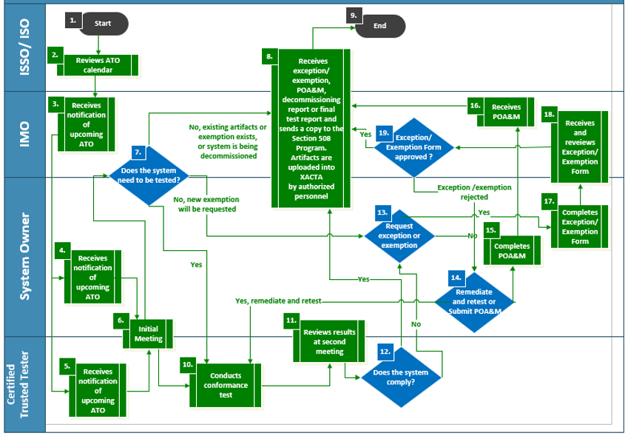
ATO/508 Alignment Workflow

Slide 13
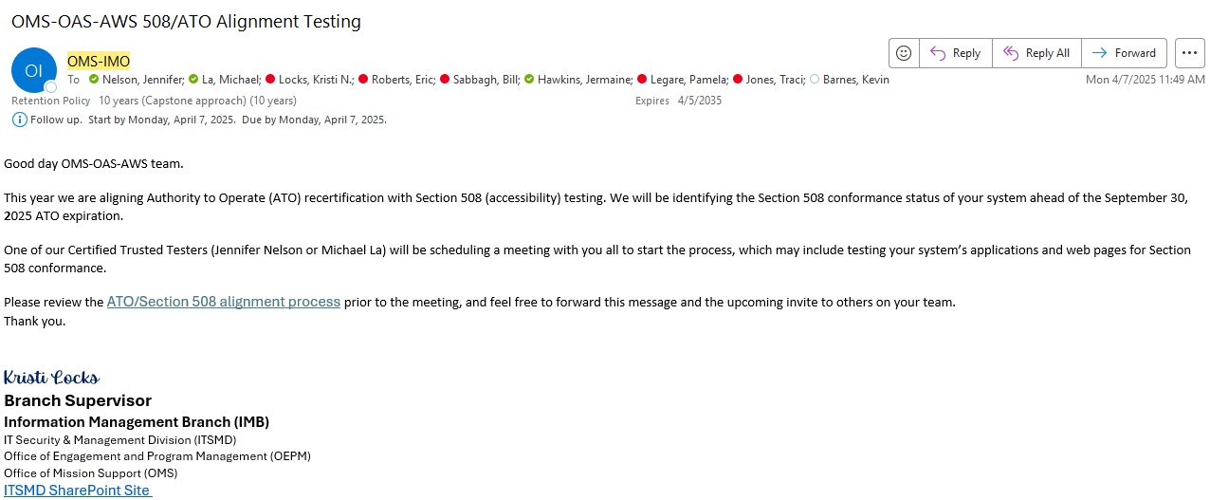
ATO Process Explained: Step-By-Step @ EPA
Kickoff Phase
IMO sends kickoff email 4-6 months prior to ATO expiration date
Notes:
Invited Parties:
System Owner(s)
System Contact(s)
IMO
ISSO
Section508 Contact/SME
CTT

Slide 14
ATO Process Explained: Step-By-Step
Kickoff Phase
IMO sends kickoff email 4-6 months prior to ATO expiration date
Trusted Tester schedules initial meeting for 2-3 weeks later. The purpose of this meeting is to prepare for 508 testing; identify if the system needs to be tested, what will be tested, and who will be testing it.
System owners complete the following before the initial meeting:
List all applications within the system boundary
Send past 508 documentation
Review the 508-ATO process document
Review the Section 508 exceptions procedure
Forward meeting invitation as needed

Slide 15
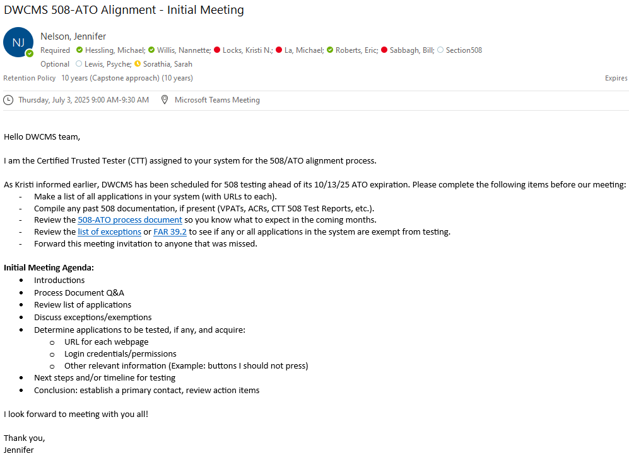
508/ATO Alignment Initial Meeting
Who’s Invited?:
System Owner(s)
System Contact(s)
IMO
ISSO
Section508 Contact/SME
CTT

Slide 16

ATO Process Explained: Testing
Testing Phase
Trusted Tester tests the system and contacts the system owner as needed
COTS Products: CTT reviews the Accessibility Conformance Report (ACR) provided by the vendor
Internal: CTT manually tests the system using the CTT framework
Testing time varies based on the size and complexity of the system but generally takes 1-4 weeks to complete.

Slide 17
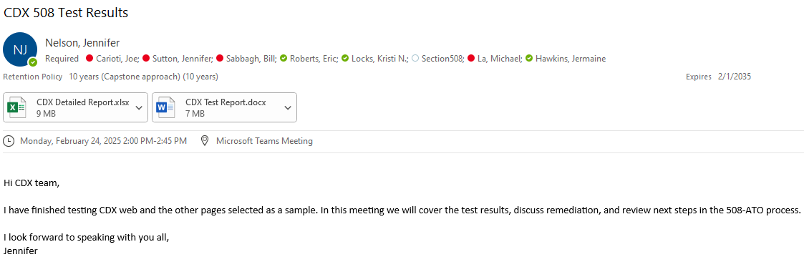
ATO Process Explained: Results Meeting
Results/Remediation Phase
Trusted Tester schedules results meeting immediately after testing is complete (with test report attached). The purpose of this meeting is to review the results of testing and determine next steps.
Who’s Invited?:
System Owner(s)
System Contact(s)
IMO
ISSO
Section508 Contact/SME
CTT

Slide 18
ATO Process Explained: Results/Remediation
Results/Remediation Phase
Trusted Tester schedules results meeting immediately after testing is complete (with test report attached). The purpose of this meeting is to review the results of testing and determine next steps.
Passing Result: zero 508 failures identified; 508-ATO process complete
Failing Result: 508 failures identified; requires vendor remediation (COTS product), internal remediation (in-house product), or an approved exception or exemption
A POA&M should be created to document the path forward unless an exception/exemption is granted
System owners may request retests for remediations made and the CTT will retest the system when able. Once the system achieves a passing result, the 508-ATO process is complete.
Notes:
1-year vs 3-year ATO explained

Slide 19
ATO Process Explained: Documentation
SECTION 508 (ACCESSIBILITY) ATO ALIGNMENT SharePoint
Homepage for the OMS 508-ATO process located on the ITSMD site. Explains the process, roles and responsibilities, and provides links to all other resources.
OMS Accessibility Testing SharePoint
Houses system information, testing results, and compliance ratings. Feeds data to the Power BI status dashboard.
OMS 508-ATO List of Applications
Excel spreadsheet that lists all applications contained within each FISMA system.
Section 508-ATO Alignment Frequently Asked Questions (FAQs)
PDF document containing frequently asked questions about the process.
OMS' Power BI 508-ATO Status Dashboard
Visualizations showing Section 508 compliance for OMS systems and offices.
Notes:
Internal Documentation with links:
ITSMD SharePoint – Section 508-ATO Process Explained
OMS Accessibility Testing SharePoint – Testing Information & Results
OMS 508-ATO List of Applications
Section 508-ATO Alignment - Frequently Asked Questions (FAQs)
OMS' Power BI 508-ATO Status Dashboard

Slide 20

Practical Strategies and Lessons Learned
Cross-team collaboration is required in this effort. It is helpful to have frequent (or standing) meetings to flesh out the process and fix issues as they arise.
Test the process before implementation. OMS piloted the process on 6 systems prior to publishing to identify areas for improvement.
Data should be maintained in a single repository to avoid duplicates and inaccuracy. Make sure data is current through frequent updates.
Follow the process but remain flexible; unique cases may arise that require additional consideration. In such cases, consult all stakeholders to ensure the solution is acceptable.
It is helpful to include employees whose main responsibility is implementing the process, especially those that understand the day-to-day work involved. Example: OMS created 2 new FTEs for CTTs
Notes:
Stress the importance of upper management buy-in and mention the CIO memo again.

Slide 21
Resources
EPA Email Addresses for Questions:
Section508@epa.gov
OMS-CTT@epa.gov

Slide 22

Questions?
22

