Slide 1

Project Managing Accessibility Compliance: The Section 508 Assessment from a Project Management Perspective
Claudia Guidi UX Analyst and Section 508 PM
Defense Technical Information Center
May 20, 2025

Slide 2
Disclaimer
The views and opinions expressed are those of the speaker and do not reflect the views of the Defense Technical Information Center (DTIC), the Department of Defense, or the U.S. Government.

Slide 3
Agenda
DTIC: Who We Are
Why Section 508 at DTIC
The assessment
The assessment as project
Challenges and opportunities

Slide 4
DTIC: Who We Are Why Section 508 at DTIC

Slide 5
DTIC: Who We Are
Central hub for R&E for the DoD
Our mission

Slide 6
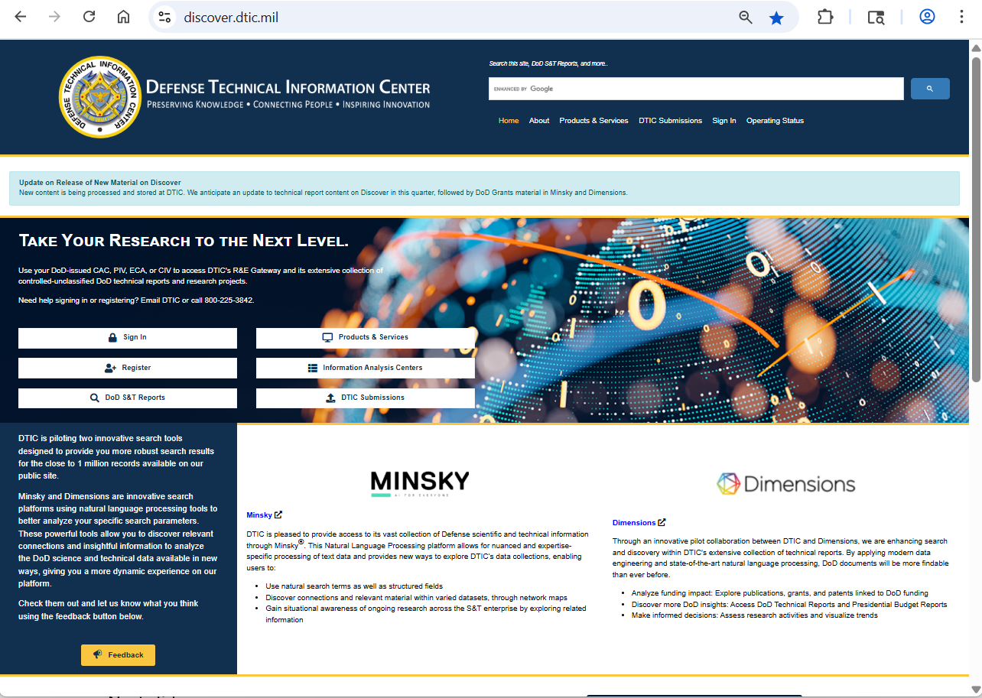
DTIC: Who We Are, cont’d
https://discover.dtic.mil/
https://discover.dtic.mil/about/

Slide 7
DTIC: Why Section 508 at DTIC?
Digital first
Over the web
Large e-collections
Compliance as mission-critical

Slide 8
The Assessment You can find DTIC’s summary of results on page 178 of GSA’s “FY24 Governmentwide Section 508 Assessment” report. The report can be found at https://www.section508.gov/manage/section-508-assessment/

Slide 9
The Assessment
Multiple dimensions
Multifaceted
Multilevel

Slide 10
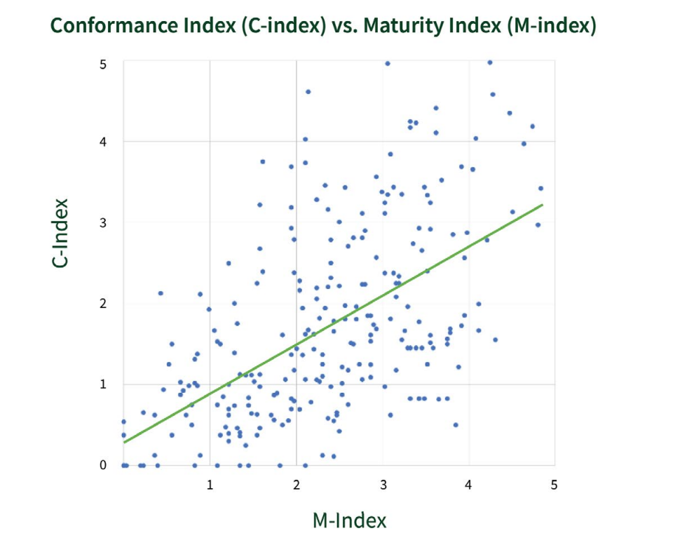
GSA report Figure 7: Scatter Plot with trendline of all reporting entities’ conformance and maturity index results https://www.section508.gov/manage/section-508-assessment/

Slide 11
The Assessment: Reach
Agency wide reach

Slide 12
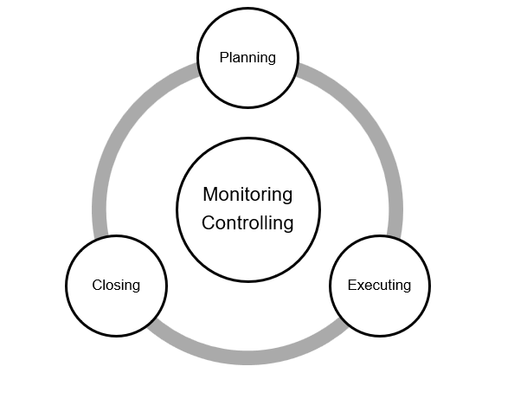
The Assessment: Life Cycle
Cyclical

Slide 13
The assessment as project

Slide 14
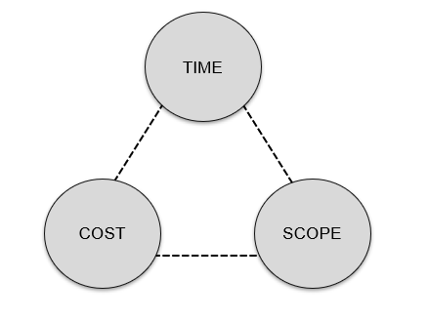
The Project Perspective
A vocabulary to anticipate, plan, communicate, and measure
The triad: scope, time, and cost (resources)

Slide 15
Project methods
Anticipate, plan, communicate, measure
Keep it lean
Keep it agile
Examples

Slide 16
The assessment as project: Scope
Managing scope for the assessment: Examples

Slide 17
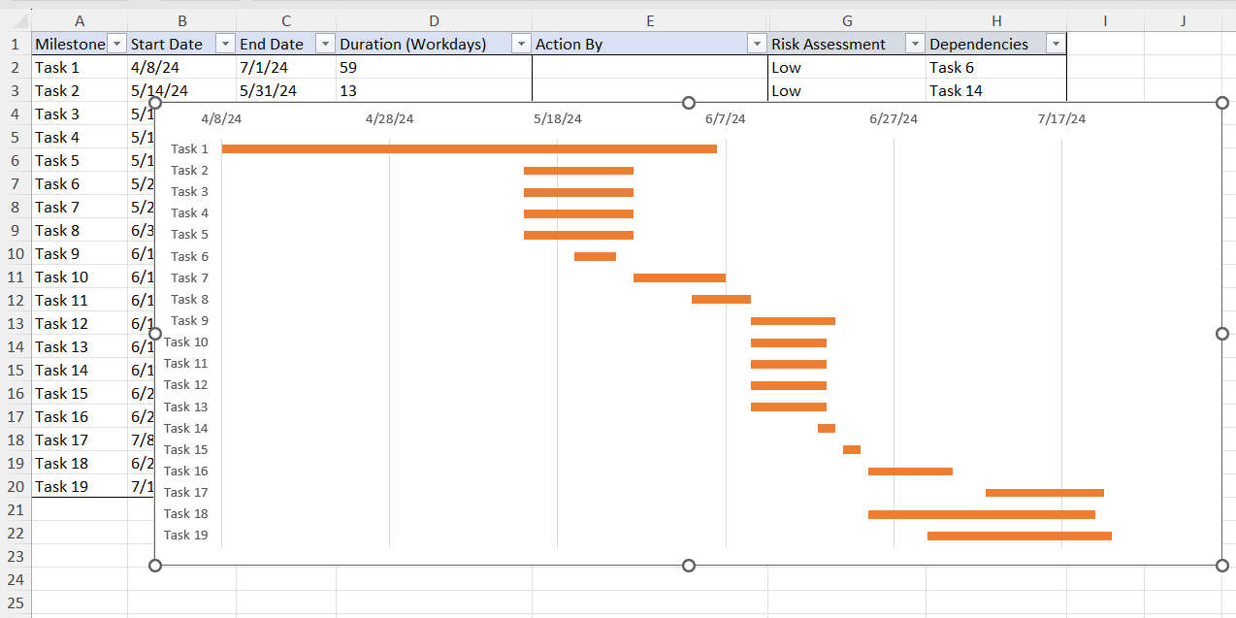
The assessment as project: time
Mapping the assessment through time: Gantt chart

Slide 18
The assessment as project: resources
Resource allocation
RACI

Slide 19
Challenges and Opportunities

Slide 20
Challenges
Complex does not need to mean “complicated”
Communication still needs care
Change needs balancing
Project management is part art part science
To much granularity can lead to documentation creep

Slide 21
Opportunities
A way to operationalize “done”
Makes process orderly and clear
Explicit and concrete

Slide 22
Project management perspective
A success strategy

Slide 23
DTIC: Connect with Us
https://discover.dtic.mil/
https://discover.dtic.mil/about/
Claudia.guidi.civ@mail.mil

