Slide 1

How to be successful in the Trusted Tester Certification Process March 12, 2020
CSUN Presentation
Department of Homeland Security
Office of Accessible Systems and Technology (OAST)
This presentation is available on line www.dhs.gov

Slide 2
Today’s Agenda
Introduction of Speakers
Advantages of Trusted Tester Process
Benefits to IT Vendors and Service Providers
Trusted Tester Course Success Predictors
Testimonials
Questions and Answers

Slide 3
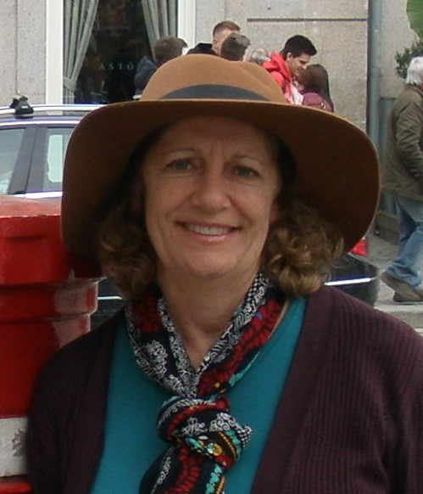
Ann Marie Davis
Senior Section 508 Technical Specialist
Department of Homeland Security
OAST

Slide 4
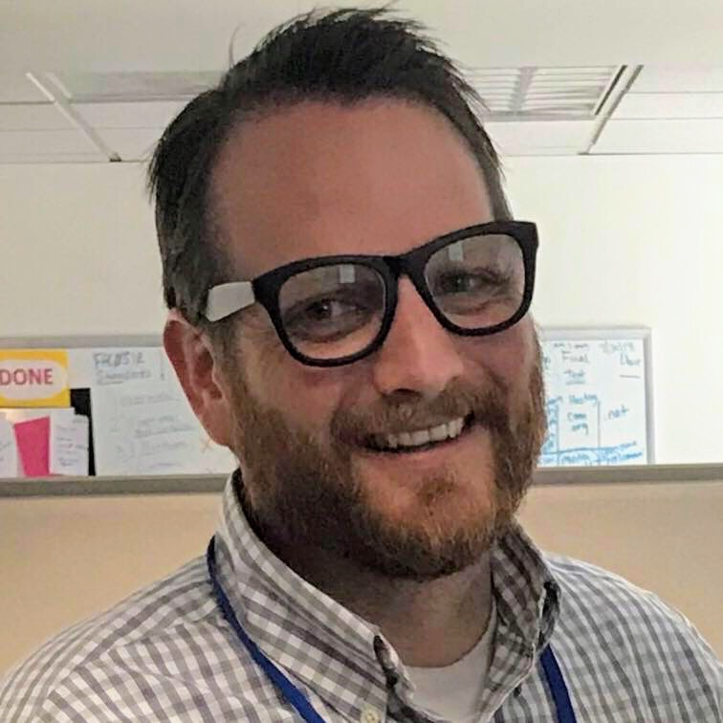
Andrew Nielson
ICT Accessibility Subject Matter Expert
General Services Administration

Slide 5
Purpose
Encourage you to pursue becoming certified as a trusted tester
Provide guidance to enable you to be a successful web accessibility tester

Slide 6
Advantages of Trusted Tester
1
The test process is repeatable, dependable, verifiable.
4
Course is free.
2
Free, open-source tools are used. The main tool (ANDI) developed by the Social Security Administration.
5
Students can post questions to instructors.
3
Differences in versions of Assistive Technology do not impact test results.
6
Global participation by public, private, and government sectors.

Slide 7
Benefits to IT Vendors and Service Providers
1
Aligned with WCAG 2.0 and recognized by GSA as best practice.
4
Test results are simply PASS, FAIL, or DNA. No ambivalence about accessibility issues.
2
Conformance with Section 508/WCAG 2.0 required on all government contract and IT purchases.
5
Strengthens acceptance of vendor’s Accessibility Compliance Report (ACR) when a Trusted Tester Seal authenticates results.
3
Strong complement to automated testing.

Slide 8


Trusted Tester Course Success Predictors
Students are more successful when they …
UNDERSTAND HTML and ARIA code
A rudimentary understanding of code allows concepts to be grasped more easily.
Testers are better able to interpret results.

Slide 9
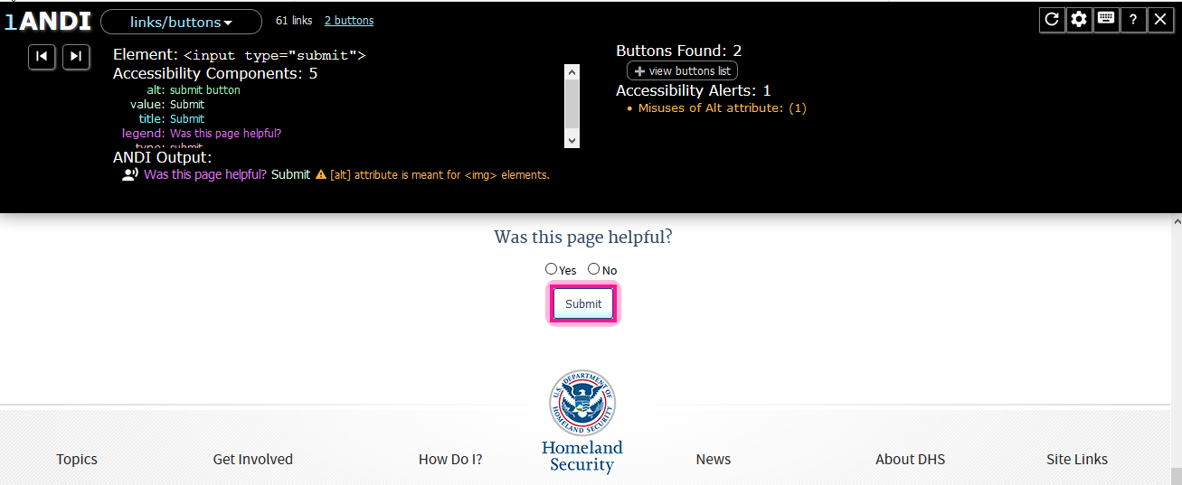
Committed to Understanding Process

Slide 10

Trusted Tester Course Success Predictors
Students are more successful when they …
APPLY the test process
Make a commitment to understand the test process.
Learn how to evaluate results in the same way.

Slide 11

Trusted Tester Course Success Predictors
Students are more successful when they …
Strive for understanding
Understand what is covered in each Test ID,
Appropriately use the ANDI tool to interpret results.

Slide 12

Trusted Tester Course Success Predictors
Students are more successful when they …
Use self-help features
Course Resources include: Test Process, Q&A Board, Q&A Database, Video library
Notes:
I’m open to a different icon OR the screen icon needs to be grey.

Slide 13
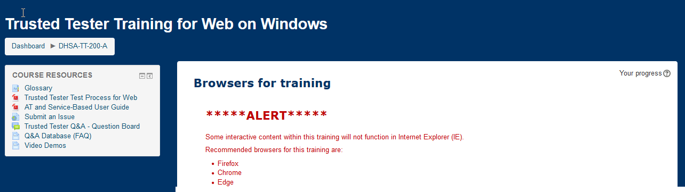
Course Resources
1
The Trusted Tester Test Process for Web should be used while testing. Take notes in it.
3
Question Boards and Q&A Database (FAQ) provide instructor guidance and are searchable.
2
AT and Service-Based User Guide guides those needing accommodations.
.
4
Library of Video Demos used in the course are cross-referenced here.

Slide 14

Trusted Tester Course Success Predictors
Students are more successful when they …
Apply concepts holistically
Can understand and evaluate how multiple concepts apply (A single form field may be evaluated for keyboard access, focus, focus order, descriptive and programmatic label, color contrast, change in content, etc.)
Notes:
I’m open to a different icon OR the connection icon needs to be green.

Slide 15

Trusted Tester Course Success Predictors
Students are more successful when they …
Read content thoroughly
Including instructions for how to mark answers (e.g., Mark the last item that received focus when encountering a form field that does not receive visible focus.)

Slide 16
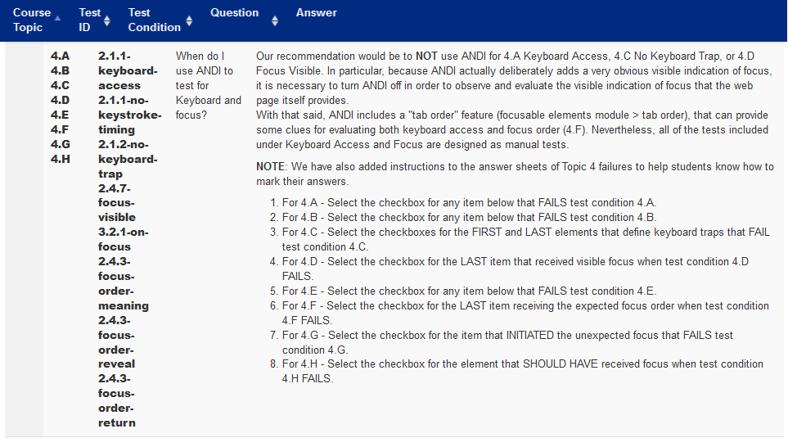
Trusted Tester Course Success Predictors

Slide 17

Trusted Tester Course Success Predictors
Students are more successful when they …
REVIEW course content as needed
Revisit the appropriate course lesson if incremental exam score is less than 100%

Slide 18

Trusted Tester Course Success Predictors
Students are more successful when they …
RETEST with fresh eyes
Test each randomized exam page independently of any previous results

Slide 19
An Expert’s Testimonial
Laura Renfro Renfro Consulting
The initial Trusted Tester Certification really helped grow me as a tester.
I was very happy when the DHS and OAST were going to allow testers, like me, outside the US Government space to take the course for the V5 Certification....
The course is demanding. I think it should be.…. I recommend this course wholeheartedly.... When I go to help a product or application or website improve I can speak to how the developers should be coding and then testing so that it can be compliant….
This V5 course has so many improvements over the last TT Certification and I definitely felt helped and supported with the Q & A board, emailing for help if I needed it and the detailed instructions…
1

Slide 20
Practitioner and Global Testimonials
2
3
Jay Trinckes Wind Stream
I really enjoyed taking the Section 508 Trusted Tester training. It was probably one of the best training curriculums I've seen put out by the government. It was challenging, yet fair and provided practical knowledge on how to perform these types of test. The staff was very helpful and responded quickly to requests. Great job!!!
Sonali Wabale Tata Consultancy Service
Thank you so much for all your support. …this course is very helpful in terms of knowledge and it covers all the important topics which we never realized in our daily life. All topics are very well described in all aspects like examples, description etc.

Slide 21
An AT User’s Testimonial
4
User of Assistive Technology
I shared my vision impairment … and felt encouraged to began (sic) the program…. I have called the Help Desk a couple of different times to discuss issues related to my vision.
I would like to convey my dcreep (sic) gratitude to … for their patient assistance. …. Everyone I've encountered on the Trusted Tester team has helped me.... also the instructors who have posted on the Q&A database.

Slide 22
Contacts and Resources
DHS Online Training Self-Registration
https://training.section508testing.net/
OAST Accessibility Help Desk
accessibility@hq.dhs.gov
Please complete the Presentation Evaluation Form csun.at/sessions

Slide 23
