Slide 1
Access Israel at U.S-GSA
Yuval Wagner, Chairman,
Michal Rimon, Adv. - CEO
ACCESS ISRAEL

Slide 2

About Access Israel
About Access Israel

Slide 3


Access Israel
Promoting accessibility and improving quality of life for people with various disabilities in Israel so they are integrated into society with dignity, respect, equal rights and high level of independence
Notes:
How is it done? First Awareness – making people understand the need and importance. Then if needed promoting legislation and developing models for implementation. We believe in creating an innovation center and conducting consultation for those who need it for implementation of the idea. It is important to act on an international level since the challenges are global and so are benchmark technological companies it is important to work on international level and for first step work on the website – the front stage of technology used.

Slide 4




What is Accessibility?
To be able to reach and enter a destination
The be able to receive service
To be able to use a product
with dignity, respect, as equals and with maximum level of independence – with no disappointment and with minimum need for assistance.

Slide 5

Israeli Accessibility Law and Regulations
Israeli Accessibility Laws and Regulations
Equality Law
Accessibility Regulations
Accessibility Standards
Government
Municipal
Private
NGOs
Notes:
The law in Israel is an “umbrella law” stating the right for equality and accessibility in all areas of life for people with all types of disabilities and requiring the various ministries to legislate regulations relevant to their area of focus. The Accessibility Standards give a detailed specification on how to reach such accessibility. These laws applys to the Government, Municipalities, the Private sector and NGOs in Israel.
The Law on Equal Rights for People with disabilities - The Principles and Time table
Accessibility Regulations - What is required – how much, when etc.
Israeli Standard 1918 - The technical Specifications

Slide 6



Advantages in Israel’s Accessibility
Advantages in Israel’s Accessibility
Law with “Teeth”
Accessibility on Country Level
Mandatory Training by law
Notes:
The Challenges we face in Israel are many – budget, Stigmas, Old cities etc. similar to many other countries around the world. However there are certain advantages in the Israeli accessibility solution – First the law has teeth - both civil and criminal; Accessibility is done on national level and finally there is a unique requirement for training for accessible service by law for all service providers.
Accessibility for all disabilities
Accessibility for all areas of life
The Stick
Accessibility director
Experiential training of service givers
Advertise organization Accessibility
Accessibility profession by law – Built environment, services

Slide 7
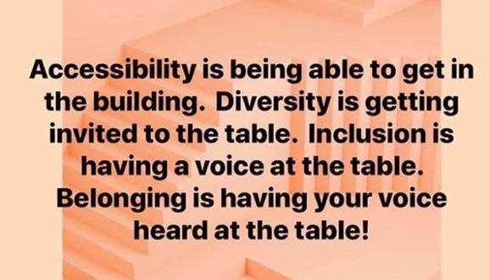

Reminder – Why we are here
Accessibility as a means to an end
Similarities between People with Disabilities and the Elderly
Goal – Inclusion - Belonging
Notes:
תזכורת למה אנחנו פה --- שילוב
הרבה משותף
העמותה מתייחסת לאע"מ וקשישים עם הרבה דברים זהים – מקדמים נגישות בשירות – להגיע להשתתף להיות פעילים

Slide 8

The Human Ramp

Slide 9


How is it done?
Training for Accessible Services
Knowledge
Getting to know the person
Experience
The power to change
Notes:
How is it done? First Awareness – making people understand the need and importance. Then if needed promoting legislation and developing models for implementation. We believe in creating an innovation center and conducting consultation for those who need it for implementation of the idea. It is important to act on an international level since the challenges are global and so are benchmark technological companies it is important to work on international level and for first step work on the website – the front stage of technology used.

Slide 10
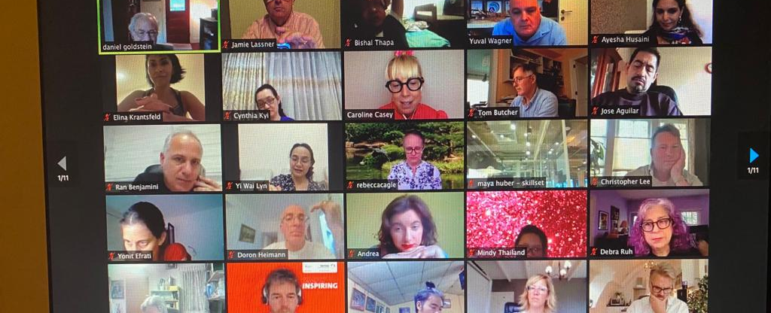
Global Accessibility Trend
Sharing and transforming Information
Don’t invent the wheel when it already exists
Over 2,000 people from 83 countries
COVID 19 – as an accelerator
Borderless, Similar challenges, need for localization and customization

Slide 11
The Access Israel Consulting Model
Organization
Building / Interior
Employees
Call Centers
Web / Apps / ATM
Info
Events
Employment

Slide 12
The Access Israel consulting model
Management presentation and decision
Management Leader
Accessibility Director
Accessibility Board
Accessibility Gap Survey
Work Plan and Budget
Accessibility Consulting and Implementation
Working with Clients with Disability
PWD Audits
Advertising The Accessible Services

Slide 13
Tech Era Accessibility by Design Mission
We have to learn from past mistakes –
No More Accessibility Retroactively !
The mission – Making Israel fully tech accessible by design for all disabilities in all areas of life.
Our path-
Legislate a new LAW
Eco-System for Accessible Technologies
Accessibility Matrix Gap Analysis to define accessibility tech barriers / challenge’s
Various activities in the ecosystem to solve challenges
Finding budgets for development of tech challenges with no business case
Notes:
(disabilities/ technologies/areas of life)

Slide 14
