Slide 1

A 508 Program on the Move: Health and Human Services (HHS) Centers for Medicare and Medicaid Services (CMS)
Presented by:
Antoinette “AJ” Johnson
Section 508 Program Manager
Center for Medicare and Medicaid Services (CMS)
Director, Division of IT Oversight and Governance (DIOG)

Slide 2

Today’s Discussion
Program Background
Current State of Affairs
How we structure our program
Education and Awareness Campaign
Annual Training
Future Planning
Questions we can answer
INFORMATION NOT RELEASABLE TO THE PUBLIC UNLESS AUTHORIZED BY LAW: This information has not been publicly disclosed and may be privileged and confidential. It is for internal government use only and must not be disseminated, distributed, or copied to persons not authorized to receive the information. Unauthorized disclosure may result in prosecution to the full extent of the law.

Slide 3
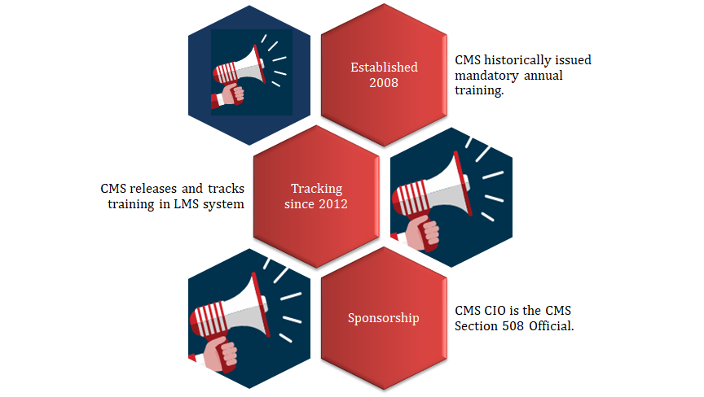
CMS Section 508 : Program Background
INFORMATION NOT RELEASABLE TO THE PUBLIC UNLESS AUTHORIZED BY LAW: This information has not been publicly disclosed and may be privileged and confidential. It is for internal government use only and must not be disseminated, distributed, or copied to persons not authorized to receive the information. Unauthorized disclosure may result in prosecution to the full extent of the law.

Slide 4
Today’s Discussion
Program Background
Current State of Affairs
How we structure our program
Education and Awareness Campaign
Annual Training
Future Planning
Questions we can answer
INFORMATION NOT RELEASABLE TO THE PUBLIC UNLESS AUTHORIZED BY LAW: This information has not been publicly disclosed and may be privileged and confidential. It is for internal government use only and must not be disseminated, distributed, or copied to persons not authorized to receive the information. Unauthorized disclosure may result in prosecution to the full extent of the law.

Slide 5
CMS Section 508 Program: Current State of Affairs
Department of Health and Human Services (DHHS) policy delegated authority through CMS Section 508 Official for adherence to the Law, and Section 508 Policy related to Procurement of information, communication and technology (ICT), Testing, and Training.
CMS Section 508 Policy
Revised and released February 2018 based on HHS policy updates.
CMS Annual Training
Illustrated in CMS revised policy which required (shifted away from ‘mandatory’) all CMS employees to complete Section 508 Training annually.
Section 504 interested in annual training.
CMS Commitment
Incorporated into CMS Senior Executive Service (SES) Plans:
Have an awareness and adhere to applicable Section 508 laws and policies
Appoint a CMS Section 508 Clearance Officer
Goal: All CMS employees complete Section 508 Annual Training
INFORMATION NOT RELEASABLE TO THE PUBLIC UNLESS AUTHORIZED BY LAW: This information has not been publicly disclosed and may be privileged and confidential. It is for internal government use only and must not be disseminated, distributed, or copied to persons not authorized to receive the information. Unauthorized disclosure may result in prosecution to the full extent of the law.

Slide 6
Today’s Discussion
Program Background
Current State of Affairs
How we structure our program
Education and Awareness Campaign
Annual Training
Future Planning
Questions we can answer
INFORMATION NOT RELEASABLE TO THE PUBLIC UNLESS AUTHORIZED BY LAW: This information has not been publicly disclosed and may be privileged and confidential. It is for internal government use only and must not be disseminated, distributed, or copied to persons not authorized to receive the information. Unauthorized disclosure may result in prosecution to the full extent of the law.

Slide 7
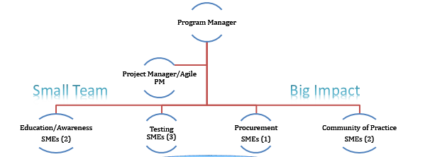
CMS Section 508 Program: Our Core Team Structure
Clearance Officers (130+ Ancillary team members)
INFORMATION NOT RELEASABLE TO THE PUBLIC UNLESS AUTHORIZED BY LAW: This information has not been publicly disclosed and may be privileged and confidential. It is for internal government use only and must not be disseminated, distributed, or copied to persons not authorized to receive the information. Unauthorized disclosure may result in prosecution to the full extent of the law.

Slide 8
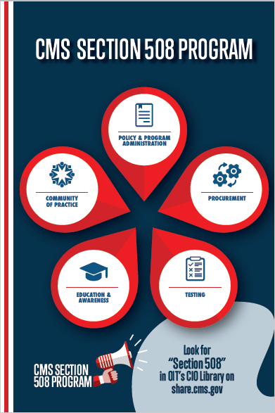
CMS Section 508 Program: Our Program Structure
Policy & Program Administration
Procurement
Testing
Education & Awareness
Community of Practice (CoP)
INFORMATION NOT RELEASABLE TO THE PUBLIC UNLESS AUTHORIZED BY LAW: This information has not been publicly disclosed and may be privileged and confidential. It is for internal government use only and must not be disseminated, distributed, or copied to persons not authorized to receive the information. Unauthorized disclosure may result in prosecution to the full extent of the law.

Slide 9
CMS Section 508 Program: Program Pillars
Policy and Program Administration
Authorized representative for CMS’ Section 508 Official;
Reviews and update CMS Policy (usually biannually);
Executes 508 Policy and Guidance Oversight activities;
Establishes Section 508 Testing protocols;
Provides guidance on accessibility ICT standards, guidance and requirements across agency and ;
Collaborates with both internal partners (Office of Acquisition and Grant Management, Center for Clinical Standards and Quality , Office of Hearings and Inquires, etc.) & external (IAAF, CDC, GSA, etc.) partners.
INFORMATION NOT RELEASABLE TO THE PUBLIC UNLESS AUTHORIZED BY LAW: This information has not been publicly disclosed and may be privileged and confidential. It is for internal government use only and must not be disseminated, distributed, or copied to persons not authorized to receive the information. Unauthorized disclosure may result in prosecution to the full extent of the law.

Slide 10
CMS Section 508 Program: Program Pillars
Testing
Execute monitoring and oversight of 508 testing activity in our CMS Testing Lab.
Provide cursory validation of applications going into the CMS environment with most testing occurring on CMS vendor-developed solutions.
Review and approve all Voluntary Product Accessibility Templates (VPAT) in preparation for manual testing.
Review and approve Remediation plans submitted for applications that possess 508 issues.
Provide 508 guidance at the CMS Governance Review Board (GRB) and CMS Technical Review Board (TRB) to support IT Project Teams.
Early Automated (Agile) Testing as part of the IT Development Lifecycle - COMING SOON!
INFORMATION NOT RELEASABLE TO THE PUBLIC UNLESS AUTHORIZED BY LAW: This information has not been publicly disclosed and may be privileged and confidential. It is for internal government use only and must not be disseminated, distributed, or copied to persons not authorized to receive the information. Unauthorized disclosure may result in prosecution to the full extent of the law.

Slide 11
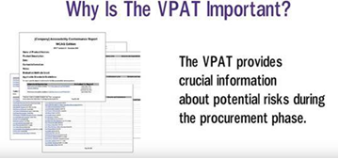

CMS Section 508 Program: Program Pillars
Procurement
Guidelines and Standards in Solicitations
Exploring GSA’s ART Tool
Voluntary Procurement Accessibility Template (VPAT) Resources
Risk- Based Approach - COMING SOON!
VPAT SharePoint site - COMING SOON!
INFORMATION NOT RELEASABLE TO THE PUBLIC UNLESS AUTHORIZED BY LAW: This information has not been publicly disclosed and may be privileged and confidential. It is for internal government use only and must not be disseminated, distributed, or copied to persons not authorized to receive the information. Unauthorized disclosure may result in prosecution to the full extent of the law.

Slide 12
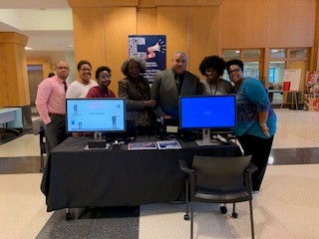
CMS Section 508 Program: Program Pillars
Education and Awareness
Dedicated team that provides resources to help employees produce accessible electronic content.
Identifies and deliveries a variety of resources and external training offerings (e.g., Instructor-led, web-based) focused on providing Section 508 conformant documents.
Develops 508 Annual Accessibility Training.
INFORMATION NOT RELEASABLE TO THE PUBLIC UNLESS AUTHORIZED BY LAW: This information has not been publicly disclosed and may be privileged and confidential. It is for internal government use only and must not be disseminated, distributed, or copied to persons not authorized to receive the information. Unauthorized disclosure may result in prosecution to the full extent of the law.

Slide 13
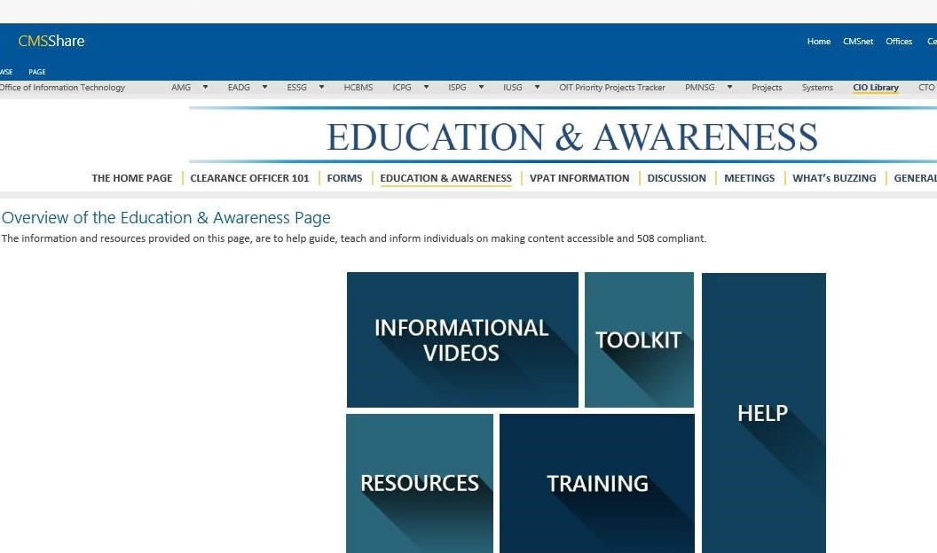
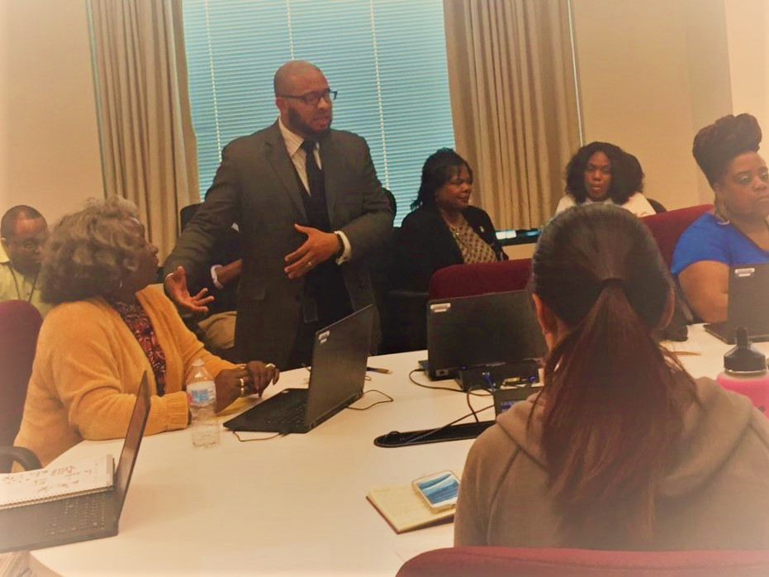
CMS Section 508 Program: Program Pillars
Education and Awareness
Small Group Trainings
Lunch and Learns
Tech Topics
Disability Day
Digital Signage
Table Top Tents
INFORMATION NOT RELEASABLE TO THE PUBLIC UNLESS AUTHORIZED BY LAW: This information has not been publicly disclosed and may be privileged and confidential. It is for internal government use only and must not be disseminated, distributed, or copied to persons not authorized to receive the information. Unauthorized disclosure may result in prosecution to the full extent of the law.

Slide 14
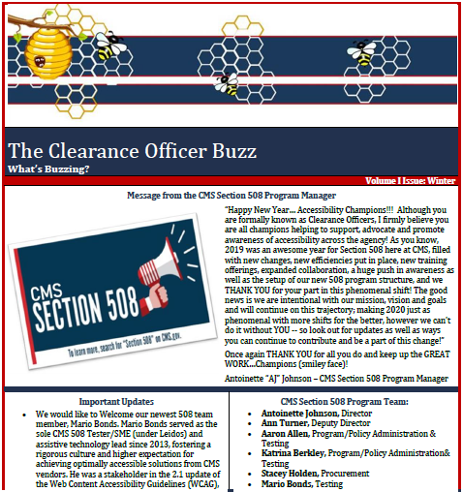
CMS Section 508 Program: Program Pillars
Community of Practice (CoP)
Clearance Officer “Buzz”
Monthly Clearance Officer Meetings
Clearance Officer Welcome Packet/Guide - COMING SOON!
Section 508 Role-Based Training Curriculum- COMING SOON!
INFORMATION NOT RELEASABLE TO THE PUBLIC UNLESS AUTHORIZED BY LAW: This information has not been publicly disclosed and may be privileged and confidential. It is for internal government use only and must not be disseminated, distributed, or copied to persons not authorized to receive the information. Unauthorized disclosure may result in prosecution to the full extent of the law.

Slide 15
Today’s Discussion
Program Background
Current State of Affairs
How we structure our program
Education and Awareness Campaign
Annual Training
Future Planning
Questions we can answer
INFORMATION NOT RELEASABLE TO THE PUBLIC UNLESS AUTHORIZED BY LAW: This information has not been publicly disclosed and may be privileged and confidential. It is for internal government use only and must not be disseminated, distributed, or copied to persons not authorized to receive the information. Unauthorized disclosure may result in prosecution to the full extent of the law.

Slide 16
CMS Section 508 Program: Training Development
We
Keep
Building
2018
Policy Revised
Program Refresh
Litigation (Settlement Agreement)
Training developed internally
2019
Program Expansion
Litigation CAP completed
GSA Partnerships (ART Tool)
2020
Policy Revised
Program Pillars Developed
Training (504/501)
Role-Based Trainings
INFORMATION NOT RELEASABLE TO THE PUBLIC UNLESS AUTHORIZED BY LAW: This information has not been publicly disclosed and may be privileged and confidential. It is for internal government use only and must not be disseminated, distributed, or copied to persons not authorized to receive the information. Unauthorized disclosure may result in prosecution to the full extent of the law.

Slide 17
Today’s Discussion
Program Background
Current State of Affairs
How we structure our program
Education and Awareness Campaign
Annual Training
Future Planning
Questions we can answer
INFORMATION NOT RELEASABLE TO THE PUBLIC UNLESS AUTHORIZED BY LAW: This information has not been publicly disclosed and may be privileged and confidential. It is for internal government use only and must not be disseminated, distributed, or copied to persons not authorized to receive the information. Unauthorized disclosure may result in prosecution to the full extent of the law.

Slide 18
CMS Section 508 Program: Annual Training
How does Section 508 Program Team tackle the process?
Content Creation
Comprehensive
Usability and Engaging, while accessible
Engage Stakeholders
Beta Testing, Section 508 Testing Lab, LMS
Collaborate w/ Disability Partners
Disability Awareness Month (October)
Implement & Report
Launch 10/1, Due NLT 12/31
Exceptions Report
End of Oct/Nov; weekly Dec; daily last week of Dec
INFORMATION NOT RELEASABLE TO THE PUBLIC UNLESS AUTHORIZED BY LAW: This information has not been publicly disclosed and may be privileged and confidential. It is for internal government use only and must not be disseminated, distributed, or copied to persons not authorized to receive the information. Unauthorized disclosure may result in prosecution to the full extent of the law.
Notes:
How does CMS Section 508 Program team tackle the process?
CMS looks at three distinct areas: Content Creation, Promotion, Implementation
Develop Annual Training- Content is reviewed and revised accordingly
Promote throughout the Agency- Look for opportunities to engage CMS Stakeholders -CMS broadcast and This Just In are used to promote training, in addition to placement at Disability Awareness Fair
Implement & Report- Regular completion reports at pre-determined increments are provided for all stakeholders once training is launched. Overdue reports are also sent 2x to provide an opportunity for all staff to take training.

Slide 19
CMS Section 508 Program: Annual Training (Champions!)
Who are our Program Champions?
CMS’ CIO through release of signed CMS-wide Broadcast
Early engagement at New Employee Orientations (NEO)
Component Leadership is key in getting compliance as completion/exception reports are sent and they encourage/remind employees to complete the Annual Training.
Leverage Clearance Officer community as ambassadors to help communicate training is available and encourage completion.
Who Participates?
The data tells us that we have enterprise buy-in and persuasive partnerships with our agency’s stakeholders.
We have consistently met the completion threshold, in last three years above 95% completion. (Goal: 90%)
Who Benefits?
2019, partnership with GSA - 98% completion rate
INFORMATION NOT RELEASABLE TO THE PUBLIC UNLESS AUTHORIZED BY LAW: This information has not been publicly disclosed and may be privileged and confidential. It is for internal government use only and must not be disseminated, distributed, or copied to persons not authorized to receive the information. Unauthorized disclosure may result in prosecution to the full extent of the law.

Slide 20
CMS Section 508 Program: Annual Training
Education SMEs take a project management approach: Allows team to guide/oversee the process through the use of a project plan with identified milestones and deliverables. Project Timeline runs from February- July.
Milestone # | Milestone (Name) | Projected Start Date
1.0 | Course Communications and Content | 2/10/2020
1.1 | Pre-Course Communications | 2/10/2020
1.1.1 | Email announcements and background | 2/10/2020
1.1.2 | Web wireframe information | 2/10/2020
1.2 | Content Development | 2/10/2020
1.2.1 | Course Overview Introduction Content | 2/10/2020
1.2.2 | Section 504 content development | 2/10/2020
1.2.3 | Section 508 content development | 2/10/2020
1.3 | Accessibility Feature Requirements | 2/10/2020
1.4 | Knowledge Check Requirements | 2/10/2020
1.5 | Course Completion Requirements (Certificates and Communication to LMS) | 2/10/2020
2.0 | Technical Implementation | 2/10/2020
2.1 | LMS Points of Contact | 2/10/2020
2.2 | LMS Development Process | 2/10/2020
2.3 | Application Ownership for Lectora and SCORM (Software License and End User License Service Agreements) | 2/10/2020
2.4 | Development Process | 2/10/2020
2.4.1 | Merged Content Package (Section 504/508) | 4/6/2020
2.4.1.1 | Development | 4/13/2020
2.4.1.2 | Compile/Publish | 4/13/2020
2.4.1.3 | LMS Integration and Test | 4/20/2020
2.4.1.3.1 | Test Environment | 4/27/2020
2.4.1.3.2 | Production Environment | 5/25/2020
3.0 | UAT and Approval | 6/22/2020
3.1 | User Acceptance Testing (UAT) | 6/22/2020
3.2 | Stakeholder Approval | 7/6/2020
INFORMATION NOT RELEASABLE TO THE PUBLIC UNLESS AUTHORIZED BY LAW: This information has not been publicly disclosed and may be privileged and confidential. It is for internal government use only and must not be disseminated, distributed, or copied to persons not authorized to receive the information. Unauthorized disclosure may result in prosecution to the full extent of the law.

Slide 21
CMS Section 508 Program: Results
INFORMATION NOT RELEASABLE TO THE PUBLIC UNLESS AUTHORIZED BY LAW: This information has not been publicly disclosed and may be privileged and confidential. It is for internal government use only and must not be disseminated, distributed, or copied to persons not authorized to receive the information. Unauthorized disclosure may result in prosecution to the full extent of the law.

Slide 22
Today’s Discussion
Our Program Background
Current State of Affairs
How we structure our program
Education and Awareness Campaign
Annual Training
Future Planning
Questions we can answer
INFORMATION NOT RELEASABLE TO THE PUBLIC UNLESS AUTHORIZED BY LAW: This information has not been publicly disclosed and may be privileged and confidential. It is for internal government use only and must not be disseminated, distributed, or copied to persons not authorized to receive the information. Unauthorized disclosure may result in prosecution to the full extent of the law.

Slide 23
CMS Section 508 Program: Future Planning
Collaborating with our Section 504 and 501 partners to produce one combined Accessibility Training for the agency:
Reduce confusion- In past, some employees would think they completed 508 when they only 504 and vice versa;
Streamlines the process and reduce burden of completing multiple mandatory/required trainings (1 less training);
Employees understands overall accessibility concepts and offerings.
INFORMATION NOT RELEASABLE TO THE PUBLIC UNLESS AUTHORIZED BY LAW: This information has not been publicly disclosed and may be privileged and confidential. It is for internal government use only and must not be disseminated, distributed, or copied to persons not authorized to receive the information. Unauthorized disclosure may result in prosecution to the full extent of the law.

Slide 24
Today’s Discussion
Our Program Background
Current State of Affairs
How we structure our program
Education and Awareness Campaign
Annual Training
Future Planning
Questions we can answer
INFORMATION NOT RELEASABLE TO THE PUBLIC UNLESS AUTHORIZED BY LAW: This information has not been publicly disclosed and may be privileged and confidential. It is for internal government use only and must not be disseminated, distributed, or copied to persons not authorized to receive the information. Unauthorized disclosure may result in prosecution to the full extent of the law.

Slide 25
CMS Section 508 Program: Questions
??
INFORMATION NOT RELEASABLE TO THE PUBLIC UNLESS AUTHORIZED BY LAW: This information has not been publicly disclosed and may be privileged and confidential. It is for internal government use only and must not be disseminated, distributed, or copied to persons not authorized to receive the information. Unauthorized disclosure may result in prosecution to the full extent of the law.

Slide 26
CMS Point of Contacts (POCs)
Program Manager: Antoinette.Johnson@cms.hhs.gov
Project Manager: Ann.Turner@cms.hhs.gov
508 General Resource Mailbox: CMS_Section508@cms.hhs.gov
508 Education & Awareness Mailbox: 508Education@cms.hhs.gov

