Slide 1
April 2020 Accessibility Program Manaters Meeting
Moving Forward
Yvette Gibson | April 7, 2020
Notes:
[Switch to HHS CMS presentation files]

Slide 2
Accessibility Program Managers Meeting
April 2020 - Moving Forward
Agenda:
Welcome
Springing Forward: What’s Growing - Training Beyond Boundaries with the Health & Human Services CMS Team
Break
Website Testing Overview - Tips for effective testing and remediation; getting the most bang for your buck.
Closing

Slide 3
Training Beyond Boundaries with the Health & Human Services CMS Team
Springing Forward: What’s Growing
Antionette Johnson and Ann Turner | April 7, 2020
Notes:
[Switch to HHS CMS presentation files]

Slide 4
Springing Forward: What’s Growing
Download this presentation from the Accessibility Presentations and Workshop Materials page on Section508.gov.

Slide 5
Getting the Most Bang for your Buck
Tips for Effective Accessibility Testing
Michael Horton, Andrew Nielson | April 7, 2020

Slide 6
Tips for Effective Accessibility Testing
Agenda
Overview of Effective Testing Approaches
“Big Ticket” Tests | ANDI Demo
Making Agency Communications Accessible to Everyone | A Section508.gov Blog
Questions and Answers

Slide 7
Overview of Effective Testing Approaches

Slide 8
Integrating Automated Testing
Make use of results from automated testing tools (as part of a hybrid test approach)
Evaluate what automated testing tools your organization has already
Buy or acquire your own if you don’t have any
Promote Trusted Tester certification among web developers, testers, and content managers within Section 508 Programs and development program offices.
Combine the two into a standardized hybrid test process.
A variety of free scanning tools available - depending on your use case
Notes:
Evaluate:
Do you have testing tools at your agency? Not just your office, but within other business units. Automated tools, manual tools, scan tools, single-page tools?
Who gets those results? How are they used?
Does your tool of choice align with the ICT Baseline? ICTB is a framework for evaluating/validating alignment to the baseline (for test processes)
We’re working with DHS to develop a framework for evaluating automated testing tools against ICT Baseline/Trusted Tester.
Buy/Acquire:
Buy, or acquire free/open source
Share rulesets across agencies
There are a number of industry tools out there for use
Promote TTC:
There is not a single automated web testing tool that can test all of the standards.
You can either create your own test process, or leverage one that’s already available and aligned with the ICT Testing Baseline: Trusted Tester.
Combine:
Again, there is not a single automated web testing tool that can test all of the standards.
Therefore you must develop a hybrid test process that includes the manual testing of test IDs which cannot be automated.
Identify what your tool can use, then use Trusted Tester to fill in the gaps.
Free Tools:
Pa11y - This underpins the Digital Dashboard Accessibility Module
Koa11y - UI for Windows and macOS for single-page testing for Section 508, and WCAG 2.0 Level AA, and AAA requirements
FAE - Functional Accessibility Evaluator (from University of Illinois) - 2.0 Level A and AA requirements.
WAVE (from WebAIM)
Deque Axe-core 3.4: (API/CI/CD)
Deque Axe-core: Attest for Chrome & Firefox browser extension
HTML Code Sniffer: Accessibility Auditory bookmarklet browser extension
HTML Code Sniffer: Koa11y Software app
Pa11y Testing Engine: Command Line Interface (can incorporate rulesets from axe and HTML Code Sniffer)
Pa11y Reporting Dashboard: Presents test results of Pa11y engine testing
Pa11y Web Service: Back-end, no UI engine for reporting Pa11y engine testing
Pa11y CI (API): Pa11y tool suitable for continuous integration implementations
Google Lighthouse
Command Line Interface: Uses axe rules
Embedded in Chrome Browser DevTools:
API: Suitable for custom programming/CI implementations
Microsoft Accessibility Insights for Web browser extension: Uses axe rules

Slide 9
Identify Trends and Problem Areas
Identify trends and address common problems
Identify low-hanging fruit (e.g., images, links, color contrast, forms, tables...)
Page Templates - Focus on page template content first (e.g., navigation, headers, footers, search results pages, tab order, skip navigation, link purpose...)
Content Management System (CMS)
Seek updates to CMS publishing UI to create workflows that inherently result in accessible information - changing the behavior of publishers (e.g., submit change requests to CMS publishers to fix accessibility issues)
Work with content managers to identify methods to address common problem areas
Provide training to web content managers
Tailor communications to correct problem areas and/or encourage improvements
Notes:
Low-Hanging Fruit: While automated testing is limited, it is good at what it can do. Finding or warning against possible non-conformance of programmatically determinable errors.
Do all your images have an ALT tag? All images - whether meaningful or ornamental - require an ALT tag.
Does text have sufficient contrast? You will still need to test images of text, but automated tools can quickly identify problem areas.
Do forms have an associated label? Can users provide you the information being requested? More than 10 million people have been put out of work due to COVID-19 quarantines, can they apply for services your agency offers?
Do data tables have column and row headers identified?
Page Templates:
Many sites have one or few header and footer templates containing navigation, search, site-map links, social media and contact links
CSS styles - font colors, sizes, styles, heading hierarchy, table and button styles across the entire website.
Are your frames named to help with meaning and navigation?
Is the default language set? Provides user ability to skip websites not in their language, or use a different language profile where they are multilingual.
Do your links have purposes? Avoid “Click here” or “Read more”
Content Management Systems:
Example 1: Can we make it so that an image must have associated ALT text by default, or require an opt-out action in which the content contributor certifies that the image is ornamental and will not result inaccessible information?
Example 2: Are there data table publishing modules that will automatically generate the heading structure for both simple and complex data tables?
Example 3: Can text color pickers be made smart enough to limit color options based on the background color and throw an error/adjust when the background is changed? Perhaps using the USWDS color palette to determine luminescence.
Content Managers:
If you can engineer out errors using templates and publishing UI updates, focus training on the remaining issues which can be introduced through publishing.
Images of text
Documents
Audio, Video and Multimedia
Social Media limitations and accommodations

Slide 10
“Big Ticket” Tests
ANDI Demo

Slide 11
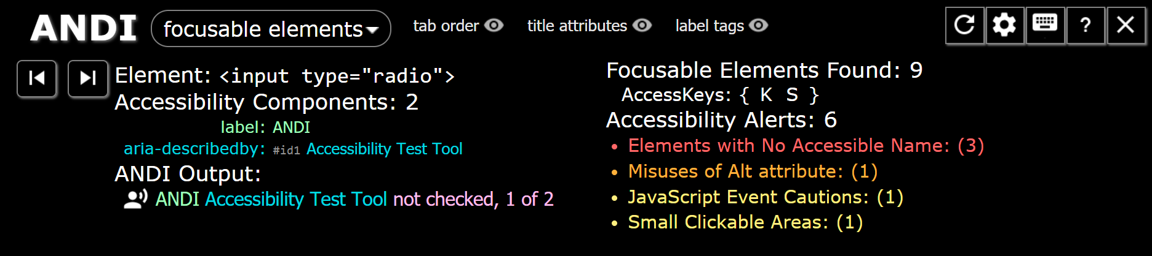
ANDI
Accessible Name and Description Inspector
https://www.ssa.gov/accessibility/andi/help/install.html
Browser “bookmarklet/favelet” -- no installation!
Semi-automated web page inspection
Facilitates manual inspection of code (without needing to know code)
Strictly follows the W3C’s Accessible Name and Description Computation (https://www.w3.org/accname/) - what a screen reader should “say”

Slide 12
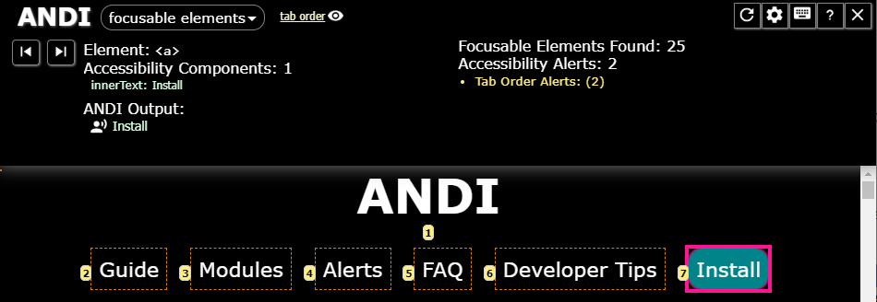
Keyboard Access and Focus
All functionality can be accessed and executed using only the keyboard
No keystroke timing
No keyboard trap
A visible indication of focus is provided
Focus order preserves the meaning and operability of the web page

Slide 13
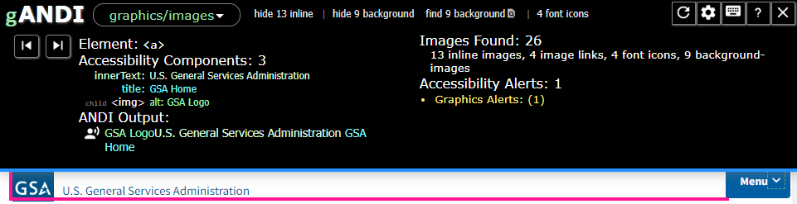
Images
The accessible name and description provides equivalent description
NO accessible name and description for decorative images
Background images are not the only method used to convey information

Slide 14
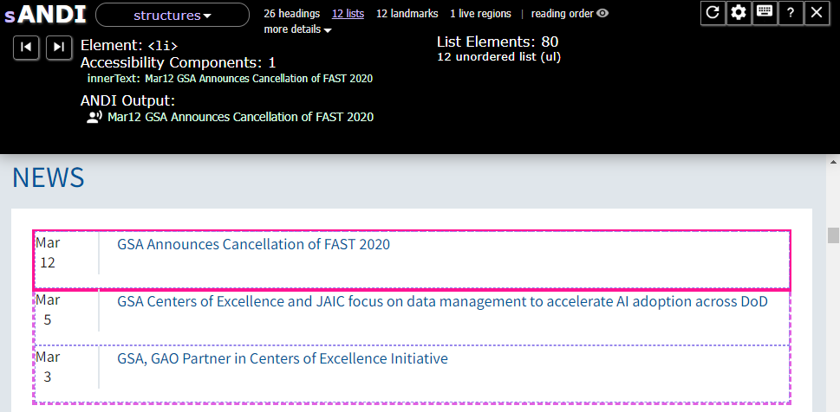
Page Structure
Headings describe the topic or purpose of content
Visual heading structure matches the programmatic structure
Lists are defined programmatically (according to their visually apparent type)

Slide 15
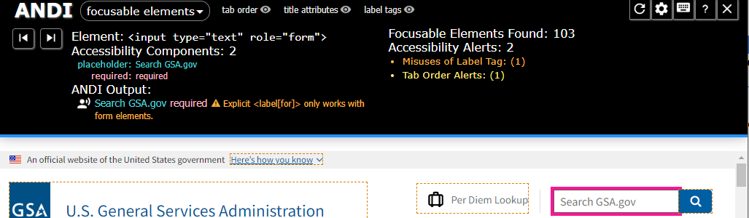
Forms
Descriptive labels or instructions are provided for form elements
The accessible name and description and other programmatic associations for each form element include relevant instructions and cues

Slide 16
Making Agency Communications Accessible to Everyone

Slide 17
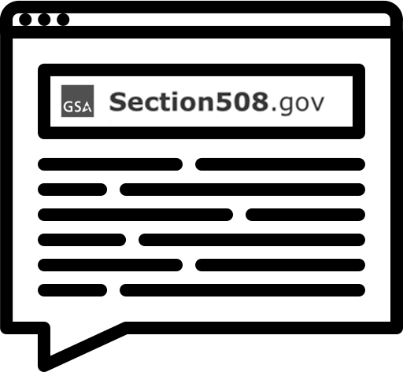
Making Agency Communications Accessible to Everyone
Section508.gov/blog
During an emergency, it is more important than usual for all people to have equal and timely access to urgent communications. To help agencies create accessible digital content, we published a blog post with tips on these topics.
Agency Official Communication
Electronic Documents
Webpages
Videos and Virtual Meetings
Social Media

Slide 18
Questions & Answers

Slide 19
Are there any questions
?

Slide 20
Closing Remarks
April Accessibility Program Managers Meeting
John Sullivan and Yvette Gibson | April 7, 2020

Slide 21
THANK YOU!
We look forward to seeing you on
JUNE 2th!

Slide 22
GSA

