Slide 1

How to
Measure Your Agency's 508 Program
Using OMB Section 508 reporting in addressing your agency's program maturity.

Slide 2
Presenters
Robert
Baker
Section 508 Program Manager
Social Security Administration
410 966 7602 (office)
robert.c.baker@ssa.gov
Norman
Robinson
Section 508 Program Manager
Department of State
202 634 0301 (office)
robinsonn@state.gov
Notes:
This work is intended for presentation by the US Federal Government in support of maturing Agency Section 508 Programs. All media used in this presentation is not for profit and believed to be in the public domain, creative commons, or permissive use. If any content is missing proper attribution or is yours and you would like it updated or removed, please contact robinsonn@state.gov.

Slide 3

What Is A Section 508 Program?
Does your agency have a Section 508 Program?
Are you 'just a coordinator' or
'the coordinator'?
Policy?
Governance?
Budgeted resources?
Notes:
“All-American Salute” NASA photo
http://www.nasa.gov/sites/default/files/images/466548main_as16-113-18339_full.jpg

Slide 4
Your Questions?
What would you like to get out of today's session?
Need better personal understanding of
Section 508?
How to address the lack of a program?
Lies, damn lies, statistics; representative samples?

Slide 5

OMB Template
The narrative is important
Narrative tells your story
Narrative should explain the approach and help in explaining the metrics reported
Template Includes: Acquisition; Agency EIT life cycle activities; Testing and Validation; 508 Compliance Validation; Results; Complaints Process; Training
Notes:
http://www.hrc.utexas.edu/enews/2009/july/images/M_MAI_UNK_001_500.jpg

Slide 6
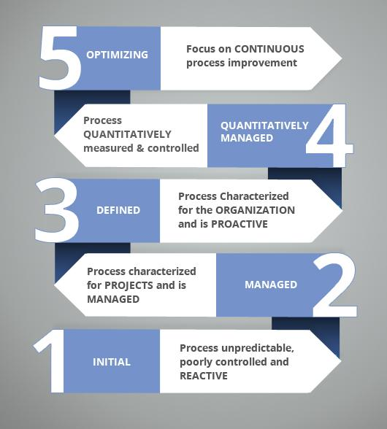
Maturity Definitions
Ad Hoc: No formal policies, process or procedures defined
Planned: Policies, processes and procedures defined and communicated.
Resourced: Resources committed and/or staff trained to implement policies, processes and procedures.
Measured: Validation is performed; results are measured and tracked
Notes:
http://freshersplane.com/interview-tips/what-is-meant-by-cmm-cmmi-levels-of-a-software-companies/

Slide 7
Measures Definitions
508 Compliance Validation Results (% meeting technical standards of those evaluated/tested)
Procurement Solicitations; EIT Life Cycle Activities; Internet Web Pages; Intranet Web Pages; Client/Web Applications; Multi-Media Files; Mobile Applications; Electronic Documents:; Purchased Hardware

Slide 8
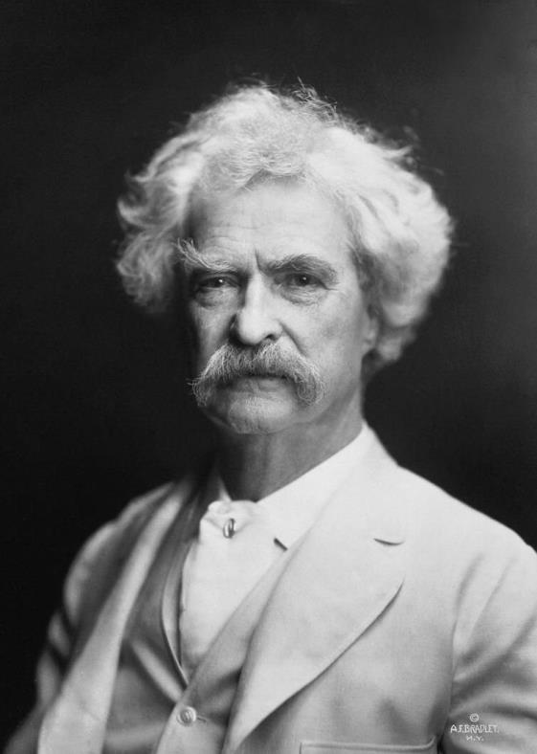
Damn Lies
There are lies, damned lies and statistics.
~ Mark Twain
Notes:
https://upload.wikimedia.org/wikipedia/commons/0/0c/Mark_Twain_by_AF_Bradley.jpg
There are two ways of lying. One, not telling the truth and the other, making up statistics.
~ Josefina Vazquez Mota

Slide 9

What is the purpose of the OMB Template?
Enables OMB to:
  Set expectations
  Gauge status
  Monitor progress
Enables CIO Council Accessibility Community of Practice
  Assess needs for support
  Prioritize best practice and training efforts
Notes:
https://commons.wikimedia.org/wiki/File:Margaret_Hamilton.gif

Slide 10
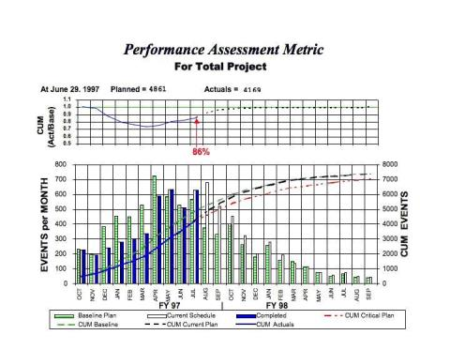
How Metrics Benefit Your Agency
Measuring your 508 program enables you to:
  identify and manage risks
  gain management support
  mature your 508 program
  (breadth & depth)
Notes:
Examples:
SSA – Enterprise application 508 compliance increased from 70% to a sustained 93-94% over a three-year period.
DHS – Dashboard raises awareness among CIOs and executives
State – Measurement provides State an effective communication tool to focus attention on foundational needs
http://llis.nasa.gov/lesson/1780
.

Slide 11
How to Count 508 Program Resources
Resources allocated to your 508 Program Support:
  Annual IT dollars spent on people who conduct 508 Program Activities (full or part time, FTE and contractors, and purchase or maintenance of 508 tools (mostly testing)
  Why is this important?
Notes:
Important because it provides context for OMB to understand how much of an investment is being made in 508 compliance activities. Expectations for a smaller agency would be different than those of a larger agency.

Slide 12
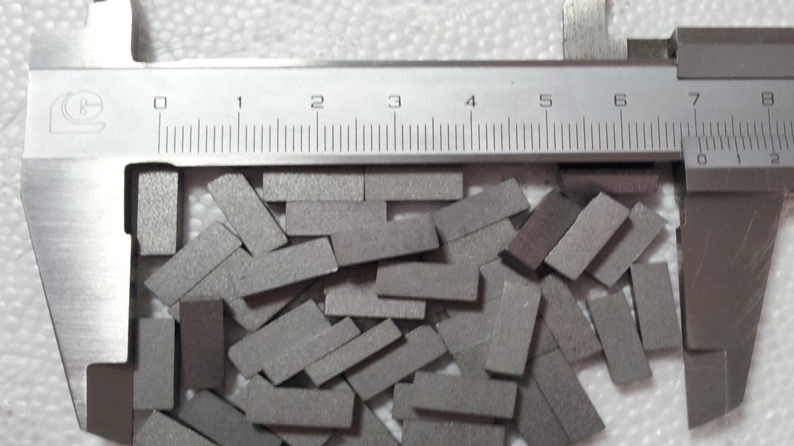
How to Measure Program Maturity
Notes:
https://commons.wikimedia.org/wiki/File:Tungsten-Carbide-inserts.jpg

Slide 13
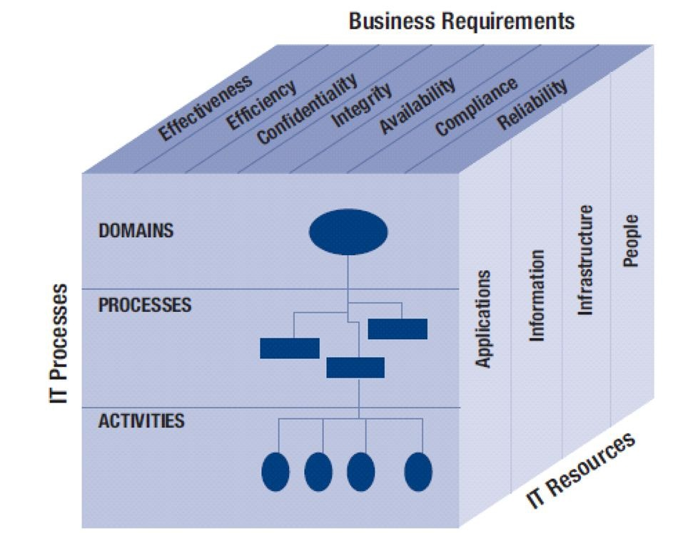
How to Define Scope
Starting point:
  Where is the most work performed today?
  If you are covering the areas where the most significant work is performed, that can be a good benchmark for gauging agency maturity
  Use the narrative to discuss progress & plans to extend practices across existing component, or to move to higher maturity levels in specific areas
Notes:
ITGI COBIT Cube 4.1:
http://history.nasa.gov/SP-4212/ch4.html

Slide 14
How to Define Maturity Levels (1/5)
5
Planned:
  Do you have a framework to define your agency actions?
  Is that framework defined at the specific or general level…is it actionable?
  Does that framework cover the areas where the most significant work is performed?
  Are you “mostly there”? Give yourself credit.

Slide 15
How to Define Maturity Levels (2/5)
4
Resourced:
Have they been trained on how to implement the policy?
Have they been provided guidelines and training to succeed?
Are they actually doing the work?
Are you “mostly there”? Give yourself credit.

Slide 16
How to Define Maturity Levels (3/5)
3
Material Weakness; be realistic in your agency assessment:
If resources are not dedicated in a key area responsible for implement policy, consider the volume of IT they support.
If it is not significant in the overall scheme of things, give your agency credit and note why in the narrative.
If it is significant, hold off giving your agency this rating. Explain in narrative.

Slide 17
How to Define Maturity Levels (4/5)
2
Measured:
Do you have an ongoing process to validate the resources are following the policy and procedures
Do you use the measurements to make changes to your 508 program?

Slide 18
How to Define Maturity Levels (5/5)
1
Examples:
IT Acquisition
Life Cycle Activities
Testing
Training
Complaints

Slide 19
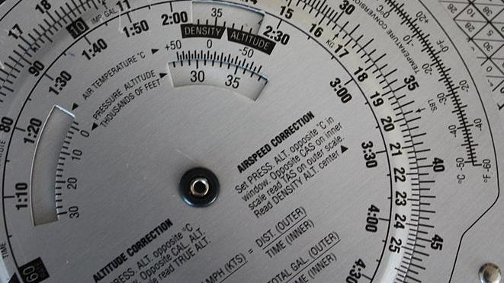
How to calculate 508 conformance metrics
Notes:
https://commons.wikimedia.org/wiki/File:Drehmeier_Slide_Rule_Flight_Computer_018.JPG

Slide 20
How to Calculate A “Representative” Sample
Should you test if you are not planned or resourced to test?
What are you resourced to measure?
Can you make data driven decisions from your sample?
What can you work towards (depth or breadth)?
Notes:
If you are not planned or resourced, how can you be testing and producing meaningful conformance metrics?
What are you resourced to measure? (testing methodology, trained testers)
Can you make data driven decisions from your sample?
Realize that one unit is typically not a representative sample.
What amount of content would raise management attention if it were not 508 compliant?
What amount of content would be sufficient to alert you of systemic risk?
What can you work towards (depth / breadth):
Work towards expanding scope of testing to address critical content.
An adequate sample could be
testing for conformance to more standards (example: automated plus manual testing)
testing for more content types (Microsoft Documents AND PDF documents)
testing for greater distribution across units
testing for greater volume (absolute increase in numbers)
Ultimate goal – gradually increase sample size to help agency manage key risk areas. This is a journey.

Slide 21
How to Calculate Conformance
Percentage applicable 508 standards supported
  Example: 85% of the applicable Section 508 standards are supported in our existing Internet websites.
Percentage ICT products that fully support the applicable 508 standards (i.e. pass/fail).
  Example: 78% of applications tested fully passed Section 508 testing.
Consistency is very important – try not to “mix and match within same category
Notes:
Percentage applicable 508 standards supported
Calculate the total # of applicable Section 508 standards supported vs. the total # unsupported for each product/deliverable tested. For example, a product may pass 22 of 25 clauses/test procedures, and can be represented as an “88% success”.
Total Percentage = the average for all products/deliverables tested in the category.
Percentage ICT products that fully support the applicable 508 standards (i.e. pass/fail).
Calculate whether each product/deliverable tested “passes” or “fails” Section 508 conformance. “Pass” means the product/deliverable meets supports all the applicable Section 508 standards.
Total Percentage = total # of passes vs. the total number of fails for all products/deliverables tested in the category.

Slide 22
How to Aggregate Results
Important! Establish expectations for how conformance will be measured and aggregated upfront!
Options:
Non-weighted average – each item in same gets equal weight (easiest)
Weighted average – each item in sample is weighted based on size of component/agency
Risk based average – each item in sample is weighted based on relative usage or importance (most complicated)

Slide 23
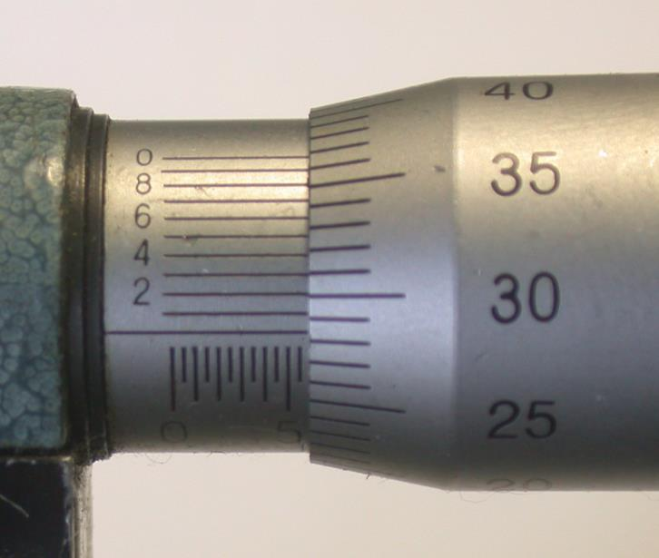
Don’t Be A Box Checker
You can achieve amazing progress if you measure and adapt your approach based on feedback from those changes.
Notes:
Goal of this slide:
Spread a little hope, encourage the participants to use measurement to help them lead, not just report.
I have been struck again and again by how important measurement is to improving the human condition. ~Bill Gates [http://www.gatesfoundation.org/Who-We-Are/Resources-and-Media/Annual-Letters-List/Annual-Letter-2013]
Measuring tools such as a micrometer, able to gauge tiny distances, allowed inventors of steam engines to see if their incremental design changes led to the improvements-higher-quality parts, better performance, and less coal consumption-needed to build better engines. Innovations in steam power demonstrate a larger lesson: Without feedback from precise measurement, invention is "doomed to be rare and erratic." With it, invention becomes "commonplace."
You can’t manage what you don’t measure

Slide 24

What Measurement Can Do For You
Drive Enterprise application 508 compliance
Raise awareness among CIOs and executives
Provide a communication tool to focus attention on program needs
Notes:
https://commons.wikimedia.org/wiki/File:International_Day_of_Persons_with_Disabilities_2012.jpg

Slide 25
Resources
Instruction Manual: http://www.section508.gov/sites/default/files/CIOC_Accessibility_Committee_508_Reporting_Template.pdf
CIO Council Accessibility Communities of Practice
Accessibility CoP: Katie.Pittman@va.gov

