Slide 1

Accessibility Community Meeting Getting the Support You Need: Strategically leveraging high-level support

Slide 2
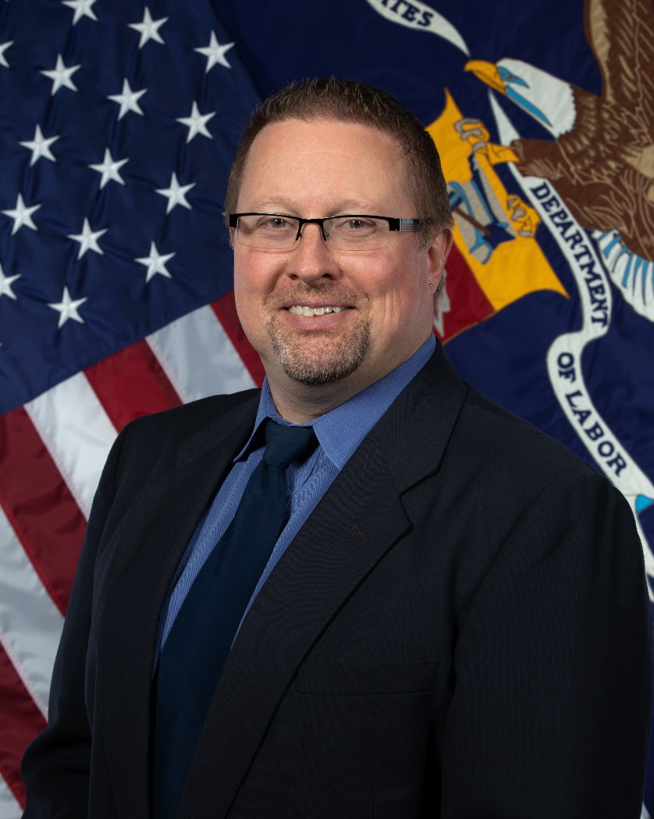
Meet your presenter
US Department of Labor Branch Chief of IT Quality Management Office of the CIO
Approximately 18,000 employees nationwide
27 mission Agencies of various sizes
450 offices across the US & its territories

Slide 3
Background
Started my career in the automotive industry
Went from manufacturing to IT procurement and Indirect Materials Management
Joined DOL in December of 2009 as a COR
Held several leadership positions, ending with Quality Management
Asked to “stand up” a Section 508 Program Office

Slide 4
Clarification
I am NOT an accessibility expert.
I am an evangelist for Section 508 and accessibility.
My expertise is in:
Lean concepts
Continuous process improvement
Communication and change management

Slide 5
Top-Level Support

Slide 6
Be cautious with top-level support!
The DOL Deputy Secretary mandated creation of a Section 508 Program Office
Support can be conditional
Support is often spontaneous and lacks commitment
You need an Executive Sponsor’s authority but control their involvement!
I set simple, clear expectations for our Assistant Secretary for Administration & Management (ASAM)

Slide 7
Two “asks” of our ASAM
Make it clear to the other Assistant Secretaries that the DepSec said to do this. (Suggested they bring concerns to him, not the DepSec.)
If an agency comes to him, ask, “What did Brandon say about it?”
If they haven’t talked to me, then send them my way.
If they HAVE talked to me, just schedule a meeting for the three of us and I’ll be there to do the talking.

Slide 8
Defining initial success
Cited a “higher authority” by using OMB’s Section 508 Maturity model
Using an existing structure gave immediate credibility to the plan.
Allowed me to bring attention to the need for process improvements.
Set us up for continued improvements because metrics help us:
Pinpoint problems
Measure the effectiveness of solutions
Track our overall progress

Slide 9
Building executive trust
Set a clear vision and aggressive but attainable goals.
Under-promise and over-deliver along the way.
Take a lesson from comedy improv:
Never say “no.”
Always take the “yes and” approach.

Slide 10
Whew! That’s a LOT!

Slide 11
Summary so far
Do NOT expect your top leadership to fight your battles for you.
Try to keep the right “authority” as the backdrop to what you’re doing, without ever having those authority figures argue your case for you.
Convince them to never discuss counterpoints unless you’re involved.

Slide 12
Critical: Clear Accountability!
Our Section 508 Points of Contact had no authority in their agencies.
DepSec mandated each DOL Agency appoint an Agency 508 Officer:
Authority to speak on behalf of the agency
Authority to communicate to agency personnel
Access to the top Agency leadership
Does NOT need to be a Section 508 expert
Accountable for Agency support of the Section 508 Program Office

Slide 13
Winning Formula
Get someone at the top of your organization to:
Set clear lines of accountability within your various mission areas
Refuse to listen to complaints
Let you “run with it!”
Do NOT expect your executives or politicals to argue on your behalf.
The IMPLIED threat of their authority is more powerful!

Slide 14
Questions? Comments? (Snide Remarks?)

Slide 15
Set a grand vision
Brandon’s 508 Vision: DOL no longer views accessibility as a roadblock and something we have to do because “it’s the law.” We make sure everything is accessible; and every person at the Department creates accessible work products because that’s how we do it here. All employees embrace the fact that accessibility is a non-negotiable and it’s everyone’s responsibility.
Problem: This requires MASSIVE change to our organizational culture!

Slide 16
Stories touch hearts!

Slide 17
Problem: Focus on remediation
People want to create something and hand it off for “remediation.”
“Remediation” is synonymous with “accessibility.”
Told stories to help people understand that accessibility is fundamental.

Slide 18
blueberry muffin example

Slide 19
Problem: Focus on remediation, cont.
Began equating remediation with “poor quality.”
Remediation is REWORK, which is one of the seven forms of WASTE!
No manager is paying their people for poor quality work!
Remediation is part of the “failure stream” and you don’t optimize for failure – you focus on first time quality, which ALWAYS includes accessibility!

Slide 20
Problem: Pleading ignorance
“My people don’t know how to ‘do’ accessibility,” says every manager everywhere!
During mandatory training for supervisors, I challenged them to simply do 3 things:
Stop passing the buck!
Stop defending ignorance!
Ask one simple question: “Is it accessible?”

Slide 21
Training to touch hearts
Awareness training was built around a truthful story because people remember stories better than lectures.
Example: Main character’s cousin uses a wheelchair and must go down the alley, past the dumpster, and down a dingy hallway to enter the restaurant.
People now picture THAT scene when they think of disabled persons struggling to access our ICT!

Slide 22
ADKAR Model of Change Management
Awareness: Make the person aware for the needed change.
Desire: Create in the person a desire to make the needed change.
Knowledge: Give the person the knowledge to make the change.
Ability: Help them turn knowledge into skills to make the change.
Reinforcement: Create processes that reinforce the changes made.

Slide 23
Reinforcement is key
DOL is tackling Reinforcement in two critical ways:
Encourage the question, “Is it accessible?”
Promote reinforcement by asking all supervisors to begin holding their direct reports accountable for accessibility.
Focus on process review and improvement.
Build accessibility into workflows and include measurement and reporting of accessibility.

Slide 24
Responsibility and Accountability

Slide 25
Establish responsibility AND accountability
DOL Policy states whoever PAYS for the ICT is accountable for accessibility.
Budget holder can delegate responsibility but NOT accountability.
DOL Agencies don’t like it but it has kept them much more actively involved in ensuring ICT is accessible!

Slide 26
A long way to go
“Give a man a fish, and you feed him for a day. Teach a man to fish, and you feed him for a lifetime.”
Our team is too small to enforce Section 508, so we’re creating a culture where we don’t have to.
People are paying attention and the culture truly is changing!

Slide 27
Questions? Comments? (Snide Remarks?)

Slide 28
We have a foundation
Stories from the 508 trenches indicate an uphill battle.
DOL has “pockets of excellence” in its IT development.
Excellent foundation in policy and acquisitions:
Well-established IT Accessibility Policy
All IT contracts required to have Section 508 “boilerplate” provision

Slide 29
A New Approach

Slide 30
Force begets force
When you push someone, the always push back!
Past failed attempts at Section 508 focused on enforcement.
Someone in leadership thinks fixing them problem just takes a strong demand and a big stick to make people comply.
Instead, we want to calmly steer people where we want them to go!

Slide 31
Messaging is critical
Be clear and consistent with your messaging.
Leadership often wants simple answers but this is a complex problem.
Don’t bore them with the details - communicate concepts they need to know:
Create messages they understand
Hammer those messages relentlessly

Slide 32
My big three messages
Accessibility is a QUALITY issue.
Remediation = Rework = WASTE
There are three IT "non-negotiables":
Privacy
Security
Accessibility
Crafted for brevity and to ANCHOR accessibility to something they understand.

Slide 33
It’s a QUALITY issue
Quality is no longer a differentiator - it's a given.
Be ready for pushback like, "Define accessible."
“Standards are well-defined. I’ll send you a link.”
Or “What if our people don't know how to do it?"
“Send them to us and we’ll help them figure it out.”
You can’t INSPECT or TEST quality into a product or service!

Slide 34
Remediation is WASTE
People understood once I linked “remediation” to WASTE.
True Story: An Agency paid a lot for training materials and asked us to remediate them!
Our ASAM understood "remediation is waste" and would tell other Agency heads to “Stop generating so much waste!"
He didn't need to understand accessibility to defend this position because I had anchored REMEDIATION to the concept of WASTE.

Slide 35
3 IT “Non-Negotiables”
Security - link to the importance but NOT to the perceived budget!
Privacy - critical in the minds of enforcement agencies
Accessibility - it’s the law, so it’s obviously a “non-negotiable”

Slide 36
Additional Messages

Slide 37
Messages for the masses
Selected two messages that are less “strategic”:
Accessibility is EVERYONE’S responsibility!
Fix your process and the outcomes will take care of themselves.
We don’t “police” everyone; we help them learn to do the right thing.
We’re training everyone we can, as fast and as thoroughly as we can!

Slide 38
Reframe the purpose of metrics
DOL has plenty of “lagging” metrics, often used to “determine blame.”
Our goal is to help supervisors create standardized processes and then measure them properly:
Don’t start with remediation (outcomes); fix the process.
Institute “leading” metrics to proactively identify problems.
Implement a solution, test its effectiveness, rinse, repeat!

Slide 39
OMB Maturity Model “Fits”
Five logical areas for Continuous Process Improvement:
Acquisitions
Tech Lifecycle
Testing and Validation
Training
Complaint Management
We ask for PROGRESS, not perfection!

Slide 40
Play an Infinite Game!
Some Section 508 veterans disagree with me:
Long-term vision is too grand
Short-term expectations are too little, too late
This is NOT a finite game, where someone wins and someone loses.
This is an INFINITE game – play to keep playing!

Slide 41
Let’s connect!
Brandon Jubar
Jubar.Brandon.T@DOL.gov
(202) 693-4289
LinkedIn.com/in/brandonjubar/

Slide 42
Questions? Comments? (Snide Remarks?)

