Slide 1

Accessibility Community Meeting Topic 1: Link & Leverage Harnessing the power of maturity models

Slide 2
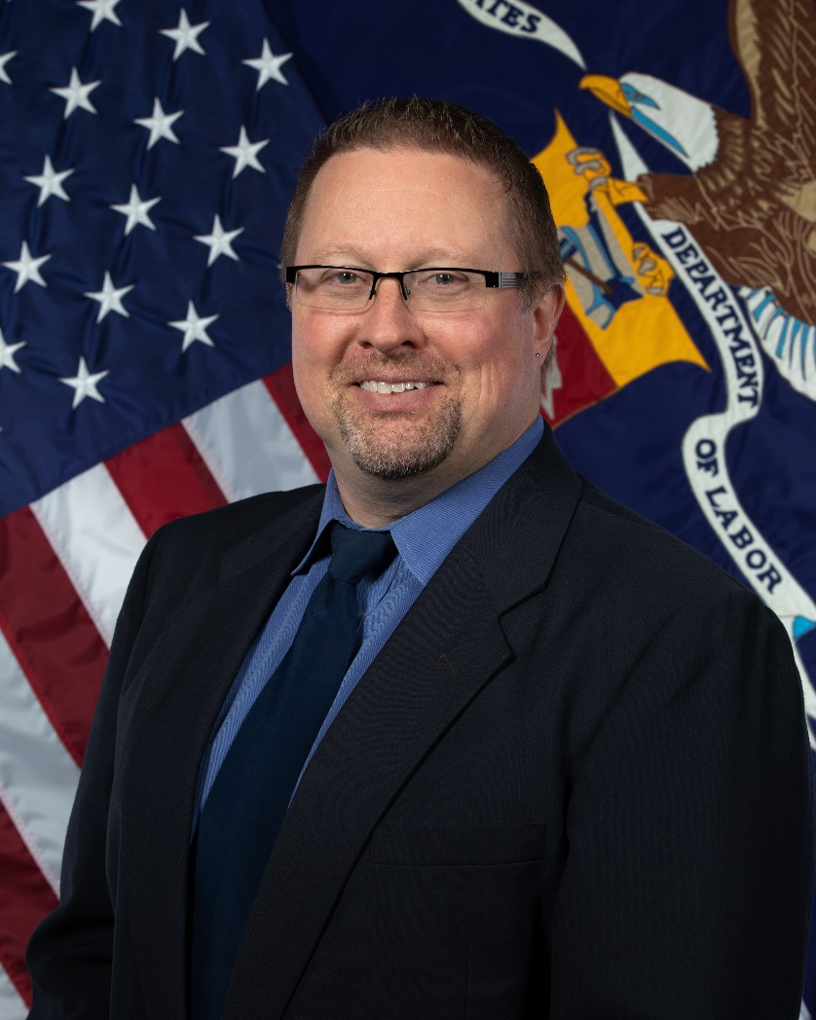
Meet your presenter
US Department of Labor Branch Chief of IT Quality Management Office of the CIO
Approximately 18,000 employees nationwide
27 mission Agencies of various sizes
450 offices across the US & its territories

Slide 3
Background
Started my career in the automotive industry
Went from manufacturing to IT procurement and Indirect Materials Management
Joined DOL in December of 2009 as a COR
Held several leadership positions, ending with Quality Management
Asked to “stand up” a Section 508 Program Office

Slide 4
Defining Success

Slide 5
How do you ‘stand up’ a 508 Office?
Deputy Secretary mandated creation of a Section 508 Program Office
DepSec did not define “success”
CIO did not define “success”
I was given 2 weeks to define “success”
The GSA 508 Playbook was thorough but not appropriate
DOL was already hitting multiple “plays”
Filling in the blanks wasn’t a reasonable approach

Slide 6
Intro to Maturity Models
Maturity Models are tools to help assess your current effectiveness and determine capabilities necessary to improve.
Structure of a typical Maturity Model:
Initial or Ad Hoc Level: just beginning to work in the area but uncoordinated
Repeatable Level: developing skill and can achieve acceptable outcomes regularly
Defined Level: implementing standard processes and a structured approach
Managed Level: measuring the work and using the results to detect and correct errors
Optimizing Level: has standardized processes, defined service levels and metrics, and is using data to drive continuous process improvements

Slide 7
The OMB 508 Maturity Model
The OMB Section 508 Maturity Model only has four levels:
Ad Hoc: No formal policies, processes, or procedures defined.
Planned: Policies, process, and procedures defined and communicated.
Resourced: Resources committed and/or staff trained to implement policies, processes, and procedures.
Measured: Validation is performed; results are measured and tracked.

Slide 8
The Power of Maturity Models
Maturity Models help us frame our work so people understand
Maturity Models help us focus on vision, strategy, and effective goals
OMB Maturity Model provides Domains that help target improvement efforts
Acquisitions
Tech Lifecycle
Testing & Validation
Complaint Management
Training

Slide 9
Project: Getting to Measured
Proposed a 9-month “Get to Measured” project
We would not be “complaint” but we’d have the foundation for more rapid ongoing improvements
DOL leadership understood the accessibility requires ongoing effort
I was provided minimal resources for the project:
One part-time Project Manager
1.5 Section 508 Subject Matter Experts

Slide 10
Questions? Comments? (Snide Remarks?)

Slide 11
Accessibility Community Meeting Topic 2: Build a Foundation Completing the “Get to Measured” Project

Slide 12
Get the Lay of the Land
Allocated 3 months for “discovery” with our 27 DOL Agencies and looked at the info through two “lenses”:
Five Domains of the OMB Section 508 Maturity Model
DOL Leadership’s lens – Software & Applications, Websites, and Documents
With the Leadership Lens, we linked every Agency to accessibility
They create thousands of documents a week
Approximately 4 million documents are in various repositories
Agency Leadership still pushes for us to do remediation

Slide 13
Determine Your End State
Completed the discovery phase and then defined our “end state”
OMB’s definition of “measured” is vague: “Validation is performed; results are measured and tracked.”
We had to define what we would consider “measured”:
Had lots of healthy debate
Considered the current state
Considered the timeframe we had to work with

Slide 14
Conduct Your Gap Analysis
Final step was to conduct a gap analysis and understand what was missing in each Domain.
Build on what came before:
Acquisitions example: Ensure policies and processes were defined and communicated, that staff were trained to implement them, and that we were performing validation and tracking results.
We identified the gaps within the levels of maturity for each Domain. This allowed us to determine what work needed to be done.

Slide 15
Run it Like a Project
We created our work breakdown structure (WBS) and broke it down into actual tasks
Assigned the tasks and set our schedule
Having an experienced Project Manager was CRITICAL!
Kept everyone focused
Tracked all the deadlines
Paid attention to all the dependencies
Protected our scope.

Slide 16
The End State, revisited
The “end” of the project was just one stop on a longer journey.
We didn’t focus on the metrics we hope to have in place some day.
We focused on what we needed to measure FIRST:
Build a foundation
Create a baseline
Inform improvement efforts

Slide 17
Metrics: Punishment, Proof or Progress?
Must address your organization’s view of metrics.
DOL leadership tends to use metrics for two things: punishment or proof.
Punish people when metrics are poor
Use them to prove their great work if metrics are good
The reason for “measuring work” is to inform and drive progress.
We have to change the narrative around metrics and measures!

Slide 18
Questions? Comments? (Snide Remarks?)

Slide 19
Accessibility Community Meeting Topic 3: Change the Narrative A Phased Approach to Metrics and Measures

Slide 20
“Show me the RED!”
I once made the mistake of saying “We’ll fix our numbers.”
Don’t fix your numbers
Fix your problems (and the numbers take care of themselves
Unless you’re perfect, having all “green” metrics isn’t that helpful.
3rd Quality Absolute: The quality performance standard is zero defects!
Measure to uncover your imperfections – “Show me the RED!”

Slide 21
Reframe the purpose of metrics
“Lagging metrics” look to the past, so you’re always fire-fighting
“Leading metrics” are forward-looking, giving actionable information before it impacts the customer (or before there’s even a problem)
The five Maturity Domains gave us specific areas to start measuring:
Identify problems
Measure impact of improvements
Track our overall progress

Slide 22
Taking a Phased Approach

Slide 23
What got you here won’t get you there!
We needed to do something different; initial progress had stalled.
We couldn’t go directly to the grand vision, so “getting to measured” would set us up for a phased approach to improving our metrics.
We started measuring to uncover problems. If those metrics helped measure the impact of corrective actions, then we’d keep measuring.
This is NOT “moving the goalposts” – it’s changing the play calling!

Slide 24
Phased Approach to Acquisition
Reviewed all active contracts for Section 508 contract provisions.
Found three categories: yes, no, and unknown. COs were not helpful.
Implemented a Section 508 “pick list” in our Acquisition Mgmt System
Phase 1: Do contracts have the right boilerplate 508 clauses?
Phase 2: Do contracts have provisions to link the boilerplate to specific requirements and deliverables?
Phase 3: Refining metrics and focusing on qualitative measurements.

Slide 25
Phased Approach to Tech Lifecycle
Tech Lifecycle started with quantitative, moving towards qualitative.
Phase 1: Measures whether Section 508 requirements are incorporated into enterprise architecture, design, development, testing, deployment, and ongoing maintenance.
Phase 2: Focus on standardizing processes, instituting best practices, and reporting the results.
Phase 3: Focus on continuous process improvement activities.

Slide 26
Phased Approach to Testing & Validation
Testing & Validation started with quantitative, moving towards qualitative.
Phase 1: Measures what is being measured and how, including testing methodologies and software tools.
Phase 2: Focus on standardizing processes, instituting best practices, and reporting the results.
Phase 3: Focus on continuous process improvement activities.

Slide 27
Phased Approach to Training
Phase 1: Focus on foundational training courses:
All DOL staff – creating accessible digital content in standard formats;
All DOL leadership –importance of accessibility, what questions to ask, and where to send employees for resources and support; and
All IT project managers –importance of accessibility and how to incorporate it throughout the project lifecycle.
Phase 2: Certification programs, Agency metrics, annual training
Phase 3: Identifying training needs and measuring Agency support

Slide 28
Phased Approach to Complaint Mgmt.
Civil Rights Center only tracks “formal” complaints.
We will expand the definition of complaints being tracked.
Phase 1: Report on “formal” complaints (open date, time to close, etc)
Phase 2: Track “informal” complaints (category/type, open date, average time to close, etc)
Phase 3: To Be Determined

Slide 29
Questions? Comments? (Snide Remarks?)

Slide 30
Accessibility Community Meeting Topic 4: Enforcement is NOT the Answer Training, Skill Building, and Empowerment

Slide 31
We’re NOT the “508 Police”
One of our senior leaders was advocating for immediate enforcement of Section 508 and I strongly disagreed.
He explained his position with a bad analogy about driving faster than the speed limit until a police office enforces the law.
People don’t understand accessibility mistakes or how to fix them.
Most haven’t been trained and definitely aren’t “licensed.”
Enforcement now will require lots of qualified people ready to help!

Slide 32
Build the Foundation
Create and track metrics to help us on our journey.
Can’t effectively act on this information without the necessary skills.
Immediate, across-the-board enforcement is not the answer.
You can't enforce your way to compliance:
Most people drive the speed limit by choice, not because cops are there.
Laws work because must people just agree to abide by them.
Section 508 and accessibility needs to be the same way.

Slide 33
Build Skills
There’s no practical or efficient way to do the 508 work for everyone.
We’re trying to empower people to do most of it themselves, often by breaking years of bad habits!
Training classes aren’t enough. People need actual skills and abilities.
Regular training, refresher training, and customized training
Coaching sessions and virtual office hours
Looking at developing 508 SME’s in each Agency

Slide 34
Empower the People
Some people take training several times and still want remediation.
Some people refuse to take training.
Some leaders advocate for accessibility until something urgent comes up and they want a “waiver,” just this once!
BUT lots of people are learning a lot, attending virtual office hours, getting help from a coach, and improving their accessibility skills.
We have leaders who are implementing internal review processes to ensure their work products are accessible without help from us!

Slide 35
The thousand mile journey…
It is NOT all unicorns and rainbows at DOL.
Many of you have areas of excellence that surpass us!
But…
We’ve built a solid foundation.
We’re executing an ambitious change management plan.
We’re making steady progress in all five Maturity Domains.
We’ll keep trudging along in the right direction!

Slide 36
Questions? Comments? (Snide Remarks?)

