Slide 1

Andrew Nielson and Alex Wilson Government-wide IT Accessibility Program
Revolutionizing Accessibility Conformance Reports with OpenACR
CSUN Assistive Technology Conference | March 2024
Office of Government-wide Policy | Office of Technology Policy

Slide 2
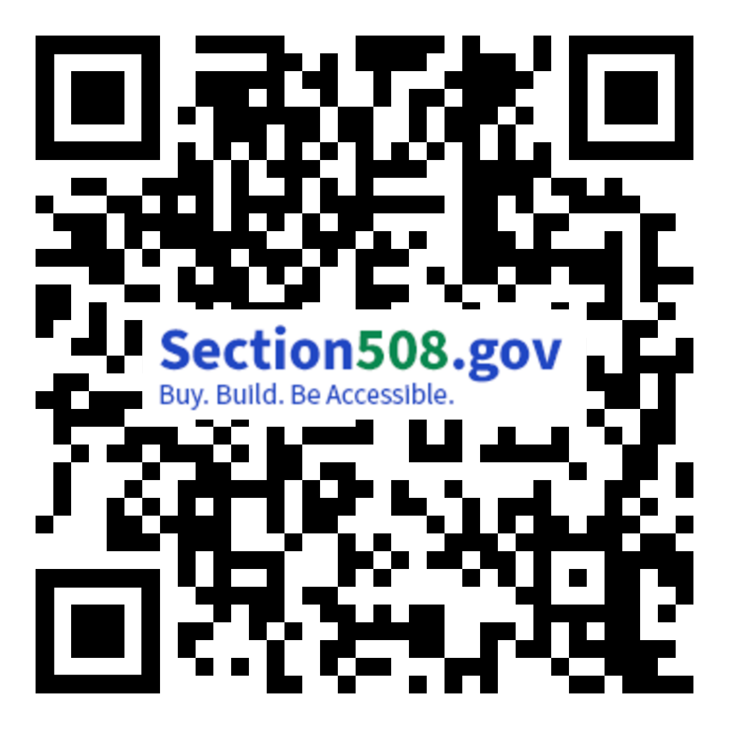
Agenda
About Us
Challenges with Traditional Accessibility Conformance Reports (ACRs)
What is OpenACR and How Can it Help?
OpenACR in Practice
The OpenACR Editor
How to Contribute to OpenACR Efforts
Coming Soon: The OpenACR Repository
Q&A
Section508.gov/csun2024/

Slide 3


About Us: The GSA Government-wide IT Accessibility Team
Host Section508.gov and assist with technical support, guidance, and advice to agencies and individuals with questions and issues relating to implementation of Section 508 requirements.
Focus on providing support to federal agencies in the following primary areas:
Policy and Program Management
Accessible Acquisition
Content Creation
Accessible Design and Development
Accessibility Testing
Accessibility Training and Events

Slide 4
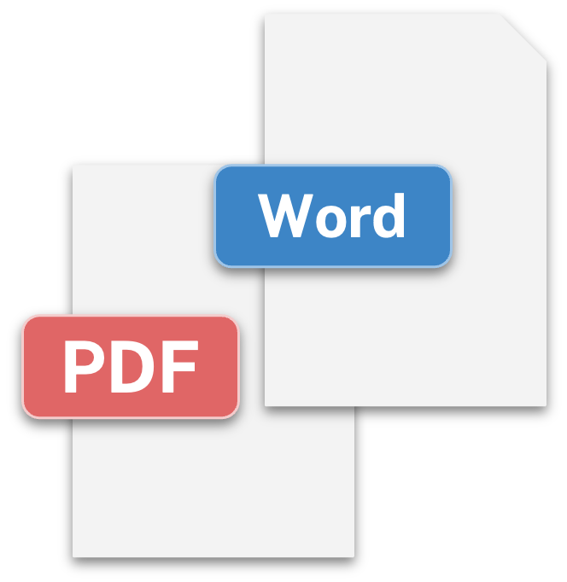
Challenges with Traditional ACRs
ACRs often in MS Word or PDF formats
But accessibility information is not in form data
Data is tied to the document container
Difficult to evaluate, search, and compare
Difficult to share details
Static snapshot of accessibility at the time of retrieval
Existence of an ACR does not guarantee product accessibility
Potential discrepancies between ACR claims and actual conformance
Difficult to understand impact of nonconformance on users

Slide 5
What is OpenACR?
The OpenACR data schema for a machine-readable ACR:
Buyers can more easily compare accessibility of different solutions
Managers gain insights into potential interface limitations
Executives more easily assess risks associated with accessibility issues in portfolio of information and communications technology (ICT) products
The OpenACR Editor - a user-friendly interface to:
Create machine-readable ACRs in the OpenACR format
Validate and edit previously-created ACRs
Export and share machine-readable data
View ACR reports in HTML

Slide 6

OpenACR in Practice
OpenACR data schema and Catalogs -
Schema defined in YAML as hierarchical, key: value pairs
Catalogs define the criteria and components for various standards such as Wcag 2.0/2.1/2.2, Section 508, EN 301 549, etc.
Command Line Interface
Validate that a YAML adheres to the OpenACR schema
Convert and output OpenACR YAML file to Markdown or HTML
Customize styles and templates for Markdown and HTML views
https://github.com/GSA/openacr/

Slide 7
In Beta: ACR Editor

Slide 8
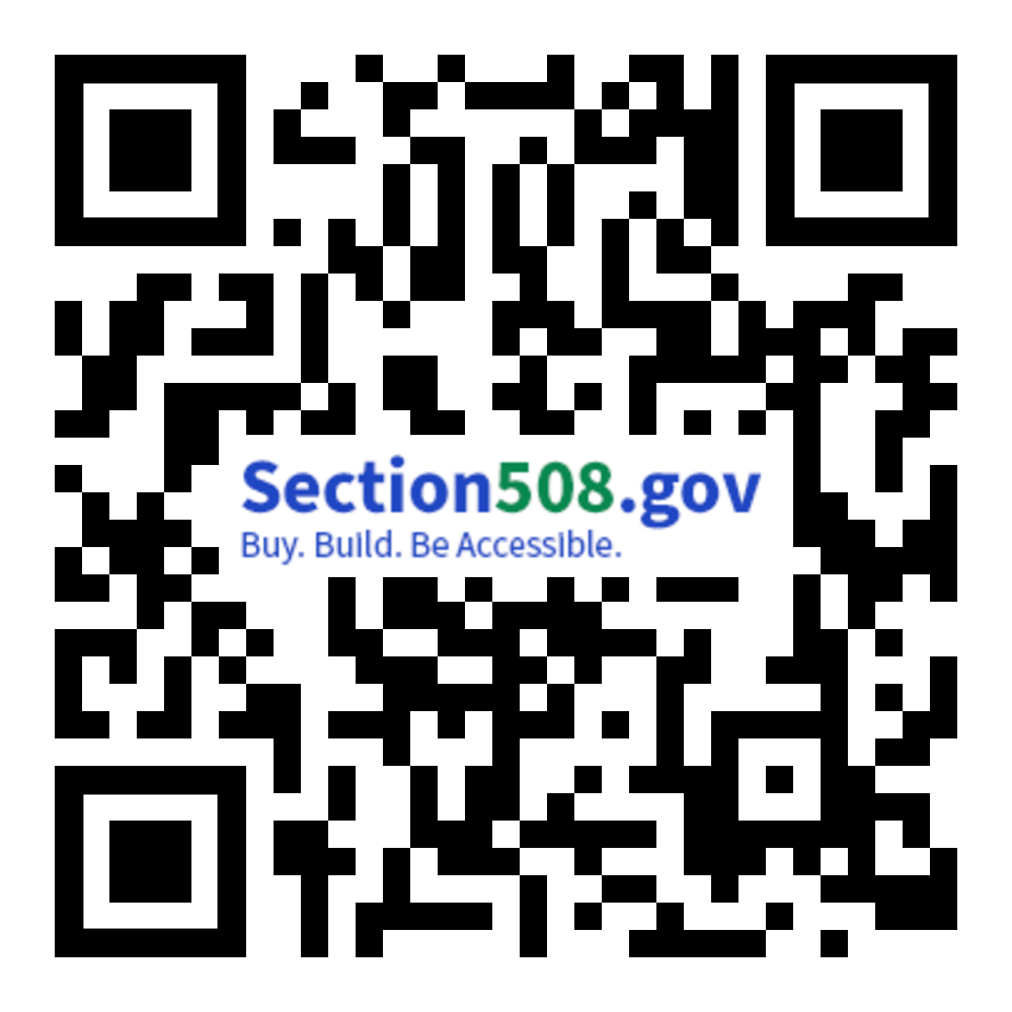
The OpenACR Editor
Seamlessly create ACRs in the OpenACR format via a user-friendly interface
Builds on foundational work of Authoring Tool Accessibility Guidelines (ATAG) and Web Content Accessibility Guidelines - Evaluation Methodology (WCAG-EM) Report Tools
Relies on and ensures output adheres to the OpenACR data schema
Incorporates OpenACR Command Line Interface (CLI) validation tool functionality
View OpenACR data in an HTML report
https://acreditor.Section508.gov/

Slide 9
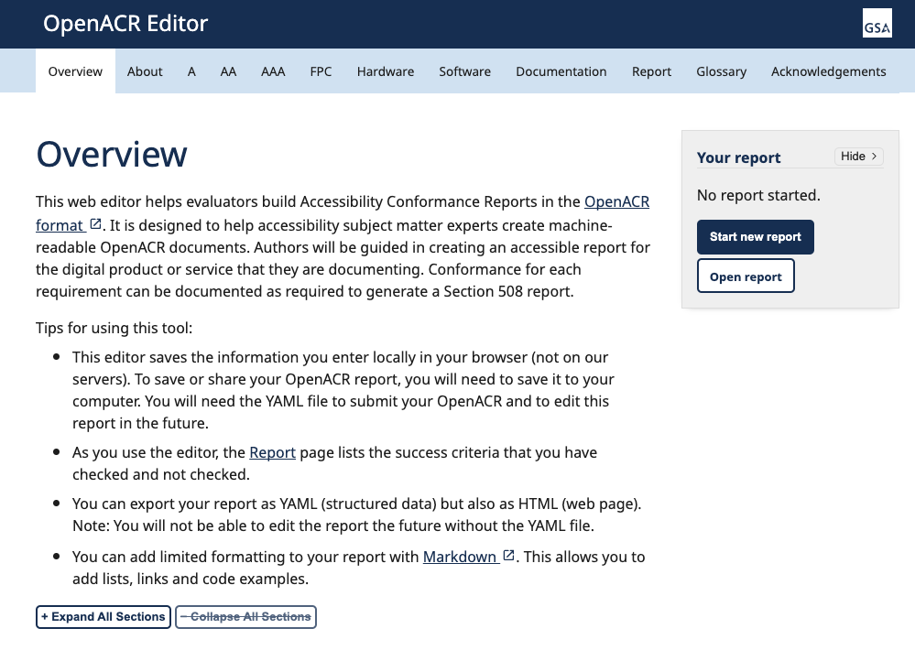
Creating a Machine-Readable ACR with OpenACR Editor
Start from scratch or edit a previous ACR in the OpenACR format
Select report type and catalog (specific standards)
Product, author, and vendor information
Report version, notes, and evaluation methods
Conformance by standard
View report
Download report (HTML) and data (YAML)

Slide 10
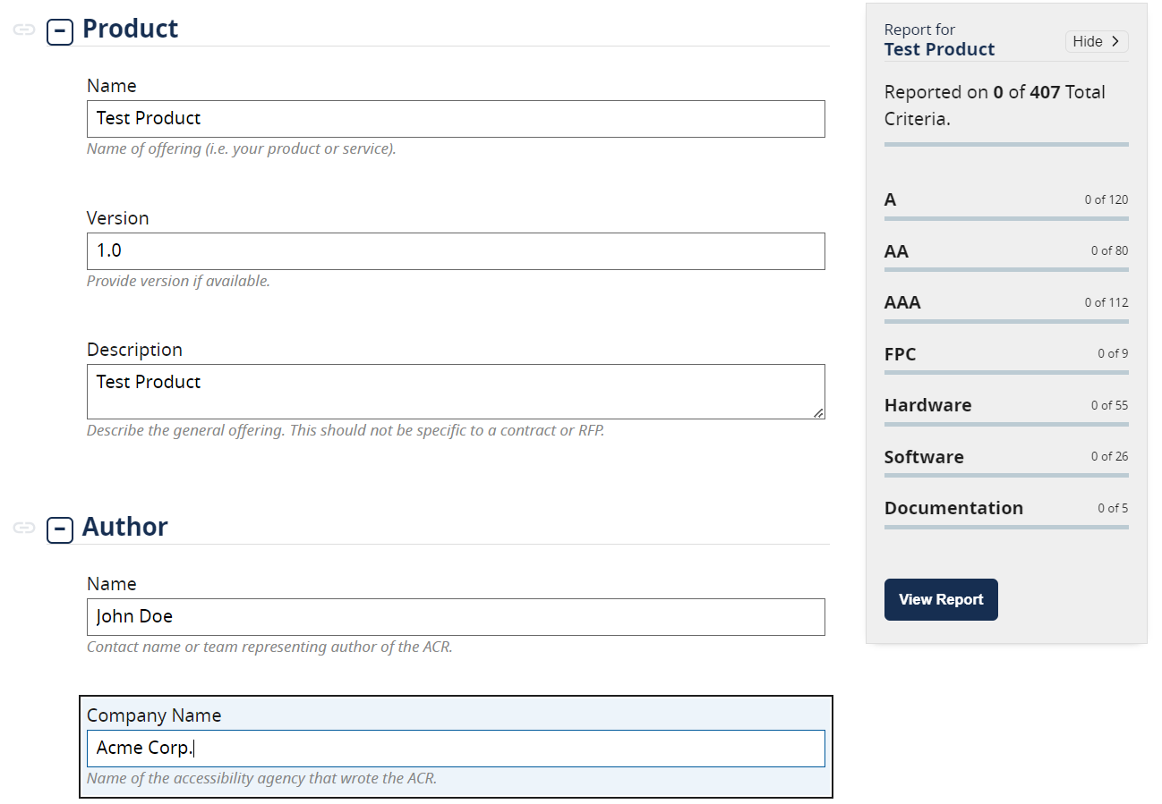
What the OpenACR Editor Looks Like in Practice (1 of 2)
The initial page of the Editor displays key descriptive information for the ACR including:
Product info
ACR author info
Vendor info
Rulesets to be used
Additional ACR report details

Slide 11
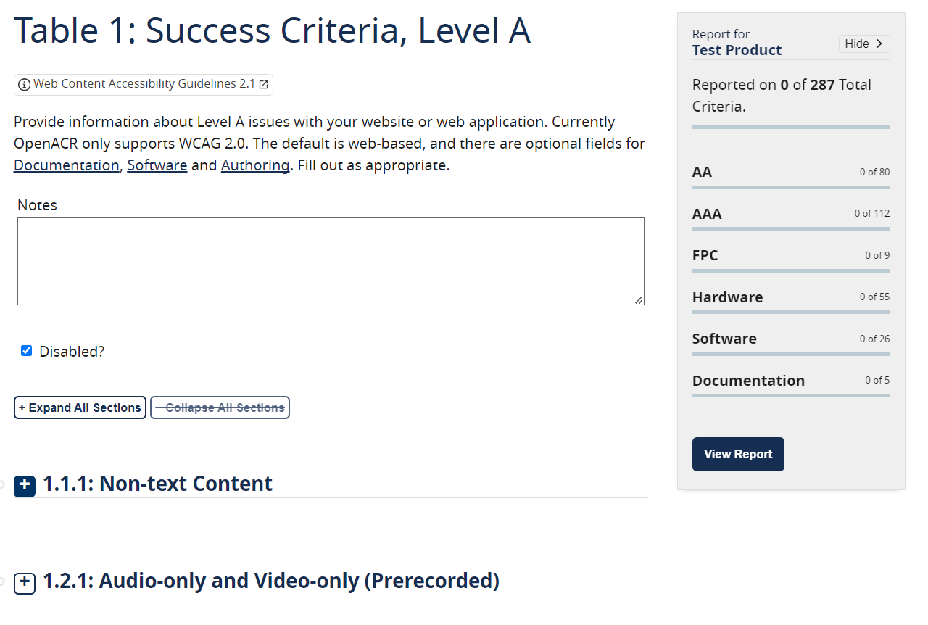
What the OpenACR Editor Looks Like in Practice (2 of 2)
The “body” of the Editor includes inputs for accessibility requirements, such as:
WCAG Level A, AA, and AAA Success Criteria
Section 508 Functional Performance Criteria
Hardware and software criteria

Slide 12
How to Contribute
OpenACR welcomes input, feedback, and contributions from the community
All contributions released under the reuse policy for works produced by the federal government. As a product of the federal government, OpenACR is not protected by copyright and is in the public domain
Submit and track issues in GitHub repositories
Clone and fork the repositories; provide suggestions and edits via Pull Requests
Updates to catalogs and schema
Bug fixes
Editorial changes
Provide feedback via section.508@gsa.gov

Slide 13
Coming Soon: ACR Repository

Slide 14

The OpenACR Repository: Key Features
The OpenACR repository will be a platform for users to store, compare, and update information for ACRs. This repository will:
Provide the ability to see all products and their ACRs in a comprehensive repository
Allow users the ability to compare ACR reports between products
Provide search functionality for vendors and their products that have ACRs
Add coworkers from your agency to also search for ACRs

Slide 15




The OpenACR Repository: FY24 Next Steps
Continue to host focus groups to give feedback on wireframes and proposed features
Incorporate feedback in an agile process
Beta ready in July for User Testing
Continually update to incorporate more features and pages as user feedback is also incorporated

Slide 16
Q & A

Slide 17
How to Contact the Gov-wide IT Accessibility Team
Visit our Contact Us page at section508.gov/contact-us/
Contact us via email at section.508@gsa.gov

Slide 18
GSA Office of Government-wide Policy, Office Technology Policy

