Slide 1


Accessibility on an International Scale
Axel Leblois
President, G3ict
2020 Interagency Accessibility Forum (IAAF) October 6 - 7, 2020

Slide 2
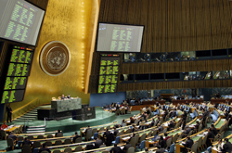
G3ict - Global Initiative for Inclusive ICTs
Formed in December 2006 in cooperation with UNDESA upon the adoption of the Convention on the Rights of Persons with Disabilities (CRPD) by the United Nations General Assembly
To promote and support the implementation of the dispositions of the CRPD on the accessibility of Information and Communication Technologies
Nonprofit 501(c )(3) advocacy organization working with the ICT industry, Organizations of Persons with Disabilities, Governments, and Standards Development Organizations
Institutional advocacy, policy development, M-Enabling Summit, training and certification (IAAP)

Slide 3

Accessibility on an International Scale: Framework of the Convention on the Rights of Persons with Disabilities (CRPD)
Ratified by 181 countries, defines ICT accessibility obligations on par with those for the built environment and transportation
Art. 9: « States Parties shall take appropriate measures to ensure to persons with disabilities access, on an equal basis with others, to the physical environment, to transportation, to information and communications, including information and communications technologies and systems… »

Slide 4
Measuring CRPD Impact - G3ict DARE Index Digital Accessibility Rights Evaluation Index
Objective: to provide a tool for in-country advocates to benchmark and track the progress made by their countries in implementing ICT/digital accessibility policies and programs
Framework consistent with Human Rights monitoring:
Country commitments
Country capacity to implement
Country actual implementation and outcomes
Our Experts: Persons with Disabilities, advocates, researchers, and community leaders identified in partnership with Disabled People’s International (DPI), RIADIS and other advocacy organizations.

Slide 5
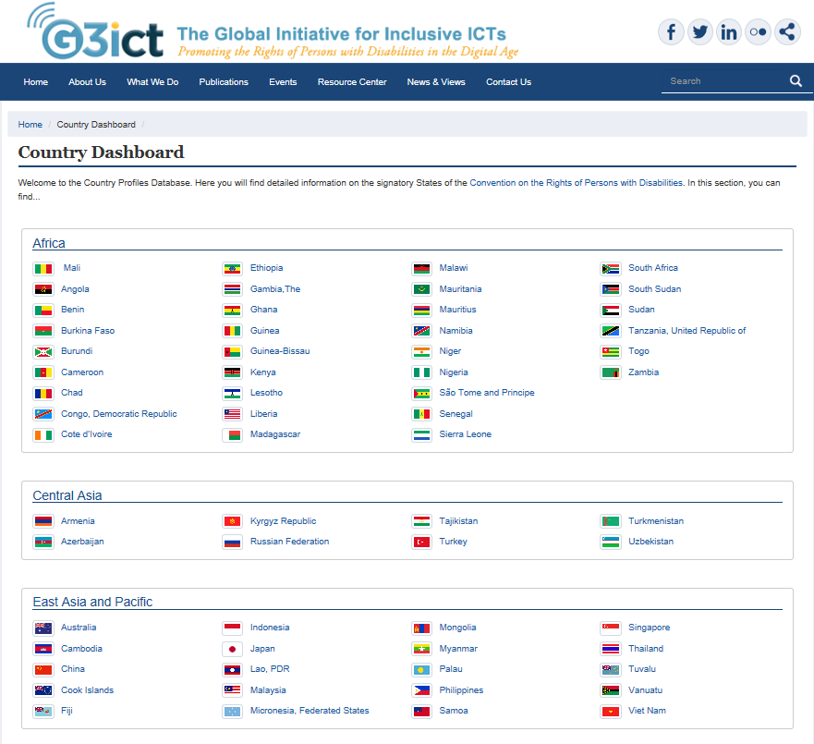
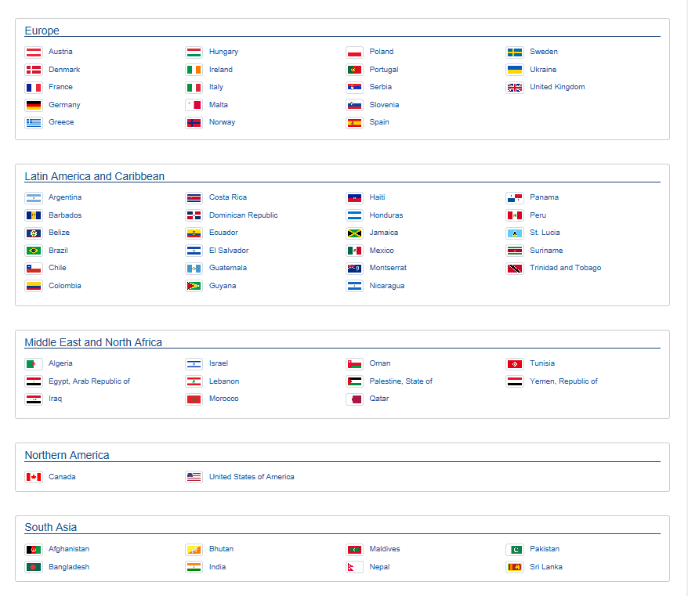
G3ict Country Data Dashboard: 137 Countries Surveyed; 91% of the World Population
Notes:
Only extensive database on digital accessibility in the world.

Slide 6
Average DARE Index 2020 - Country Scores by Region

Slide 7
Foundational Country Commitments for Public Procurement Policies
COUNTRY COMMITMENTS | GLOBAL AVERAGE % OF COUNTRIES WITH LEGAL DISPOSITIONS
GENERAL LAW PROTECTING THE RIGHTS OF PERSONS WITH DISABILITIES | 88%
REASONABLE ACCOMMODATION DEFINED | 68%
DEFINITION OF ACCESSIBILITY INCLUDES ICTs | 61%

Slide 8
Foundational Country Implementation Resources for Public Procurement Policies
COUNTRY CAPACITY TO IMPLEMENT | GLOBAL AVERAGE OF COUNTRIES WITH KEY IMPLEMENTATION RESOURCES OR PROCESSES
GOVERNMENT AGENCY FOR PERSONS WITH DISABILITIES | 88%
GOVERNMENT AGENCY FOR ACCESSIBLE ICT | 39%
PROCESS TO INVOLVE PERSONS WITH DISABILITIES IN POLICY MAKING ON ICT ACCESSIBILITY | 26%
COUNTRY REFERS TO INTERNATIONAL ICT ACCESSIBILITY STANDARDS | 44%

Slide 9
Measuring Initial Steps in Promoting ICT Accessibility in Public Procurement (1)

Slide 10
Measuring Initial Steps in Promoting ICT Accessibility in Public Procurement (2)

Slide 11
ICT Accessibility in Public Procurement: Global Steps
US TEITAC with International Participation, EU Mandate 376
Section 508 Refresh, EN 301 549
G3ict – ITU Model ICT Accessibility Policy Public Procurement Module (available in English, Arabic, Chinese, French, Russian, Spanish)
Governments web sites and public education sector drive initial focus on ICT accessibility in public procurement
As of fall 2020, few countries have implemented systematic processes to ensure the accessibility of all ICT goods and services procured by public entities, only very initial sectorial steps

Slide 12
Today’s Panel
Canada – Shannon Archibald, Chief Information Officer, Shared Services Canada.
European Union – Susanna Laurin, Chair, IAAP Global Leadership Council, G3ict Representative to the EU; Chief Research and Innovation Officer, Funka.
Initial policy steps and implementations in other regions – James Thurston, Vice President Global Strategy and Development, G3ict.

