Slide 1

From Risk to Roadmap: Tackling Accessibility Debt with the Technology Accessibility Playbook
May 21, 2025

Slide 2
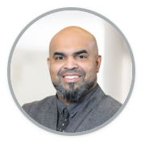
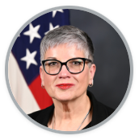

Introductions
Antonio Haileselassie
National Institutes of Health
Lisa Wilcox
Department of the Army
Michael Horton
General Services Administration

Slide 3
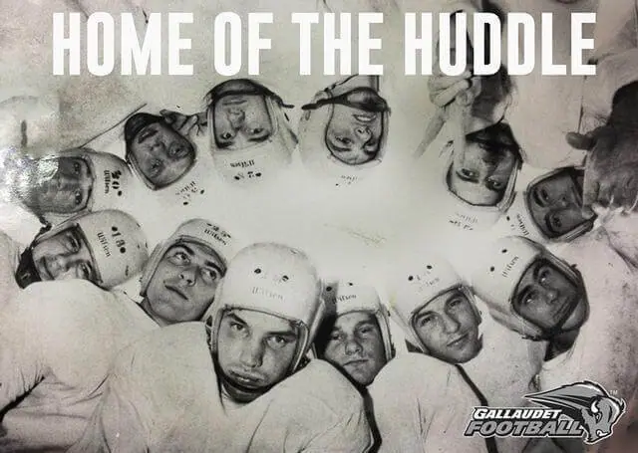
What’s in a Playbook?
In the 1890s, Gallaudet’s football team — composed entirely of deaf players — needed a new way to communicate plays without tipping off their opponents. So they formed a tight, protective circle: the very first huddle. This innovation was both strategic and involved everyone — and it forever changed the game.

