Slide 1

GSA's Government-wide IT Accessibility Division Yearly Activities Update
May 20, 2025

Slide 2
Agenda
Introductions
Section508.gov Highlights
ICT Testing Baseline Portfolio Update
FY25 Governmentwide Section 508 Assessment
Looking Ahead

Slide 3




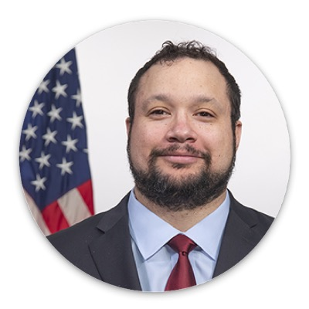
Introductions
Andrew Nielson
Director, IT Accessibility Division
Michael Horton
Senior ICT Accessibility Specialist
Laura B. Miller
Senior ICT Accessibility Specialist
Kristen Smith-O’Connor
Senior ICT Accessibility Specialist
Alex Wilson
Program Analyst

Slide 4
About Us
Section 508 of the Rehabilitation Act tasks GSA to provide technical assistance to help federal agencies comply with Section 508 requirements, and ensure that covered information and communication technology (ICT) is accessible to, and usable by, individuals with disabilities.
GSA’s Office of Government-wide Policy (OGP) created the Government-wide IT Accessibility Program to focus on providing support to federal agencies in the following primary areas:
Policy & Program Management
Accessible Acquisition
Content Creation
Accessible Design and Development
Accessibility Testing, and
Accessibility Training & Events

Slide 5
Updates and Highlights

Slide 6

IT Accessibility KPI Example
KPI ID | KPI Short Name | Draft Generic KPI | Draft KPI | Primary Aligned Dimension
1 | Dedicated Section 508 PM Time | In FYXX, the organization's Section 508 program manager spends at least XX hours a pay period doing strictly ICT accessibility work. [i.e. 1/2 time or 0.5 FTE.] | In FY26, the organization's Section 508 program manager spends at least 40 hours a pay period doing strictly ICT accessibility work. [i.e. 1/2 time or 0.5 FTE.] | General Information
Section508.gov/kpi/
Notes:
ALEX
KPIs: https://www.section508.gov/manage/accessibility-kpi/

Slide 7
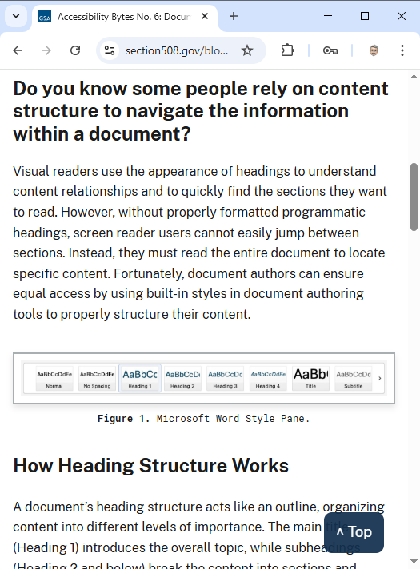
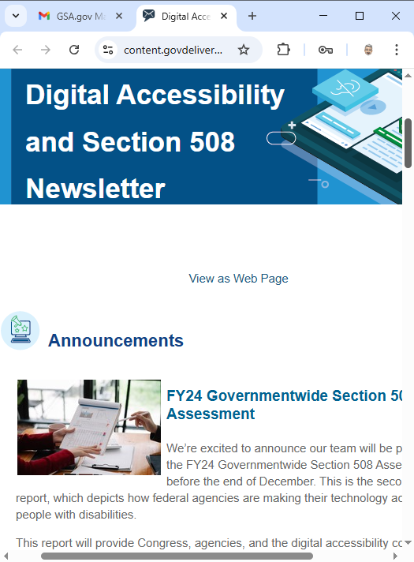
Accessibility Bytes, Section 508 Newsletter, and Listserv
Government employees and contractors invited to join our community LISTSERV.
Subscribe to Our Email Newsletters
All digital accessibility practitioners are welcome to subscribe to our newsletters:
Accessibility Bytes: Quick tips you can use to improve ICT accessibility.
Digital Accessibility Newsletter: A bi-monthly newsletter from our team sharing announcements, news, online resource updates, and upcoming events to help your team!
Section508.gov/community/
Notes:
Section508.gov/community/

Slide 8
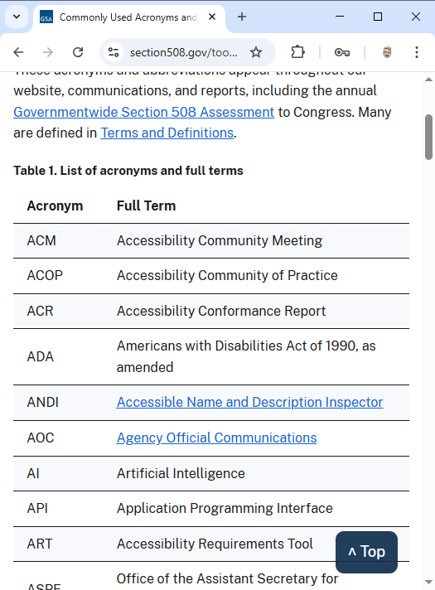
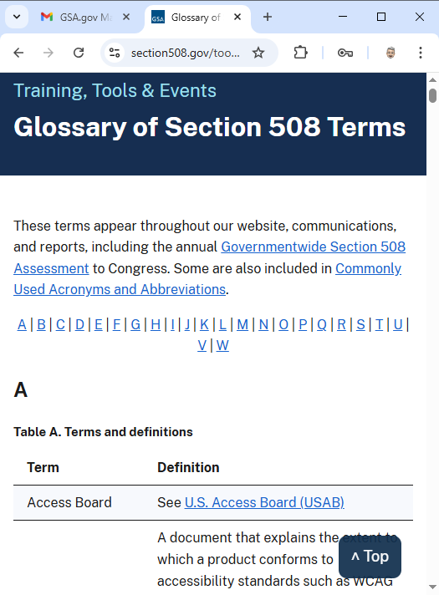
Glossary of Terms and Acronyms & Abbreviations
Every industry has its unique lingo and jargon—terminology meant to make it efficient to communicate.
To help our community of folks who work in both information technology and government spaces, we have consolidated over 200 terms and 90 acronyms & abbreviations that help SMEs find and learn the information they need to make their agency’s electronic information and digital services accessible.
Section508.gov/glossary/
Section508.gov/acronyms-abbreviations/
Notes:
Section508.gov/glossary/
Section508.gov/acronyms-abbreviations/

Slide 9
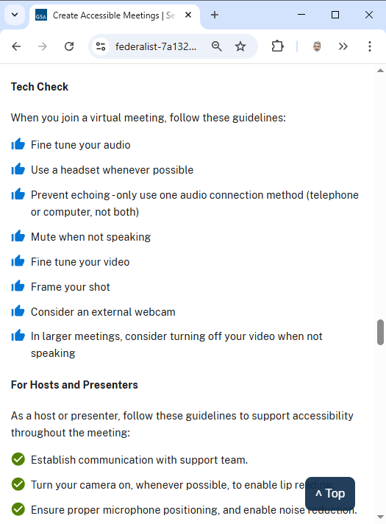
Create Accessible Meetings
In recent years, how agencies gather, collaborate, discuss, share, and learn has changed from largely in-person meetings and conference calls to virtual meetings where the audience participates remotely through voice and video from their homes.
Even with our return to office efforts, meetings are often virtual, or a hybrid of in-person and remote participants. For this reason, accessibility can and should be seamlessly integrated into your meeting.
Our updated guidance simplifies tips for hosts and participants, including how to plan for different meeting types and technology, how to configure your workspace, and tips and guidelines for how to host and participate in a virtual meeting.
Section508.gov/accessible-meetings/
Notes:
Section508.gov/accessible-meetings/

Slide 10
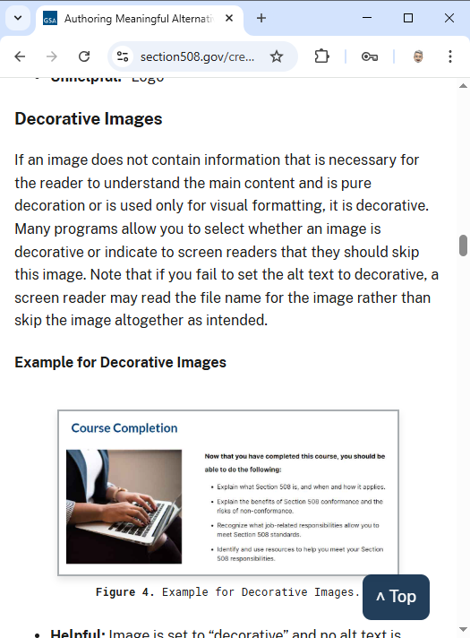
Authoring Meaningful Alternative Text
You know how to add alt text to your webpage and document, but do you need help writing meaningful text descriptions for image and non-text elements?
Our new resource provides tips for content creators to help you craft quality text descriptions, including:
general alt text guidelines
photos and portraits
images that contain text
logos
backgrounds and decorative images
controls, form elements and links
charts, graphs, and diagrams
watermarks
signatures
and event some common mistakes you can avoid
Section508.gov/alternative-text/
Notes:
Section508.gov/

Slide 11
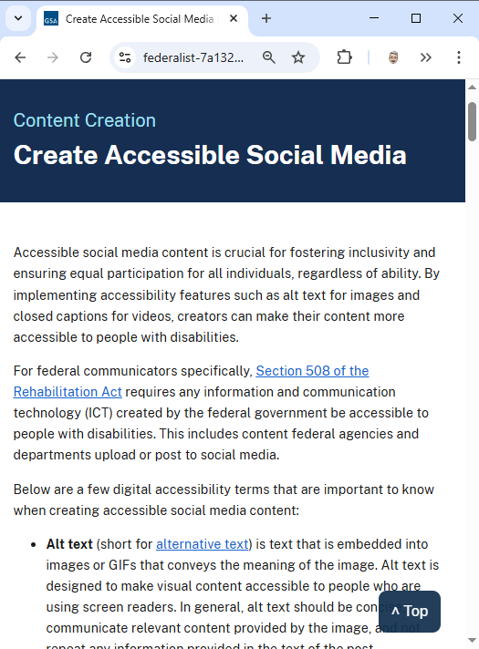

Create Accessible Social Media
Federal agencies are required to ensure that social media content is accessible to people with disabilities under Section 508.
Core Accessibility Practices:
Alternative Text
Video Accessibility: Include CC and AD
Plain Language: Use clear, jargon-free language
Hashtags: Capitalize each (e.g., #ThisIsAccessible).
Emojis: Use them sparingly and place at the end
Color & Contrast: Ensure sufficient contrast and don’t rely on color alone to convey meaning.
Links: Use descriptive link text (not “click here”).
Plus: Best Practices for Commonly Used Platforms
Section508.gov/social-media/
Contributed by the U.S. Access Board
Notes:
Section508.gov/social-media/

Slide 12
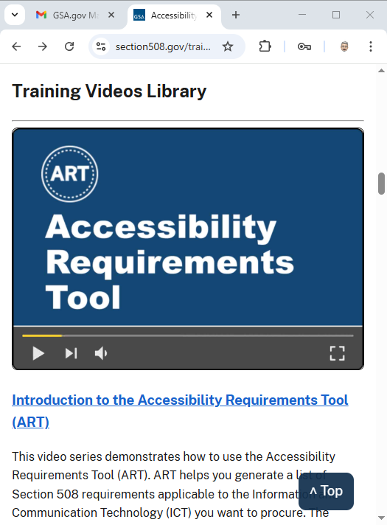
Introduction to the Accessibility Requirements Tool (ART)
ART helps you generate a list of Section 508 requirements applicable to the Information and Communication Technology (ICT) you want to procure.
Our new 5-part video series explains when to use ART, how to create and edit your list of requirements, and how to use the list generated by ART.
What is ART and When Do I Need to Use It?
Where is ART and How Do I Use It?
How Do I Use the Section 508 Requirements Created by ART?
How Do I Generate a List for Multiple Procurements?
How Do I Use JSON to Modify My Report?
Section508.gov/introducing-art/
Notes:
Section508.gov/introducing-art/

Slide 13
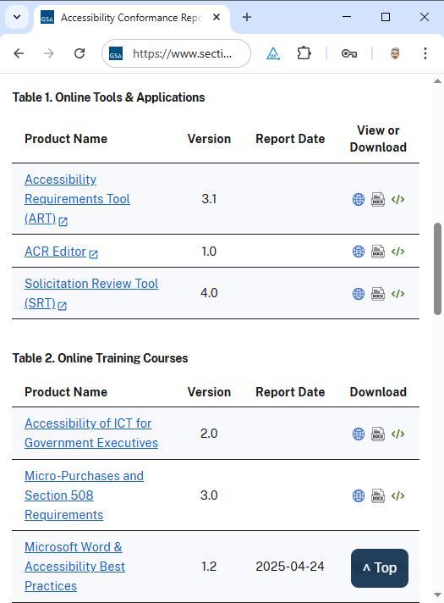
ACR Library
Just like commercial vendors, government agencies must create and maintain Accessibility Conformance Reports (ACR) for use by others in their market research to evaluate products and services in a procurement action—our team listed among them.
To ensure that agencies have access to our product ACRs, we have created a public-facing ACR Library that lists conformance reports for our online tools and online training course.
Reports will be made available in the following formats:
HTML - View in a user-friendly, readable format.
YAML - Access in a structured data format that can be saved, reused, and easily integrated with many programming languages and systems.
Section508.gov/acr-library/
Notes:
Section508.gov/acr-library/

Slide 14



GSA Tools Update
ACR Editor
Create machine-readable Accessibility Conformance Reports (ACR)
Export in easily readable HTML, or sharable, reusable YAML formats
Quickly update your ICT product ACR from one release to the next
Accessibility Requirements Tool (ART)
Quickly and efficiently generate accessibility requirements required by the Section 508 standards and regulation for your ICT solicitation
ART Applications Program Interface (API) Server
Incorporates ART logic into applications, e.g., contract writing tools
Solicitation Review Tool (SRT)
Scans SAM.gov and eBuy.gov every 24 hours, across all solicitations and delivers various reports on prior day’s news postings
Portal for agency subject matter experts to manually review flagged solicitations

Slide 15
Section508.gov Online Training
Course Catalog
Accessibility of ICT for Government Executives
Micro-Purchases and Section 508 Requirements (FAC 047)
Microsoft Word & Accessibility Best Practices
Procuring Section 508 Conformant ICT Products and Services (FAC 056)
Section 508: What Is It and Why Is It Important? (FAC 049)
Soliciting and Evaluating Accessibility Conformance Reports in Federal ICT Procurement
Notable Updates
Course Profile pages with course objectives and audience
ACRs for all courses are now available in ACR Library
SCORM files available to Federal agencies at no-cost under data agreement
Looking ahead
Reimagining of MS Word course—think, fundamentals plus advanced editing
General guidance for shared concepts separated from platform-specific how-tos

Slide 16
ICT Testing Baseline Portfolio Update
What is this? The ICT Testing Baseline Portfolio establishes the minimum requirements for evaluating the conformance of ICT with the Revised Section 508 of the Rehabilitation Act of 1973. These Baselines are a benchmark for test processes that determine Section 508 conformance for ICT across federal agencies.
ICT Testing Baseline Portfolio
Web—sets the standard for testing web content
Documents—sets the standard for testing all types of non-web documents
Coming Soon! New ICT Testing Baselines for:
Hardware—Tune into tomorrow for the Accessible Self Service Kiosks session
Software
Baseline Alignment Framework for Web now has over 400 test cases!
Notes:
The ICT Baseline Alignment Validation Framework provides test cases as a way for agencies to check whether their own test processes and use of testing tools adequately address all Section 508 requirements. Two different processes that align to the Baseline should produce the same replicable and reliable test results.

Slide 17
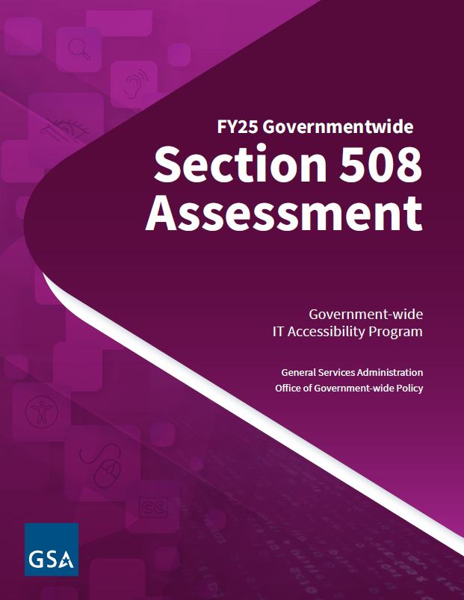
FY25 Governmentwide Section 508 Assessment
Third annual reporting is underway!
Agency instructions are live on MAX.gov for federal agencies subject to Section 508
Response data due by August 1st to Office of Management and Budget (OMB) and GSA
Streamlined questions to reduce burden
Focuses on the following categories: Section 508 management, acquisition and procurement, testing and remediation, and conformance
Comprehensive report due to Congress by end of December
Redesigned Assessment content on Section508.gov
Easier to find past year Reports
Highlights where to find prior year criteria, response options, and understanding content

Slide 18

Looking Ahead…
FY25 Section 508 Governmentwide Assessment Report to be released by end of December 2025
Technology Accessibility Playbook update including new artifacts expected to be release end of FY25
IT Accessibility Risk Assessment Framework
Baseline Alignment Framework for Web: New test cases will be added and the website redesigned
SRT updates (more to come during “A New Look at ART & SRT” Session)
Notes:
Accessibility Bytes is a new series from the team that brings you Section508.gov to share quick tips you can use to improve the accessibility of the information, communications, and technology you create for federal employees and members of the public.

Slide 19
Looking Ahead Even More…
New Accessibility Bytes monthly
Section 508 Newsletter (Semi-monthly)
IT Accessibility Community Meetings
Next one is scheduled for August 12 at 1:00 PM ET
See Section508.gov/events/ for more information
Online training
Expect more resources to be available on Section508.gov for SMEs and creators
Notes:
See Section508.gov/events/ for more information

Slide 20
Questions?

Slide 21

Visit our Contact Us page at section508.gov/contact-us/
Contact the team via email at section.508@gsa.gov
Notes:
Visit our Contact Us page at section508.gov/contact-us/
Contact the team via email at section.508@gsa.gov

Slide 22
Backups

Slide 23

Section508.gov Highlights
Organizational IT Accessibility Key Performance Indicators (KPI) published
Accessibility Bytes and Newsletters continue to be released regularly
Updated Glossary of Terms and a new consolidated Acronyms & Abbreviations
Blog on How the General Services Administration Developed and Tested Accessible E-Learning Training
Create Accessible Meetings with simplified guidance for hosts and attendees
Authoring Meaningful Alternative Text and What is Alternative Text? (Video)
Create Accessible Social Media update in collaboration with U.S. Access Board
Multi-part video series Introduction to the Accessibility Requirements Tool (ART)
New ACR Library for our products: training courses, ACR Editor, ART, and SRT
Notes:
Organizational IT Accessibility Key Performance Indicators (KPI) published
Accessibility Bytes and Newsletters continue to be released regularly
Updated Glossary of Terms and a new consolidated Acronyms & Abbreviations
Blog on How the General Services Administration Developed and Tested Accessible E-Learning Training
Create Accessible Meetings with simplified guidance for hosts and attendees
Authoring Meaningful Alternative Text and What is Alternative Text? (Video)
Create Accessible Social Media update in collaboration with U.S. Access Board
Multi-part video series Introduction to the Accessibility Requirements Tool (ART)
New ACR Library for our products: training courses, ACR Editor, ART, and SRT

