Slide 1
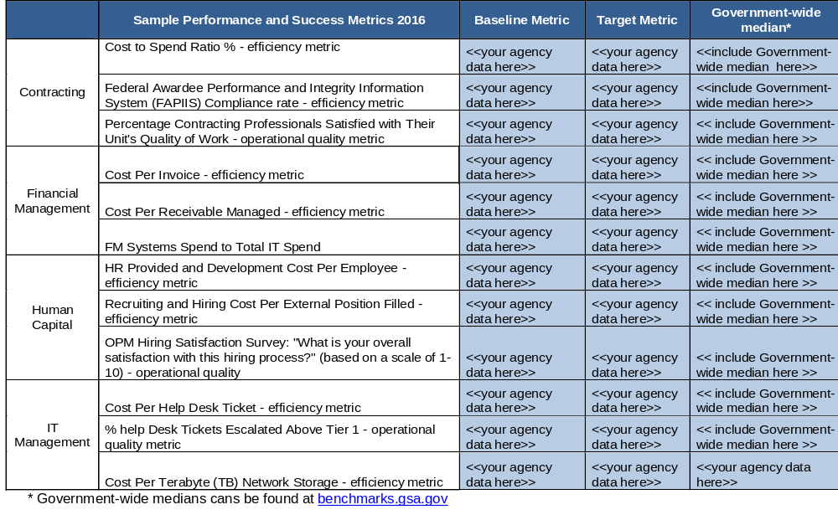
Baseline and Target Performance Success Metrics
Agencies may use existing federal-wide benchmarks available at https://benchmarks.gsa.gov/ or create their own. Below are sample Performance and Success metrics by service area.

