Slide 1

Ventera GSA GHG Hack-a-thon
October 16, 2015

Slide 2
Problem Statement

Slide 3
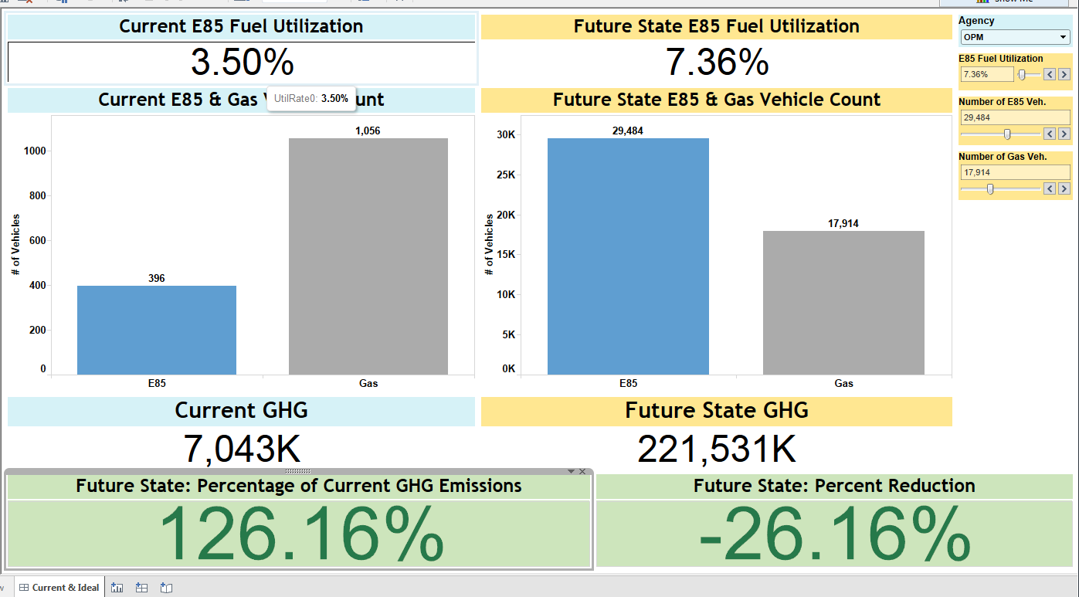
Problem Statement
How does increasing an agency’s use of other alternative fuel vehicles such as diesel-powered, hybrid, and electric vehicles rather than traditional gas-powered vehicles affect the level of greenhouse gas emissions over a period of time?
Notes:
Describes the business organization and business needs as clarification on the goal.
Describes the history of what has occurred to date and how/why this project was approved for execution at the present time.

Slide 4
Our Solution

Slide 5
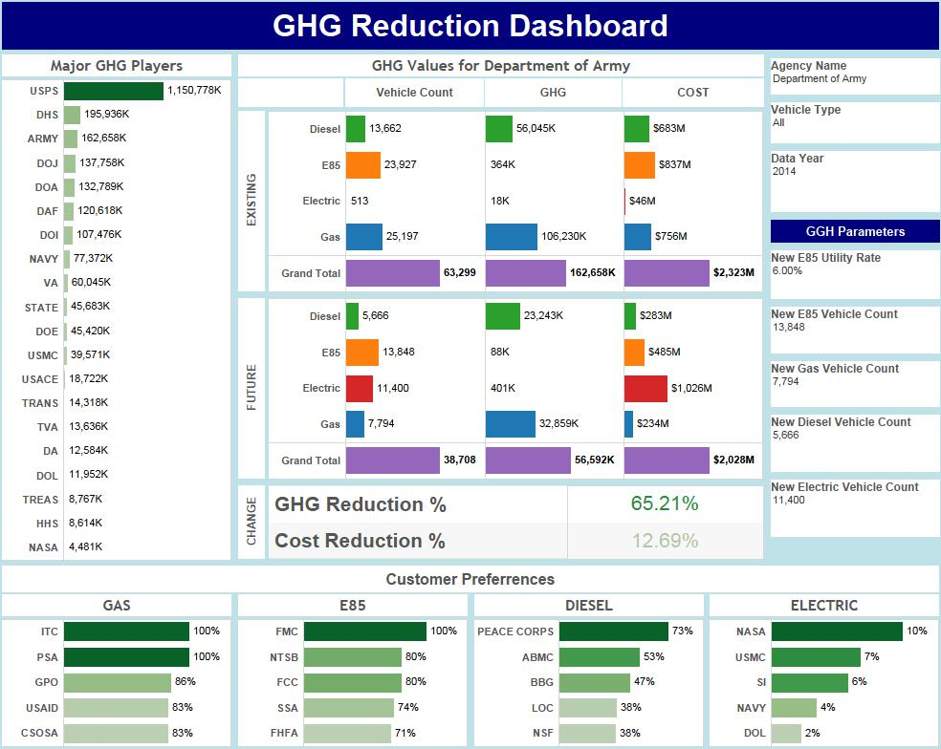

Slide 6
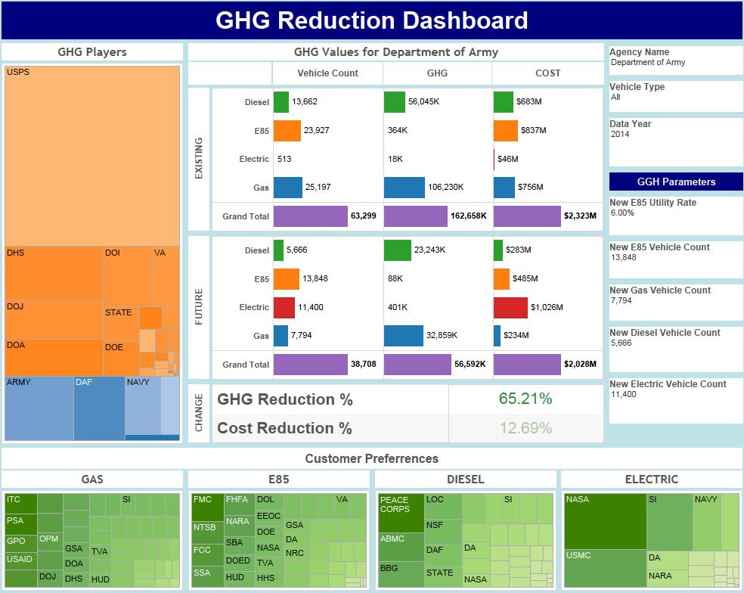
Variation

Slide 7
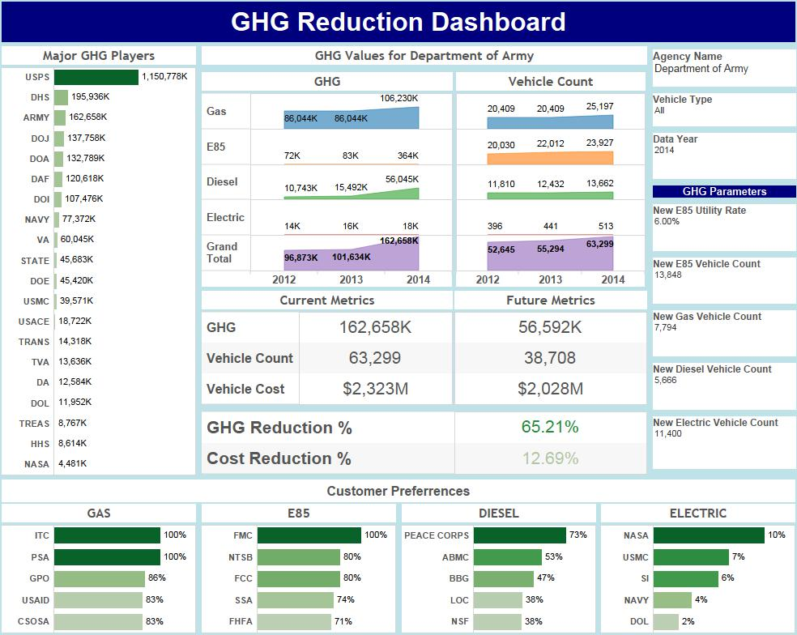
Variation

Slide 8
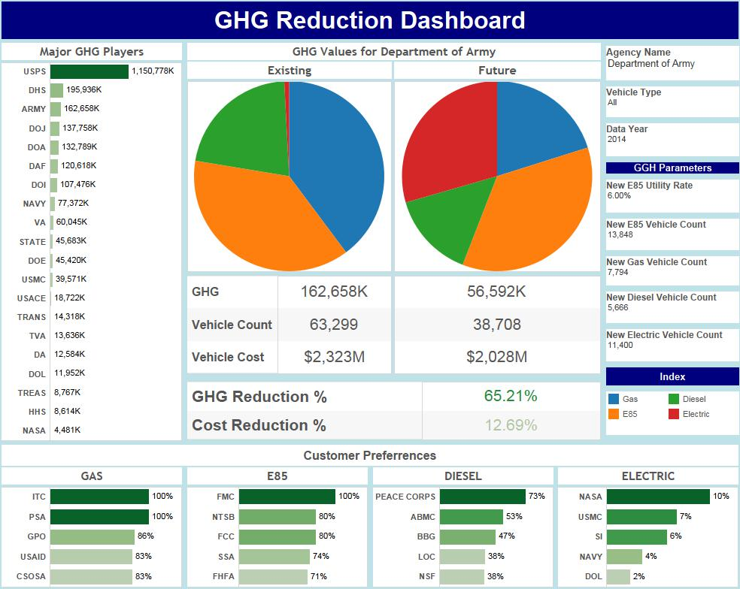
Variation

Slide 9
Next Steps…
October 16, 2015

Slide 10
Our Vision
Help an agency visualize overall reduction of GHG using the Executive Order 13514 section (g) as baseline goals.
Agencies are faced with many considerations related to fleet management such as:
Fleet replacement rate
Rate of change in fleet size
Cost per vehicle type
Allocation of newly purchased vehicles (by type)
To help achieve emissions goals, we’ve provided the ability to adjust a set of variables based on those factors.
Long-term goal:
Produce an actionable plan for fleet management to achieve GHG emission goals.
Notes:
Lists and describes items out of scope.

Slide 11
Other Information
October 16, 2015

Slide 12
Considerations
Variables
Default values for Vehicle Cost, Rate of change in fleet size, Vehicle replacement rate, Allocate of vehicles per vehicle type
Assumptions
Zero inflation rate
Zero maintenance cost (ie. Electric vehicles)
Consistent emission rate over time
Constraints
Time
Extensive Data
Notes:
Lists assumptions, constraints, dependencies, and milestone commitments.

