Slide 1
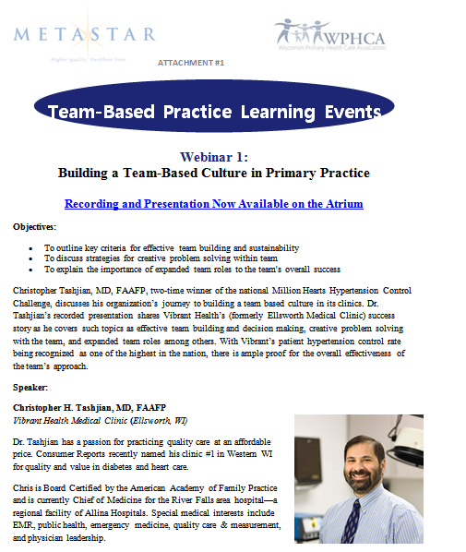

Slide 2


Slide 3
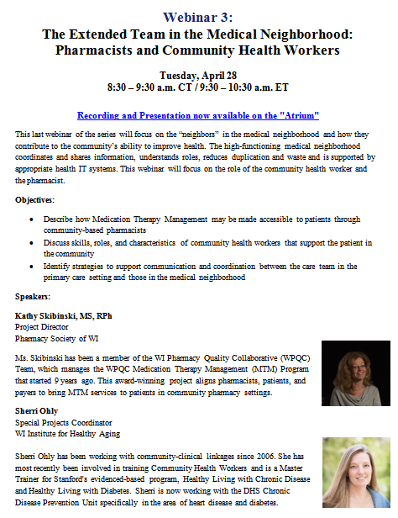

Slide 4
Welcome!
Team Based Practice Series Part 2:
The High Functioning Team: Spotlight on the Medical Assistant
Remember to connect to the audio
Dial: 1.866.740.1260
Access Code: 1274980
This 3-part webinar series is made possible through funding from the Centers for Disease Control and Prevention (CDC), RFA-DP 13-1305: State Public Health Actions to Prevent and Control Diabetes, Heart Disease, Obesity and Associated Risk Factors and Promote School Health.
Notes:
Welcome to the first of our 3 part learning series on Team Based Practice. As the audience connects, I want to let you know that this webinar is being recorded and will be available to access within a week.

Slide 5
Save the Dates!
Webinar 3 The Extended Team in the Medical Neighborhood: Pharmacists and Community Health Workers
Tuesday, April 28, 8:30 – 9:30 am
The Team-Based Primary Care Practice Summit Thursday, June 25 8:30 a.m. – 4:30 p.m. CT / 9:30 am. – 5:30 p.m. ET Great Wolf Lodge, Wisconsin Dells Join WPHCA, MetaStar and the WI Nursing Association—in person or virtually
Watch for more details to come
For more information:
Ashley Green, MetaStar agreen@metastar.com
Pam Crouse, WPHCA pcrouse@wphca.org
Notes:
Good Morning:
In partnership with Ashley Green, from MetaStar, and the Wi Nurses Association, we are pleased to welcome you to the second of our Team Based Primary Care Practice learning series today with the topic, “The High Functioning Team: Spotlight on the Medical Assistant”. We have excellent guests who will be introduced in a moment.
My name is Pam Crouse, and I am Clinical and Quality Improvement Director for the Wisconsin Primary Health Care Association. This 3-part webinar series is made possible through funding from the Centers for Disease Control and Prevention, and our partners at the Wisconsin Department of Health Services, Division of Public Health, in the Chronic Disease Prevention and Control Unit.
Before we get started on our topic for today, please mark your calendars for the rest of the webinar series:
Webinar 3 Tuesday, April 28, 8:30 – 9:30 am The Extended Team in the Medical Neighborhood: Pharmacists and Community Health Workers
The Team-Based Primary Care Practice Summit, Thursday, June 25, 8:30 a.m. – 4:30 p.m. CT / 9:30 am. – 5:30 p.m. ET Great Wolf Lodge, Wisconsin Dells
Join WPHCA, MetaStar and the WI Nursing Association—in person or virtually—for a one-day summit featuring presentations from additional experts, as well as resources, on team-based care best practices
Because of the large number of participants, all phones will be muted. There will be time for questions after the presentation by our guests. You can submit your questions through the chat feature of the webinar that you should see to the left on your screen.
We are glad you are a part of this session today and we invite you to share this information freely with your colleagues. This webinar will be recorded and the link to the recording will be provided to you following this event.
In our first webinar, Building a Team-Based Culture in Primary Practice, Dr. Chris Tashjian described the journey he and his team are on as they continually build their team and now keep refining and improving and spreading their successful practices. A critical piece of that work is to define roles and distribute tasks among care team member that reflect the skills, abilities and credentials of team members. Today we will continue that discussion as we learn more about the team in which Dr. Tashjian is a member.
With that, I’d like to introduce my colleague, Ashley Green, Quality Improvement Specialist from MetaStar in Wisconsin, who will introduce our speakers today.

Slide 6
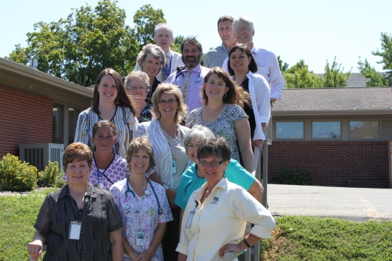
Team Based Practice Learning Series:
Mary Boles, LPN Clinic Manager
Rosanne Matzek, CMA Care Coordinator
Vibrant Health Family Clinics
Ellsworth, Wisconsin

Slide 7
The High Functioning Team
Spot Light on the Medical Assistant

Slide 8
Vibrant Health Is……
Our Ellsworth staff includes Family Practice providers with accessibility to Internal Medicine, Pediatrics, General Surgery, OB/GYN, ENT and Cardiology clinicians at our River Falls location.
Patient Care Team Members
Provider
Medical Assistant
Care coordinator
Midlevel
Front Office Staff
Others
NCQA Certified PCMH since 2013

Slide 9
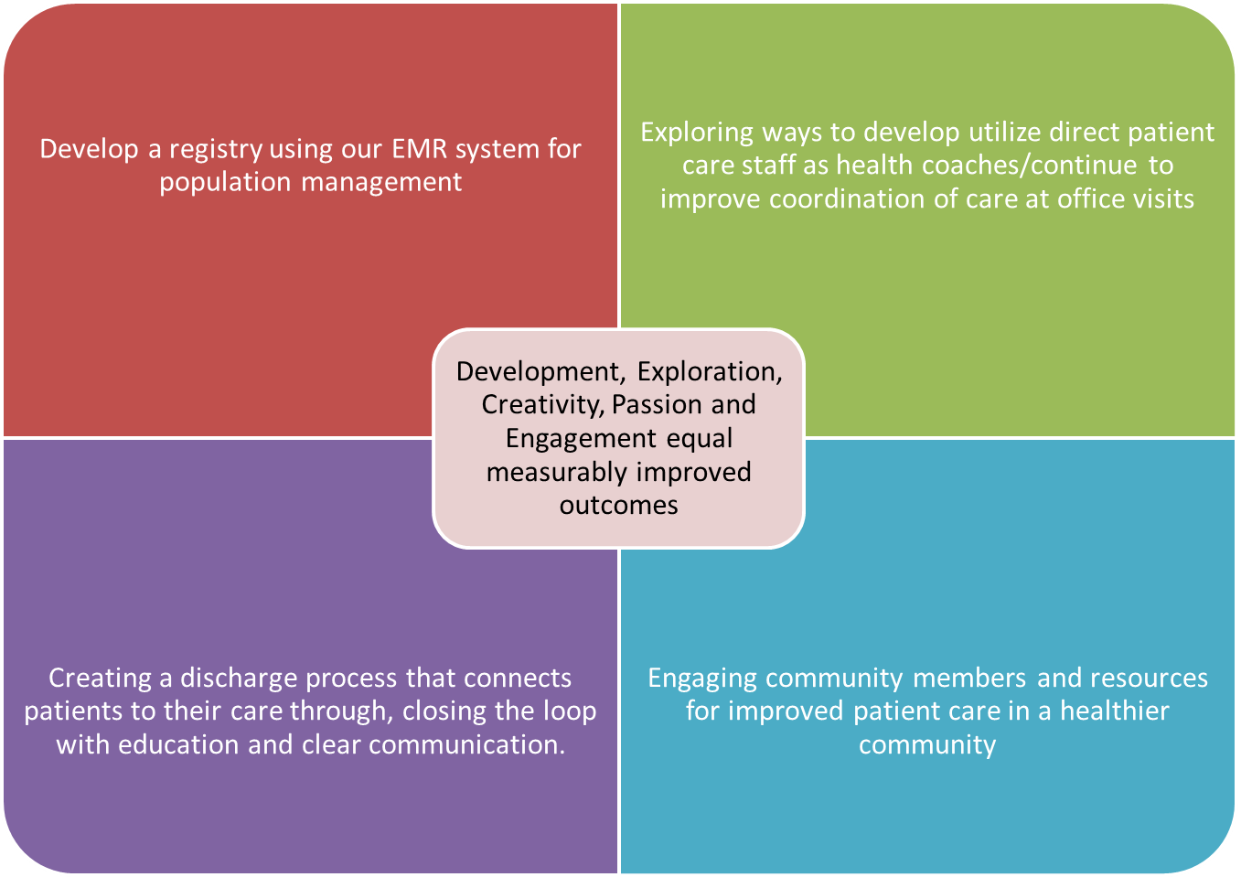
Improvement Philosophy

Slide 10

Team Vision
To design a system of care that will improve the value of health care for the patients we serve.
To provide whole person care, well-coordinated services and enhanced access to the clinical teams.
As a result, we will achieve the Triple Aim of improved health, improved experience and reduced cost as well as staff and provider satisfaction.

Slide 11

Primary Clinical Support Staff
Previsit Plan
Review HCP schedules for the day---determine ability to work in patients
Plan of care for specific patients as determined in the huddle---Care Coordinator assist
Room patients for PCP as determined at huddle
Depart patients for PCP
Communicate throughout the day with team mates

Slide 12

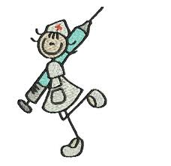
Team Clinical Support Staff
Room any/same day patient for either PCP
Assist with Depart for both PCP
Other duties as assigned
Both primary and Team Clinical Support Staff are equally Important

Slide 13

Complex Patient Care Coordination
Facilitate/participate in morning huddles (Review care plans)
Room patients already managed by CC/Identify need to CC during PVP/Huddle
Create and Update Care plans
Assist with Depart Process for identified complex patients--Coaching, motivational interviewing, goal setting, education, recheck BP’s if needed
Provide Community Resources (Home care, drug programs, ADRC)
Follow up with patients discharged from the hospital
Assist CSS with other care needs throughout the day

Slide 14

Start Your Day Off Right!!!
HCP/CSS/CC huddle in the morning and afternoon
Less than 3 minutes
Be consistent and predictable
Develop plan of action for the day
Review daily schedule
Identify patient needs such as the need for additional time, work in spots, CC involvement…
Communication is key to the days success
Proxy team EMR In Boxes
Have fun and start the day right!! Smile☺

Slide 15

PREVISIT PLANNING
Develop Standard Previsit Planning form
Chart Review—last 2-3 visits, hospital discharge notes
3. Identify and order services
Immunizations
Lab work
Preventive needs
Prep exam room and anticipate provider needs
4. Prepare for your Depart visit with patient
Prepare order forms
Prepare for entry into recall system
Identify medication refill needs-

Slide 16
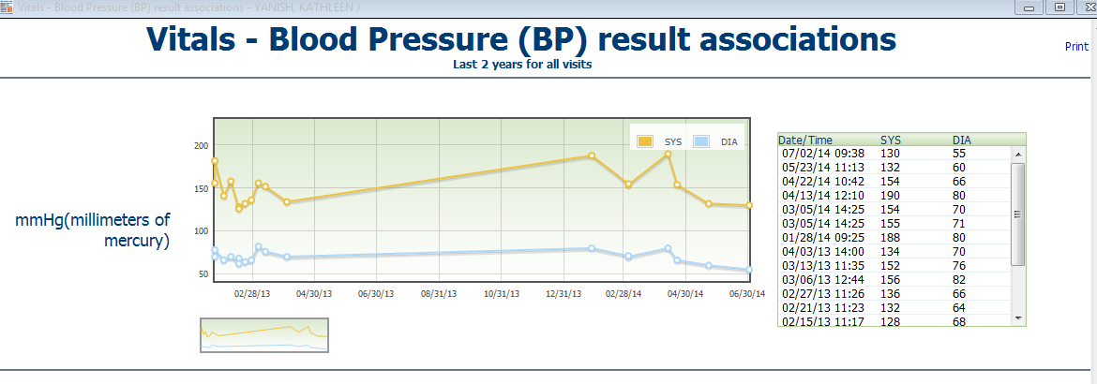
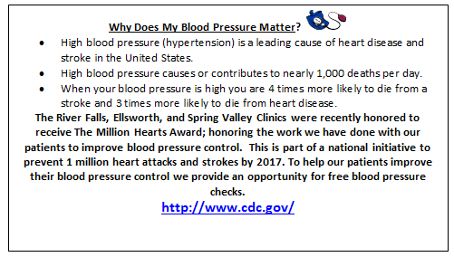
Patient Engagement
Provide patients with information so they can see how interventions or changes have made a difference. Visuals are important!
We have challenged our staff to use every patient encounter as an opportunity to recheck blood pressures and provide appropriate patient education; this keeps the patients actively involved in managing their health.

Slide 17

Depart Process Goal
Every patient leaves their visit with a thorough understanding of next steps and a completed After Visit Summary in hand.
Patient has the ability to ask additional questions about medication changes and refills, preventive needs, future appointment details, and referrals.
Decrease in calls for medication refills and patient inquiries to the Message Center between visits.
Patient feels complete and satisfied with visit.
Closing the informational loop
Provide the necessary resources so that there is time at the end of the visit for CSS to meet with patient.

Slide 18
DEPART CHECKLIST
_____ Review white charge ticket, Orders and Charges in EMR and enter orders as indicated
_____ Explain medication changes to patient and add to After Visit Summary
_____ Assure medications have been refilled and patient is aware
_____ Place RTC orders for chronic disease and preventive visits
_____ Complete order forms as indicated Mammo/Dexa/Preventive.
_____ Print “After Visit Summary”, review with patient and answer questions
_____ Print rehab/order requisitions and review with patient. Provide Rehab. Referral Provider List
_____ Print and review Stress Test Protocol and education if needed
_____ Provide patient education or print from EMR as indicated
_____ Complete DOT, H&P, PHQ9 and other forms, fax/copy
_____ Escort to Referrals, Radiology, Scheduling, or Lab as indicated
_____ Recheck BP and inform patient about follow up needs, education

Slide 19
Tools
PVP
Standing orders
Process Mapping
Policies & Procedures
Shared decision making—colon cancer risk assessment
PDSA process
BP rechecks algorithms
(BP magnets)
In order to provide the excellent, personalized care that we do, we must have the proper tools in place for our Healthcare Providers and staff.
Using the PDSA format assures that we continually work to create and improve our processes and define accountability.

Slide 20
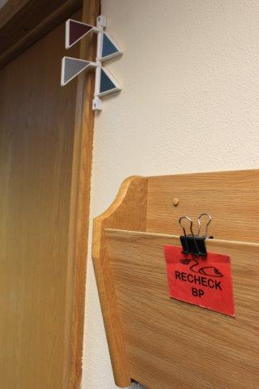
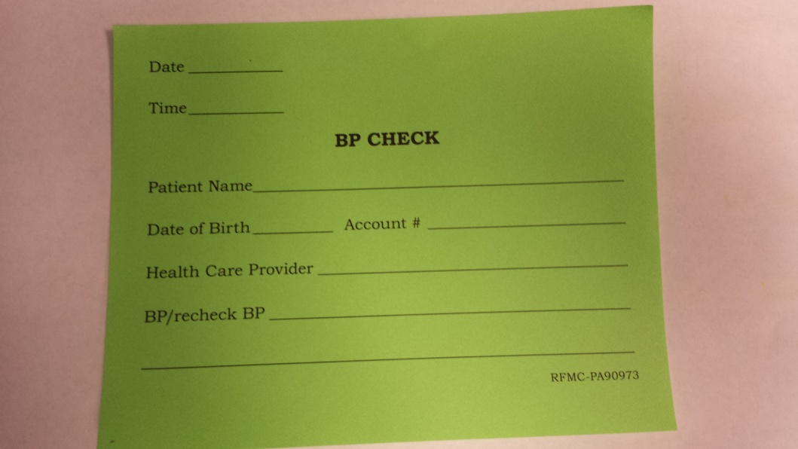
TOOLS FOR CLINICAL STAFF
Blood pressure magnets outside of the exam room door remind us to recheck elevated blood pressures.
As part of our pre-visit planning we fill out BP slips for all patients who have orders for repeat blood pressure checks. These slips are also used for walk-in free blood pressure checks.

Slide 21
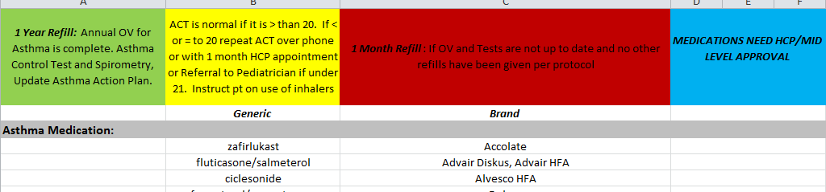
Empower your Clinical Staff
Develop Standing Orders and Protocols:
Chronic Disease Standing Orders
Preventive Service Standing Orders
Medication Refill Protocol:

Slide 22
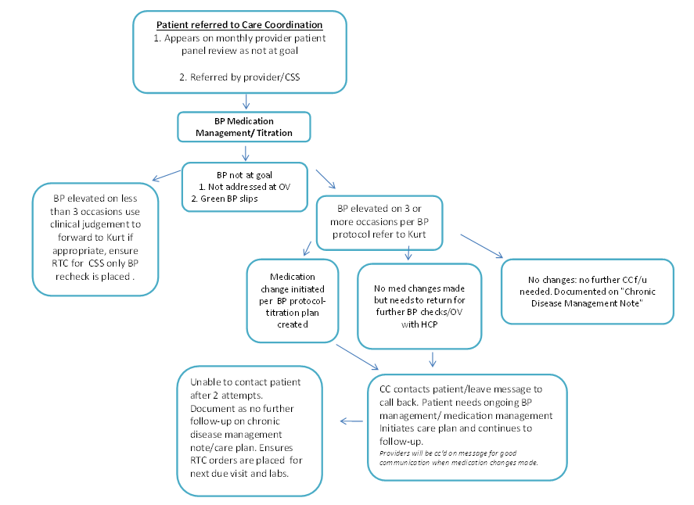
Initiation and Titration of Medications Using Established Protocols

Slide 23
Care Coordination Staff
Four experienced CMAs
Work exclusively with our chronic disease populations
Focus is on assuring our patients are informed, accountable and educated about their illness and treatment.

Slide 24
Care Coordination
Chronic Care Model Procedures
Develop evidence-based protocols specific to our practice
Medication titration for HTN, lipid and glycemic management tools specific to our practice
Relationships with partners (cardiology & others)
Transition of Care process
Preventable Readmission rates
Vulnerable Patient Population identification
Care Coordinators ensure patient-centered care by building relationships directly with patients; and facilitating effective relationships between patients and key players in their care team.

Slide 25

Care Coordination
Identify complex patients
Assist with phone calls/messages/med refills as needed for more complex, time consuming patients
Staff training and updates on Chronic Disease items
Patient Education on chronic disease topics
Identify patients needing medication titration
Contact patients between visits
Review chronic disease data base

Slide 26
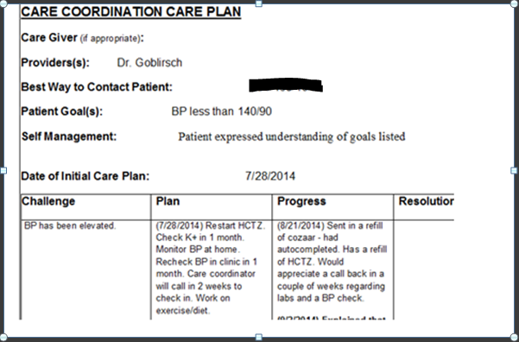
Care Plans

Slide 27
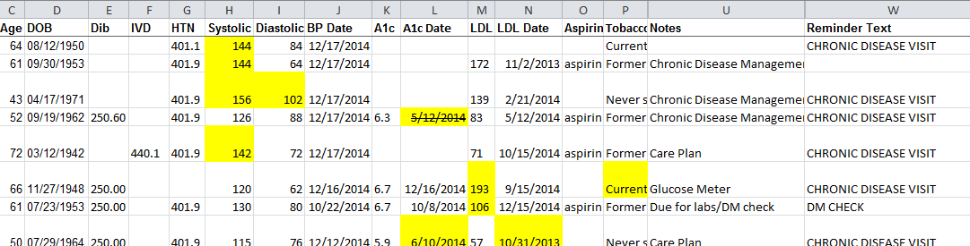
KEEPING TRACK OF YOUR PATIENTS
We extract patient data from our EHR and practice management system using our EHR Reporting program. We manipulate the data in Excel to create patient lists that function for our needs. We can therefore also collect up to date and current data. We look at this together EVERY MONTH!

Slide 28
LEAP Program: Learning from Effective Ambulatory Practices
Team Care Guide
https://www.youtube.com/watch?v=nc1dCKmTnUA
*Video that Dr. Tashjian made for this project
www.improvingprimarycare.org
*Vibrant Health was one of thirty clinics across the country that participated in development of this Team Care Guide

Slide 29
Why it all works!
Leadership supports the process
Providers and all staff are engaged
Patients are engaged
Clinical Staff are Empowered
All staff are encouraged to work at the highest level of their role
We are transparent with data
We are proud of our success
We believe in helping our patients get well and stay well
We have caring and compassionate Care Coordinators
Team Work !!

